Slide 1


Slide 2
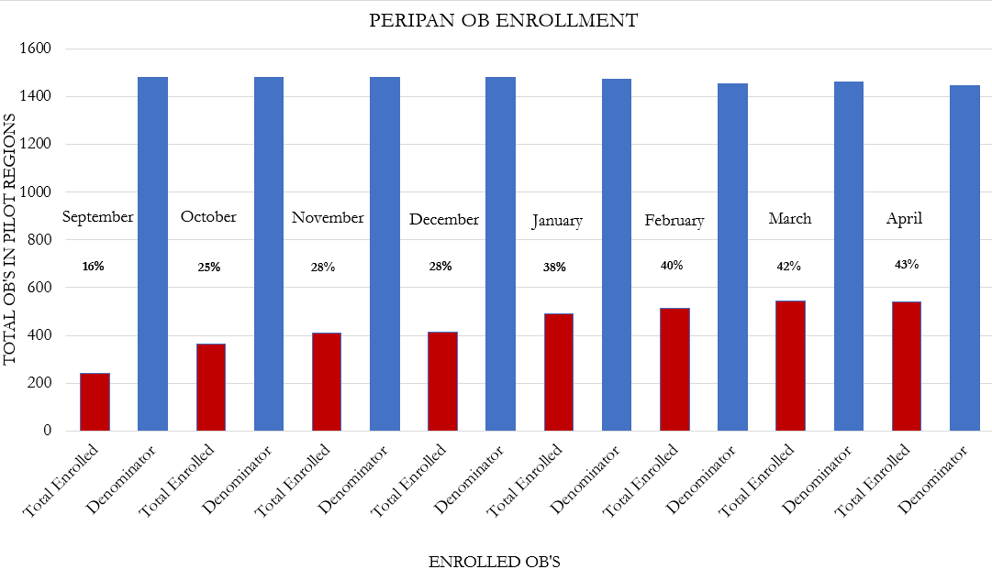
PeriPAN
Pilot-wide
Enrollment
43%

Slide 3
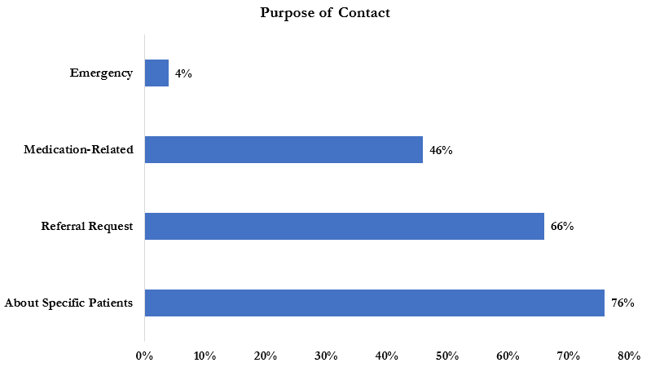
PeriPAN
Consult Activity

Slide 4
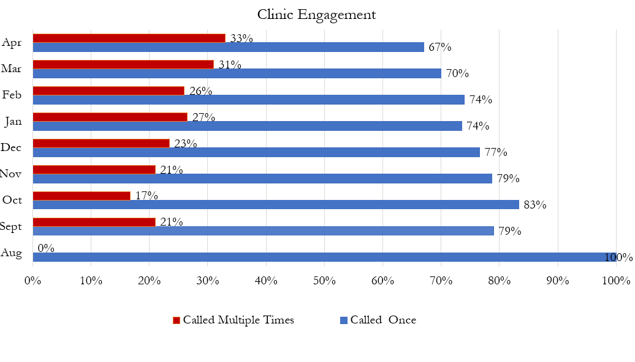
PeriPAN
Consult Activity

Slide 5
PeriPAN Updates
Upcoming Webinar
"Suicide Risk and Safety Assessment in Perinatal Mental Health"
May 16, 2023 | 12:00-1:00 pm
Project ECHO Launch
"Introduction to ECHO" | May 9, 2023
"Screening and Diagnosis of Anxiety and Depression in the Pregnancy and Postpartum Period" | May 23, 2023
PeriPAN Promotional Video
Filming in Austin
May 16th
Guest Collaborator: UTSW OB

Slide 6
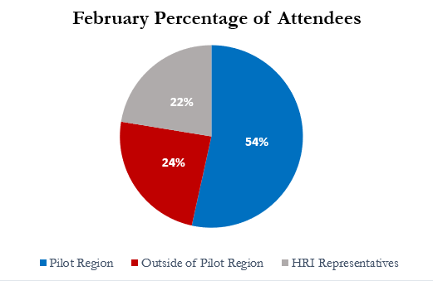
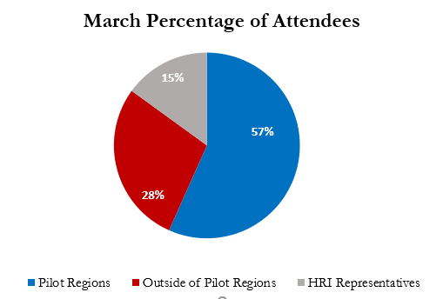


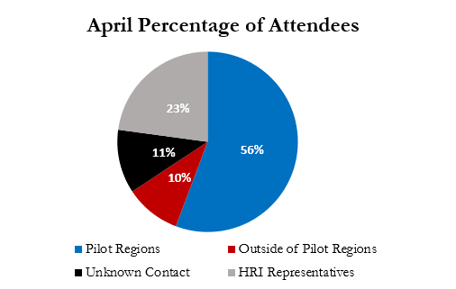

PeriPAN Webinar Activity
Regional Participation
Pilot Regions Represented (4)
UT Dell | UTSW | BCM | TTUHSC
Outside of Pilot Regions Represented (7)
TAMU | UTSA | UTRGV | UTH UTT | UNT | UTMB

Slide 7
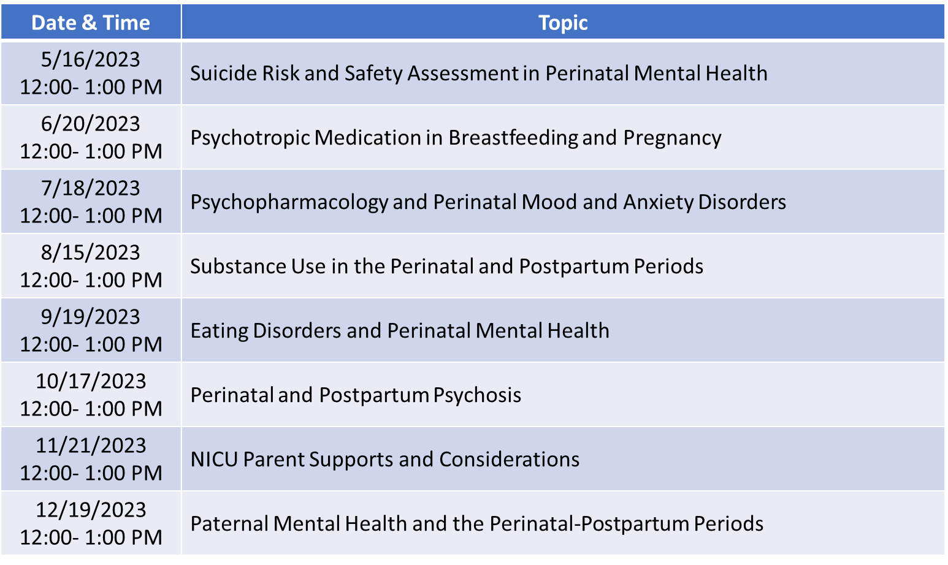
Upcoming Webinar Schedule

