Slide 1
ARPA Project Overview
Executive Committee Meeting
July 2023

Slide 2
ARPA Operations
“ARPA Project Informational Sessions” held by TCMHCC and facilitated by participating HRIs
1-1 project and goal review sessions completed between TCMHCC and project leads

Slide 3



Risks and Actions
Staffing
Data
Timing
Issues
Turnover
Hiring Difficulties
Actions
Reviewed staffing models in budget meetings
Explore additional employment benefits that can be offered to help recruitment (like supervision hours)
Encourage use of interns and other provider types
Issues
Data collection sources
Missing reports
Actions
Data reviewed in 1-1 meetings with HRIs for accuracy
ARPA Power BI dashboard is being built with direct TRAYT data to reconcile manual reports
Missing reports requested/escalated
Issues
Delays due to fellowship/residency cycle
Actions
Revise goals based on actual onboarding timelines
3

Slide 4
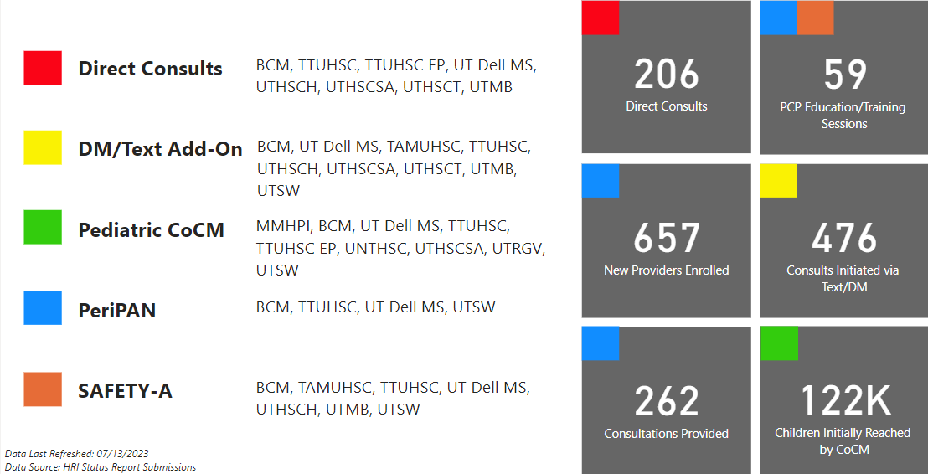
CPAN ARPA Metric Overview

Slide 5
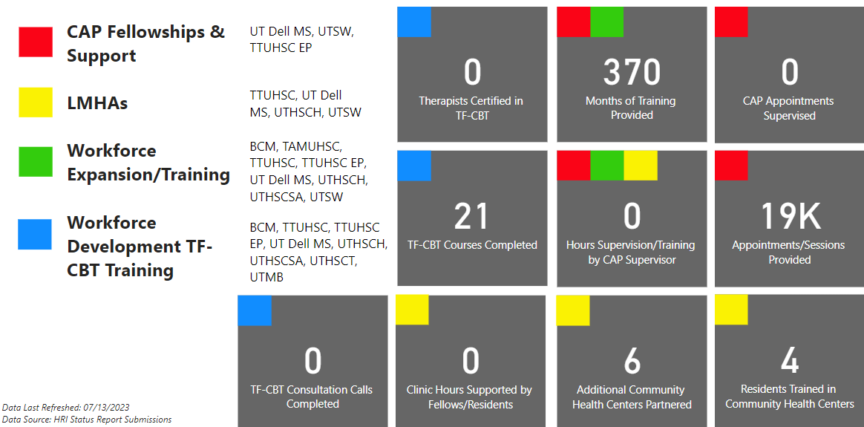
CPWE ARPA Metric Overview

Slide 6
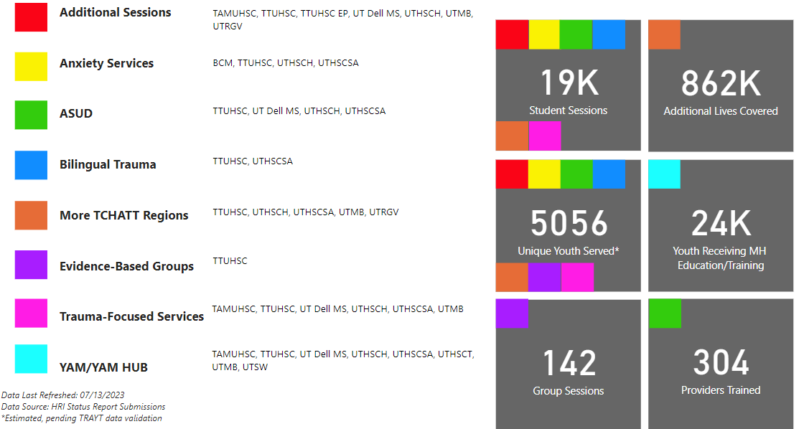
TCHATT ARPA Metric Overview

Slide 7
Questions?

