Slide 1


March 20, 2023
Arpa sb 8 section 8
fiscal agent – UT Austin
Linda haster
Associate Director of Grants Financial Management
Office of Sponsored Projects (OSP)
The University of Texas at Austin

Slide 2
Texas Child Mental Health Care Consortium
Contract Update
  All contracts fully executed
  Several amendments executed, additional in progress
Invoicing
  Receiving recurring Sub invoices
  Payments are being process promptly
Reporting
  Executive Status Report as of 2/28/23
  Next Quarterly Report ending 3/31/23 due April 28th

Slide 3
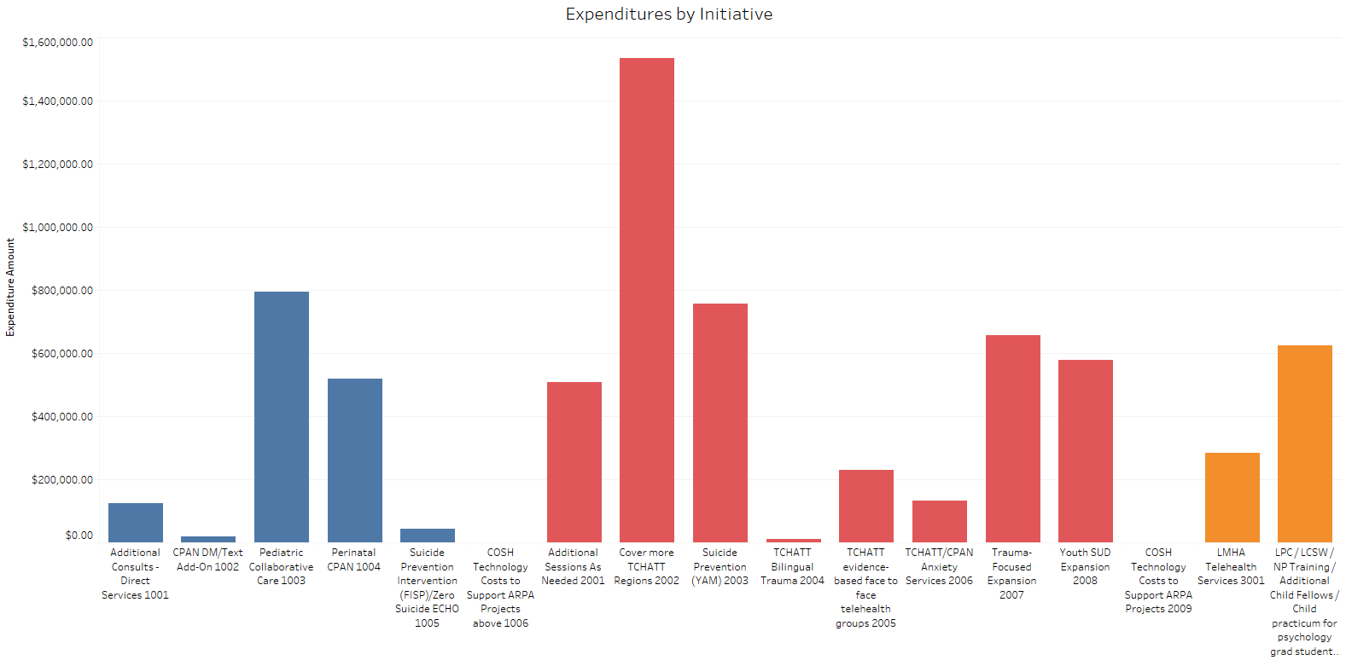

Slide 4
Contact Information
Linda Haster, Authorized Official
  linda.haster@austin.utexas.edu
Joy Hatch, Financial Contact
  joyhatch@austin.utexas.edu
Laura Ochoa, Administrative Contact
  ochoa@austin.utexas.edu
Rachael Holt, Administrative Associate
  rachael.holt@austin.utexas.edu
    Process sub-award reimbursements

