Slide 1
Approved ARPA Projects and Draft Budget

Slide 2
ARPA Overview
Section 8 of SB 8 provides $113,082,885 for “…supporting the operations and expansion of the Texas Child Mental Health Care Consortium to expand mental health initiatives for children, pregnant women, and women who are up to one year postpartum during the two-year period beginning on the effective date of this Act.”
The funds are provided for the following services:
  $20,578,442 for enhancements and expansion of the Child Psychiatry Access Network;
  $56,218,976 for enhancements and expansion of the Texas Child Access Through Telemedicine program;
  $32,991,791 for expansion of the child and adolescent mental health workforce; and
  $3,293,676 for administrative expenses.
Changes, up to 10%, can be made to the budgets above.
Governor Abbott signed SB 8 on November 8, 2021.

Slide 3
ARPA Overview
HRIs were asked to resubmit a spreadsheet indicating which of the approved projects they would like to participate in along with associated 2-year budgets.
They were also asked to complete a project form for any projects they will participate in to help with project tracking & PIA development.
An application process is being used to identify PPAN Pilot sites.
Submitted budgets have been consolidated to identify estimated budgets for each of the three areas.
Budget meetings have been scheduled over the next few weeks to meet with HRIs individually to go over their estimates and refine allocations.

Slide 4
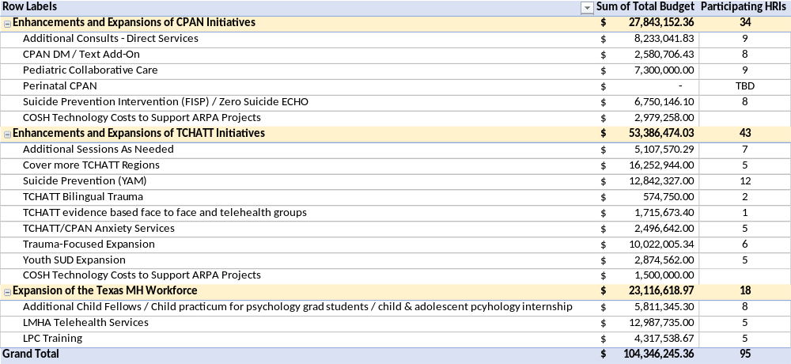
Current Estimated Allocations (Work in Progress)
Notes:
Language doesn’t specify which category Perinatal CPAN would come out of
We currently have $ 5,442,963 that hasn’t been allocated which could be used for Perinatal CPAN

Slide 5
CPAN-Related ARPA Projects
Suicide Prevention
  FISP – Participating HRIs will adapt, test, and implement a brief evidence-based intervention, the Family Intervention for Suicide Prevention (FISP), for suicidal youth in primary care settings across Texas, with a focus on underserved youth.
  Zero Suicide Participating HRIs will expand work down through their CPAN ECHO and partner with primary care clinics currently enrolled in CPAN to implement the evidenced based Zero Suicide framework within the clinics.
CPAN DM / Text Pilot
  Development of a secure direct messaging and/or text messaging option to allow PCPs to reach out to a CPAN hub at a time of their choosing.
Direct Consults
  Provision of direct clinical psychiatric or psychological consultation for a select number of patients for whom telephone or text-based consultation does not suffice due to the complex nature of the presenting complaint.

Slide 6
CPAN Related ARPA Projects (Cont.)
Pediatric Collaborative Care:
  Partnering HRIs will fully implement early detection & treatment in primary care in one or more health systems. They will implement within each health system two proven approaches: Measurement-Based Care (MBC), the systematic use of repeated, validated measures to track symptoms and functional outcomes in clinical settings, and the Collaborative Care Model (CoCM), an approach to the treatment of depression that involves the integration of care managers and consultant psychiatrists directly within primary care settings.

Slide 7
CPAN-Related ARPA Projects (Cont.)
Perinatal Psychiatry Access Network
  Enhance the existing CPAN program to include a service that will bring the experience of specialty academic psychiatrists to Obstetricians/Gynecologists and other primary care providers in the care of women suffering from perinatal mental health issues including substance use disorders and depression.

Slide 8
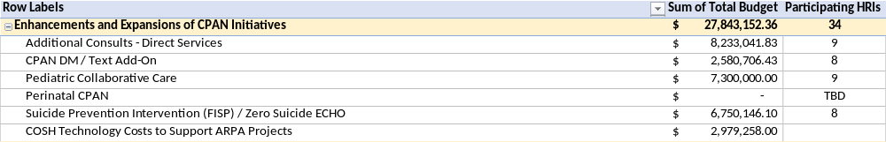
CPAN Draft ARPA Budget

Slide 9
TCHATT-Related ARPA Projects
Expansion to more TCHATT Regions
Provision of additional sessions, as needed
Bilingual Bereavement Services
  Bereavement telehealth groups for the large number of mutigenerational households in our region who have suffered from COVID-related mortality. A cadre of bereavement specialists with bilingual service capability will be established.
Anxiety Services
  This project provides face-to-face interventions to help address the increase in debilitating anxiety disorders being seen in youth that feature avoidance of out-of-home activities, such as school, that will leave developmental scars and sustained impairment if not addressed early.

Slide 10
TCHATT-Related ARPA Projects (Cont.)
Evidence-Based Face to Face and Telehealth Groups
  Development of a variety of evidence-based groups for children and families across the region via telehealth. Initial focus with be in creating groups related to anxiety, depression, suicide risk, and parenting skills.
Trauma-Focused Expansion
  Many of the children seen in the TCHATT program are experiencing symptoms of grief, stress, trauma, anxiety, and depression related to their exposure to COVID, the disruption to their normal routine, socialization and lack of access to support systems. Trauma Focused CBT, Unified Protocol, and other interventions will be used to provide longer term counseling services for students who aren’t able to engage elsewhere.

Slide 11
TCHATT-Related ARPA Projects (Cont.)
Youth Substance Abuse Disorder Expansion
  Develop, implement, and evaluate a first-line targeted intervention that leverages TCHATT’s extraordinary reach and access. Services for substance abuse in youth are minimally available, more so for fresh onset, lower severity cases. This project will provide training and staffing to address the surge in substance abuse by youth.
Suicide Prevention / YAM
  Expand YAM, Youth Aware of Mental Health. YAM is an interactive program for adolescents promoting increased discussion and knowledge about mental health, suicide prevention, and the development of problem-solving skills and emotional intelligence. YAM brings different learning methods together with the fundamental components of the program being as follows: five interactive sessions, role-playing, informational reading materials and posters for display in the classroom.

Slide 12
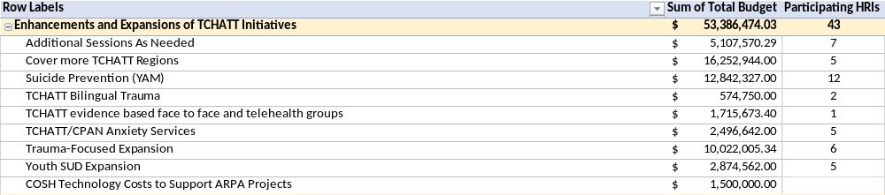
TCHATT Draft ARPA Budget

Slide 13
Workforce Expansion Related ARPA Projects
Increase the number of mental-health professionals entering the workforce:
  Increase number of CAPs and/or
  Facilitate a child practicum for psychology graduate students, and/or
  Establish a child and adolescent psychology internship
LMHA Telehealth Services
  Expand CPWE to provide mental health assessment and treatment via telemedicine and telehealth services for children, adolescents, and transitional aged youth being seen by LMHAs covering a significantly rural and underserved area with difficult access to child and adolescent mental health expertise.

Slide 14
Workforce Expansion Related ARPA Projects
LPC /LMSW Training
  Many graduates of counseling programs leave for other cities as there are very few placements for completing the supervised hours required for a full license as a Licensed Professional Counselor. Current waiting lists to see therapists in our community are 3-6 months long. We would like to add a two-year program for LPC- Associates who are newly graduated to complete their hours while serving our community’s children and adolescents both in our own academic clinics and in community mental health centers in our region. This program would improve access in both the short term and long term.
  Masters level social work students and recent graduates of accredited graduate social work programs will be recruited to receive supervised clinical training to deliver effective child and adolescent mental health services to increase the number of mental health practitioners available to support the mental health needs of school‐aged children and youth.

Slide 15
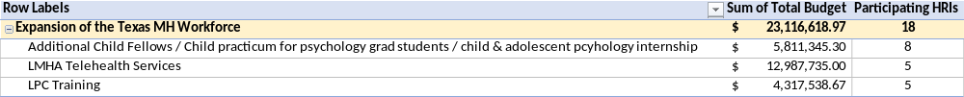
Workforce Expansion Draft ARPA Budget

