Slide 1
Texas Child Mental Health Care Consortium
Melanie Susswein, MSW

Slide 2
CPAN Project Update
Q&A
Agenda

Slide 3
Notes:
CHC Message Design Process

Slide 4
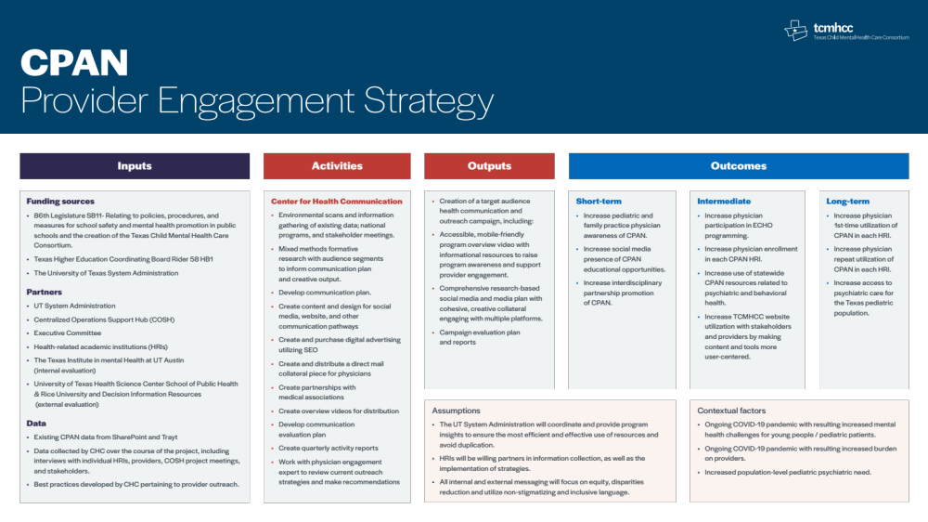

Slide 5

timeline
FALL 2021
Fall +
Winter 2021
Project onboarding
Information gathering
Formative research
Initiating creative development
Formative research
Develop/ refine outreach and communication plan
Collaborate with physician engagement expert
Provide HRIs with initial tools and strategies

Slide 6

Timeline (Cont’d)
Spring +
summer 2022
fall +
winter 2022
Paid search/keyword marketing
Overview video launch
Continued outreach support
Social media
Other implementation tactics
Continued engagement
and implementation of communication plan
Evaluation plan

Slide 7
Communication plan
research + Overview
The Center for Health Communication (CHC) staff conducted research to understand the CPAN program better and ground the proposed strategies, messages, and tactics in evidence. The formative research included:
Environmental Scan
Continuing Medical Education (CME) Participation
  Participated in multiple CMEs to learn about provider engagement and HRI-provider direct communication.
ECHO Participation
  Participated in multiple ECHO sessions to learn about provider engagement and HRI-provider direct communication.
National Program Review
  Conducted a review of the National Network of Child Psychiatry Access Programs (NNCPAP) to learn about other program offerings, messaging, websites, and direct provider
  engagement materials.
Internal and External Evaluation Data
  Reviewed data and reports provided by internal and external CPAN evaluation teams and attended meetings to learn about their findings and insights.
Trayt Data Review
  Reviewed metrics for individual HRI and cumulative data
SharePoint
  Reviewed materials including lessons learned and
  progress reports
Stakeholder Interviews
Creative Review
  CHC communications team reviewed and assessed the brand style guide and HRI produced assets
Website Review
  CHC conducted a review of the CPAN website
Provider interviews
Conducted in-depth one-on-one Interviews with CPAN using
providers (n=15)
HRI Focus groups
Conducted focus groups with each HRI (n=12) with a total of approximately 46 individuals

Slide 8
Communication plan
Message Themes
Based on the formative research, CHC recommends seven key message themes to prioritize increasing PCP awareness and utilization. See below for the key message themes and the formative origin:
Theme | HRI Interview Input and Materials | Provider Interview Input | COSH Provider Focus Group | Trayt, SharePoint, Evaluation | CME | Review of National Programs | ECHO
Peer to Peer Collaborative | ✓ | ✓ | ✓ | ✓ |  | ✓ | ✓
Free Program Reimbursement Coding Opportunity | ✓ | ✓ | ✓ |  |  | ✓
Time for Providers & Time for Patient to be Seen | ✓ | ✓ | ✓ |  |  | ✓ | ✓
Educational Opportunities for Providers |  | ✓ |  |  | ✓ | ✓ | ✓
Discomfort in Domain | ✓ | ✓ | ✓ | ✓ |  |  | ✓
Resources | ✓ | ✓ | ✓ | ✓ |  | ✓ | ✓
Pandemic Related Increase for Mental Health Services | ✓ | ✓ | ✓ |  | ✓ | ✓ | ✓

Slide 9
Communication plan
Engagement Strategies + Tactics
2 STRATEGIES
Outreach
Media

Slide 10
Communication plan
Engagement Strategies + Tactics
Outreach Planning Tactics
Media Planning Tactics
A flexible and structured
outreach plan
Self-assessment
CPAN coordinators meeting
Search Engine Engagement
Social Media
Infrastructure Outreach Support
Video
Print/Website
Digital Media
Branded Content/Paid Partnerships
Direct Mail
Events
Email

Slide 11

Q & A

