Slide 1

Centralized Operation
Support Hub (COSH)
May 2023
Dr. Laurel Williams Dr. Sarah Wakefield
Edith Ortiz Jenn Erdige
Jenn Cole

Slide 2

COSH Updates
CPAN
PeriPAN
TCHATT
Topics for
Discussion

Slide 3
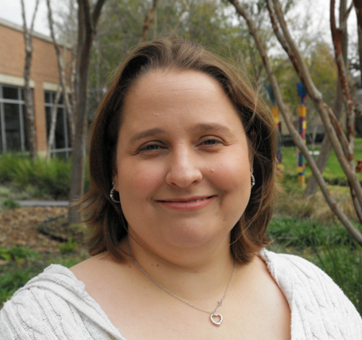
Started March 27
Over 15 years implementing school-based mental health programming
20 years of program development, implementation and expansion experience
Part of the leadership team that stood up the UT Houston TCHATT Program

Slide 4


Slide 5
Welnity Updates
Improvements for better user experience being worked on:
  Streamlining search capabilities
  Data input improvements
Phase: Defining requirements

Slide 6
Lantana Updates
Development Phase: Vetting new voice recording
Timeline: will be determined once vetting process is completed

Slide 7
Direct Consult
9 teams currently doing direct consults
142 number of direct consults have been completed
Direct Consult across the state
HRI coverage
BCM | Dell | Texas Tech El Paso | Texas A&M | UTSA | UT Tyler
UT Houston | UNT | Texas Tech Lubbock | UTMB | UTRGV | UTSW
*HRI coverage order could change

Slide 8
Completed Trayt Initiatives
Feature | Phase | Completed Release Date
PeriPAN Build Insights & Reporting Phase 1: Exports without perinatal characteristics | Completed | September 2022
PeriPAN Build Insights & Reporting Phase 2: Perinatal Characteristics Exports | Completed | November 2022
PeriPAN Build Insights & Reporting Phase 3: Insights Dashboard without perinatal characteristics | Completed | November 2022
PeriPAN Build Insights & Reporting Phase 4: perinatal characteristics insight dashboard | Completed | January 2023

Slide 9
Current Trayt Initiatives
Feature | Phase | Estimated Release Date
Medication Recommendation Improvements | Development | Q2 - 2023
Medication History Improvements (Behavioral Consult) | Development | Q2- 2023
Call Form Part 1 Improvements | Development | June 2023
Call Form Part 2 Improvements | Defining Requirements | TBD
Call Form Part 3 – Direct Consultation | Defining Requirements | TBD
Direct Consult PCP letter | Defining Requirements | TBD
PCP Web Portal | Focus Group | TBD

Slide 10

Trayt Dashboard

Slide 11


Slide 12
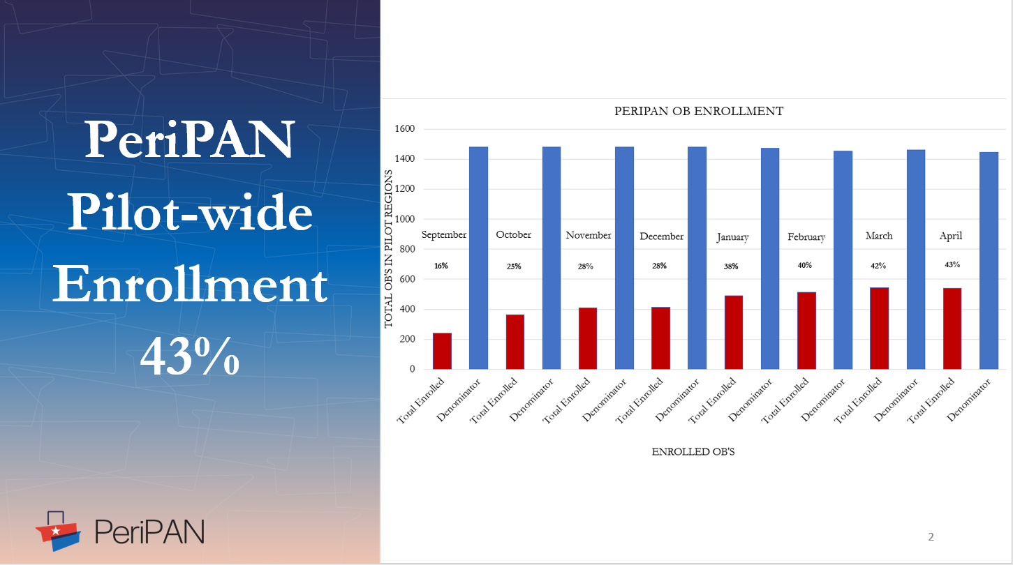

Slide 13
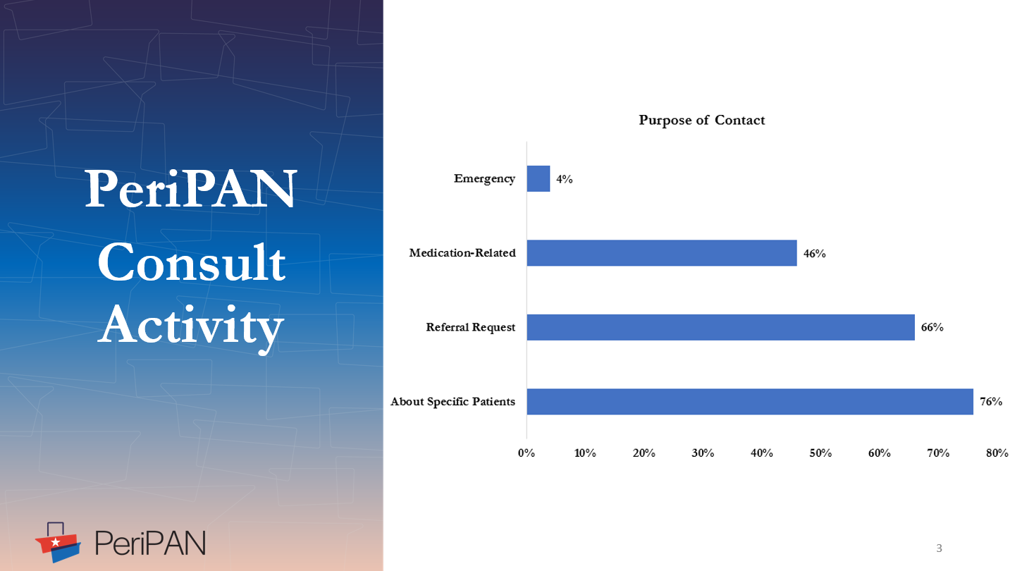

Slide 14
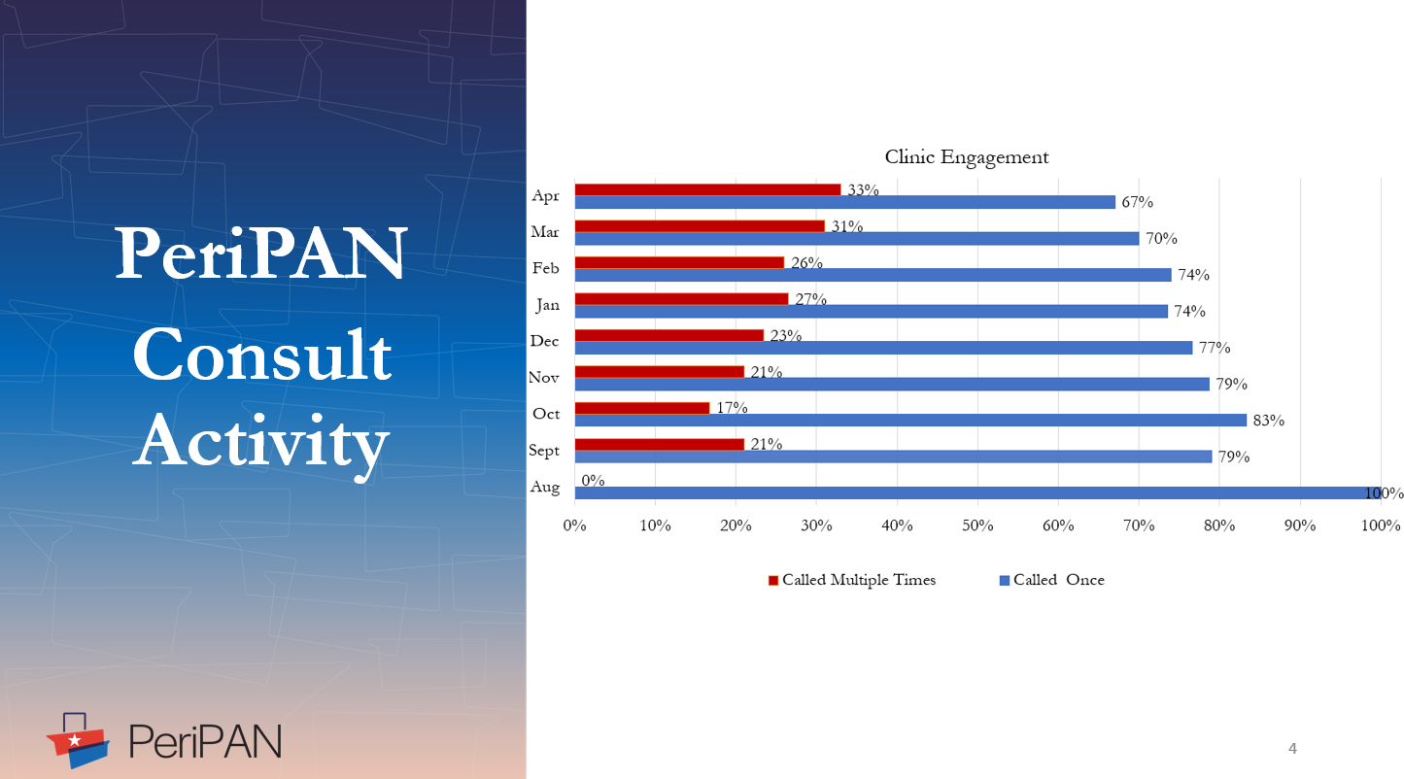

Slide 15


Slide 16
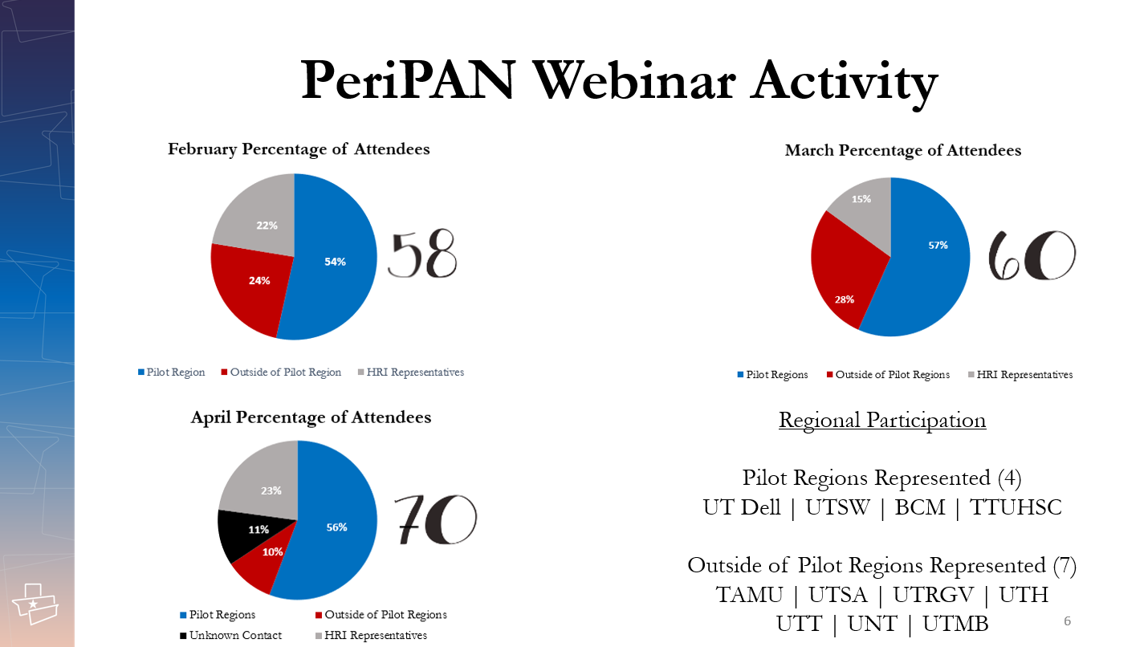

Slide 17
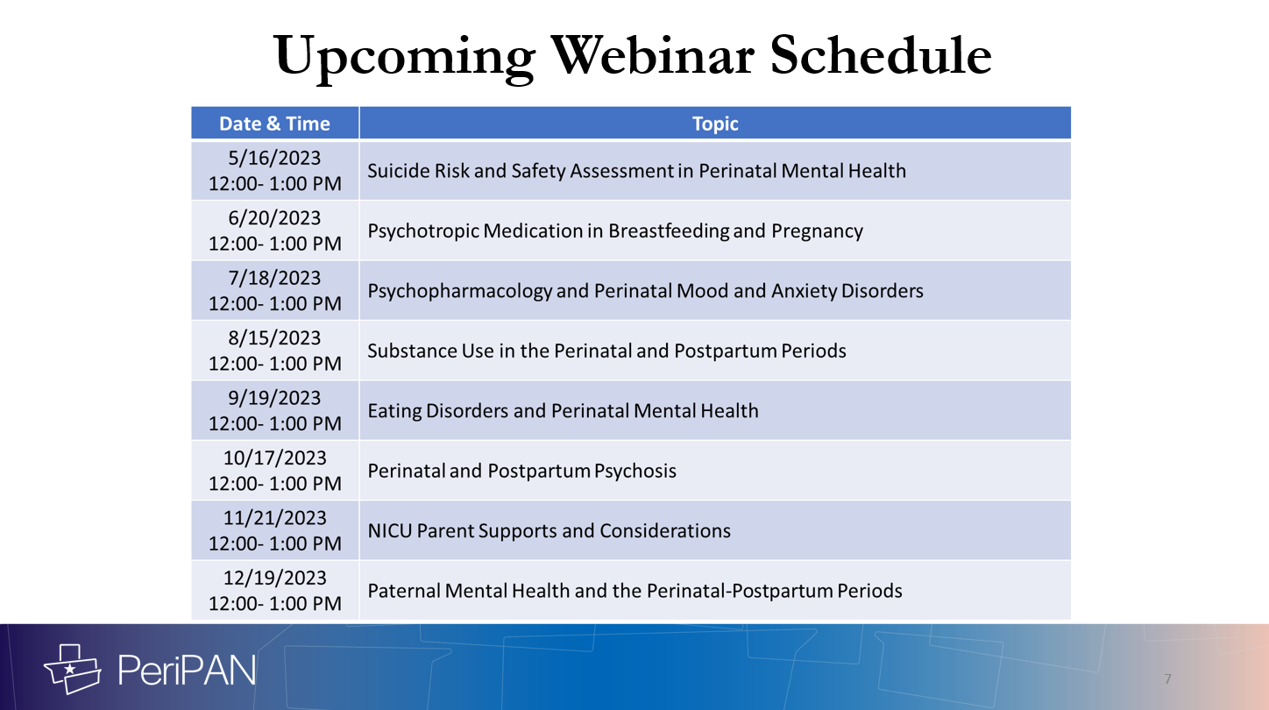

Slide 18


Slide 19
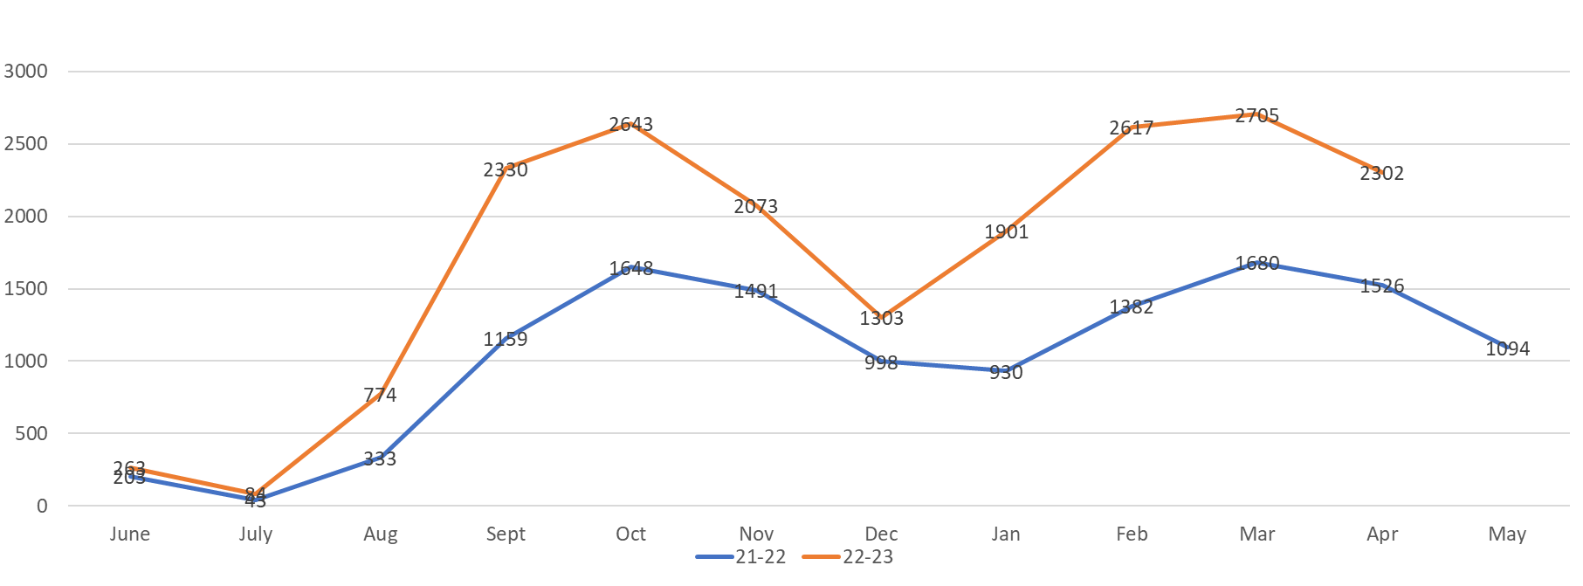

Slide 20
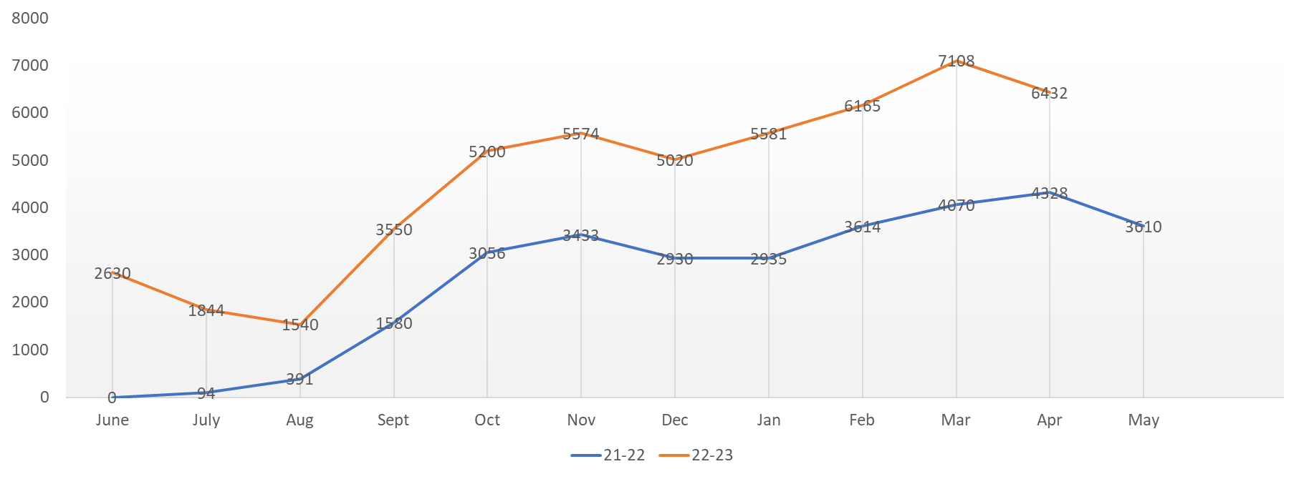

Slide 21
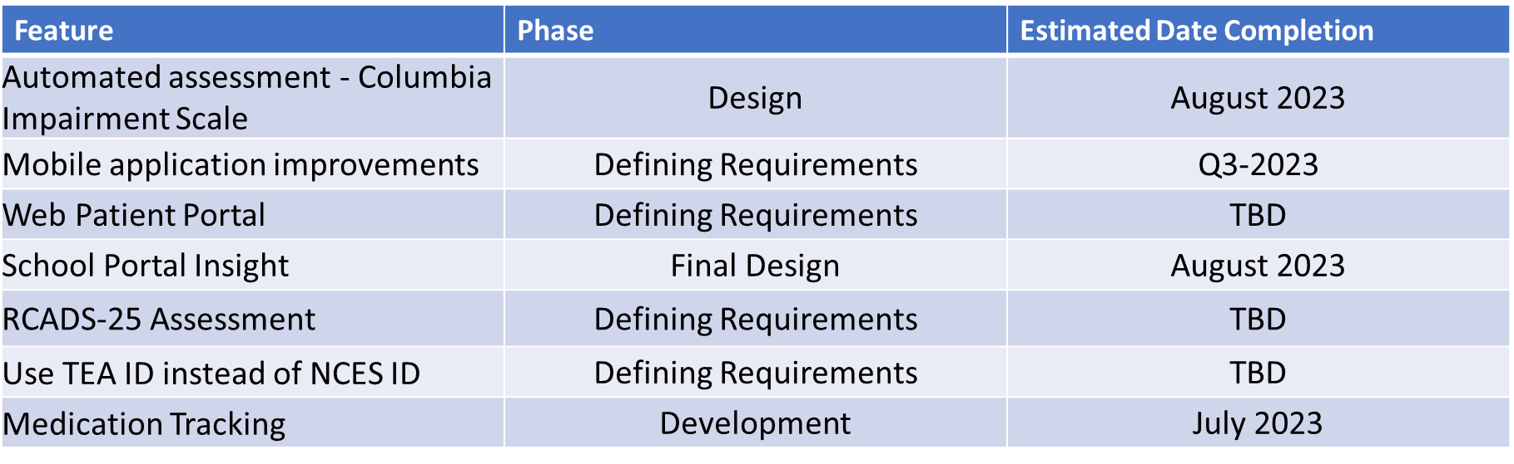

Slide 22
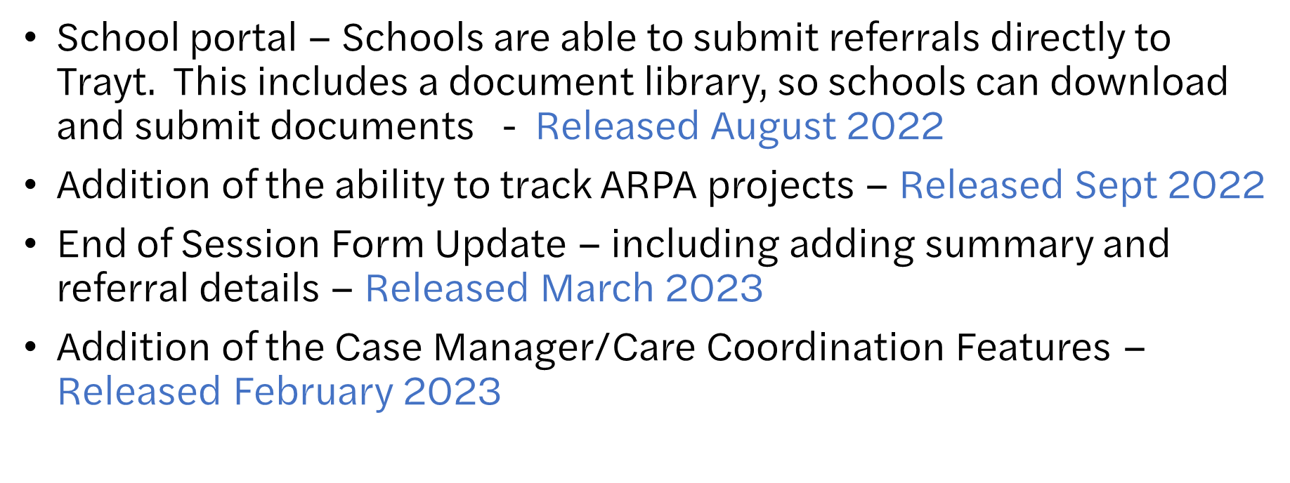

Slide 23


