Slide 1

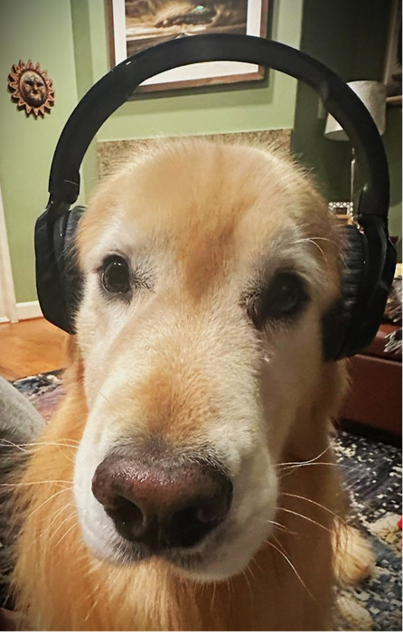
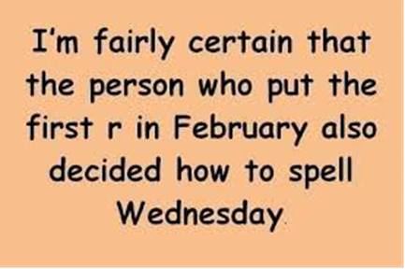
Centralized Operation Support Hub -COSH Updates
Dr. Laurel Williams
Edith Ortiz
Jenn Cole

Slide 2


Slide 3
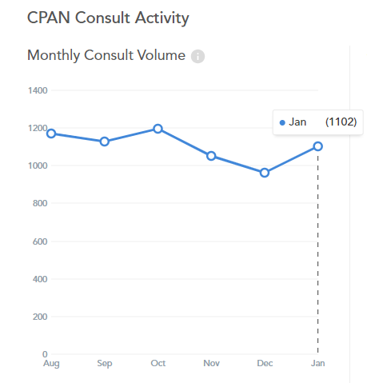
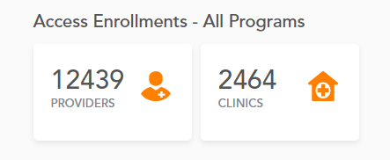
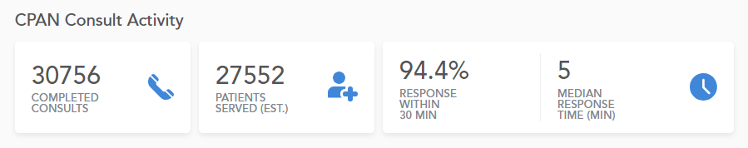
Jan 2024 Consultation Volume
2023 vs 2024
Jan 2023: 1016
Jan 2024: 1102
Notes:
Percent of the increase : 30% increase

Slide 4
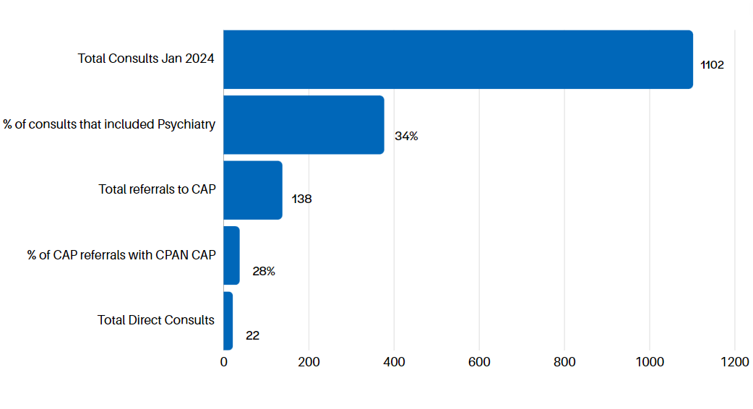
January 2024 CPAN Consultations
* this data is preliminary and is subject to change​

Slide 5
Summit Outcomes for COSH
Communication -Collaboration -Coordination
  Daily leadership huddles
  Role specific support meetings
  Quarterly statewide meetings
  CPAN/PeriPAN Book Club
  CME workgroup

Slide 6
QI Project:
Increase contact with providers enrolled and never utilized CPAN
Begin first week of March
Outreach phone line
  HRIs have identified one phone line used for pcp outreach
    Voicemail added to line for pcp to leave a message
Provider list
  List contains all pcps enrolled in HRI region who have not yet utilized the program
  CAP are to outreach to pcps until contact is made
  Spreadsheet is formatted to track outreach
  Scripts were created along with videos- to assist CPAN CAP in conducting outreach- collaboration with PeriPan, Lainie and Melanie

Slide 7
Trayt Roadmap
Feature | Phase | Estimate Release Date
Direct Patient Consultation Process | Design Workgroup Feedback uniformly positive- will review with Evaluation Teams and CPAN leadership groups next | Q2 2024
PCP Caller (Calling on behalf of the doctor) | Design Workgroup feedback uniformly positive= will review with Evaluation teams and CPAN Leadership Groups next | Q1 2024
PCP Web Portal | Design | Q1 2024
Add unique physician identifier (NPI) | Defining Requirements | TBD
PCP experience/engagement surveys | Defining Requirements | TBD

Slide 8


Slide 9
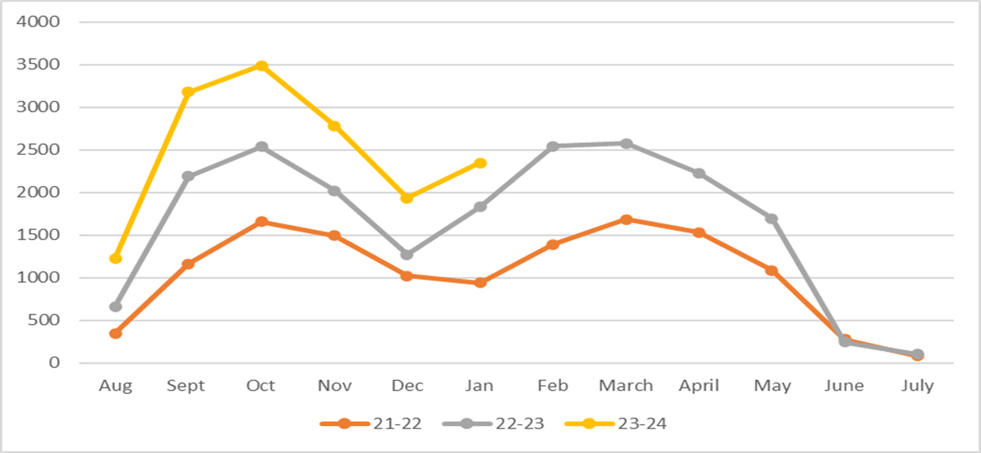


TCHATT Referrals​
* this data is preliminary and is subject to change​

Slide 10
* this data is preliminary and is subject to change​

Slide 11
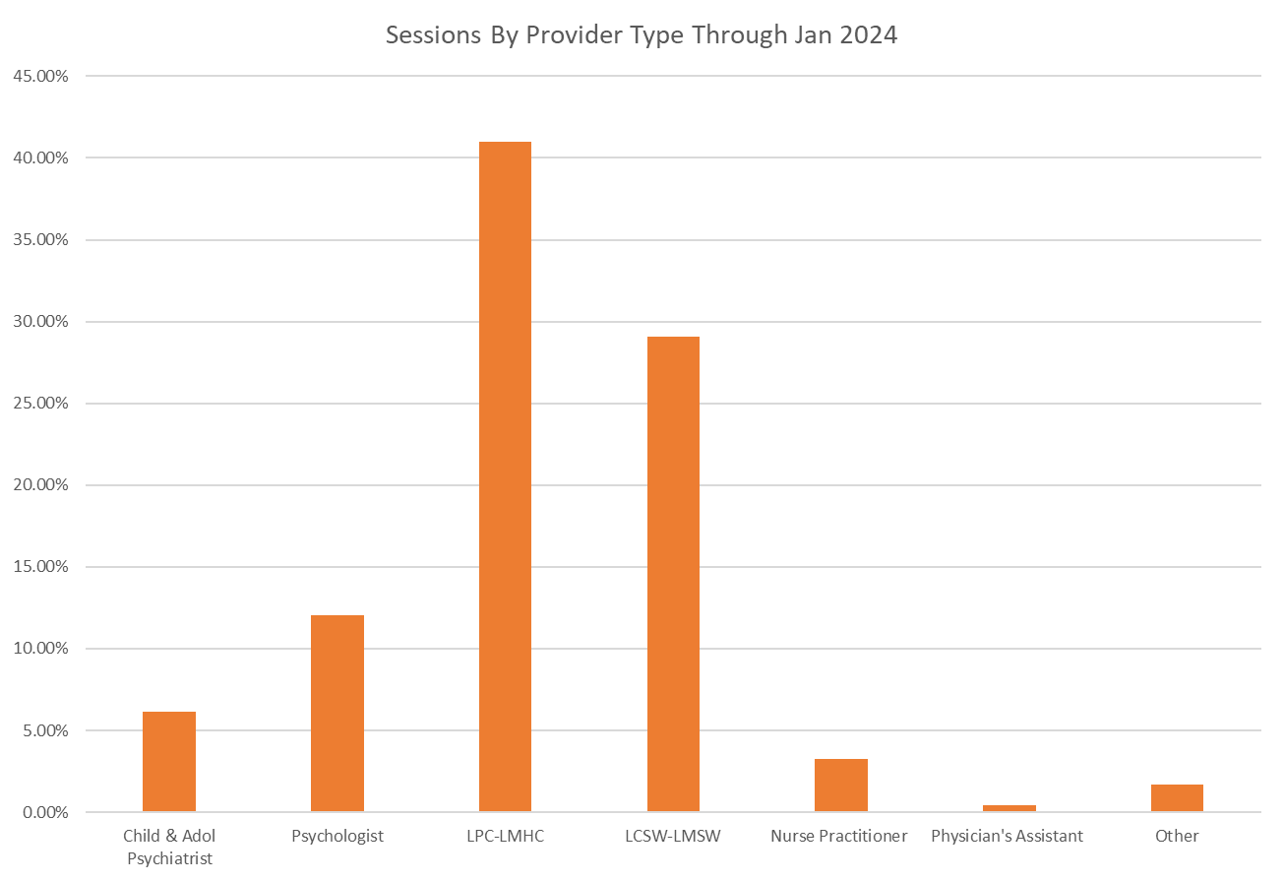
Cumulative Total Sessions - 129,275 ​
* this data is preliminary and is subject to change
This is comprehensive since program start​

Slide 12
Provided 1:1 Support to HRIs
Working with HRIs to manage waitlist concerns and partner with HRIs with capacity. Monitoring capacity across the state as we move in to peak time.
Worked with teams to refine case management and care coordination processes
Provide support and feedback to help create efficient processes
Met with Teams to integrate data available with current processes and look at ways to streamline scheduling and processes.
1:1 Trayt training and support for HRIs

Slide 13
TCHATT Highlights
Finalizing recommendations from referral triage and processing workgroups
Hosted Massachusetts Association for Mental Health Team, and coordinated visits and information with 3 local HRIs as well as COSH
Coordinated with CHC on focus groups with school counselors
Review communication submissions to provide feedback related to operations and clinical items
Worked with Trayt to develop visuals and mock ups to help facilitate better product development

Slide 14
Current Trayt Initiatives
Updates to the referral form to capture more accurate archiving data – LIVE
School Portal Dashboard Expansion – In Design
Reorganization of Diagnosis Data to create more accurate data – LIVE
Automation of End of Care Survey – In Process
CIS Automation, including reminder, and follow up session launch – LIVE

Slide 15


