Slide 1


Centralized Operation Support Hub -COSH Updates
Dr. Laurel Williams
Edith Ortiz
Jenn Cole

Slide 2


Slide 3
Topics
CPAN
Welnity Updates
Trayt Releases
Trayt Roadmap
CPAN Call Volume
CPAN Medication Recommendation Data
Notes:
Percent of the increase : 30% increase

Slide 4
Welnity Update
Contract has been executed
Workgroup are currently working on providing feedback and data for build
Timeline for completion: April 2024

Slide 5
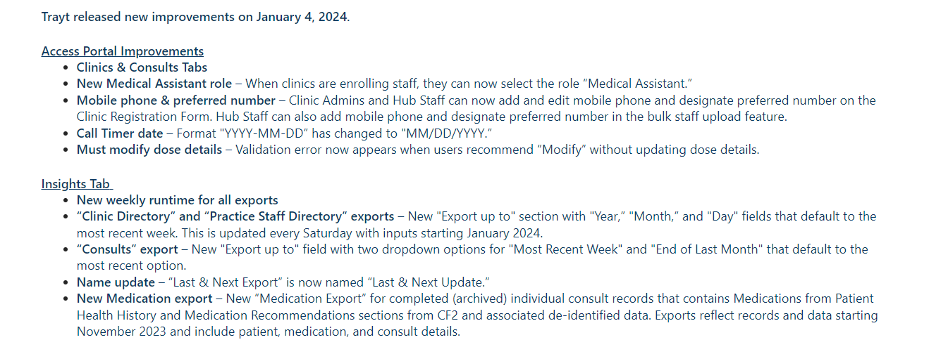
Trayt - New Releases

Slide 6
Trayt Roadmap
Feature | Phase | Estimate Release Date
CF2 improvements | Development | January 30/February 6
Direct to Patient Consults | Design | Q1 2024
PCP Caller (Calling on behalf of the doctor) | Design | Q1 2024
PCP Web Portal | Design | Q1 2024
Add unique physician identifier (NPI) | Defining Requirements | TBD
PCP experience/engagement surveys | Defining Requirements | TBD

Slide 7
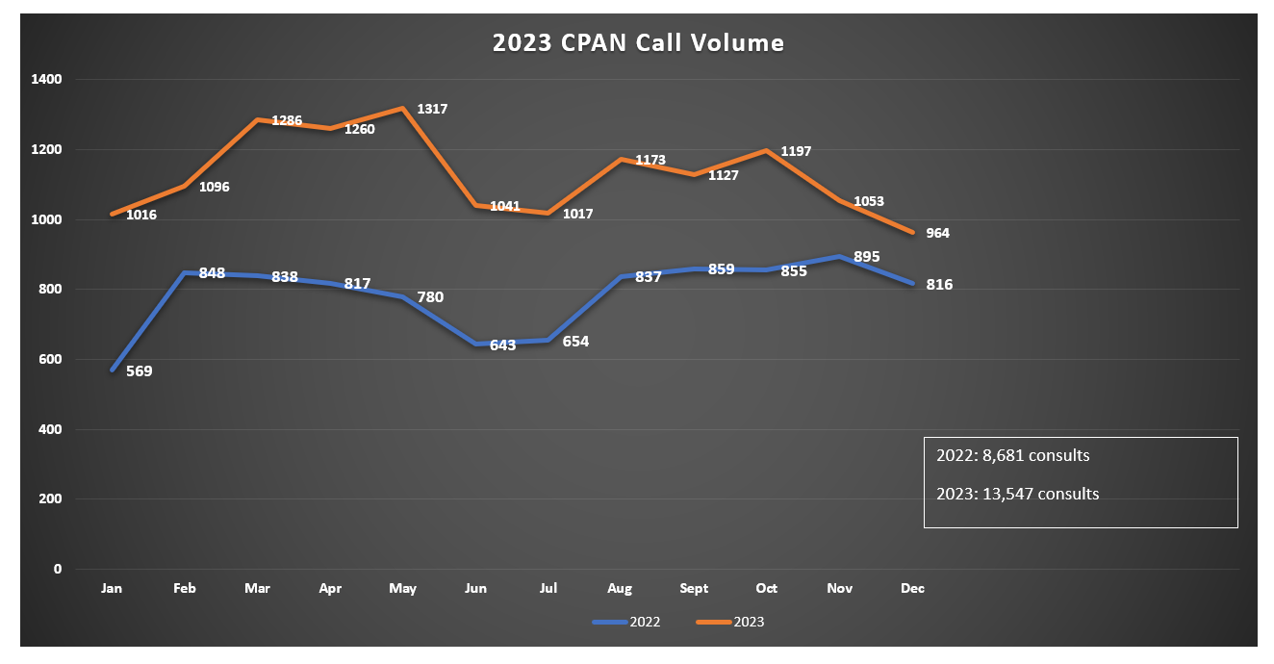
* this data is preliminary and is subject to change​
*As of end of November 344 Direct Consults have been completed

Slide 8
2024 CAP Outreach Strategies
Goal | Strategies | COSH support
Reaching enrolled providers not using the service | Calling enrolled providers | COSH providing pcp list Providing instructions on process Meeting regularly with HRI for support
Supporting pcps who referred to HRI clinics with long waitlist | Calling enrolled provider that have referred to HRI clinics | Team monthly meetings to provide support/ guidance in process
Streamlining provider calls to CAP | CAP will assist with answering calls when possible | COSH providing psychiatrist with trainings and materials of process COSH regular meetings with all CPAN psychiatrist
TCHATT/CPAN connection | CPAN psychiatrist also work in TCHATT will use CPAN time to reach out to patient pcps | COSH developing and providing process and guidance
CPAN and Collaborative Care partnership | Collaborative Care initiative working with CPAN CAP | COSH developing process and guidance

Slide 9
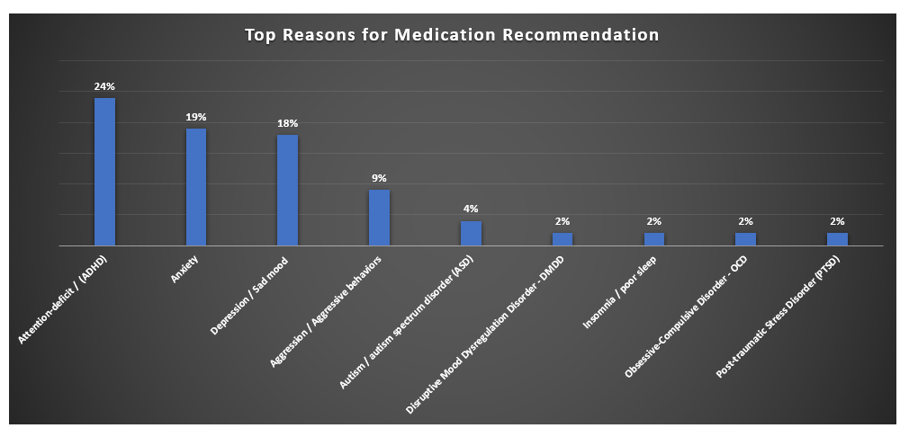
​
*Percent based on 350 medication recommendations in December 2023
* this data is preliminary and is subject to change​

Slide 10
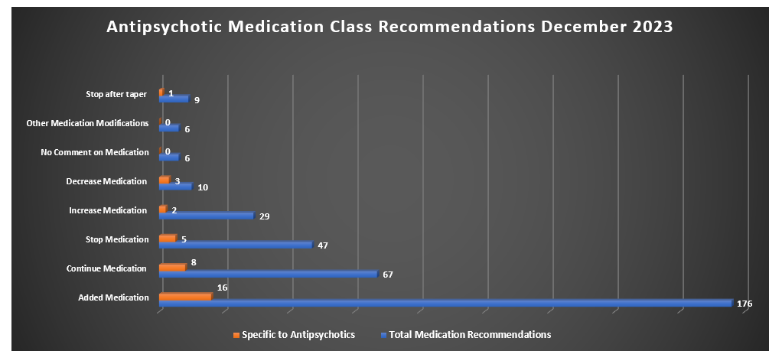
* this data is preliminary and is subject to change​

Slide 11
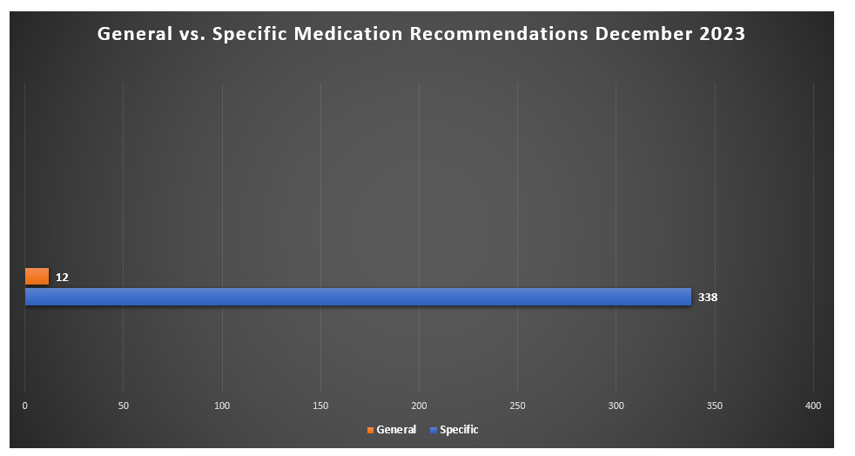
​
* this data is preliminary and is subject to change​

Slide 12


Slide 13
TCHATT Referrals​
Total Students Referred to the Program – 52,527​
* this data is preliminary and is subject to change​

Slide 14
TCHATT Highlights
Lead Triage and Prioritization Workgroup and Referral Processing Workgroup. Recommendations being reviewed by Leadership Groups
Collaborated with UT Systems on content for TCHATT Newsletter
Coordinated with UT Systems on projects related to TEA meetings and presentations
Planned Houston visit with representatives from other states to share program info
Coordinated with CHC on setting up and preparing HRI Interviews
Collaborated with UT Systems on TCHATT 2.0
Review communication submissions to provide feedback related to operations and clinical items

Slide 15
Provided 1:1 Support to HRIs
Set up waitlist transfer process, and coordinate meetings between HRIs
Managed/supported new staff training
Provide support and feedback to help create efficient processes
Consulted on scheduling,
Support for data pulls, and integrating data in processes.
1:1 Trayt training and support for HRIs

Slide 16
Current Trayt Initiatives
Updates to the referral form to capture more accurate archiving data
School Portal Dashboard Expansion – In Design
School Staff Bulk Upload – In Design
Use of TEA number to help better track and identify schools and referral patterns
Automation of End of Care Survey
CIS Automation
Medication Tracking and data capture

Slide 17
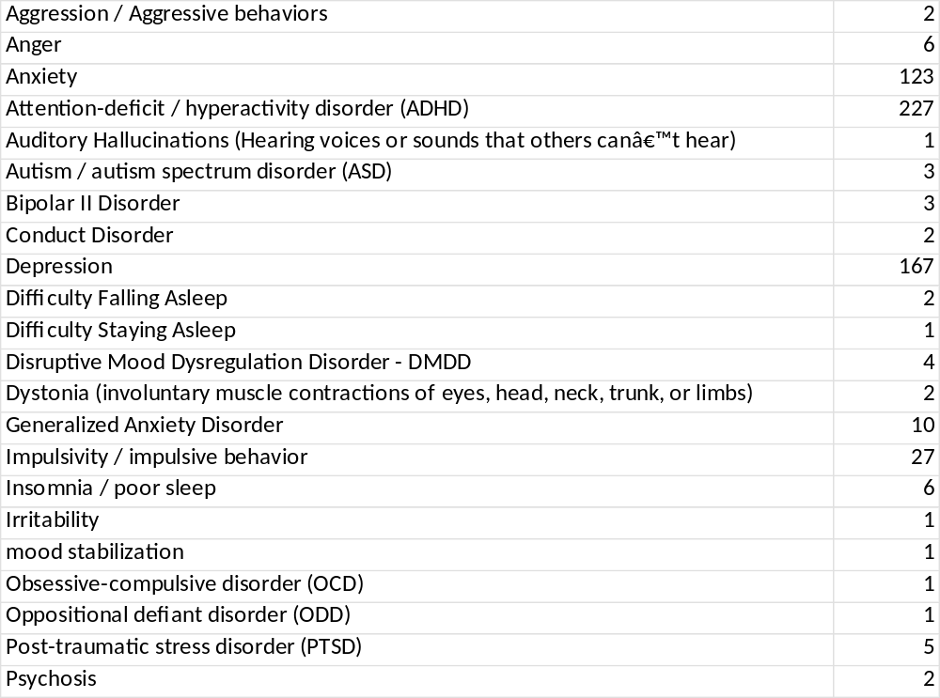
TCHATT Medication Tracking – Statewide December 2023
Diagnosis Related to Prescribed Medication
Unique Patients seen by Psychiatry
453
Unique Patients prescribed Medication
357
* this data is preliminary and is subject to change​

Slide 18
TCHATT Medication Tracking – HRI Example December 2023
Unique Patients
Diagnosis
Specific Medication
35 Patients Seen By Psychiatry
25 Patients Prescribed Medication
15 ADHD
3 Anxiety
1 Aggression
1 Bi Polar
3 Depression
2 Depression/Anxiety
6 patients received Concerta
Range 18-36 mg
ADHD
* this data is preliminary and is subject to change​

Slide 19


