Slide 1

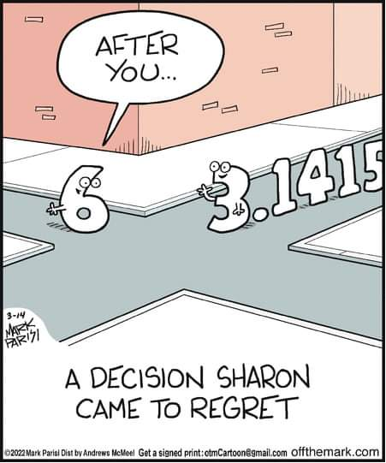
Centralized Operation Support Hub -COSH Updates
Dr. Laurel Williams
Edith Ortiz
Jenn Cole

Slide 2


Slide 3
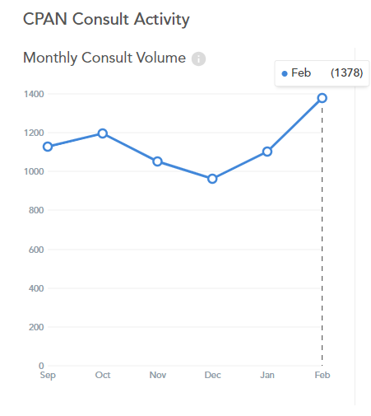
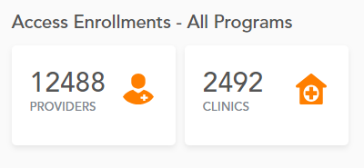
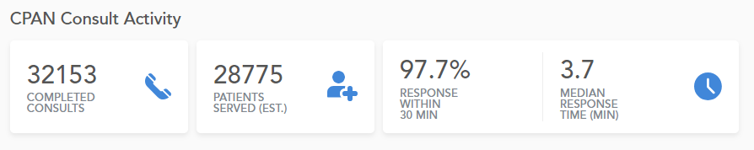
February 2024 Consultation Volume
2023 vs 2024
February 2023: 1096
February 2024: 1378
Notes:
Percent of the increase : 30% increase

Slide 4
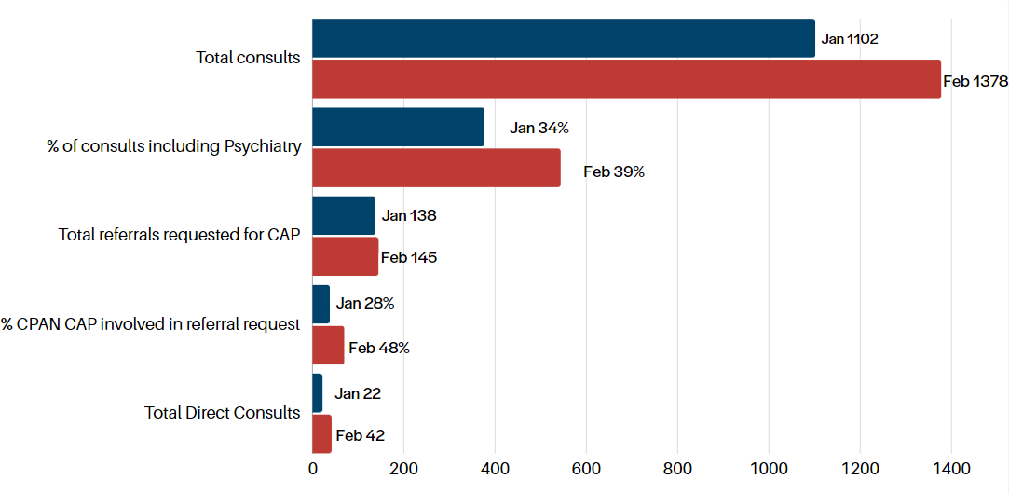
February 2024 CPAN Consultations
* this data is preliminary and is subject to change​

Slide 5

QI Project Update:
Increase contact with providers enrolled and never utilized CPAN
COSH CPAN/PeriPAN Psychiatrist meeting first week of March
  Review of process
  Address questions
  Offered additional support if needed
As of March 19th
  562 outreach calls have been made
    8 resulted in CPAN consults
    20 resulted in CPAN education
    3 resulted in a CPAN ethics presentation request

Slide 6
Highlighting: Texas Tech University Health Sciences Center El Paso
Direct Consult
  Scheduled : *328
  Completed: 213
QI Project: Pilot with Pediatric Residency
  Team will present finding outcome when completed
*Data includes patients still waiting to get seen or rescheduled

Slide 7
COSH Workgroups
Educational Resource Workgroup
Collecting resources from HRIs
Identifying experts
Topic : Anxiety
  Anxiety Disorder
  Separation Anxiety Disorder
  Social Anxiety
  Selective Mutism
  School Avoidance
  Specific Phobias
  Panic Disorder
  Obsessive-compulsive disorder

Slide 8
Trayt Roadmap
Feature | Phase | Estimate Release Date
Direct Patient Consultation Process | Design | Q2 2024
PCP Caller (Calling on behalf of the doctor) | Design | Q1 2024
PCP Web Portal | Design | Q1 2024
Add unique physician identifier (NPI) | Defining Requirements | TBD
PCP experience/engagement surveys | Defining Requirements | TBD

Slide 9


Slide 10
TCHATT Referrals​
Total Students Referred to the Program – 58,126
* this data is preliminary and is subject to change​

Slide 11
Top 10 Reasons for Referral
*as of Feb 2024
* this data is preliminary and is subject to change​

Slide 12
Referrals, Enrolled, and Served 23-24 School Year

Slide 13
Reasons for Decline as of Feb 2024

Slide 14
Cumulative (Sept 2020 – Feb 2024) TCHATT Encounters
Cumulative Encounters- 138,113
* this data is preliminary and is subject to change
This is comprehensive since program start​

Slide 15
Provided 1:1 Support to HRIs
Working with HRIs to manage waitlist concerns and partner with HRIs with capacity. Monitoring capacity across the state as we move into peak time.
Worked with teams to refine case management and care coordination processes
Site visits to work with teams to identify opportunities for streamlining and improving workflow
1:1 Trayt training and support for HRIs
Working with Teams to identify needs for growth or changes with TCHATT 2.0 Implementation

Slide 16
Current Trayt Initiatives
Improvements to the Referral Form – In Design
School Portal Dashboard Expansion – In Design
Automation of End of Care Survey – In Process
Development of Referral Processing Dashboard – In Design

Slide 17


