Slide 1


Centralized Operation Support Hub -COSH Updates
Dr. Laurel Williams
Edith Ortiz
Jenn Cole

Slide 2


Slide 3
Topics
CPAN
Trayt Releases
COSH Trayt Training
Trayt Roadmap
Project ECHO
CPAN Call Volume
Trayt Dashboard
Notes:
Percent of the increase : 30% increase

Slide 4
Trayt - New Releases
Phase 1: CF1 and CF2 Improvements (Part 1) – Nov 7th
Fully Editable CF1 - Hub staff can edit all on CF1 (except for PCP information) on a Consult. While HRI’s are training on staging, we will be implementing edit and transfer functionality from the Read Only CF1.
Add and Save Mobile and Preferred Contact - Mobile number (optional) and preferred contact number is now saved every time a PCP calls in
Add Chief Complaints/Diagnosis on CF1 - Add chief complaints and diagnosis to Call Form Part 1 which will update Call Form Part 2 and vice versa.
Update Name to Patient Health History - Rename “Behavioral Consult” to “Patient Health History”
Move Emergency Concern - Moving the emergency question to the top of the form
Visibility of HRI-to-HRI Notes
Medication History & Recommendation Updates - Updates to patient’s medication history documentation, streamlined dosage documentation, and expanded medication recommendation options (continue, modify, stop after taper, stop, no comment), and option to recommend specific or general class of medication.

Slide 5
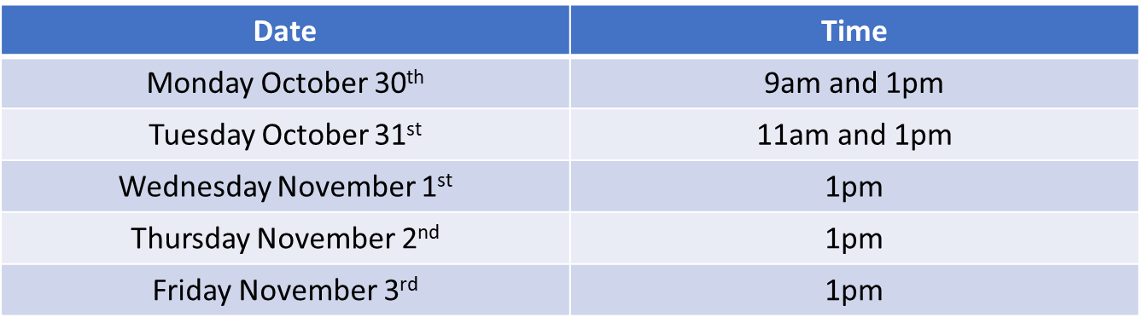
Trayt – COSH Trayt Training
Week of October 30th
72% of CPAN and PeriPAN attended
Team members not in attendance received training video
Training schedule

Slide 6
Trayt Roadmap – Call form call
Feature | Phase | Estimate Release Date
Phase 2: Call form part 1 and 2 Improvements | Development | End of November
Medication History and Recommendation Improvements - Phase 2: Recommendation Reasons | Development | Week of 12/04/2023
Medication History and Recommendation Improvements ​​ - Phase 3: Medication Data Exports | Development | End of December
Documenting Direct to Patient Consults | Design | Q1 2024
PCP Web Portal | Design | Q1 2024
Multiple consultations on a single call | Defining Requirements | TBD
Consult Summary Printable Version​ | Defining Requirements | TBD
30-minute callback improvements | Defining Requirements | TBD

Slide 7
Project ECHO Fall 2023
Date | Topic | Attendance
Week of September 18, 2023 | Behavior Disorders in Preschool/ Early Childhood | 130 learners
Week of October 2, 2023 | Treating Patients with Passive Suicidal Ideation and NSSI | 138 learners
Week of October 16, 2023 | Anxiety Disorder in Children and Adolescents | 126 learners
Week of October 30, 2023 | Youth and Trauma Exposures: The Effects on Mental Health and Treatment Options | 106 learners
Week of November 13, 2023 | Depression and Suicide Risk Assessment
Week November 27, 2023 | Risky Behavior in Adolescence

Slide 8
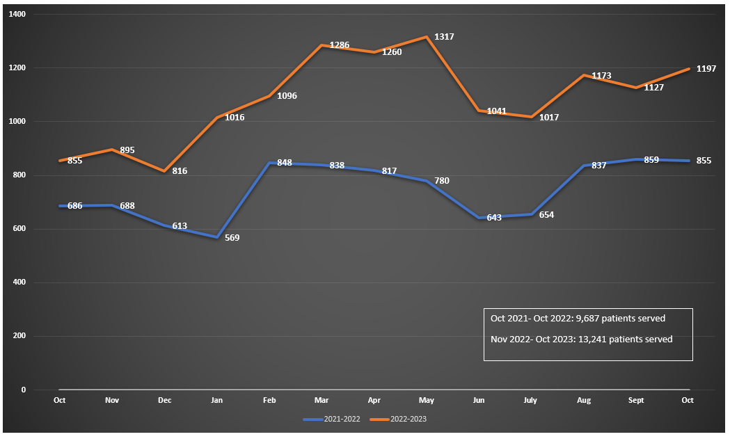
CPAN Call Volume ​
* this data is preliminary and is subject to change​

Slide 9

Trayt Dashboard

Slide 10


Slide 11
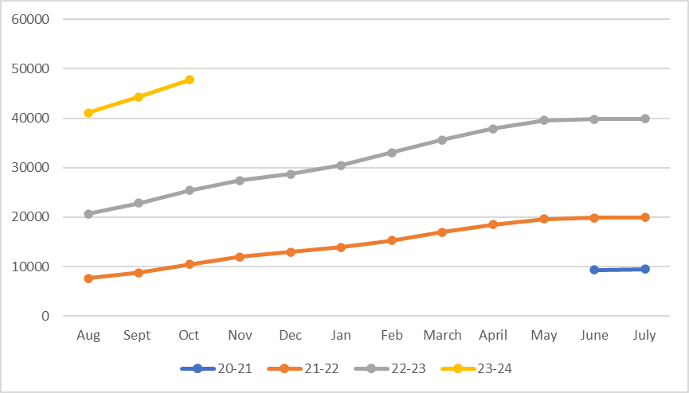
TCHATT Students Referred Since Program Start ​
Total Students Referred to the Program – 47,809 ​
* this data is preliminary and is subject to change​

Slide 12
TCHATT Updates
Working with HRIs to ensure they are able to see/schedule patients in a timely manner with the increase in referrals for the new school year.
Monthly meetings with all HRIs focused on streamlining processes, making sure data is accurate, and address any changes in staff/systems to help make sure that program continues to run effectively
Worked to make sure that all teams are trained in the new Med Tracking features, which included offering trainings and office hours to support the launch of the new feature.
Launched workgroups to look at referral triaging and prioritization as well as streamlining the referral processing

Slide 13
Current Trayt Initiatives
Medication Tracking – Launched
School Portal Dashboards – In Design
School Staff Bulk Upload – In Design
CIS Automation – Coming soon

Slide 14


