Slide 1


Centralized Operation Support Hub -COSH Updates
Dr. Laurel Williams
Edith Ortiz
Jenn Cole

Slide 2


Slide 3
CPAN Updates
CPAN State Educational Resources
Welnity
Lantana
Trayt
Ethics PRESENTATIONS to improve outreach to PCPs
Project ECHO
CPAN statistics
Updating contracts with CHC, Welnity, Lifeline for Moms
Coordinating with UTS on CPAN/PeriPAN Summit January 2024
Notes:
Percent of the increase : 30% increase

Slide 4
CPAN State Educational Resources
ALL CPAN teams utilize the same vetted list to ensure quality of resources recommended
Workgroup standard process
  Representative from each HRI hub participate
  Cadence of 6-8 weeks per resource
  Reps assist in organizing current list of resources from ALL HUBS arranged by need: PCP, Parent, Patient (age range) and Type (article, book, website, video)
  Reps locate and review list with statewide experts
  Process will keep resources that were not approved to assist during future updates and when teams are looking for resources = Help ensure quality of resources recommended
Notes:
Percent of the increase : 30% increase

Slide 5
CPAN State Educational Resources
3. Eating Disorder Resources were the first vetted. Now on Teams Site
4. Training needed for all TEAMS to ensure that teams utilize the new resource
5. 120 resources approved
6. Current topic is Psychosis
  HRI reps currently organizing all hub resources in the teams' folders.
  HRI reps are locating Psychosis experts for the vetting process
Notes:
Percent of the increase : 30% increase

Slide 6
Welnity
Teams are now organizing their internal lists based on new Welnity structure in anticipation of bulk upload
  This includes PeriPAN resource lists
COSH working with BCM contracting to update Welnity contract
Once approved 8 weeks for the build out
  2-4 weeks to upload each hub list
Trainings on new product will be scheduled prior to launch ~ January 2024
Notes:
Percent of the increase : 30% increase

Slide 7
Lantana
New process for how calls are placed on hold is working well
Calls are being picked up on average in 12 seconds
7% calls are being transferred after 3 minutes to a new hub
Review of Lantana ticket volume primarily due to hub coverage
Notes:
Percent of the increase : 30% increase

Slide 8
Trayt
Medication Changes and Call form 1&2 Changes
Final sign off by CPAN leadership, workgroups, Data governance and evaluation teams for updates to
  Call form part 1
  Call form part 2
  Medication documentation improvements
  Trayt is currently in production of these improvements slated to be completed in November 2023
  COSH working on training materials and trainings to relevant CPAN/PeriPAN Team members in preparation of upgrades
Notes:
Percent of the increase : 30% increase

Slide 9
Trayt
PCP Portal
Completed interviews with un-engaged PCPs enrolled in CPAN to discuss scope of a CPAN portal
Included in the process was COSH, Melanie Susswein and Trayt. Overall PCP agreed a portal that is secure would increase the likelihood of utilizing the service. Portal would allow PCPS to:
      Send in the request after hours
      See the written response from the team once the consult is completed and download to place in EMR if desired
      Have information, resources shared via portal to save and/or download/print for patient/family or EMR
3. COSH creating Change order request to be vetted through our processes and then provided to Trayt team
Notes:
Percent of the increase : 30% increase

Slide 10
PCP engagement strategy: Ethics Presentation
Teams are working to engage directly with PCPs
This is seen as core process to educating about CPAN/PeriPAN and encourage engagement/utilization
Created a 30- and 60-minute Ethics Presentation given that all physicians in Texas are required to annually have specific ethics credits
Process:
  Presentation focuses on the ethical imperative for PCPs to engage in collaborative care work for mental health and discusses specifically how CPAN/PeriPAN like programs work and the outcomes when PCPs utilize the model.
  Ends with a PCP group doing an exercise to consider how they might incorporate collaborative care in their respective clinical endeavors/workflow.
Teams are working to schedule with PCPs, singly or in groups. Team message is to schedule when a PCP wants it- and utilize other teams as needed.
Notes:
Percent of the increase : 30% increase

Slide 11
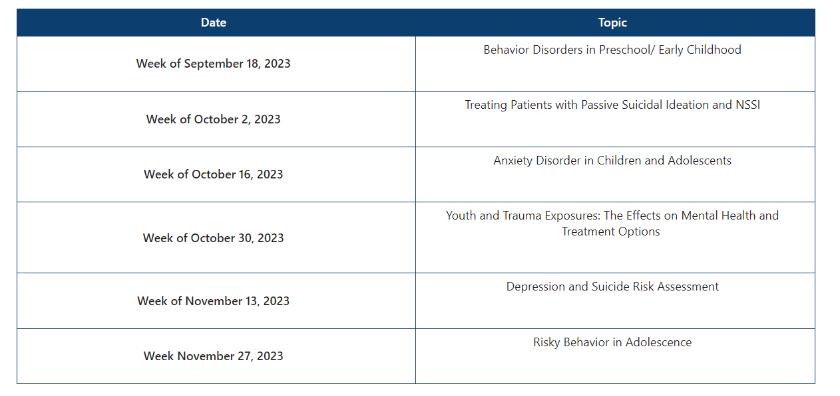
Project ECHO Fall 2023
Attendance
Session 1 : 125 learners
Session 2 : 125 learners
Notes:
Percent of the increase : 30% increase

Slide 12
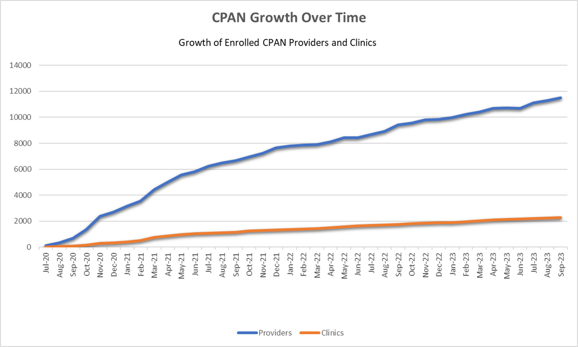
CPAN Enrollment
* this data is preliminary and is subject to change
Notes:
Percent of the increase : 30% increase

Slide 13
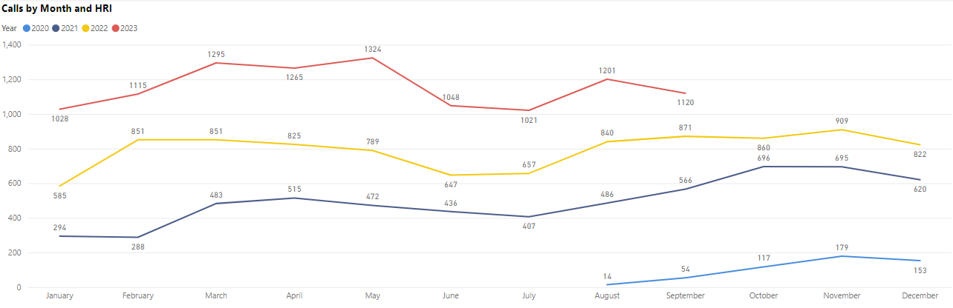
CPAN Call Volume ​
* this data is preliminary and is subject to change​

Slide 14


Slide 15
TCHATT Students Referred Since Program Start ​
Total Students Referred to the Program – 44,349 ​
Students Served – 24, 829
Sessions with Students – 100,834
* this data is preliminary and is subject to change​

Slide 16
TCHATT Updates
Working with HRIs to ensure strong processes to evaluate, triage, and schedule student referrals in the most efficient manner
Monthly meetings with all HRIs focused on back to school, and making sure that HRIs have needed capacity and are able to communicate as that changes with the increase in referrals
Partnered with UT Systems to conduct site visits
Led HRI participation in statewide conference to help engage school leadership and connect with districts that have not signed up for TCHATT services
Data focus – working with teams to evaluate data input training needs, and make sure data is as accurate as possible

Slide 17
Current Trayt Initiatives
Automation of CIS
Medication Tracking
School Portal Dashboards
School Staff Bulk Upload

Slide 18
Automation of the CIS
To support the collection of CIS data, Trayt will automate sending the CIS to families upon enrollment, and will send reminders at identified follow ups.
Design is near completion, and will be released in stages, with the first part of the automation available in November.
The final phase should roll out in December.
COSH presented this to the TCHATT Leadership Team, and is working with Trayt to developing roll out and implementation materials.

Slide 19
Trayt – Medication Tracking
Approved by Workgroups, COSH, UT Systems, Data Governance, Internal Evaluation Team
Set to go live in November
Currently working to create and update training materials and messaging
Will capture data on any medications prescribed by TCHATT Providers

Slide 20
School Portal and Bulk Uploads
For this school year, COSH worked with Trayt to develop a school portal dashboard. School personnel are now able to access aggregate data about number of students that have been referred. We will continue to develop metrics and aggregate data for the dashboard to provide to schools to help with their reporting, etc.
One of the challenges with onboarding schools is getting all the counselors uploaded and activated. COSH has been working with Trayt and HRIs to be able to allow for a bulk upload by School Staff, so they can more easily and directly add school staff.

Slide 21


