Slide 1


COSH October Report
100%
Laurel L. Williams, DO
Jennifer Evans
Edith Ortiz, MBA

Slide 2

COSH Order of Business
COSH updates
Welnity
CPAN
TCHATT
Data Governance

Slide 3

COSH UPDATES
COSH met with Executive Team and Internal Evaluation Team for an all day planning session October 19, 2021
Recommendations as follows:
  Re-configure monthly team meetings to be outcome/metric based
  Use QI Processes to assists teams achieve operational success
  Develop reporting form for those meetings that will be shared with Team and Executive Team (not TCMHCC EX Members) to track progress
  Working with Lashelle to utilize Microsoft teams for purposes related to communication, storage of documents, management of meetings.

Slide 4

COSH UPDATES
Working to complete the CPAN Manual. Again the goal is for this to be housed hopefully on Teams. Help standardize and harmonize procedures and policies related to CPAN
Still searching for a Senior Data Analyst- team member must live in Houston area but can work remotely: https://jobs.bcm.edu/job/Houston-Senior-Data-Analytics-Associate-Texa/808776600/

Slide 5
COSH UPDATES:
Developed Change Request Process for data and procedural improvements for our vendor platforms. The request for changes runs through several committees to ensure (see attachment)
  The change is necessary,
  Review the impacts other functions
  Consider the impact of instituting the change- ie how much of an improvement
  Cost of the change
  Impact to data
Collaborating with vendors (Lantana, Trayt, and Welnity) to develop enhancement for ARPA funded programming
Collaborating with Data Governance, Evaluation Teams, Operational teams related to product enhancements in order to drive towards budgets, timelines, and amended contracts for Spring 2022 launches for most ARPA changes
Will take lead in organization of FISP ARPA program- new team members will be hired as Project Manager and Research Associate
  As decisions are made today possibly start sending out meetings to HRIs to start mapping out FISP

Slide 6

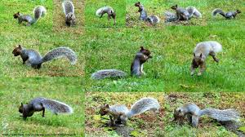
Welnity Updates:
To date 9,089 resources have been uploaded
Welnity team is meeting with each HRI to get feedback related to the site to improve functionality. All have meet with them to date.
  Welnity feedback is that many HRI teams were NOT aware of new functionalities
Biggest concern is that teams are not imputing their referral information into the platform. This will impact how teams can cross cover for each other.
  COSH and Welnity will review feedback from teams
  Meet with CPAN and TCHATT leadership to Re-Inforce the goal of having a state referral database.
  Work on processes related to utilization of the site
  We EXPECT teams will have multiple ways to search for resources so Welnity is NOT the only source
  What we are hoping for is to eliminate HRI resource lists that are squirreled away and don’t give all teams access.

Slide 7


Slide 8
CPAN UPDATES
Project ECHO was successfully launched
7 sessions August through November 2021
  239 attended
  174 CME credits issued
ECHO is a collaborative team-based learning model- expectation is smaller group and review of cases
Allows us to lean on State experts to help develop content
Feedback from participants related to high yield topics
Enhances consistency in teaching as all teams teach from the SAME material
Spring ECHO is being planned current again 7 sessions: April thru June 2022

Slide 9
CPAN UPDATES
  ARPA Funding Projects High Level TRAYT
    Add new features
      Direct Care Consultation Process Data Collection
      Web and APP Portal for PCP to more seamlessly request consultation and be provided documentation related to consultations
    Develop CPAN for Moms (TMOM MindCare TMMC)
    Add new data items to report for ARPA
      Texting, app based, email, phone
      Information related to direct consultation for CPAN
      CPAN for Moms Insight Dashboard-similar to CPAN dashboard

Slide 10
CPAN UPDATES
  ARPA Funding Projects High Level Lantana
    Add new features
      Routing calls based on PCP (OB-GYN) providing their work Zip code to allow quicker access to CPAN team
        9-15k FOR THE WORK
        715.00 per month to current invoice
      Texting already available at no cost to PCP
        Costing out additional texting features beyond current capabilities
        Develop CPAN process flow for allowing PCPs to texting for consultation assistance

Slide 11


Trayt Dashboard: Live presentation of dashboard

Slide 12


Slide 13

TCHATT UPDATES
TCHATT School Portal will be available to ISDs in January
Trayt working with HRI teams now to assist with training and organizing
Portal will allow
  Schools to directly input referrals (immediately) and stop teams from having to input
  Have insight dashboard by Role type to track referrals – no PHI (near future)
  Send and Receive documents needed to coordinate and collaborate care (middle future)

Slide 14
TCHATT UPDATES
  ARPA Funding Projects High Level TRAYT
    Add new features
      Web Portal for Families to enter information to improve access and decrease disparities
      Simplified Trayt intake form to improve access and decrease disparities
      Parent and Patient Satisfaction Surveys to be sent out after completion of TCHATT services
    Add new data items to report for ARPA
      Additional fields on enrollment form related to each ARPA funded project
      Additional fields on psychosocial interventions at the level of session tracking
      Additional fields for extensions related to ARPA funding

Slide 15

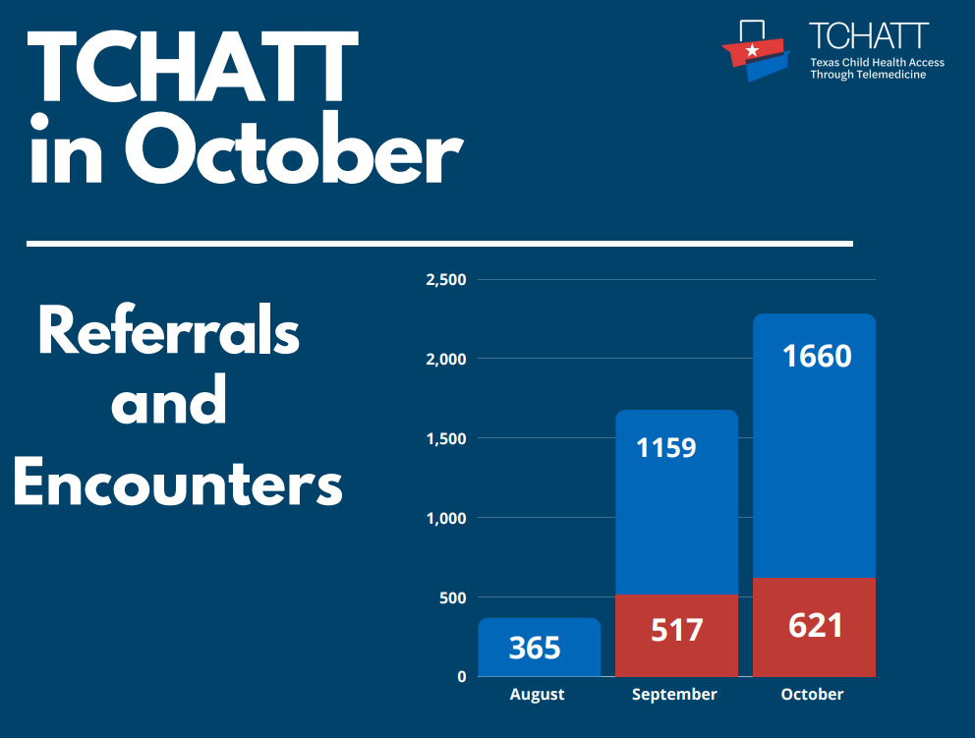

Slide 16

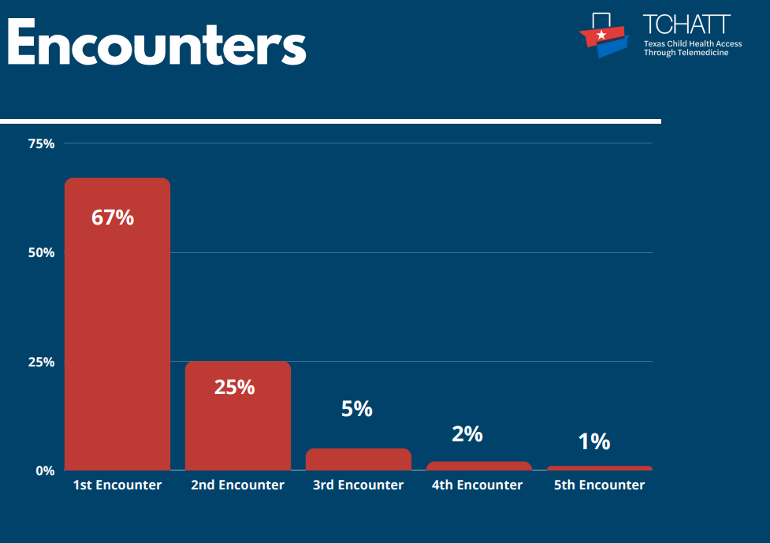
Notes:
416 (67%); 155 (25%); 31 (5%); 12 (2%); 6 (1%)

Slide 17

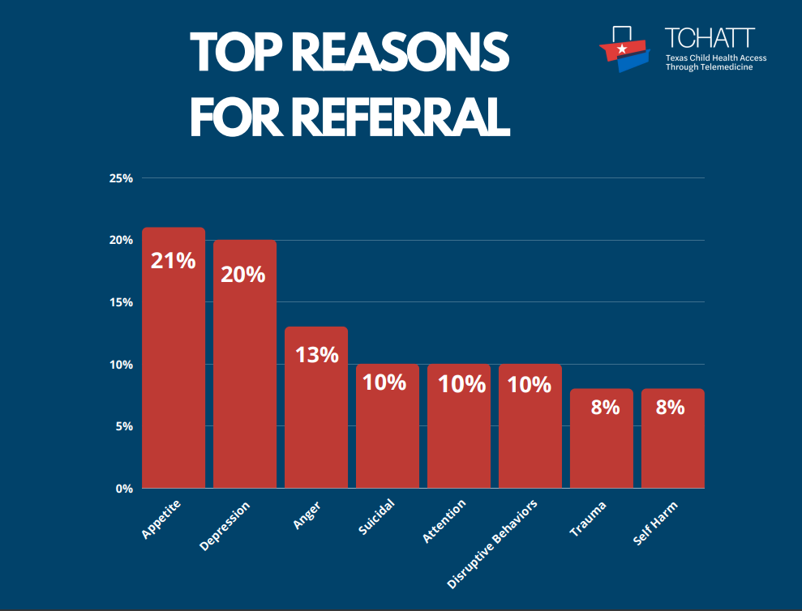

Slide 18
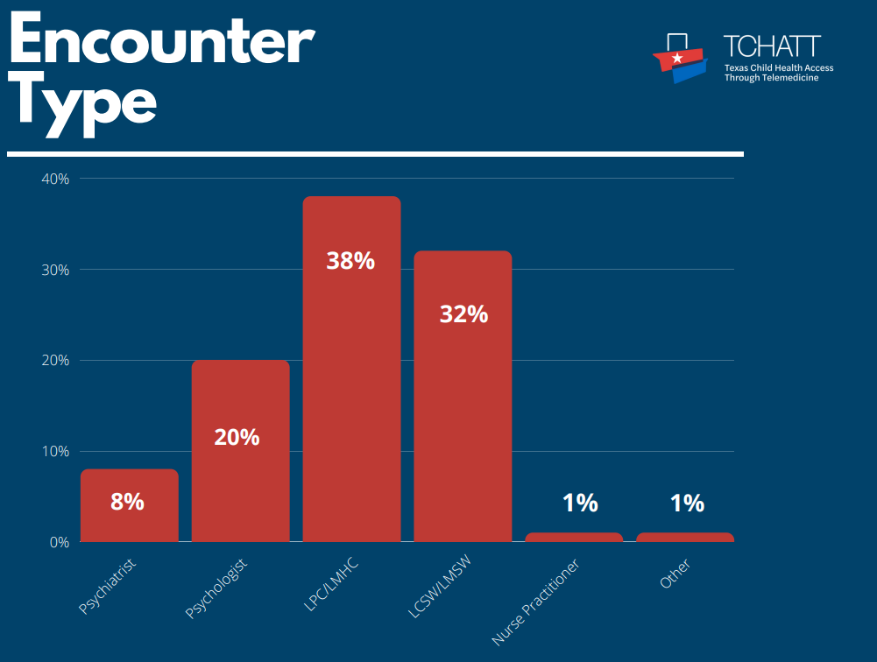

Slide 19
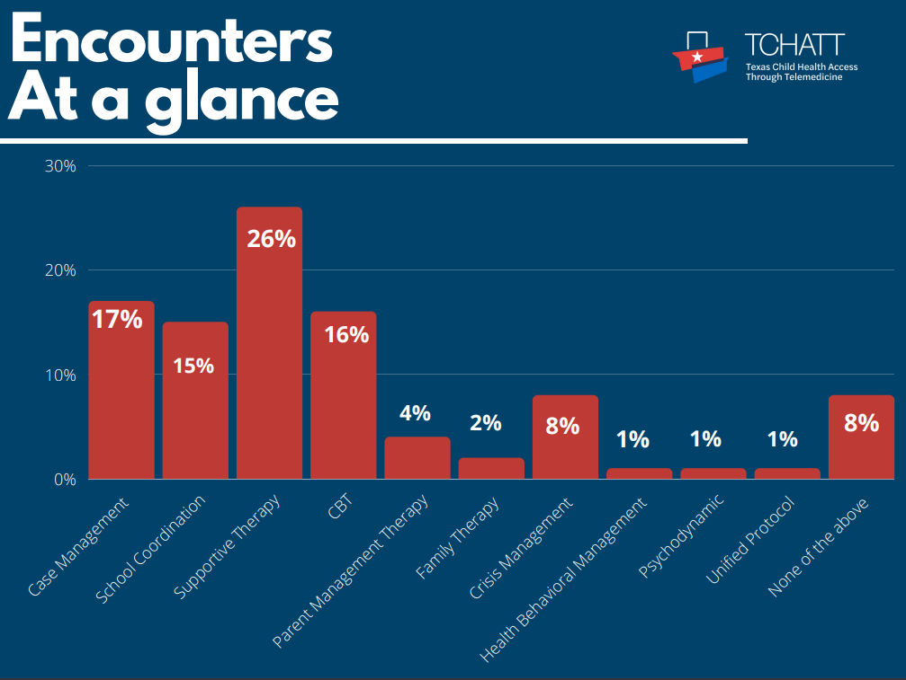

Slide 20

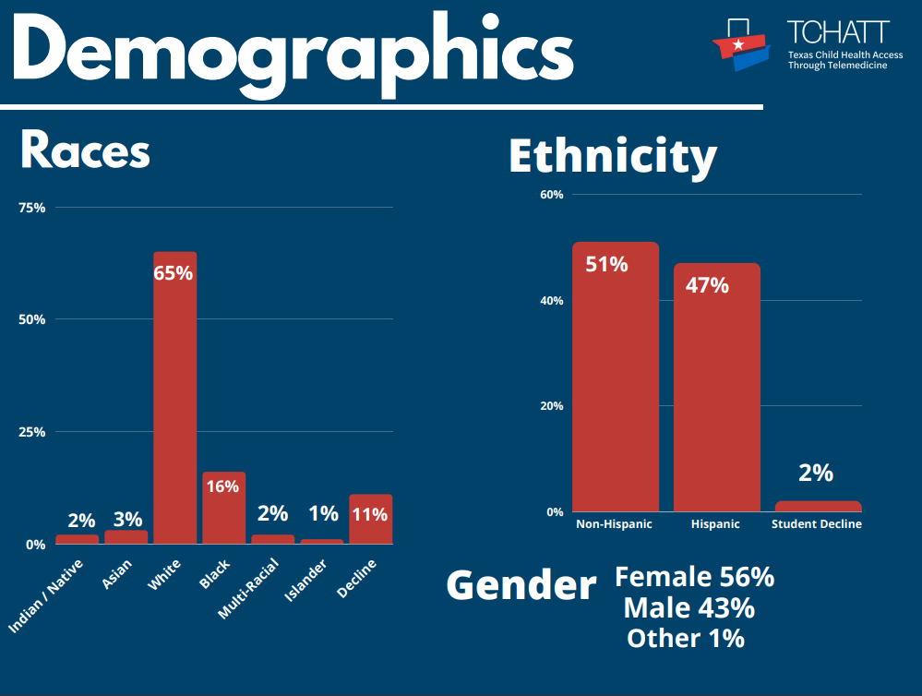

Slide 21

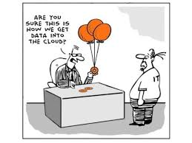
Data Governance Committee
Data Governance Council Updates
    Drs. Pliszka and Vo
    Meets weekly
    Approved the CPAN PCP List Process- see attachment
    Approved the TCHATT State Metrics Trayt
    Dashboard – see attachment
    Approved the CPAN/TCHATT Education and
    Professional Development Monthly Database- see attachment
    Working thru issues related to
      TCHATT and CPAN Satisfaction Survey return rate
      TCHATT Parent/Child Assessment Return Rate

Slide 22



