Slide 1
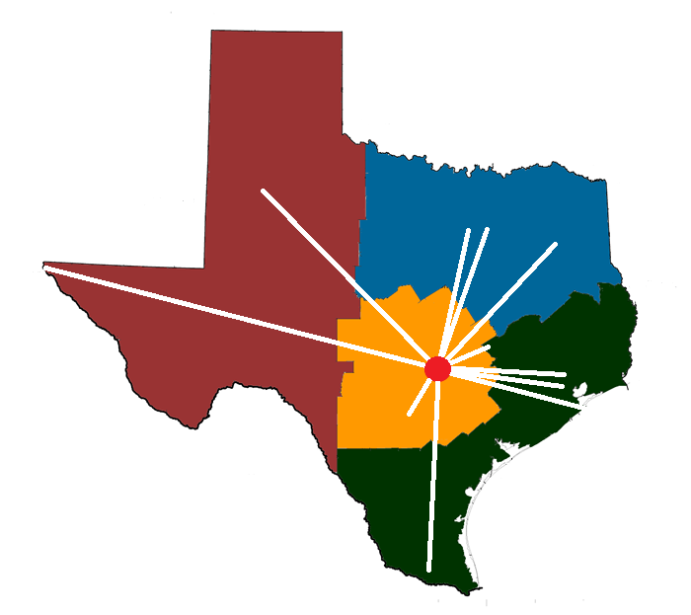
Texas Childhood Trauma Research Network
TCMHCC Executive Committee Meeting February 6, 2023

Slide 2
Cumulative Enrollment & Visits
Thru 01/29/2023
Node | Enrolled (N) | Visits (N)
UT Austin | 258 | 799
UT SW | 211 | 829
UT Houston | 192 | 530
U North Texas | 165 | 415
UT MB | 164 | 513
UT San Antonio | 150 | 444
UT RGV | 115 | 272
Baylor | 98 | 279
Texas Tech EP | 67 | 234
Texas A&M | 65 | 176
Texas Tech | 53 | 153
UT Tyler | 12 | 24
TOTAL | 1,550 | 4,668
N=1,550
N=1,308
N=884
N=592
N=280
N=54
-2020-- -----------------2021------------ ------------2022--------------- -2023-

Slide 3
Participant Retention
Thru 01/29/2023
Month 1
Month 6
Month 12
Month 18
Month 24
Complete Incomplete

Slide 4
Primary DSM-5 Diagnoses at Baseline
Thru 1/29/2023
N = 1,550
Percentage

Slide 5
Worst DSM5 Criterion A Trauma
Exposed to death, threatened death, actual/threatened serious injury, actual/threatened sexual violence
Thru 2/23/2022
N = 1,550
Percentage

Slide 6
Primary DSM-5 Diagnoses at Baseline by Worst Trauma Type
Thru 1/29/2023
N = 1,550
Worst Trauma | PTSD | MDD | Anxiety D/O | Other 1⁰ Diagnosis | No Diagnosis
Family Violence (n=75) | 38.7% | 32.0% | 10.7% | 17.3% | 1.3%
Family Threats (n=33) | 30.3% | 36.4% | 15.2% | 15.2% | 3.0%
Sexual Abuse (n=231) | 48.5% | 23.8% | 3.5% | 20.8% | 3.5%
Physical Abuse/Attack (n=123) | 49.6% | 18.7% | 8.9% | 17.9% | 4.9%
Family Member Imprisoned (n=19) | 31.6% | 10.5% | 21.1% | 31.6% | 5.3%
Separated from Family (n=57) | 22.8% | 26.3% | 19.3% | 24.6% | 7.0%
Threat of Violence (n=42) | 45.2% | 14.3% | 7.1% | 26.2% | 7.1%
Other (n=81) | 33.3% | 29.6% | 7.4% | 22.2% | 7.5%
Natural Disaster (n=21) | 4.8% | 14.3% | 23.8% | 42.9% | 14.3%
Fam/Friend Ill or Dying (n=253) | 21.0% | 18.9% | 13.8% | 32.0% | 14.6%
Accident Witnessed (n=32) | 6.3% | 12.5% | 28.1% | 37.5% | 15.6%
Accident (n=292) | 19.8% | 9.3% | 13.0% | 28.8% | 29.8%
Animal Attack (n=20) | 5.0% | 20.0% | 15.0% | 30.0% | 30.0%
Hospital/Surgery (n=192) | 6.3% | 13.5% | 16.7% | 32.3% | 31.3%
Violence/Maltreatment Accident/Disaster Medical Fam Estrangement
Notes:
Sorted in ascending disorder by “No Diagnosis” percentage. Note that intrafamilial trauma and child maltreatment percolate to the top.

Slide 7
CTRN Manuscripts
Lead Author(s) | Title
J Shahidullah | Establishing a training plan and estimating inter-rater reliability across a multi-site state-wide trauma research network. In submission. Psychiatry Res
C Dodd | Measurement invariance of PTSD symptom models in a diverse longitudinal study of trauma-exposed youth
S Clark | Predictors of alcohol and substance use in trauma-exposed youth
J Sandoval, A Garrett | Associations between ethnic identity, dissonance, and posttraumatic stress in youth
R Brown, J Cisler | The Impact of childhood resiliency on internalizing symptom severity among trauma-exposed youth
A Nazan | Characterizing trauma exposure of children and youth with TESI: criterion validity for concurrent diagnostic profiles
J Rousseau | Methods to support data quality through clinical research informatics for the Texas Childhood Trauma Research Network
K Wagner, C Dodd | Risk factors associated with the development of posttraumatic stress, anxiety, and depressive symptoms in a diverse cohort of youth exposed to traumatic events
O Onyeka | Exploring resilience profiles of trauma exposed youth: a heterogeneous, person-centered approach

Slide 8
CTRN Derivative Studies
Alcohol Use Disorder & PTSD After Adolescent Trauma: Prediction of Disease Vulnerability & Treatment Response
PI: Nemeroff
Funding Source: NIAAA R01
Amount: $4,381,991
Duration: 2023-28
Dissemination and Evaluation of Evidence-Based Psychotherapies for Trauma Exposed Teens
PI: Cisler
Funding Source: Hogg Foundation
Amount: $50,000
Duration: 2022-2024

Slide 9
New Biennium 2023-25

Slide 10
New Biennium
CTRN Protocol 2023-25
Observational Protocol
Psychotherapy Protocol
Trauma
Baseline Visit
Therapy
Visits
Weekly for
4-6 Months
Assessment
Visits
Monthly Symptom Scales
PTSD Diagnosis?
Follow-Up
Visits
Month 1
Month 6
Month 12
Month 18
Month 24
Complete

Slide 11
New Biennium
Visit & Stipend Forecast 9/2023 – 8/2025
Extrapolated from Previous 12 Months Enrollment & Retention
Node | Last Yr Enroll |  | Retention Rate |  |  |  | Forecast Visit Count for New Biennium |  | FC M01 | FC M06 | FC M12 | FC M18 | FC M24 | FC Total
 | Tot | Avg | M 01 | M 06 | M 12 | M 18 | BL | M 01 | M 06 | M 12 | M 18 | M 24 | Tot | Stipend
UT Austin | 86 | 7.2 | 88.4% | 72.2% | 64.6% | 60.4% | 173 | 153 | 126 | 112 | 104 | 96 | 764 | $52,450
UT Houston | 76 | 6.3 | 85.9% | 56.5% | 53.7% | 54.8% | 151 | 130 | 85 | 81 | 83 | 75 | 605 | $41,850
UNT | 69 | 5.8 | 63.3% | 49.2% | 49.2% | 47.6% | 139 | 88 | 68 | 68 | 66 | 59 | 488 | $34,750
Baylor | 47 | 3.9 | 91.0% | 68.1% | 66.7% | 66.7% | 94 | 86 | 64 | 63 | 63 | 58 | 428 | $29,250
UT SA | 46 | 3.8 | 86.7% | 69.3% | 62.9% | 61.8% | 91 | 79 | 63 | 57 | 56 | 52 | 398 | $27,300
UT MB | 45 | 3.8 | 92.1% | 75.2% | 67.5% | 30.5% | 91 | 84 | 68 | 61 | 28 | 23 | 355 | $25,350
UT SW | 35 | 2.9 | 96.0% | 86.0% | 78.7% | 72.3% | 70 | 67 | 60 | 55 | 51 | 47 | 350 | $23,750
UT RGV | 46 | 3.8 | 84.6% | 32.7% | 32.7% | 32.7% | 91 | 77 | 29 | 29 | 29 | 24 | 279 | $19,950
Texas A&M | 32 | 2.7 | 90.2% | 55.6% | 55.6% | 55.6% | 65 | 59 | 36 | 36 | 36 | 33 | 265 | $18,300
TT Lubbock | 24 | 2.0 | 91.7% | 71.4% | 60.0% | 60.0% | 48 | 44 | 34 | 29 | 29 | 26 | 210 | $14,350
TT El Paso | 15 | 1.3 | 95.2% | 76.7% | 76.7% | 71.4% | 31 | 30 | 24 | 24 | 22 | 21 | 152 | $10,350
UT Tyler | 2 | 0.2 | 100% | 40.0% | 40.0% | 40.0% | 5 | 5 | 2 | 2 | 2 | 2 | 18 | $1,250
 |  |  |  |  |  |  | 1,049 | 902 | 659 | 617 | 569 | 516 | 4,312 | $298,900

Slide 12
New Biennium
Tiered Node Budgets for 2023-25
TIER 1 BUDGET
Title | Base | FTE | Fringe | FTE | Total
PI | $250,000 | $250,000 | 21% | 0.1 | $30,313
Sub-I | $250,000 | $250,000 | 21% | 0.0 | $0
Research Coordinator | $55,000 | $55,000 | 21% | 0.5 | $33,344
Research Assistant | $45,000 | $45,000 | 21% | 1.0 | $54,563
Psychotherapist Sr. | $120,000 | $120,000 | 21% | 0.25 | $36,300
Psychotherapist | $80,000 | $80,000 | 21% | 0.25 | $24,200
 |  |  |  | Subtotal | $178,719
Item Description
Participant Stipend |  |  |  |  | $17,500
 |  |  |  | CTRN Node FY24 Total | $196,219
TIER 2 BUDGET
Title | Base | FTE | Fridge | FTE | Total
PI | $250,000 | $250,000 | 21% | 0.1 | $30,313
Sub-I | $250,000 | $250,000 | 21% | 0.1 | $30,313
Research Coordinator | $55,000 | $55,000 | 21% | 0.5 | $33,344
Research Assistant | $45,000 | $45,000 | 21% | 2.5 | $136,406
Psychotherapist Sr. | $120,000 | $120,000 | 21% | 0.375 | $54,450
Psychotherapist | $80,000 | $80,000 | 21% | 0.375 | $36,300
 |  |  |  | Subtotal | $321,125
Item Description
Participant Stipend |  |  |  |  | $22,500
 |  |  |  | CTRN Node FY24 Total | $343,626
TIER 3 BUDGET
Title | Base | FTE | Fringe | FTE | Total
PI | $250,000 | $250,000 | 21% | 0.1 | $30,313
Sub-I | $250,000 | $250,000 | 21% | 0.1 | $30,313
Research Coordinator | $55,000 | $55,000 | 21% | 0.5 | $33,344
Research Assistant | $45,000 | $45,000 | 21% | 3.5 | $190,969
Psychotherapist Sr. | $120,000 | $120,000 | 21% | 0.4 | $58,080
Psychotherapist | $80,000 | $80,000 | 21% | 0.4 | $38,720
 |  |  |  | Subtotal | $381,738
Item Description |  |  |  |  | Total
Participant Stipend |  |  |  |  | $37,500
 |  |  |  | CTRN Node FY24 Total | $419,238

Slide 13
New Biennium
Comparative CTRN Annual Budgets
Fiscal 2022-23 (Current Year)
Site(s) | Per Site Budget | N | Total Budget
Hub | $1,179,613 | 1 | $1,179,613
Nodes | $198,788 | 12 | $2,385,456
Stipend Paymt | $150,000 | 1 | $150,000
TOTAL |  |  | $3,715,069
Fiscal 2023-24
Fiscal 2024-25
Site(s) | Per Site Budget | N | Total Budget
Hub | $1,971,914 | 1 | $1,971,914
Nodes – Tier 1 | $196,219 | 5 | $981,095
Nodes – Tier 2 | $343,625 | 5 | $1,718,125
Nodes – Tier 3 | $419,238 | 2 | $838,476
TOTAL |  |  | $5,509,610
Site(s) | Per Site Budget | N | Total Budget
Hub | $2,032,555 | 1 | $2,032,555
Nodes – Tier 1 | $202,089 | 5 | $1,010,445
Nodes – Tier 2 | $354,134 | 5 | $1,770,670
Nodes – Tier 3 | $431,707 | 2 | $863,414
TOTAL |  |  | $5,677,084

