Slide 1
Texas Child Mental Health Care Consortium
Enhancing Awareness and Outreach for CPAN and PeriPAN | May 2023 Update
Melanie Susswein, MSW

Slide 2

Mental Health awareness Month
CHC is amplifying Mental Health Awareness Month through digital outreach and social media posts.
Notes:
Cross-use of videos:
A total of 7,445,439 impressions:
562,452 on Facebook
6,836,050 programmatic display via websites
46,937 Google Ads
22,544 clicks total, 138 resulting in CPAN calls.
Website traffic (/CPAN):
33,677 users (553% increase*)
27,405 new users (719% increase*)
33.677 sessions (626% increase)
Top acquisition channels driving traffic to website are attributable to digital campaign (see figure)
Sessions by device
15.1K Mobile
16.4K Desktop
2K Tablet

Slide 3

CPAN 3rd Anniversary
CHC is celebrating CPAN’s 3rd anniversary by emphasizing key messages and achievements.
Coordinated this effort with HRIs while also offering a Community of Practice on outreach best practices.

Slide 4
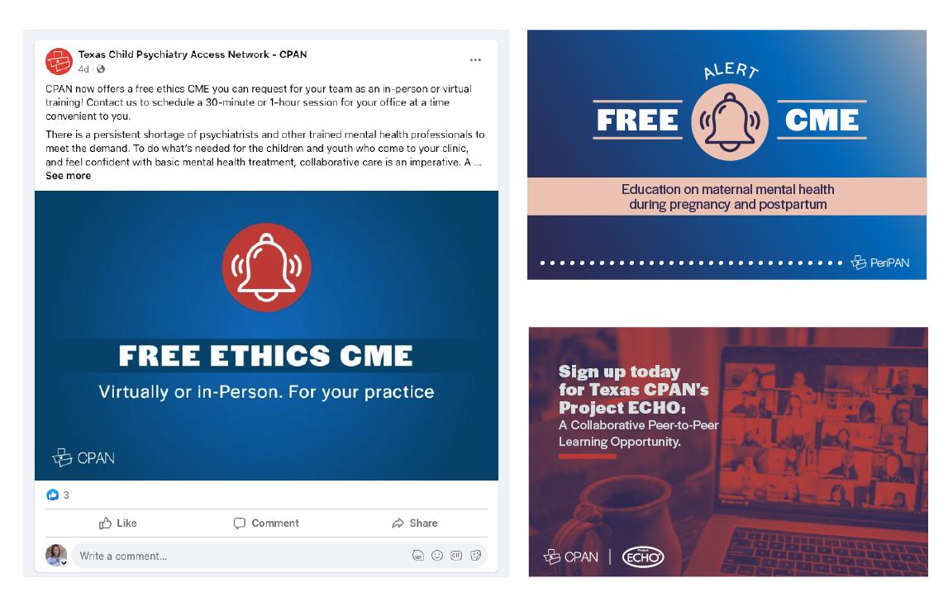
CPAN Social Media: Creating community
& Education
Added 147 accounts to follow, fostering collaboration and enhancing awareness and enrollment for CPAN by integrating it with national, state, and regional organizations focused on pediatric medical care and mental health. National and state accounts include:
CDC
TX Institute for Excellence in Mental Health, Meadows Mental Health Policy Institute, Hogg Foundation
NAMI & NAMI Texas
American Foundation of Suicide Prevention & TX Chapter
American Academy of Family Physicians
WI Child Psychiatry Consultation Program
TX HHSC
TX DSHS
Office of the Texas Governor
TMA, TPS, TAFP, TACHC

Slide 5
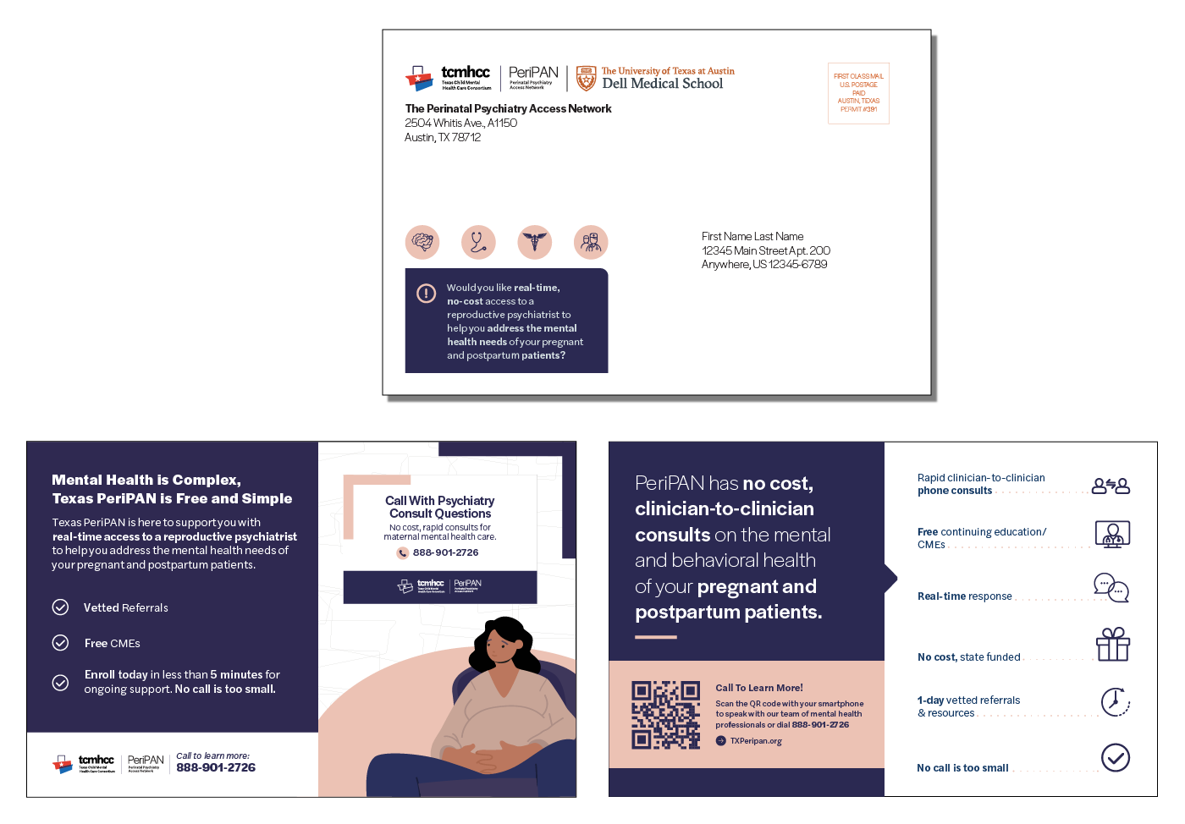
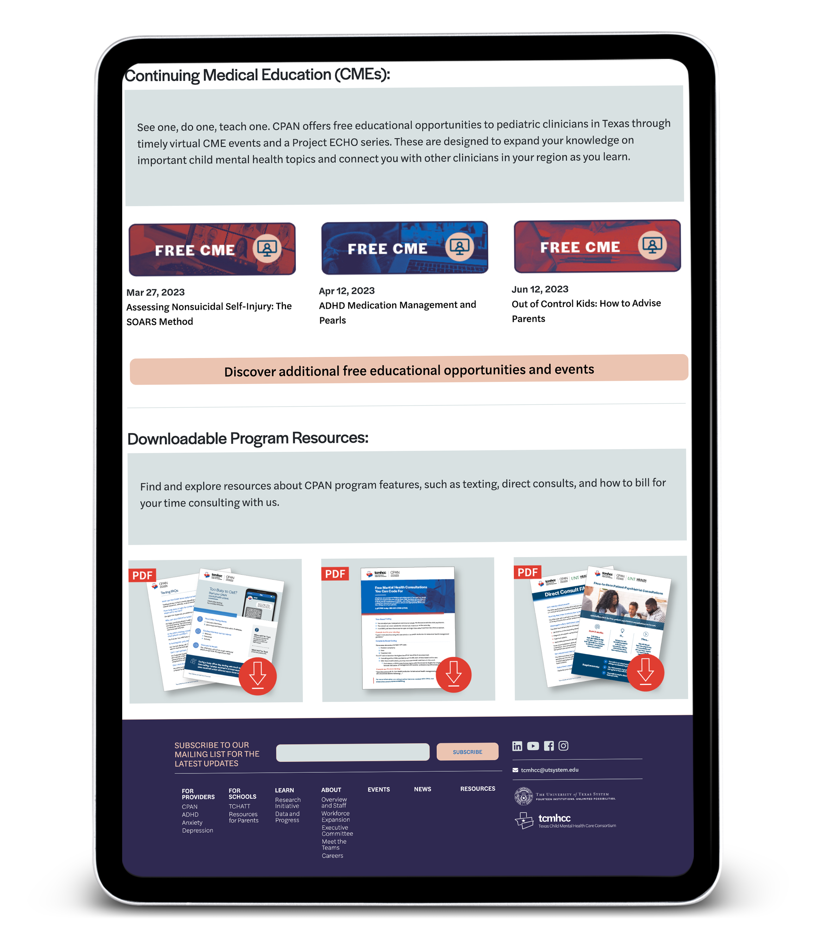
What’s Next?
9x6 envelope
CPAN and PeriPAN Web Pages and SEO
PeriPAN Foundational and Outreach Items:
  Provider Toolkit
  Video
  Key Stakeholder Partnerships
  Direct Mail- Draft Shown
Purchased
TXPeripan.org
domain name
FRONT: 8.5x5.5 mailer
BACK: 8.5x5.5 mailer

Slide 6
Q & A

