Slide 1
TCMHCC Communications Update
Laura Cruzada-Davis
Director of Communications
TCMHCC

Slide 2
Agenda
Uvalde Response
Media
Web Updates
Future Activities
July 19, 2022
Executive Committee Meeting

Slide 3


Uvalde Response
Statement and Resources (English and Spanish)
Notes:
Links on each page
Web traffic

Slide 4
Uvalde Media Requests
Texas Tribune
Univision Noticias
KXAN
Associated Press
Texas Tribune
Texas Monthly
CBS News Dallas
KXAN Austin
Spectrum News
Freelance Journalist
Process with HRIs and UTS
Status

Slide 5
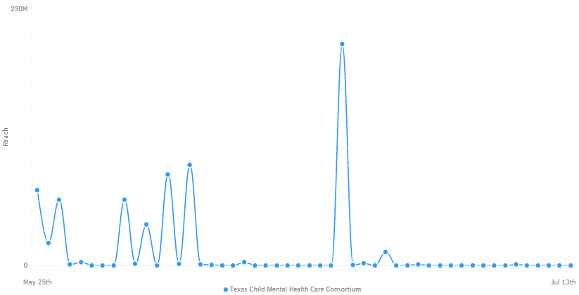
Post Uvalde Media Coverage
Range: May 25-July 13
Total Reach: 705M
Mentions:
  TCMHCC
  TCHATT
  CPAN
Key Points in Time:
  Mentions by Governor, Lt. Gov. and Speaker
  Hearings at Capitol
  Media

Slide 6


Slide 7
Web Updates
Careers
ARPA
2023 target for website refresh
  Based on strategic communications research/plan
  Questions?

