Slide 1
Data Management and Governance Committee
Proposal for Uniform Assessment of Outcomes
June 6, 2023
Steven R Pliszka MD, Co-Chair
Alexander Vo PhD, Co-Chair

Slide 2
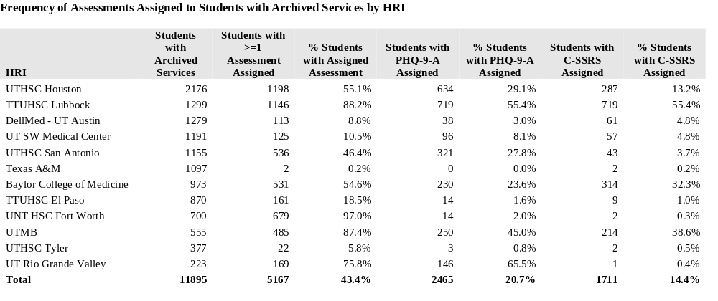
Measurement Based Care in TCHATT/Data in TRAYT
Original data show in Spring 2023

Slide 3
Broad Questions for a Uniform Assessment
What are the outcomes of TCHATT?
  Columbia Impairment Scale (Global, all clients)
  Specific symptom groups (Depression, anxiety, PTSD, suicide, Substance abuse, Disruptive behavior, ADHD)
What are the baseline characteristics (Moderators) that influence TCHATT outcome?
What are the aspects of treatment (Mediators) that influence TCHATT outcome?
Operationalizing symptom measurements
  All scales entered into TRAYT (either manually by staff or by patient/parent)

Slide 4
Scales obtained before (-2 weeks) or at baseline assessment
 | Baseline | Age group | Informant | Time to Administer | Clinical Range
Depression | PHQ-A | 11 +kid | Youth | < 5 min | For MDD: ≥10 For suicide risk: answer of 1, 2, or 3 to item 9
Anxiety | GAD & | Age 11-13 + Kid | Youth | 5-10 min | For GAD: ≥10
ADHD | Vanderbilt | 5-17 | Parent | 5-10 min | Parent Scale only: For ADD: Score 2 or 3 on ≥6 of items 1-9 (Inattentive) or on ≥6 of items 10-18 (hyperactive/ impulsive) or both –AND– score ≥4 on at least 2 or score 5 on ≥1 of items 48-54 (performance questions)
ODD | Vanderbilt | 5-17 | Parent |  | Parent Scale only: For ODD: Score 2 or 3 on ≥4 of items 19-26 –AND– score ≥4 on at least 2 or score 5 on ≥1 of items 48-54 (performance questions)
Suicide | Columbia 7 items | 12+ | Youth | 5-20 min | Yes on Item 1 or 2 ONLY: Behavioral health referral Yes on Item 2 AND (3 OR 6b) but No on 4 and 5: Behavioral health consultation + consider safety planning Yes on Item 2 AND 4, 5, or 6: Behavioral health consultation + safety planning
Substance Abuse | CRAFT 2.0- (bsl) GAINS (f/u) | 12 + kid | Both | 5-10 min | CRAFFT 2.0: 2 or more non-zero responses Part B is positive screen GAIN-SS: 1 or more non-zero responses to Item 3a.-3e.
PTSD | CATS- | Parent/kid | Both | 5-10 min each | Caregiver version ages 3-6: score 12-14 is moderate distress, ≥15 is probably PTSD Youth version ages 7-17: score 15-20 is moderate distress, ≥21 is probable PTSD
Impairment | CIS | all | Clinician administered |  | Impairment: score ≥15

Slide 5
Follow up scales
Done at same interval as Columbia Impairment Scale (CIS).
Only those scales that are above the clinical range (when applicable) will be done at follow- need to be define for each scale, including a cut off for those that do not have a published clinical range.
Executive committee may need to consider funding issues for added staff if this is determined to be needed in order to be sure data is gathered/recorded.

