Slide 1
Data Management and Governance Committee
Steven Pliszka, MD, Co-Chair
Alex Vo, PhD, Co-Chair

Slide 2
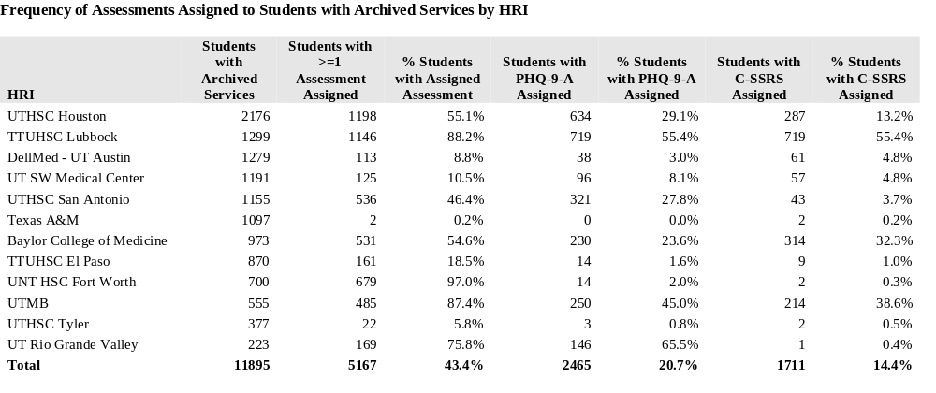
Measurement Based Care in TCHATT/Data in TRAYT

