Slide 1
TCMHCC External Evaluation February 2024

Slide 2
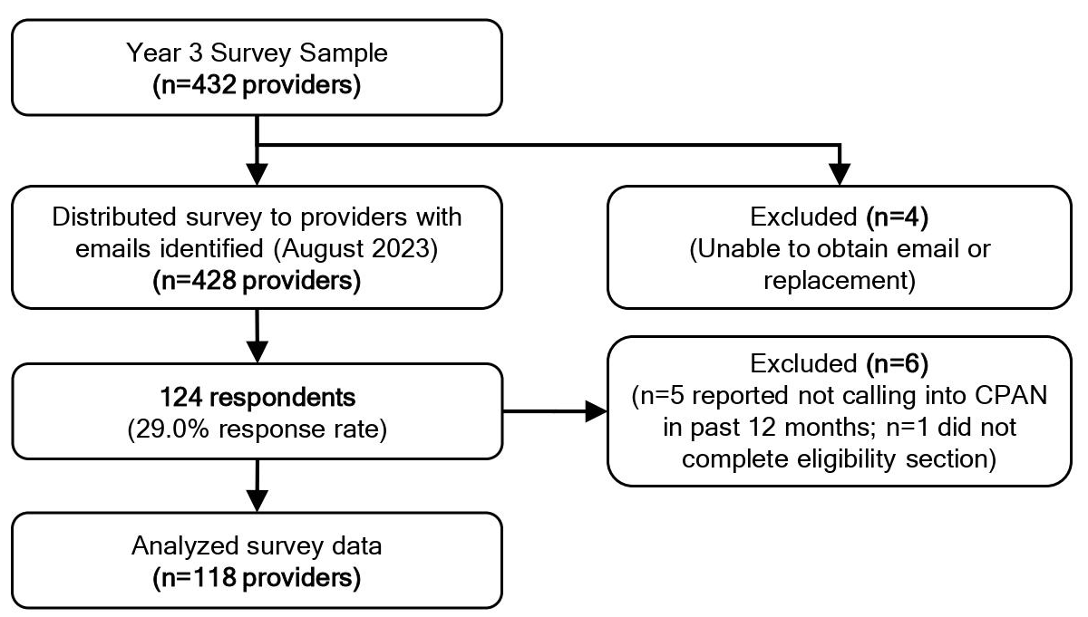
CPAN Provider Survey
Surveyed enrolled providers who have used CPAN in the past 12 months
Sample: Identified a diverse sample of providers across HRIs based on social vulnerability and population density (n=428 providers)
124 providers responded (29% response rate)
Recommendations and future use reported by surveyed providers:
  98% would recommend CPAN to other providers
  96% intend to continue using CPAN in the next 6 months
CPAN Provider Survey Sample & Responses

Slide 3
CPAN Survey Themes (Qualitative)
What is the biggest barrier to using CPAN?
Time constraints
How can the CPAN program be improved?
Improved connections to community resources and referrals, including:
  More resources for uninsured and underinsured patients
  Ensuring that community resources are accessible
Improved outreach and awareness of CPAN
“Consults can be helpful but are harder to fit into clinic flow. (can't wait for call back if I am seeing patients)." –Pediatrician
“I think a lot of community providers do not know about CPAN. I learned about it through a coworker. I believe greater community outreach to pediatrician offices in the community would ensure more people know about this program.” –Physician Assistant

Slide 4
CPAN Survey Themes (Qualitative)
What do you see as the biggest benefit of the CPAN program?
Accessibility of consultation services, information, and resources
Increased confidence in treating patients with mental health needs*
Educational and training opportunities (e.g., CME)
What, if anything, surprised you about CPAN?
Program was easy and efficient
Resource and referral lists received were tailored to patients
“Very quick response both by phone and then with resource lists; nothing else related to consultation support happens this quickly and efficiently!" –Pediatrician
"It is an amazing resource. It is very beneficial to run cases by a psychiatrist. The referrals are great because they take patient insurance and location into consideration. They are non-judgmental, very helpful, and their advice and support make a huge positive impact on patient care." –Pediatrician

Slide 5
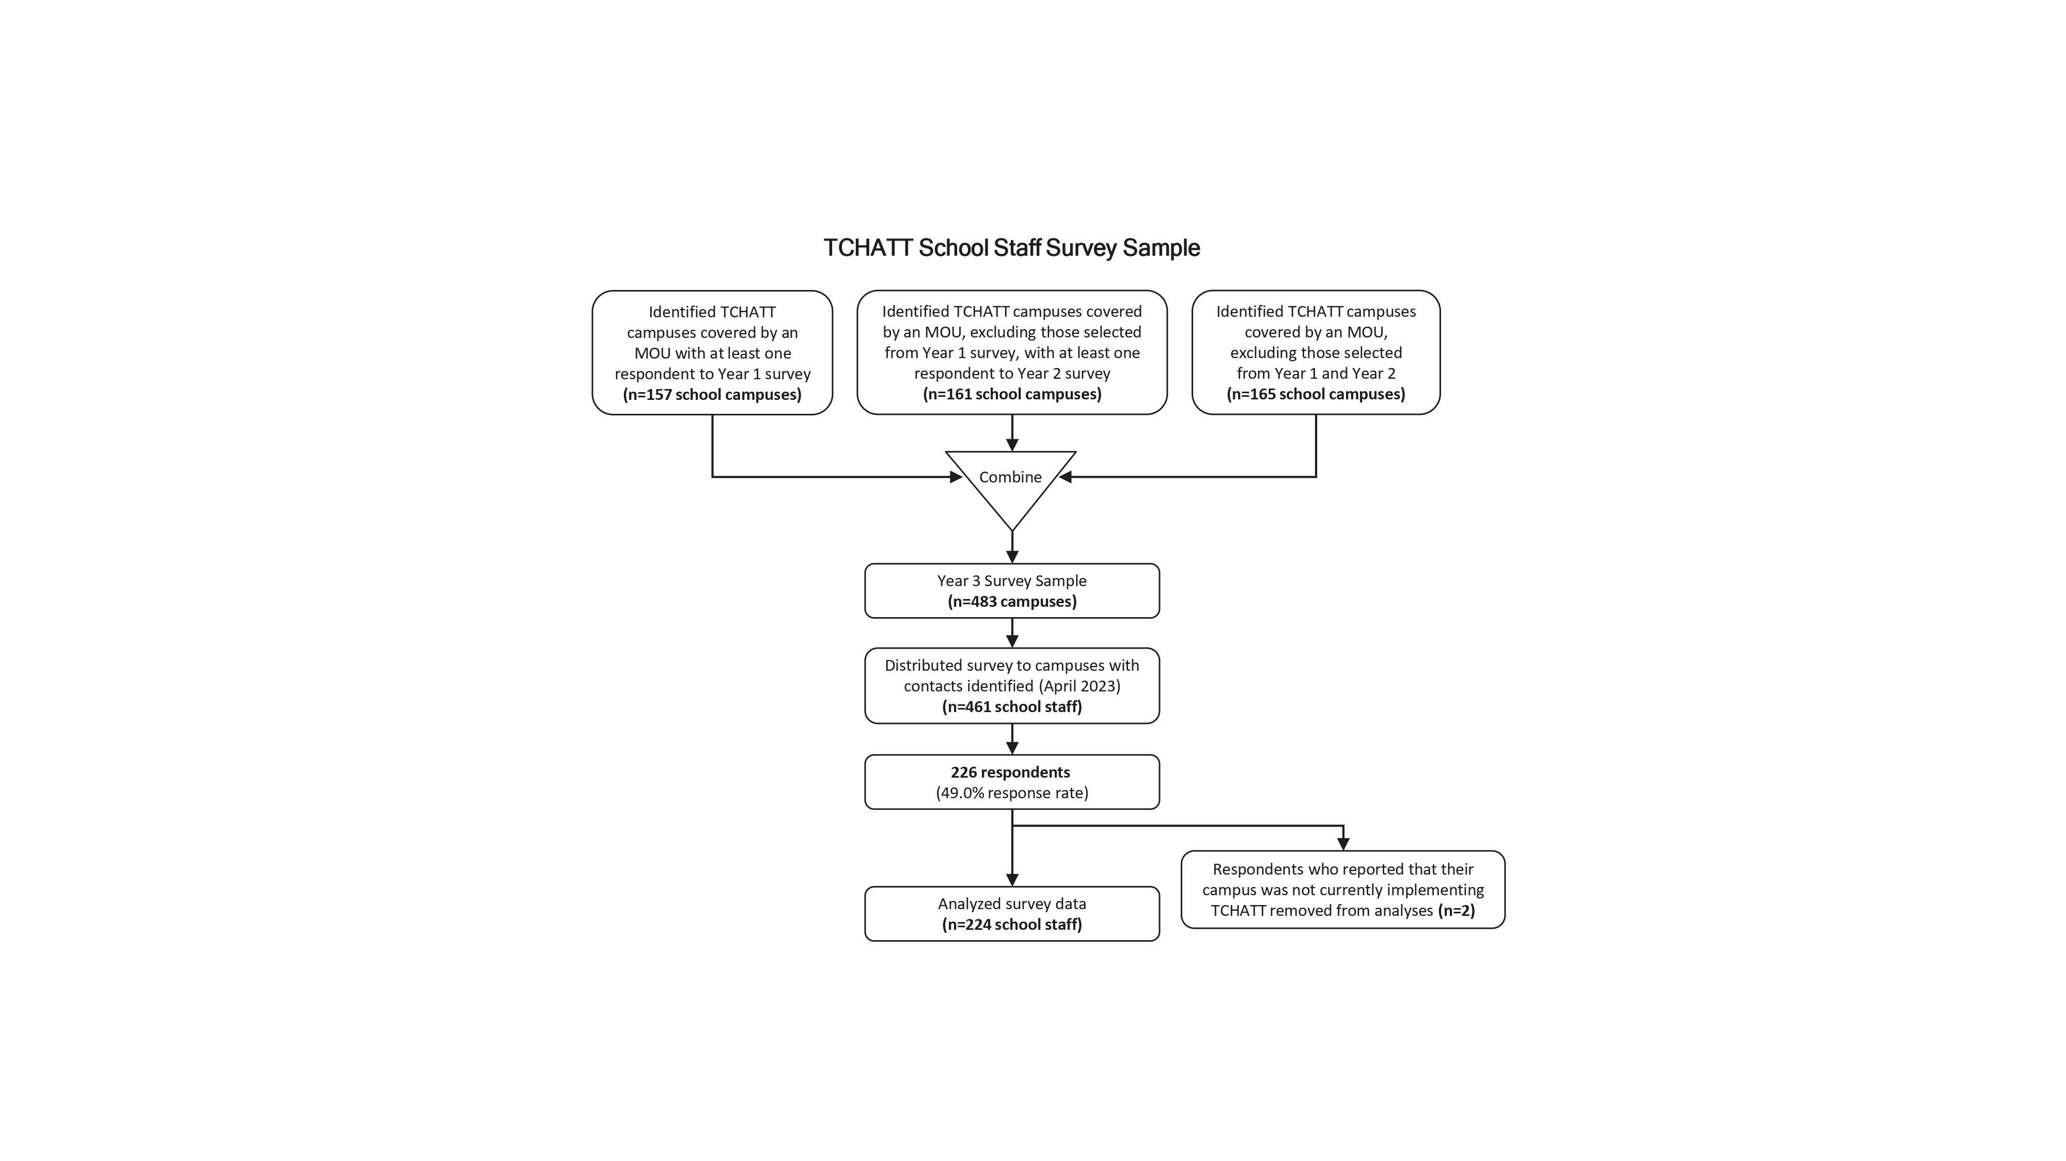
TCHATT School Staff Survey
Sample: Identified a diverse sample of enrolled campuses across HRIs based on rural/urban/charter classification, economic disadvantage, and district size (n=483 campuses)
Distributed survey to TCHATT program implementers (one per campus)
226 school staff responded (49% response rate)
Recommendations and future use reported by school staff:
  89% would recommend TCHATT to other schools
  93% intend to continue using TCHATT in the next 6 months
TCHATT School Staff Survey Sample & Responses

Slide 6
TCHATT Survey Themes (Qualitative)
How can the TCHATT program be improved?
More efficient referral, enrollment and scheduling process
Better communication and follow-up while students are enrolled in TCHATT
More TCHATT providers and sessions for students
What do you see as the biggest benefit of having the TCHATT program available in your school?
Accessibility of free mental health care for underserved students in need
Mental health support that extends beyond the capacity of school counselors
“Our kiddos are being seen right away. This is so helpful for our families, and so many of them are grateful for the free services they would not have received otherwise.” –Counselor
“It would be nice to get updates on students receiving services...the school could help to follow up and ensure that the parent connects with a local provider to continue receiving support." –School Administrator

Slide 7
Questions?

