Slide 1
Face to Face Outreach with Texas Tech University Health Sciences Center El Paso
Sarah Martin
Adrianne Harrel

Slide 2
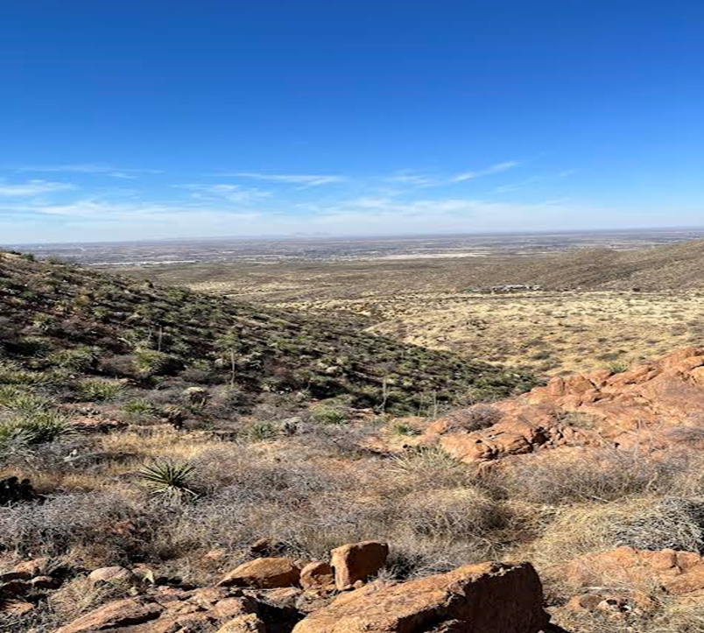
West Texas
Along the Border
A Cultural Education:
The people
The lifestyle
The land

Slide 3
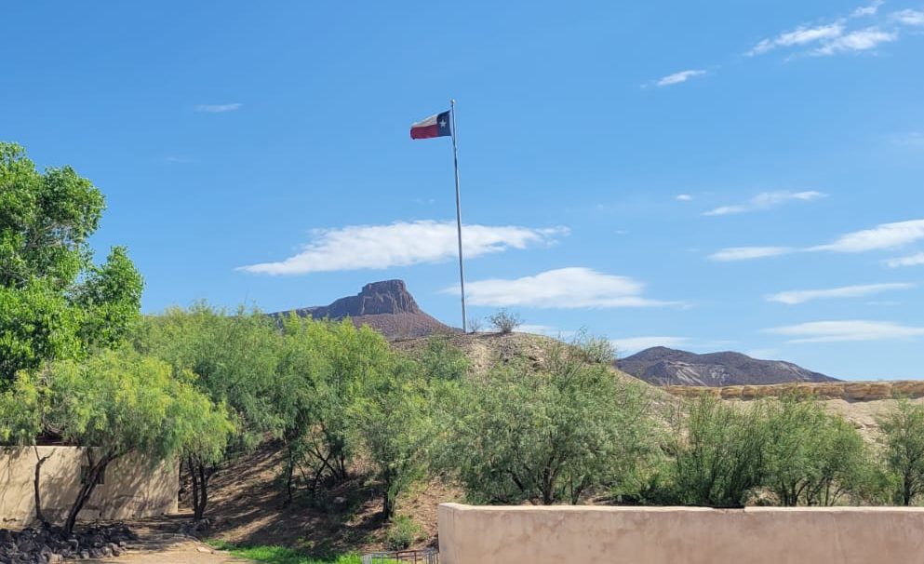
The Beginning
Doctors, counselors and medical school staff
No experience with outreach
Why didn’t everyone didn’t want to join our awesome (and free) projects?
Pandemic issues
Phone calls: front desk staff trained to keep out the riffraff
Too many emails
Not enough progress

Slide 4
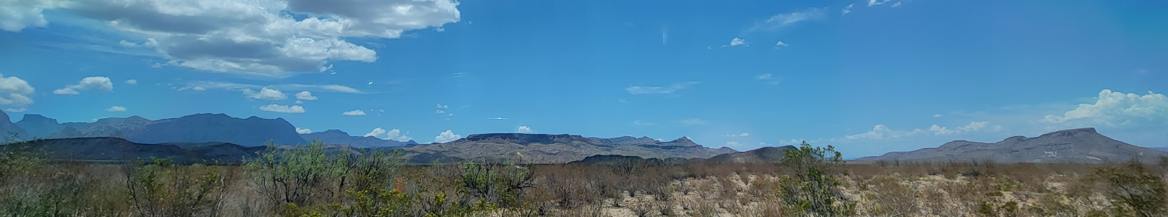
Planning Retreat
Face to Face Outreach Strategy
  Dates for overnight travel (monthly 2 or 3 consecutive days)
  Dates for local travel (biweekly EP County)
  TCHATT - Identify ISDs in area not enrolled
  CPAN - Identify Clinics in areas not enrolled
  Plan travel routes to visit areas with identified and not enrolled for both CPAN & TCHATT

Slide 5
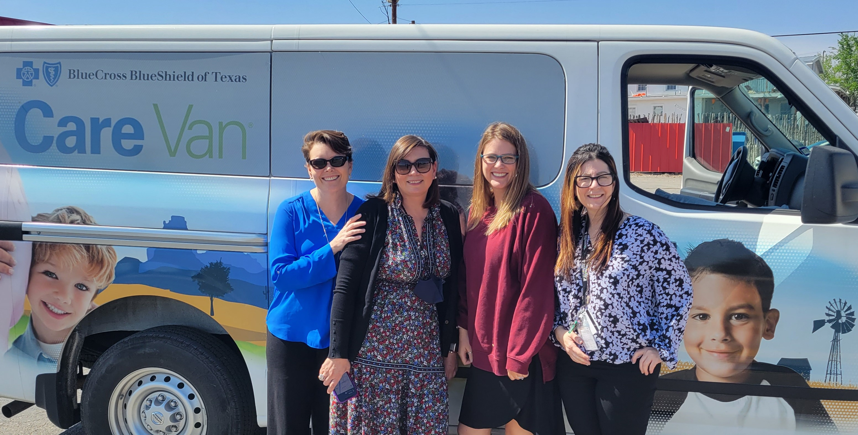
Plan a Road Trip
Identify Area
Identify route that works within the time frame
Try to make appointments
Don’t worry too much if you only few
Assign each person a role
  Adrianne Harrel- interviews all the locals
  Sarah- makes sure people know she’s a doctor and so they should definitely talk to her
  Bethany- makes sure we behave ourselves

Slide 6
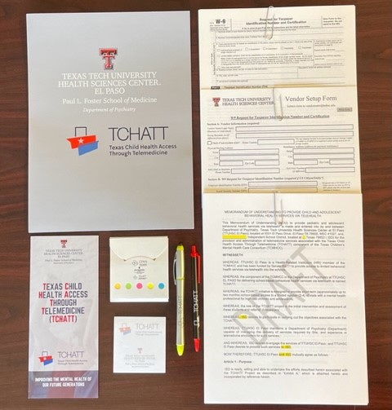
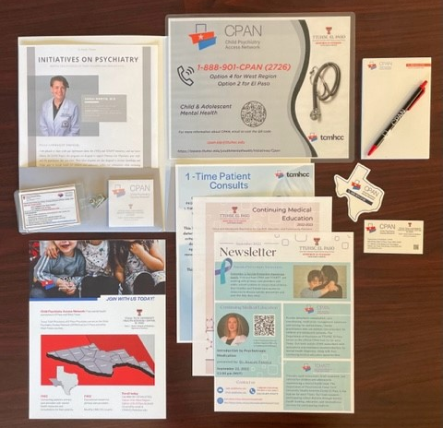
TCHATT Folder
CPAN Folder

Slide 7
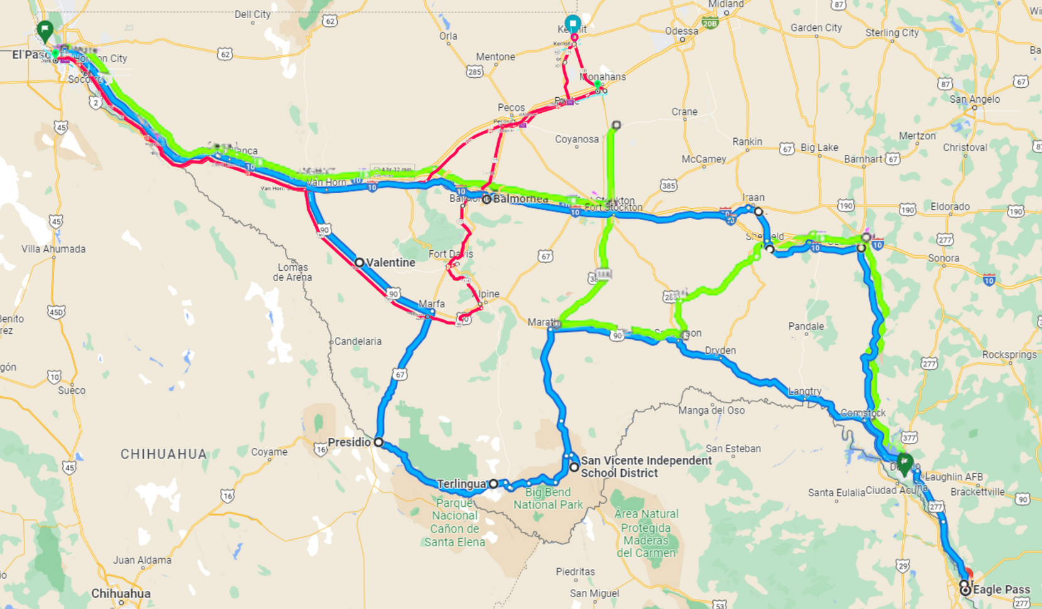
Trip #1 (4 Days)
Trip #2 (2 Days)
Valentine (TCHATT) Day 1
Marfa (TCHATT/CPAN) Day 1
Presidio (TCHATT/CPAN) Day 1
Terlingua (TCHATT/CPAN) Day 2
San Vicente ISD (TCHATT) Day 2
Marathon (TCHATT) Day 2
Sanderson (TCHATT/CPAN) Day 2
Del Rio (CPAN) Day 2/3
Eagle Pass (TCHATT/CPAN) Day 3
Ozona (TCHATT/CPAN) Day 4
Sheffield (TCHATT/CPAN) Day 4
Iraan (TCHATT/CPAN) Day 4
Fort Stockton (TCHATT/CPAN) Day 4
Marfa (TCHATT/CPAN) Day 1
Alpine (TCHATT/CPAN) Day 1
Fort Davis (TCHATT/CPAN) Day 1
Balmorhea (TCHATT) Day 1
Monahans (TCHATT/CPAN) Day 2
Kermit (TCHATT/CPAN) Day 2
Wink (TCHATT) Day 2
Pecos (CPAN) Day 2
Trip #3 (4 Days)
Fort Stockton (TCHATT) Day 1
Grandfalls (TCHATT) Day 1
Marathon (TCHATT) Day 2
Sanderson (TCHATT) Day 2
Ozona (TCHATT/CPAN) Day 2/3
Del Rio (TCHATT/CPAN) Day 3
Brackettville (TCHATT) Day 4

Slide 8
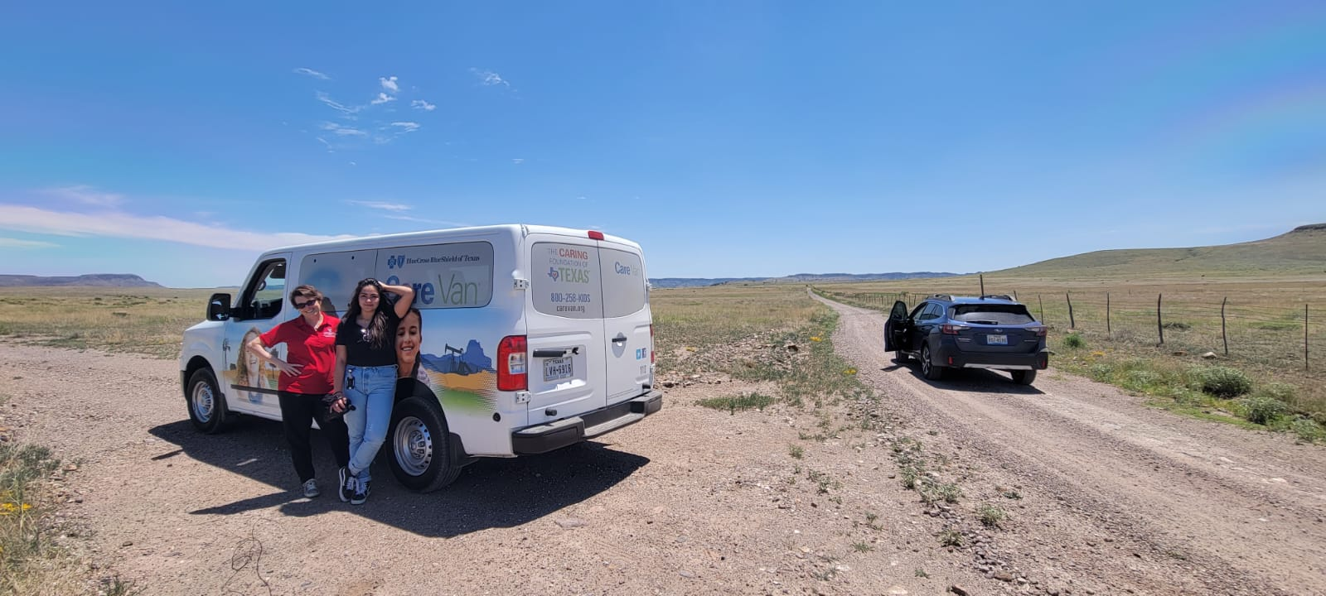
Follow Up Phase
TCHATT
Schedule initial trainings for interested ISDs
Schedule follow up meetings for those not as interested
CPAN
Add to Trayt
Add to CME and Project ECHO Listservs

Slide 9
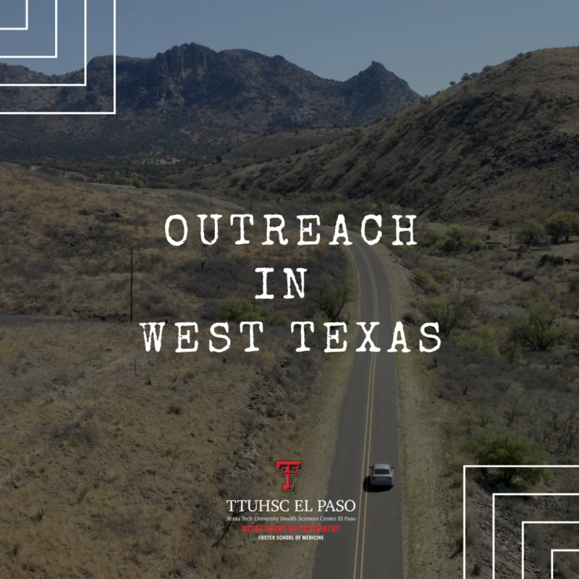
TCHATT
CPAN
38 Districts in Region:
15 Active MOUs
12 NEW MOUs in process/contracting
9 NEW Districts in talks with us
1 Services by CAP Fellow /Free Clinic
1 ISD tabled at this time
Enrolled 18 NEW CPAN Clinics
Enrolled 50 NEW Providers
Increased CPAN Consults
  August 2021 – 18 Consults
  August 2022 – 35 Consults

