Slide 1


January 16, 2024
Arpa sb 8 section 8
fiscal agent – UT Austin
Linda haster
Associate Director of Grants Financial Management
Office of Sponsored Projects (OSP)
The University of Texas at Austin

Slide 2
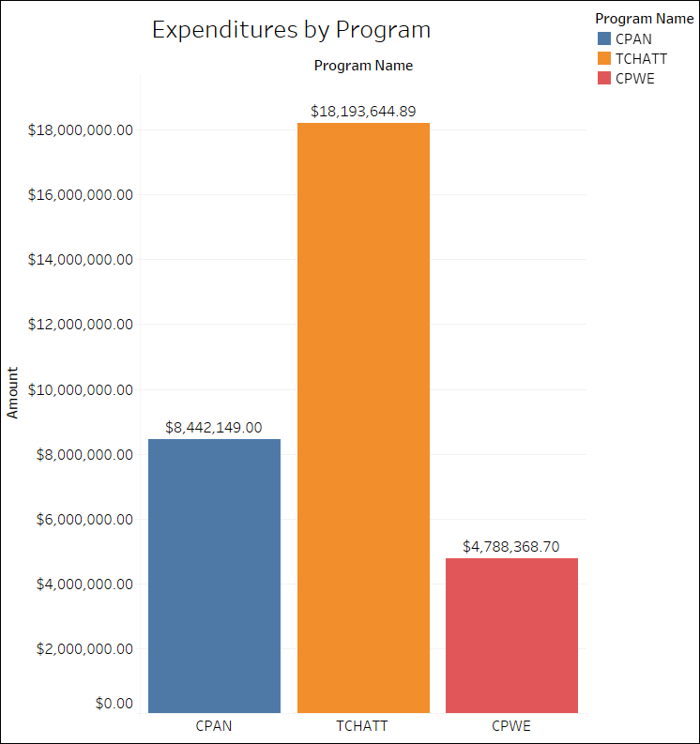

Slide 3
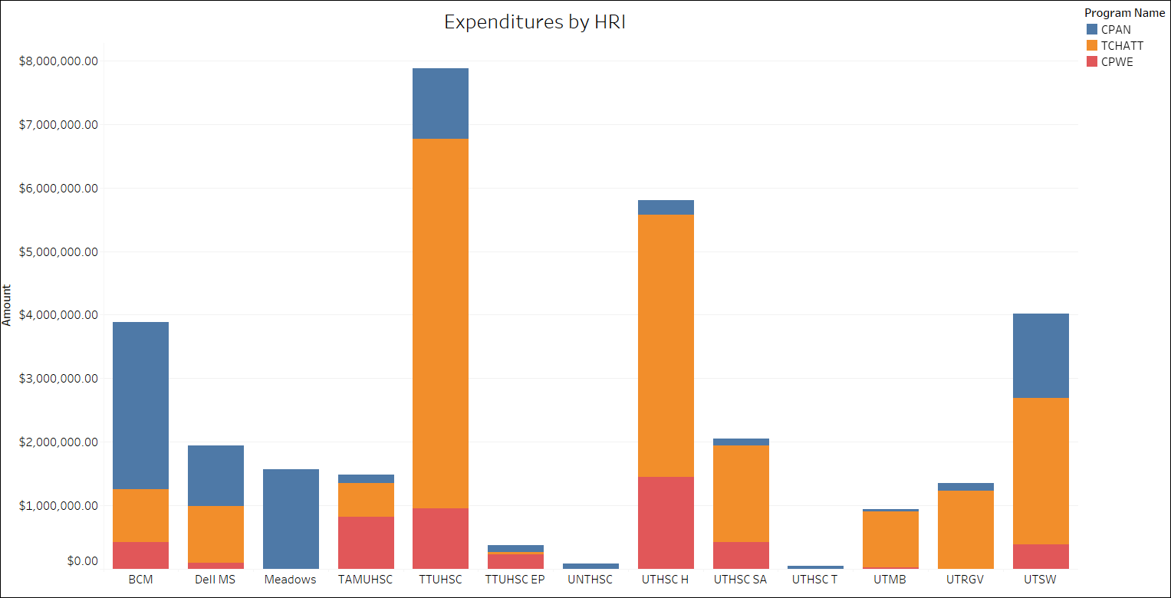

Slide 4
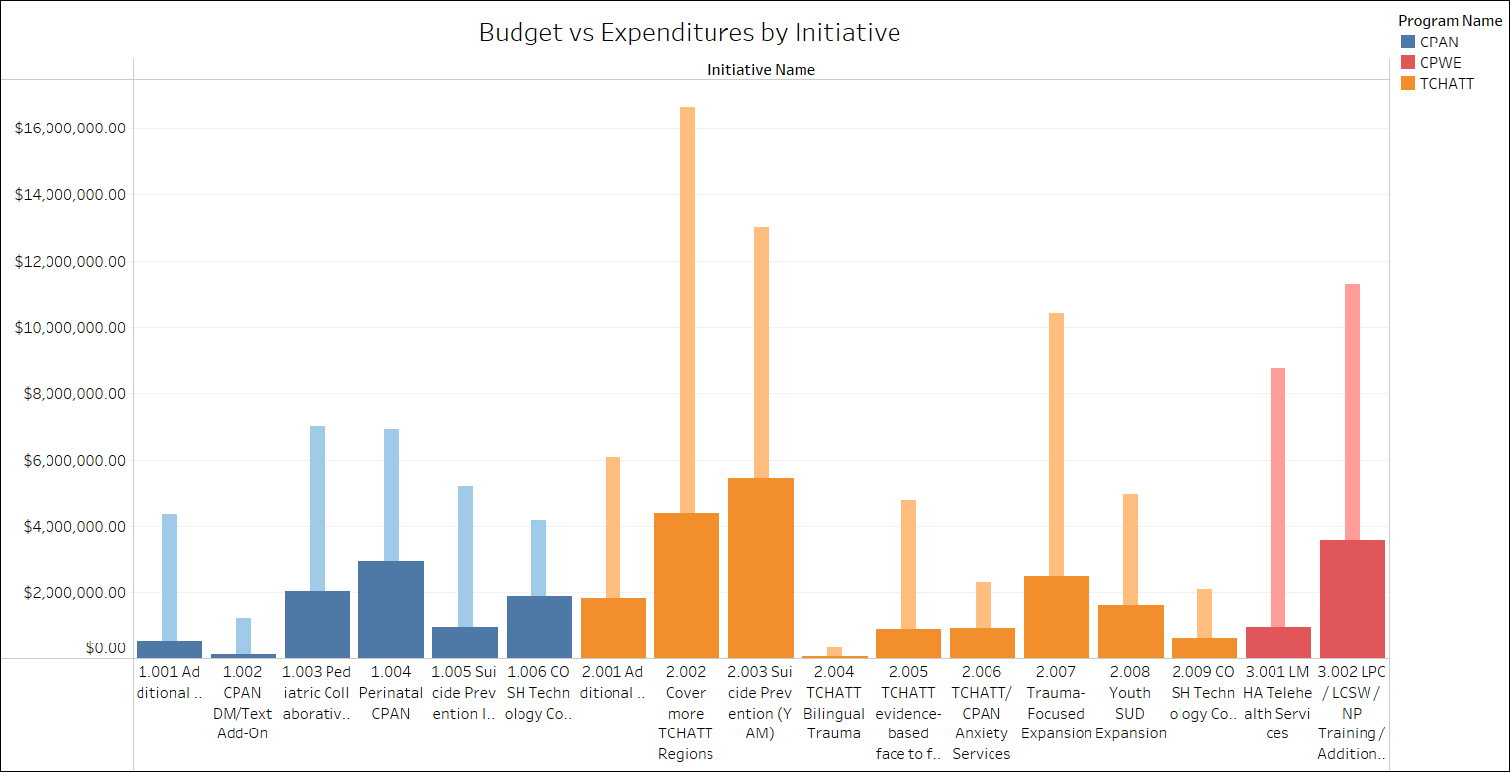

Slide 5
Contact Information
Linda Haster, Authorized Official
  linda.haster@austin.utexas.edu
Joy Hatch, Financial Contact
  joyhatch@austin.utexas.edu
Laura Ochoa, Administrative Contact
  ochoa@austin.utexas.edu
Rachael Holt, Administrative Associate
  rachael.holt@austin.utexas.edu
    Process sub-award reimbursements

