Slide 1


february 6, 2023
Arpa sb 8 section 8
fiscal agent – UT Austin
Linda haster
Associate Director - SPAA, Office of Sponsored Projects, The University of Texas at Austin

Slide 2
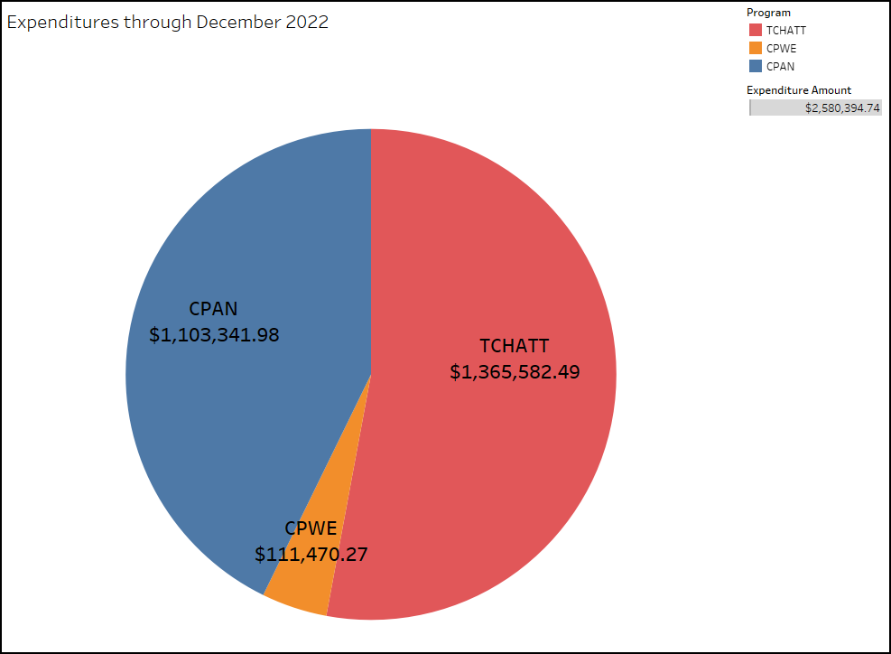
Texas Child Mental Health Care Consortium

Slide 3
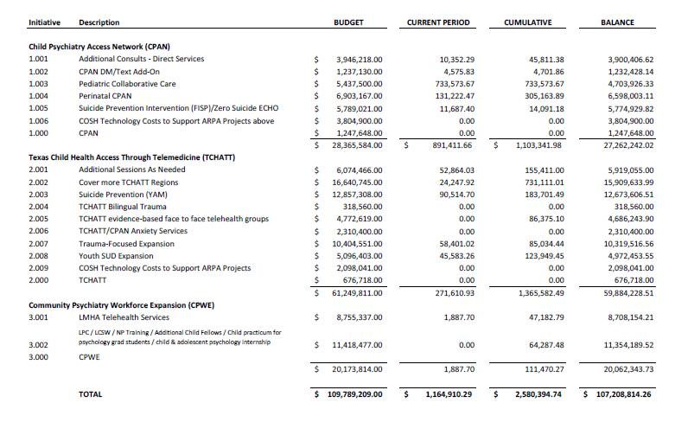
Quarterly Report as of 12/31/22

Slide 4
Contact Information
Linda Haster, Authorized Official
  linda.haster@austin.utexas.edu
Joy Hatch, Financial Contact
  joyhatch@austin.utexas.edu
Laura Ochoa, Administrative Contact
  ochoa@austin.utexas.edu
Rachael Holt, Administrative Associate
  rachael.holt@austin.utexas.edu
    Process sub-award reimbursements

