Slide 1
Internal Evaluation Updates
August 29, 2022

Slide 2
TCHATT Program Evaluation
Addressing the question on the impact of TCHATT
Discussions with TCHATT leadership on potential measures
Discussions with Data Governance
Next Executive meeting: Recommendation for measure(s)

Slide 3
TCHATT Progress in Campus Enrollment
Shifting to focus on universe of Texas schools
Campus level list assigned to HRIs
New Categories
  Planned
  Pending
  Onboarding
  Active
  Inactive
  Declined
Monthly reports to Governor’s Office

Slide 4
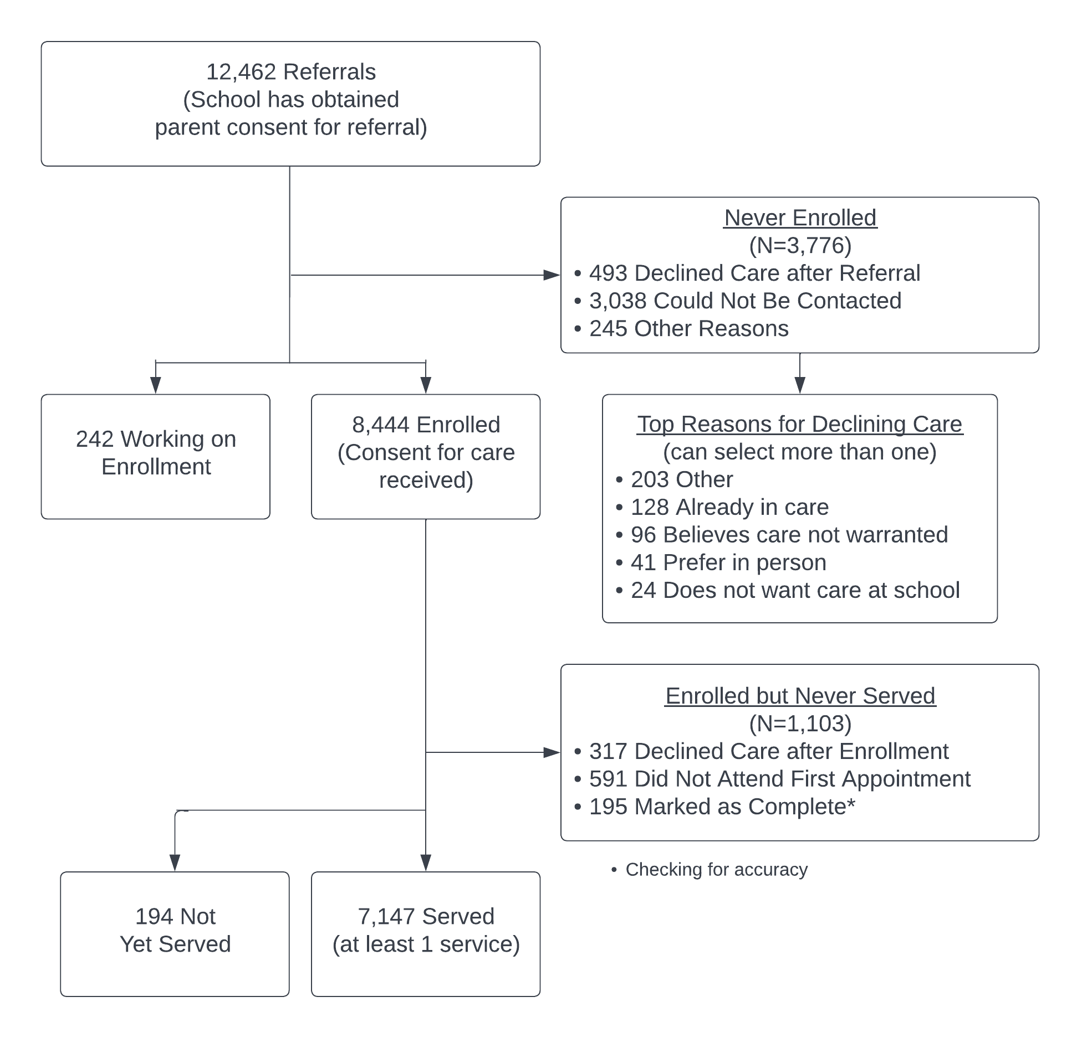
Progression through
TCHATT Processes
Data Source: Trayt, Referrals from 9/1/2021-7/30/2022

