Slide 1
Internal Evaluation Updates
October 16, 2023

Slide 2
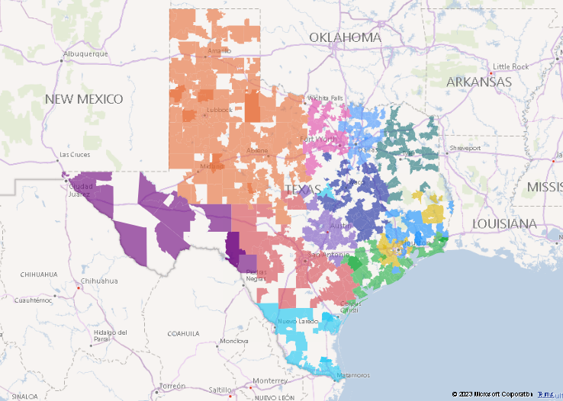
TCHATT Campuses Active in August 2023
3,533,790
27%
Number of Students Able to Access TCHATT Care
Student Lives Remaining to be Covered by TCHATT
690
5,546
Number of School Districts Enrolled
Number of School Campuses Enrolled
Notes:
3533790 active
425380 declined
34014 inactive
378104 unresponsive
418711 planned
316080 onboarding
5504270 total census

Slide 3
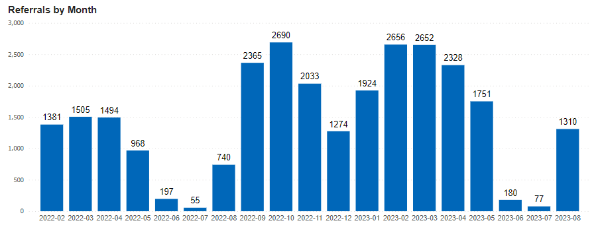
TCHATT Referrals

Slide 4
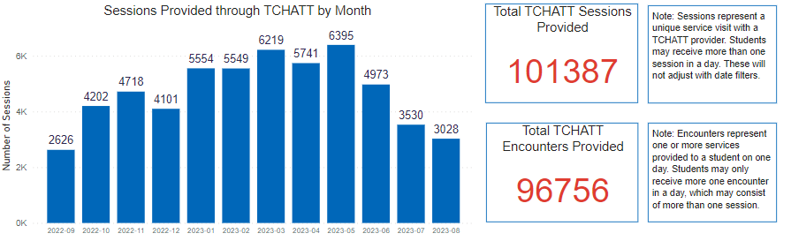
TCHATT Sessions

Slide 5
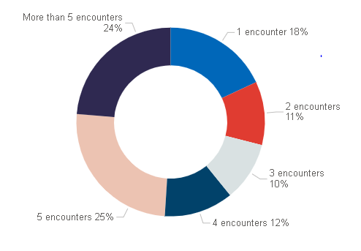
Types of Supports Families Receive through TCHATT
Number of Encounters

Slide 6
Referrals Following TCHATT Care
56.1%
Students or
Families Referred

