Slide 1

Centralized Operation Support Hub -COSH Updates
Dr. Laurel Williams
Edith Ortiz
Jenn Cole

Slide 2


Slide 3
CPAN Call Volume
* this data is preliminary and is subject to change

Slide 4
CPAN Direct Consult
Total Direct Consult: 206
9 teams doing direct consults
Teams are collaborating on direct consults
Currently developing the statewide direct consultation process

Slide 5
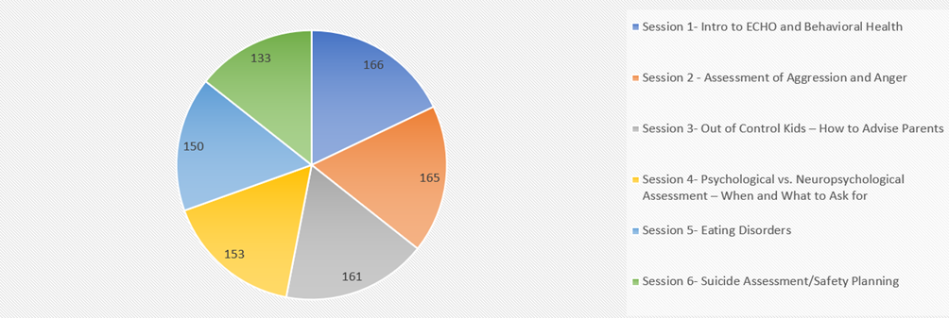
CPAN Project Echo: Spring 2023
Total attendance: 928

Slide 6
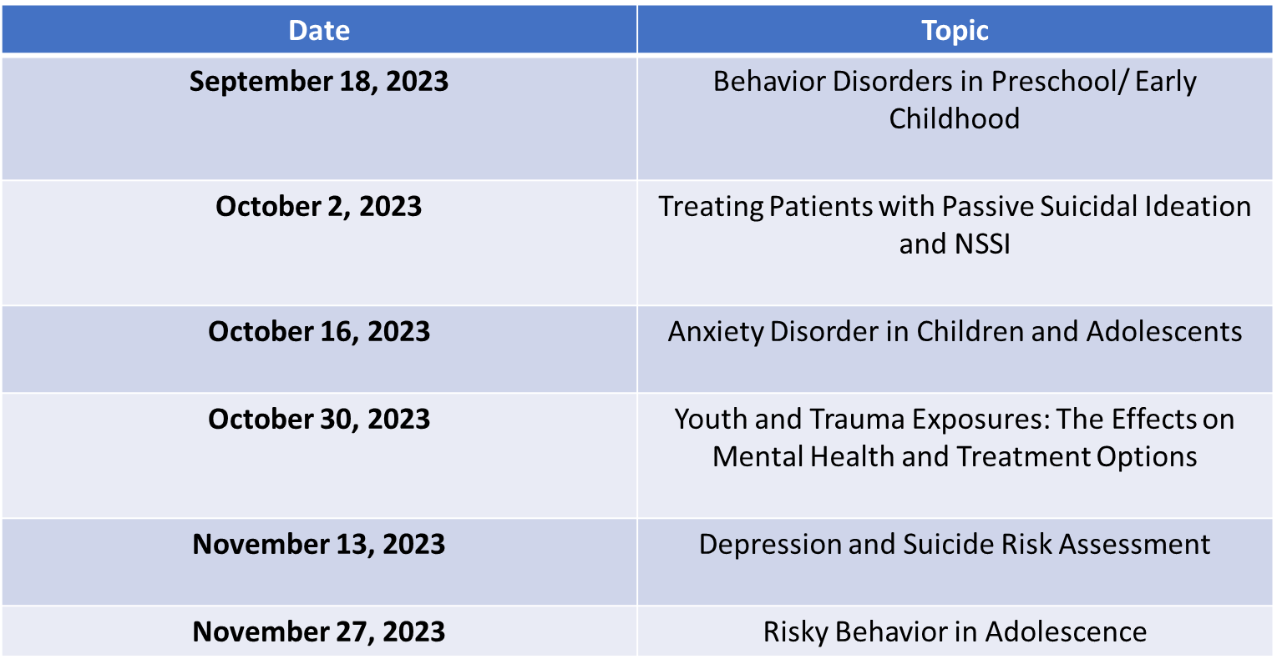
CPAN Project Echo: Fall 2023

Slide 7
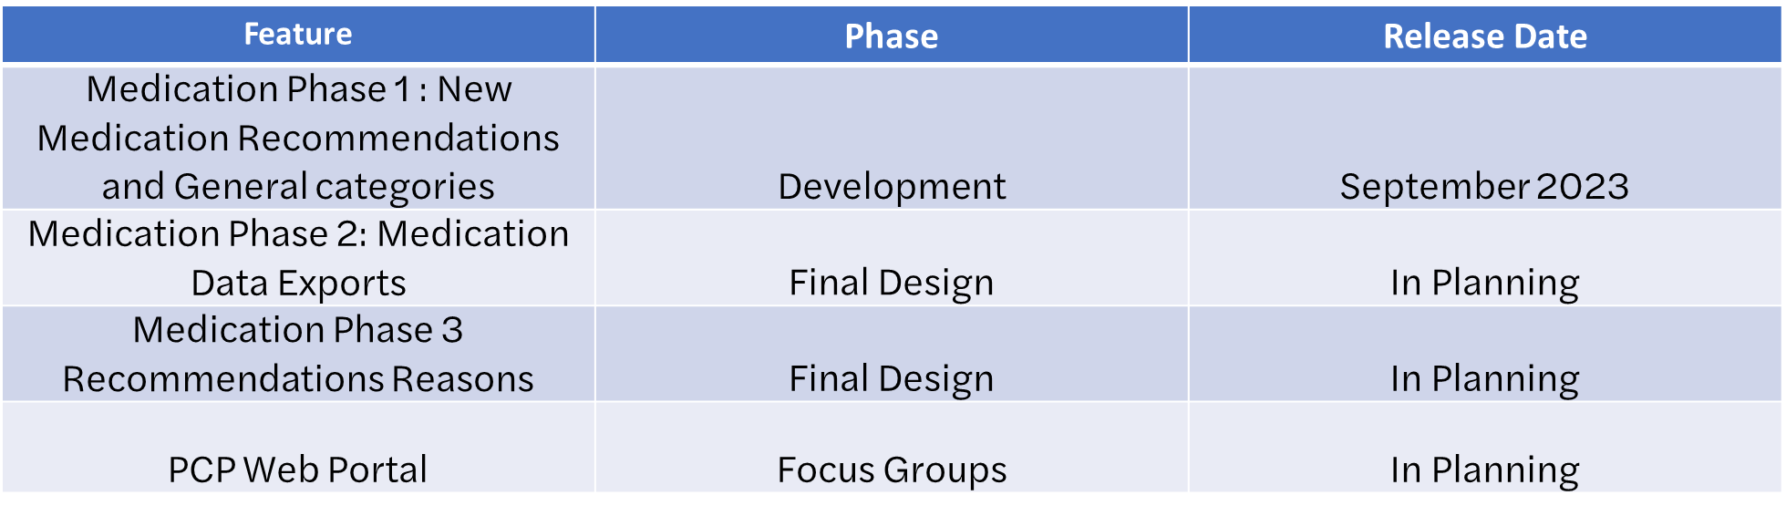
System Updates: Trayt CPAN Roadmap

Slide 8
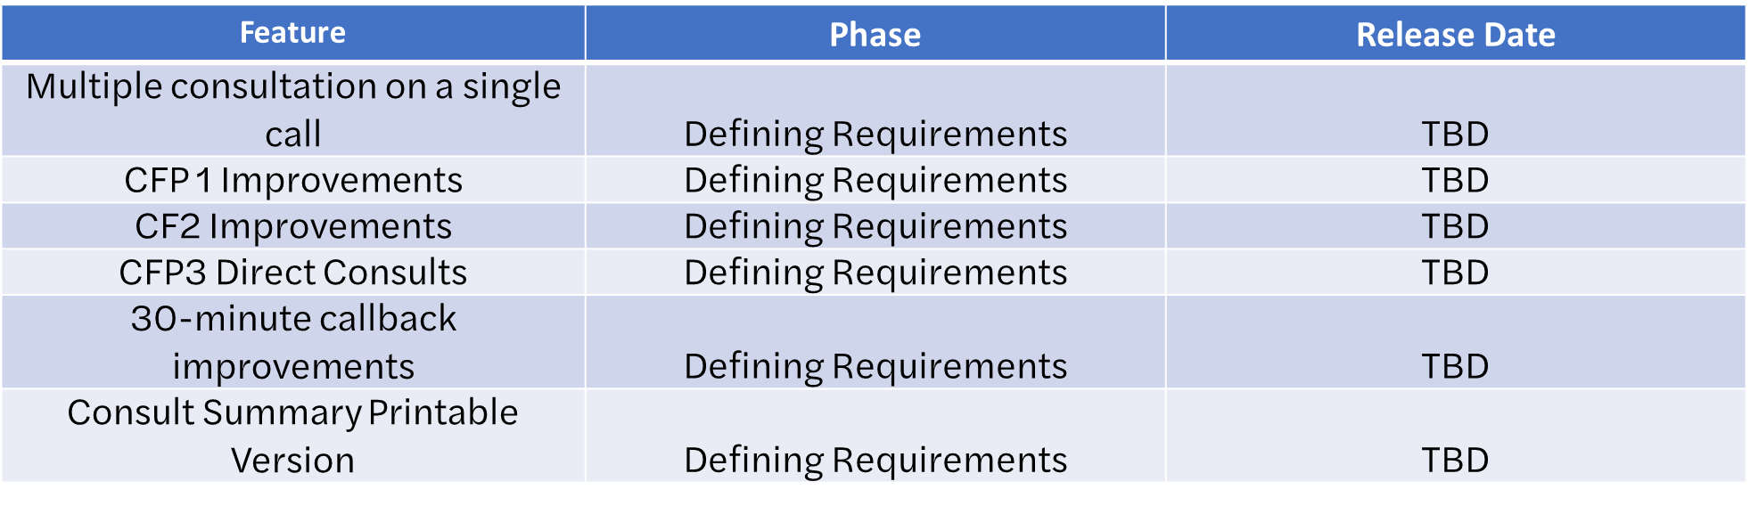
System Updates: Trayt CPAN Roadmap

Slide 9
System Updates: Welnity
Improvements in Welnity are being finalized
HRI customizations
User customizations
Searchability of information
Adding New Resources
Editing existing resources and Tracking changes
Ensuring Quality of Resource
Extracting Resources for Distribution to providers
Reporting
Timeline: 2-3 months
Phase 1 : 2 months for focus search and customizations
Phase 2: 1 month for reporting

Slide 10


Slide 11
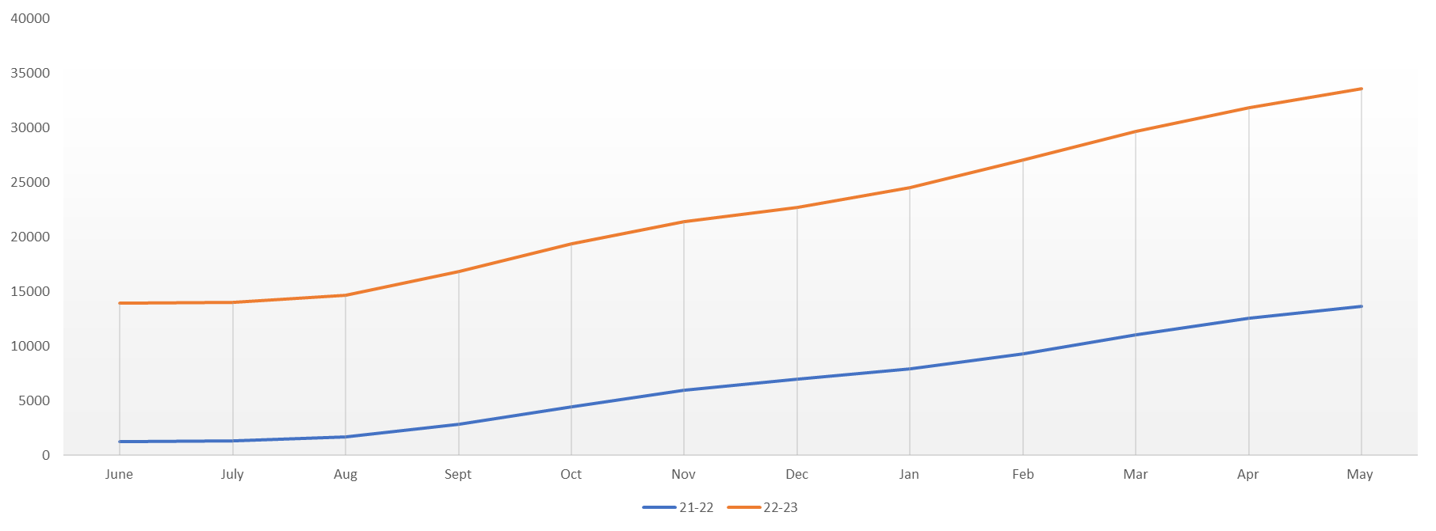
TCHATT Services Since Program Start
Total Students Referred to the Program – 40,854
Students Served – 23,497
Sessions with Students – 89,204 * this data is preliminary and is subject to change

Slide 12
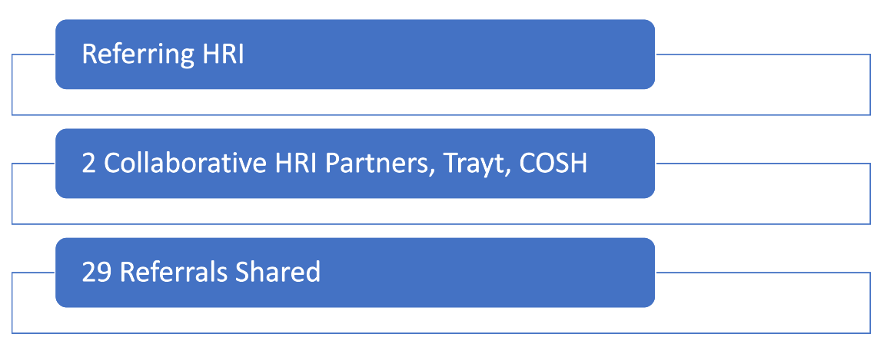
Cross HRI Collaboration

Slide 13
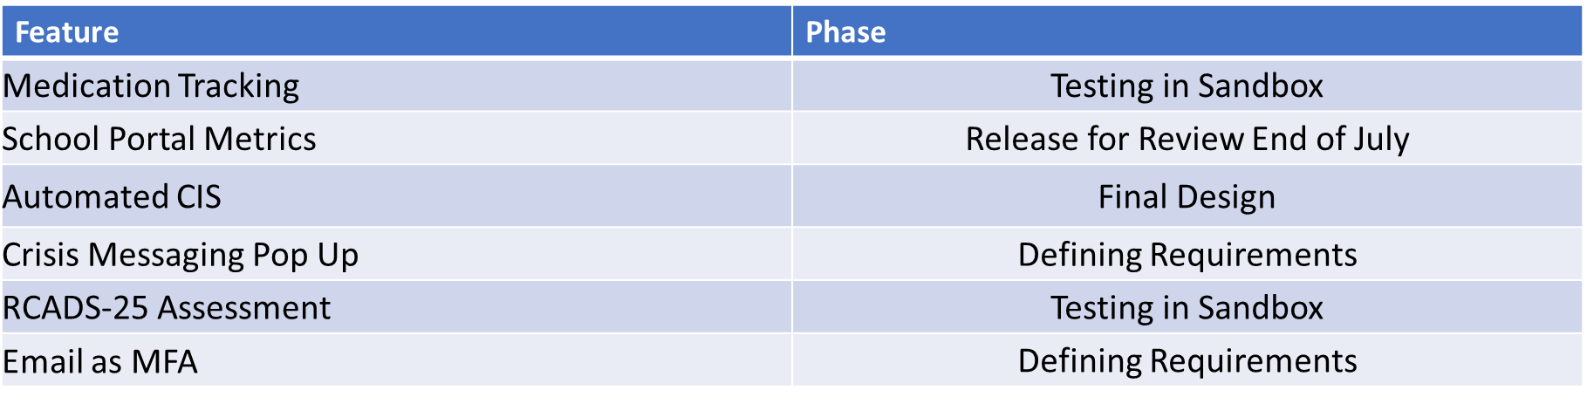
Current Trayt Initiatives

Slide 14


