Slide 1
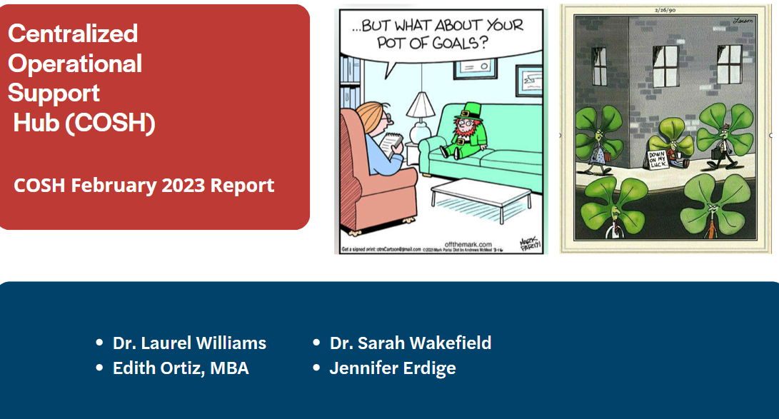

Slide 2
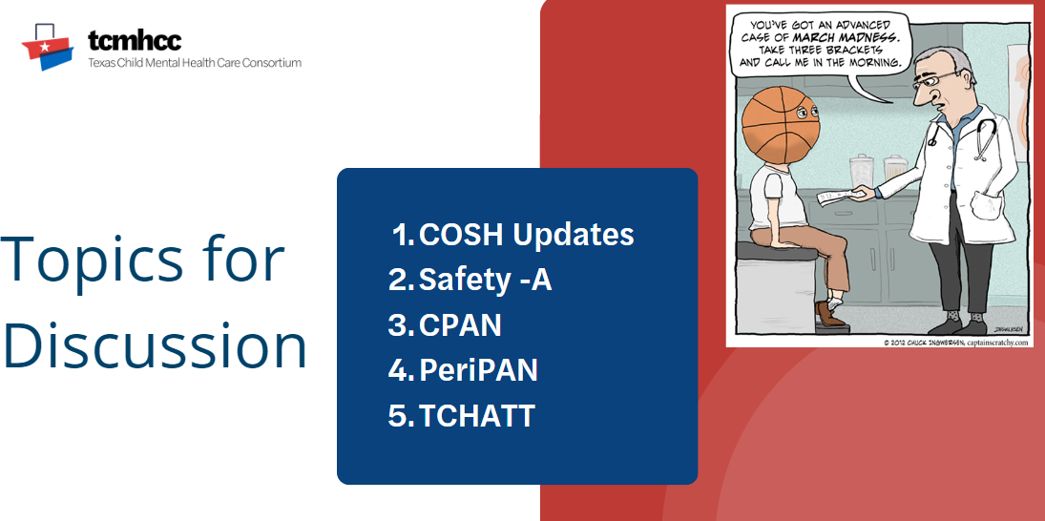

Slide 3
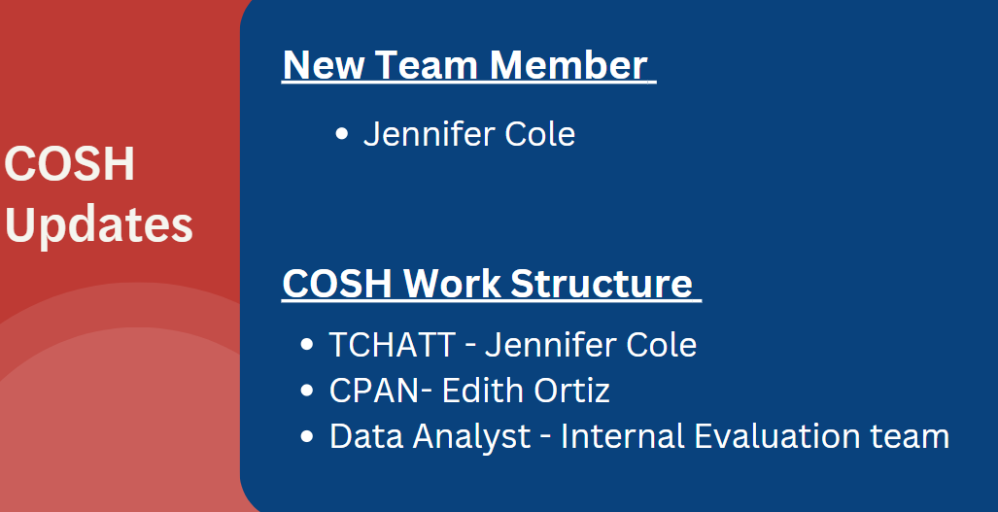

Slide 4

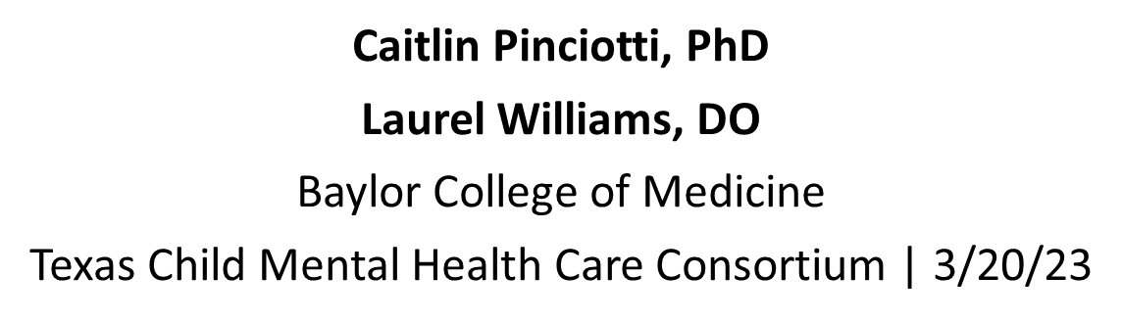

Slide 5

Evidence-based, cognitive behavioral youth- and family-centered intervention for suicide and self-harm
Adapted from emergency rooms into primary care visits
Goals:
  Reduce risk
  Ensure safety
  Assist with linkage to care in the community
    Adequate safety planning in session is preferred to immediate referral to ER

Slide 6
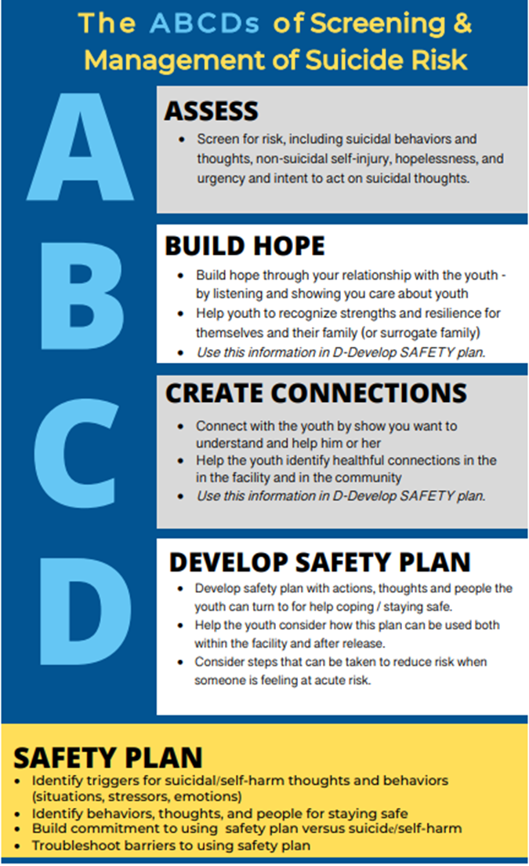
SAFETY-A Youth Session
Assessment of suicidality
Identify youth strengths
Identify strengths in family and environment
Understand emotional reactions associated with suicide risk
Develop personal safety plan
Counseling on means restriction and disinhibiting effects of substances

Slide 7
SAFETY-A Family Session
Identify youth and family strengths
Strategies for ensuring safe settings
  Psychoeducation on suicide warning signs
  Taking suicidal talk/behavior seriously
  Lethal means restriction
  Protective monitoring
  Disinhibiting effects of substance use
  Supporting youth in safety plan use
  Review emergency protocol

Slide 8
ARPA Implementation
Feasibility and acceptability of SAFETY-A training and implementation
Collaboration across 7 sites to achieve goal of 50 PCPs trained on SAFETY-A
  BCM: lead hub
  UT-SW: data
  Texas A&M: recruitment
  UTMB: recruitment
  UT-Houston: recruitment
  Texas Tech: recruitment
  UT-Austin Dell: recruitment

Slide 9
SAFETY-A Progress
19 PCPs trained in first training cohort (last month)
  46 total in attendance
  12 staff undergoing training as trainers
Upcoming trainings on 3/29 and 4/17

Slide 10
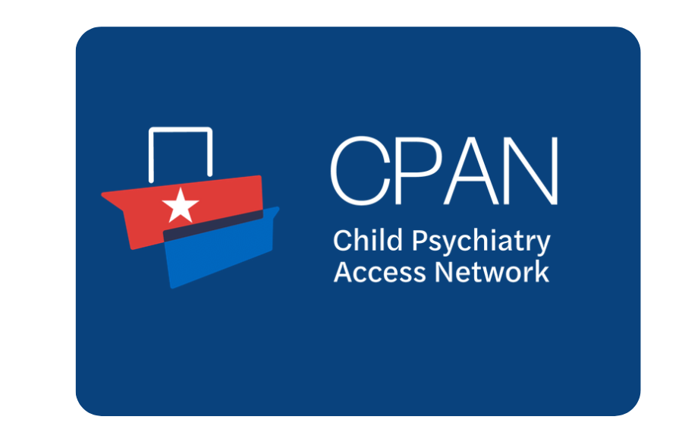

Slide 11
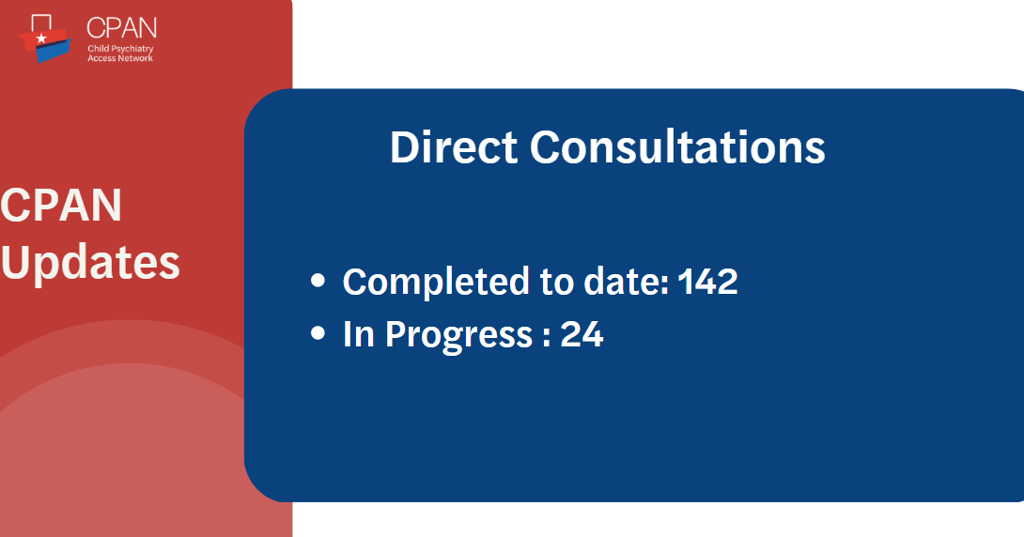

Slide 12

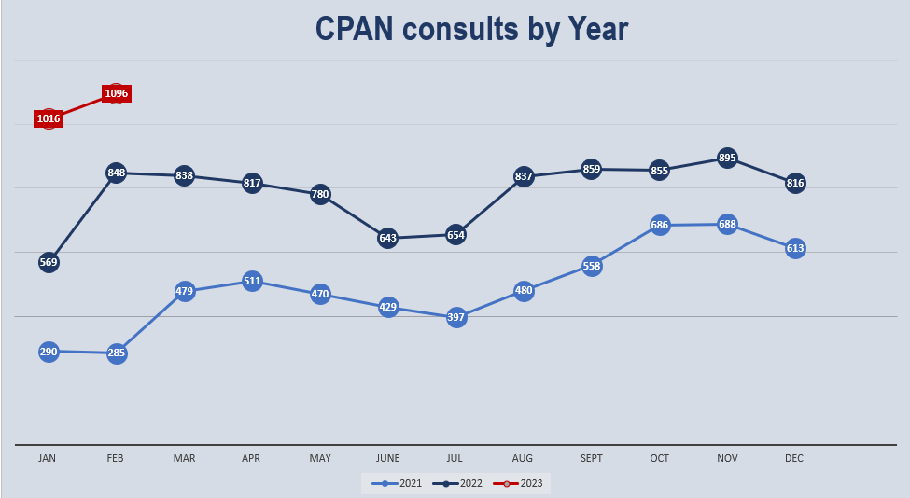

Slide 13
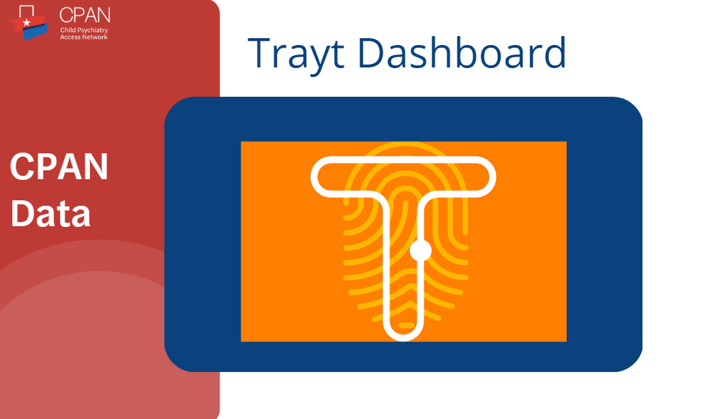

Slide 14


Slide 15
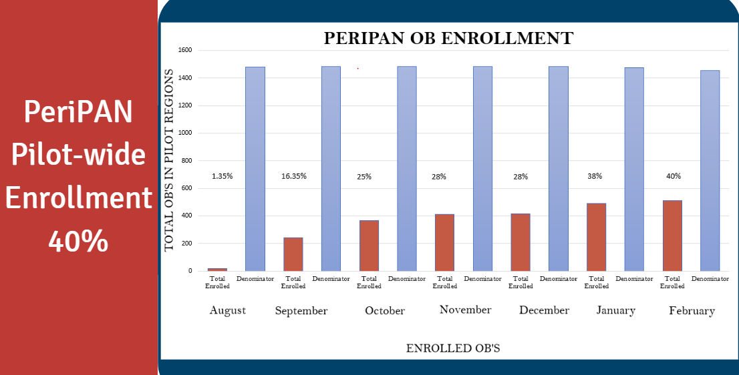

Slide 16
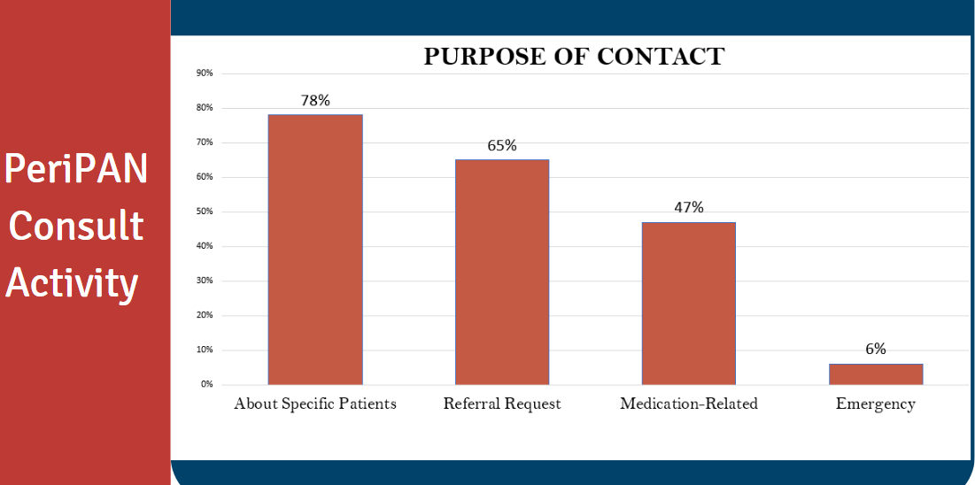

Slide 17
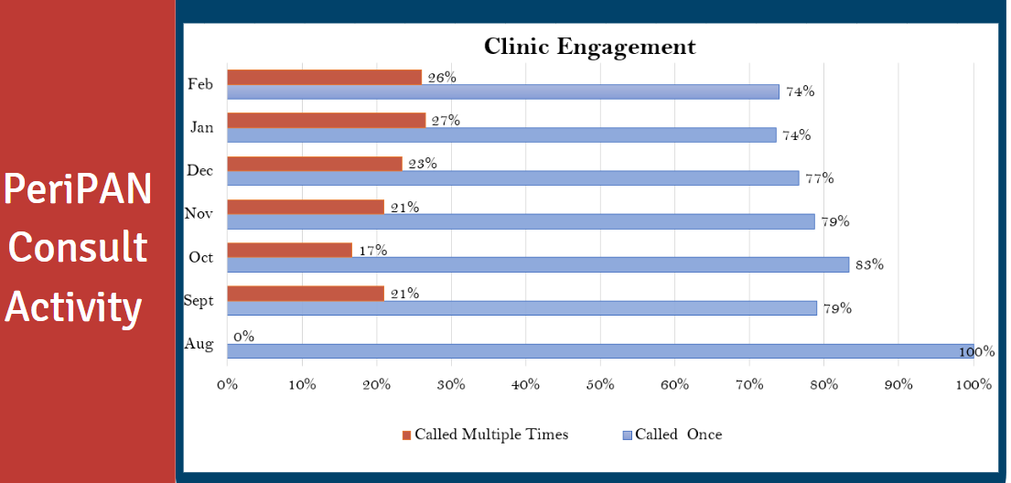

Slide 18
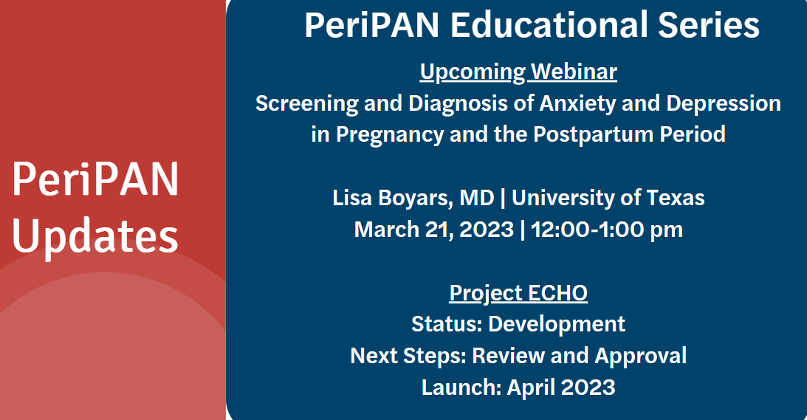

Slide 19
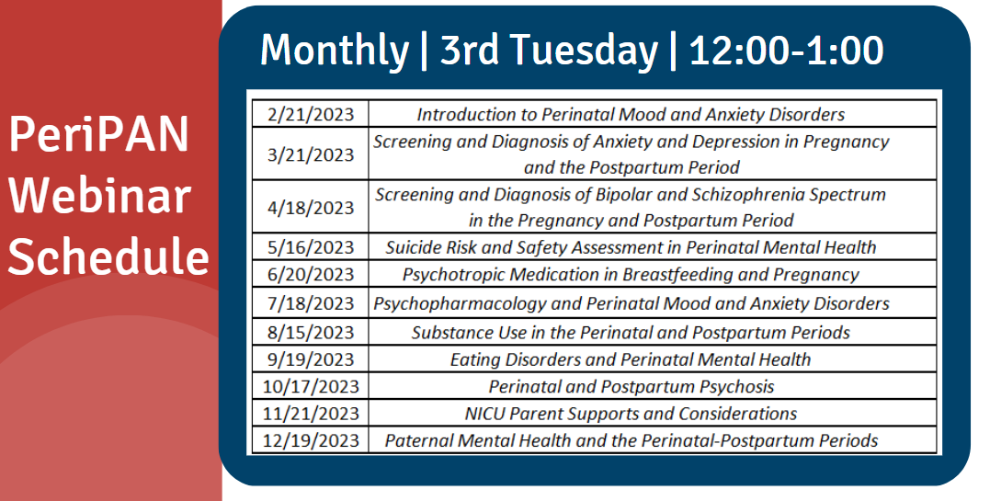

Slide 20


Slide 21
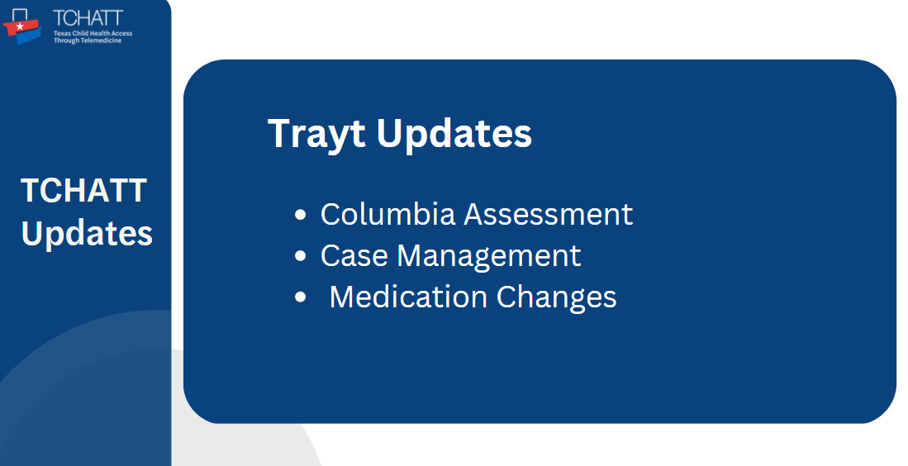

Slide 22


