Slide 1


Slide 2
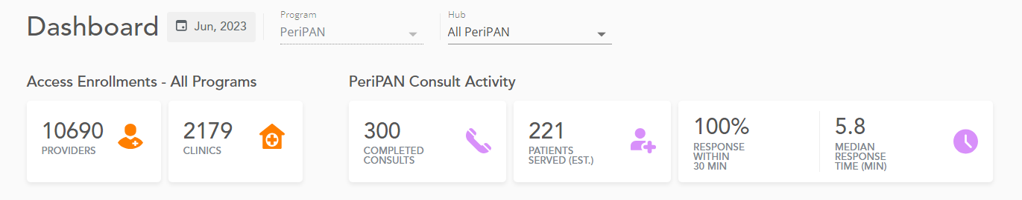
PeriPAN Activity

Slide 3
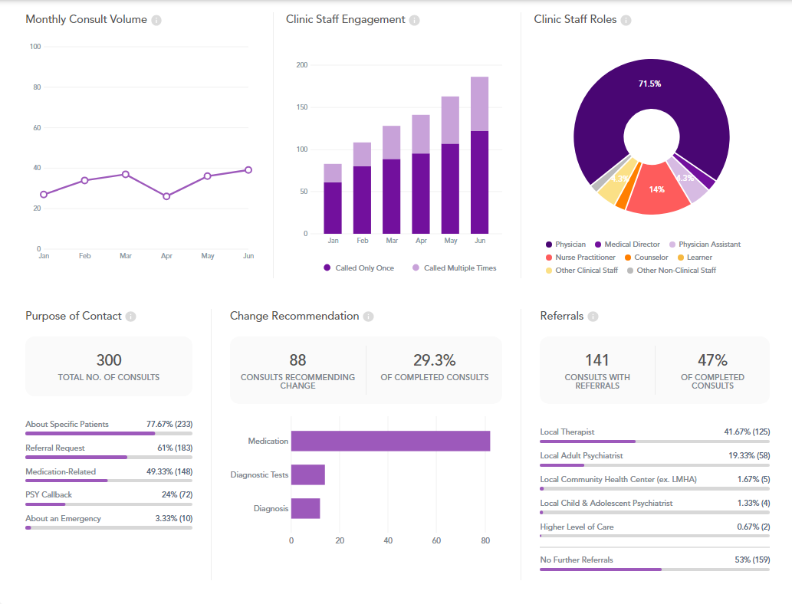

Slide 5
National Curriculum of Reproductive Psychiatry (NCRP) Proposal for PeriPAN
Background: Perinatal mental health training is not currently a requirement under ACGME guidelines for resident physicians.
Objective: Offer a statewide curriculum on perinatal psychiatry to resident physicians by utilizing the NCRP curriculum.
Target audience: All Texas resident physicians, with target disciplines in the specialties of psychiatry, family medicine, and OBGYN.
Duration and frequency: One-year track curriculum, repeated yearly. A topic will be assigned each month. There will be a weekly virtual activity offered: including lecture series, interactive activities, case studies, media review, journal review, and Q& A discussions.
Method: The NCRP (National Curriculum of Reproductive Psychiatry) curriculum offers topics of reproductive psychiatry across a women’s lifespan. We will focus on topics within the curriculum that are pertinent to perinatal psychiatry, in alignment with PeriPAN’s mission. The topics that will be covered include 12 main areas of focus, with one topic assigned per month.
Status: Contact made to residency program directors to gauge interest and capture didactic times.

Slide 6

PeriPAN NCRP Interest Survey
12 Institutions Surveyed: CAP, Adult, & Rural Residency Programs
Responses:
Yes – 9
Maybe – 1
Awaiting Confirmation – 2
Current Perinatal Psychiatry Curriculum in General Residency Program – 1
Current Perinatal Psychiatry Curriculum in Women’s MH Track – 1
Current Perinatal Psychiatry Course Hours in Residency Program – 3

Slide 7
“Two CAP fellows in clinic with me today are excited this will be an opportunity!”
“We would be very interested in incorporating this curriculum into our program!”
“Absolutely would be very interested!”
“Sounds awesome!”

Slide 8

PeriPAN Expansion Update
Recommendations from Lifeline for Moms
Based on the number of births annually in Texas
6-7 FTE Reproductive Psychiatrists
  Required expertise
    Knowledge:
      BE/BC General Psychiatry
      Women’s MH Fellowship Training OR 1-2 year minimum of longitudinal perinatal psychiatry clinical experience
    Consultation skillset:
      Consultation/Liaison Psychiatry Fellowship Training OR Effective skill set for providing quick, concise, collaborative guidance for clinical care
  Not a fully clinical job
  Responsibilities
    Outreach, education, and providing consultations
    Creating and presenting ECHO and Webinar sessions
    Engaging in implementation assistance with practices
    Increasing utilization

Slide 9
PeriPAN Expansion Update
Recommendations from Lifeline for Moms
6 FTE Program Coordinator
12 FTE Resource and Referral Specialists across hubs creates an economy of scale
Program should function as a cohesive whole at the state level
Hubs should be able to cover for another, including for direct consults
Participate in state-wide, leadership, one-on-one, and role-specific meetings
Improve utilization
Outreach & Education
Engagement in implementation assistance with practices

