Slide 1


Slide 2
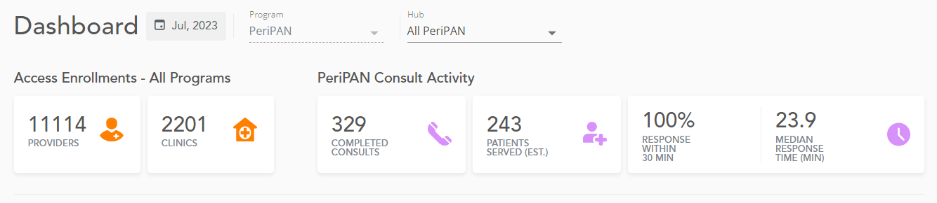
PeriPAN Activity

Slide 3
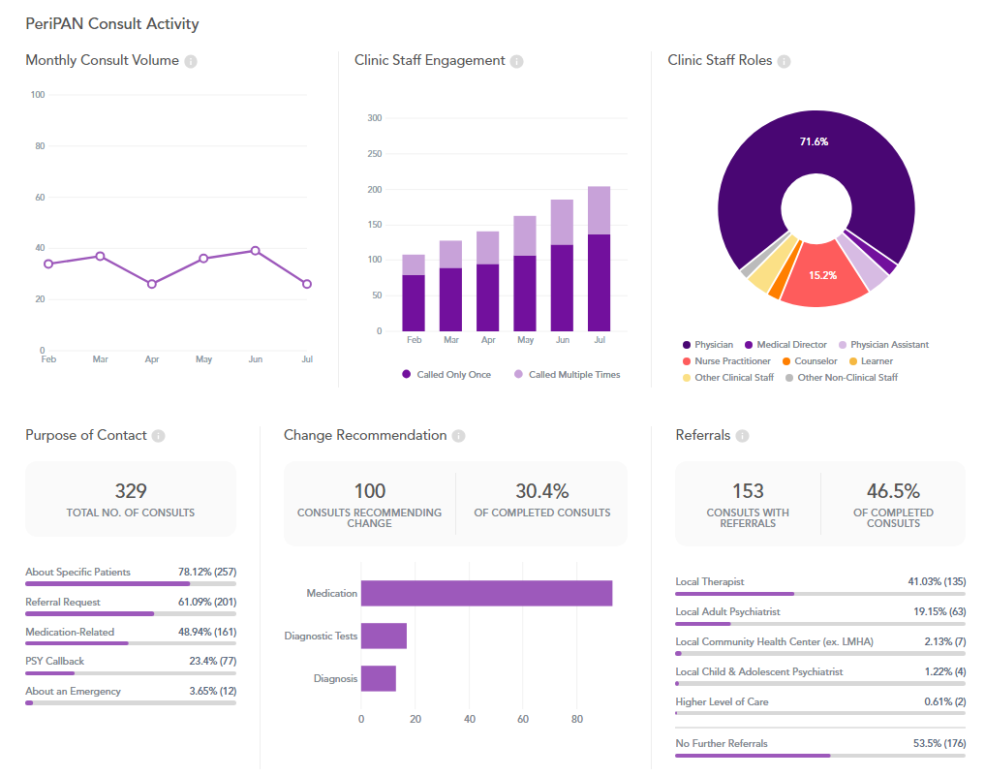

Slide 5
Register on the PeriPAN website
PeriPAN 2023 Webinars
https://tcmhcc.utsystem.edu/perinatal-psychiatry-access-network-peripan/
Date & Time | Topic
2/21/2023 | Introduction to Perinatal Mood and Anxiety Disorders
3/21/2023 | Screening and Diagnosis of Anxiety and Depression in Pregnancy and the Postpartum Period
4/18/2023 | Screening and Diagnosis of Bipolar and Schizophrenia Spectrum in the Pregnancy and Postpartum Period
5/16/2023 | Suicide Risk and Safety Assessment in Perinatal Mental Health
6/20/2023 | Psychotropic Medication in Breastfeeding and Pregnancy
7/18/2023 | Psychopharmacology and Perinatal Mood and Anxiety Disorders
8/15/2023 | Substance Use in the Perinatal and Postpartum Periods
9/19/2023 | Eating Disorders and Perinatal Mental Health
10/17/2023 | Perinatal and Postpartum Psychosis
11/21/2023 | NICU Parent Supports and Considerations
12/19/2023 | Paternal Mental Health and the Perinatal-Postpartum Periods

Slide 6
PeriPAN Expansion - Update
Pilot program launched on August 18, 2022, in four regions
Expansion soft opening: September 1, 2023
Vision
  CPAN/PeriPAN as an integrated approach at both the individual hub and overall statewide programmatic level
    Shared
      Administration
      Phone systems
      Outreach
      Resource and referral systems
Statewide meeting held on 8/17/2023

Slide 7
PeriPAN Expansion – Next Steps
Teams to review launch training materials
Individual meetings with incoming HRIs
Soft opening on 9/1/2023
  Consultation calls accepted across the state
  Pilot hubs to assist with consults
Open office hours throughout the month of September
Statewide media campaign announcing the launch
Regional OB/GYN lists shared with hubs to plan outreach
Ongoing support from COSH
Ongoing opportunities to share struggles, lessons learned, and new ideas as we move forward together!

