Slide 1

Perinatal Psychiatry Access Network
(PeriPAN)
Sarah Mallard Wakefield, MD
Medical Director of PeriPAN
Associate Professor and Chair of Psychiatry
School of Medicine, TTUHSC

Slide 2
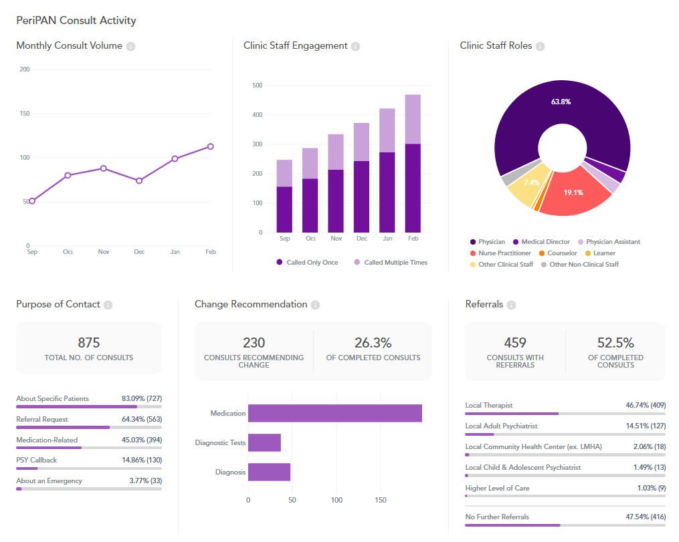

PeriPAN Activity

Slide 3
Physician Call Activity
Physicians: 64% of calls

Slide 4
PeriPAN Enrollment Activity

Slide 5
PeriPAN ECHO | Spring 2024
Tuesday’s 12:00-1:00
Date | Topic
3/12/2024 | Introduction to ECHO® and Perinatal Mental Health Consultation
3/26/2024 | Intrusive Thoughts vs. Psychosis in the Perinatal/Postpartum Period
4/9/2024 | Cultural Considerations in Perinatal Mental Health
4/23/2024 | Mental Health and Infertility Challenges
5/7/2024 | Perinatal Loss
5/28/2024 | Hyperemesis Gravidarum
6/4/2024 | Postpartum Catatonia

Slide 6
Date & Time | Topic
1/16/2024 | Introduction to Perinatal Mood and Anxiety Disorders
2/20/2024 | Screening and Diagnosis of Bipolar and Schizophrenia Spectrum in the Pregnancy and Postpartum Period
3/19/2024 | Screening and Diagnosis of Anxiety and Depression in Pregnancy and the Postpartum Period
4/16/2024 | Suicide Risk and Safety Assessment in Perinatal Mental Health
5/21/2024 | Psychotropic Medication in Breastfeeding and Pregnancy
6/18/2024 | Psychopharmacology and Perinatal Mood and Anxiety Disorders
7/16/2024 | Substance Use in the Perinatal and Postpartum Periods
8/20/2024 | Eating Disorders and Perinatal Mental Health
9/17/2024 | Perinatal and Postpartum Psychosis
10/15/2024 | NICU Parent Supports and Considerations
11/19/2024 | Paternal Mental Health and the Perinatal-Postpartum Periods
PeriPAN Grand Rounds Schedule
2024
3rd Tuesday of the month
12:00-1:00

Slide 7



PeriPAN Updates
TexasAIM Rollout
PeriPAN Perinatal Mental Health Toolkit for OBs
Postpartum Depression (PPD) Workgroup
- Collaborating with Manda Hall, MD, Associate Commissioner for Community Health Improvement at DSHS
Instructional webinar will be recorded with ACOG in early April
Released on World Maternal Mental Health Day – May 1, 2024
Serving on Texas Pediatric Society PPD workgroup
PPD is one of the three focus areas which was identified by recommendations from pediatric subspecialists and pediatricians

