Slide 1
TCMHCC
PeriPAN
May 16, 2022
TCMHCC Executive Committee Meeting

Slide 2

Today's agenda
  Reminder of our REASON
  PeriPAN Pilot sites
  National Best Practices & What we’ve learned so far
  Consideration of Texas Psychiatry Access Network language
  Support team for the project
  Phone and data product vendor discussions
  Launch Plans
  Answer Questions!

Slide 3
Perinatal Mental Health Disorders are the leading causes of maternal morbidity and mortality
  Perinatal Depression
  Perinatal Anxiety
  Substance use disorders
  Suicide
  Bipolar Disorder
  Perinatal Psychosis

Slide 4
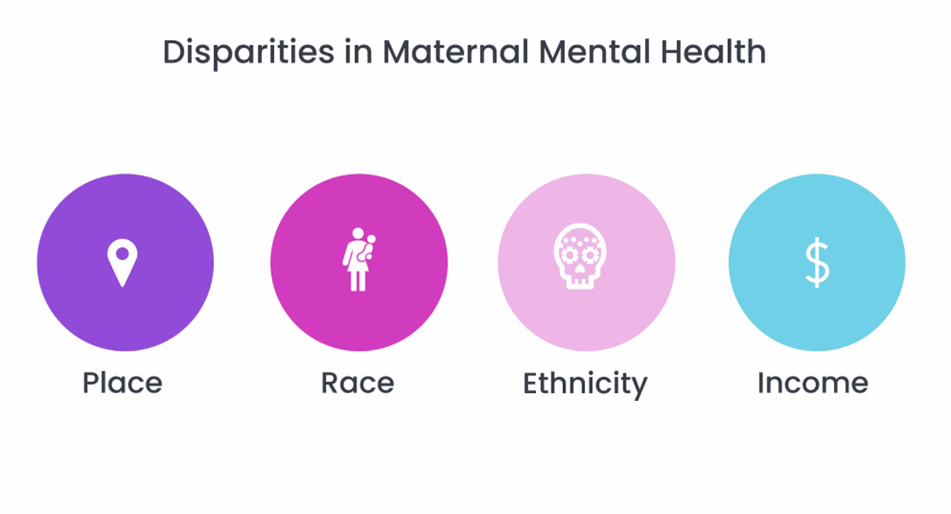
Presented by Karen Tabb Dina, MD at Lifeline for Moms Summit 2022

Slide 5
HHSC – The Texas Clinicians Postpartum Depression Toolkit, Volume 2
American College of Obstetricians and Gynecologists (2015)
  All women screened for perinatal depression at least once during the perinatal period
American Academy of Pediatrics (2017)
  Infant primary care providers integrate postpartum depression screening into the well-child visits at one, two, four, and six months

Slide 6
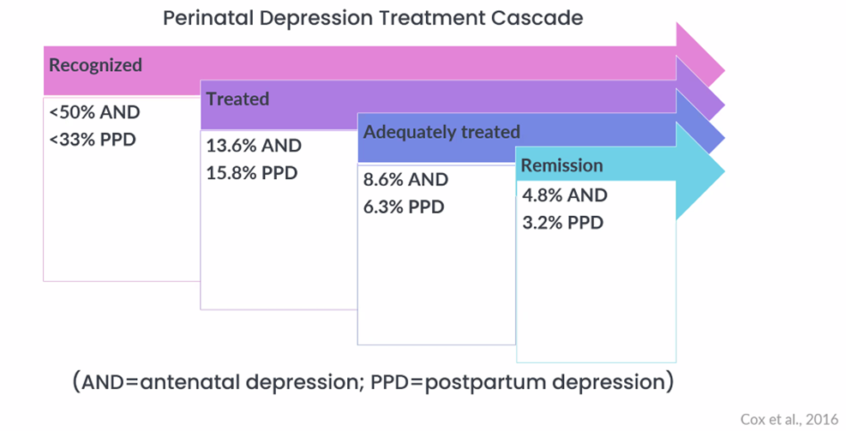
Presented by Karen Tabb Dina, MD at Lifeline for Moms Summit 2022
Screening does not equal treatment

Slide 7
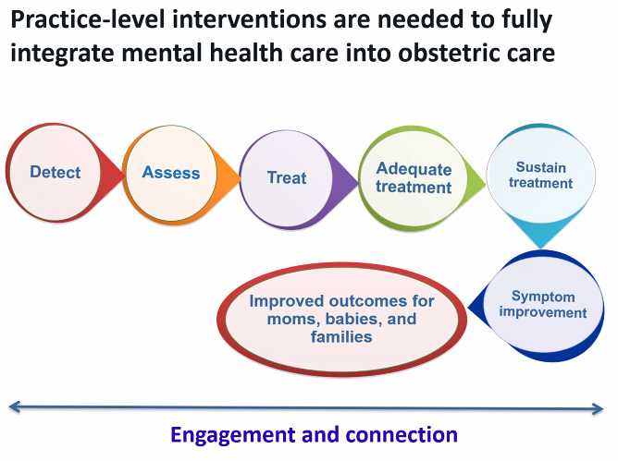
Presented by Nancy Byatt, MD at Lifeline for Moms Summit 2022

Slide 8
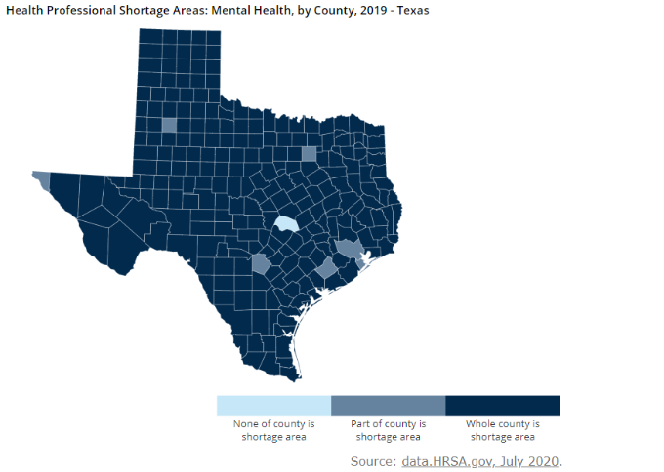
Mental Health Professionals Shortage in Texas
Texas has continued to have high shortage in mental health (MH) professionals. Of these available MH health professionals, few have perinatal mental illness training.

Slide 9

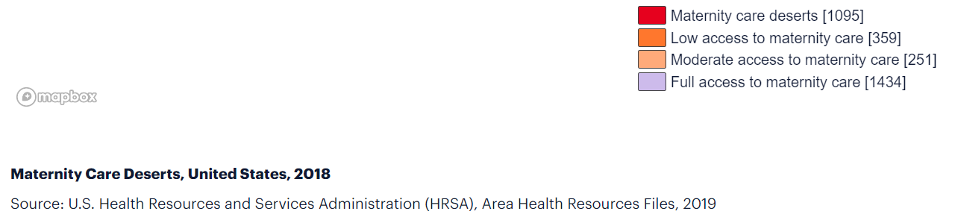
Maternity Care Deserts

Slide 10
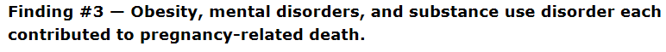
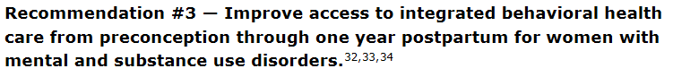
Findings from the Maternal Mortality and Morbidity Review Committee (MMMRC), December 2020
Obstetricians
Use validated screening tools to screen all pregnant and postpartum women
Incorporate basic psychiatry and behavioral health training into medical providers’ education to improve opportunities for intervention and treatment management
Increase provider education and technical assistance in national standards and best practices for care of women with SUD
Promote and use dyadic-centered treatment and recovery services
Explore strategies to increase access to behavioral health care in critical shortage areas
Pediatricians
Family Medicine Physicians engaged in obstetric and/or pediatric care
Psychiatrists
Psychologists
Nurse Midwives

Slide 11
CPAN enhancement in the 3rd Special session of the 87th Legislature
Approved programs fell under three categories:
  Child Psychiatry Access Network (CPAN) Enhancement and Expansion
      -Out of money appropriated the Consortium may enhance CPAN to improve perinatal mental health services
  Texas Child Health Access Through Telemedicine (TCHATT) Enhancement and Expansion
  Child Psychiatry Workforce Expansion
    Including other development of other mental health care professionals

Slide 12
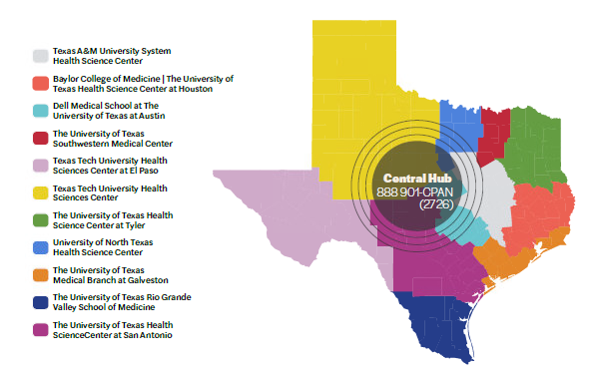
Child Psychiatry Access Network (CPAN)

Slide 13

Health Related Institutions Identified
Texas Tech University Health Sciences Center - Lubbock
University of Texas - Dell Medical School
Baylor College of Medicine
University of Texas - Southwestern
Notes:
Representatives from these HRIs have been meeting over the past few months to

Slide 14
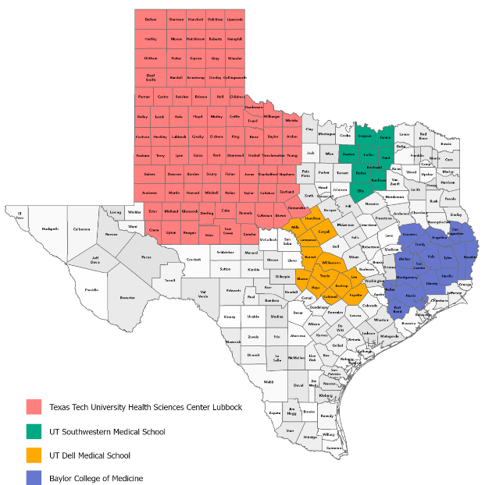
Perinatal Psychiatry Access Network (PeriPAN)
PILOT SITES

Slide 15
Why mental health treatment in frontline perinatal care?
Disease burden is great
Mental, physical health problems are interwoven
Treatment gap is enormous
Need for expanded access
Reduces stigma and discrimination
It is cost-effective
Good outcomes
WHO 2008
Notes:
*Photo purchased from Canva subscription

Slide 16
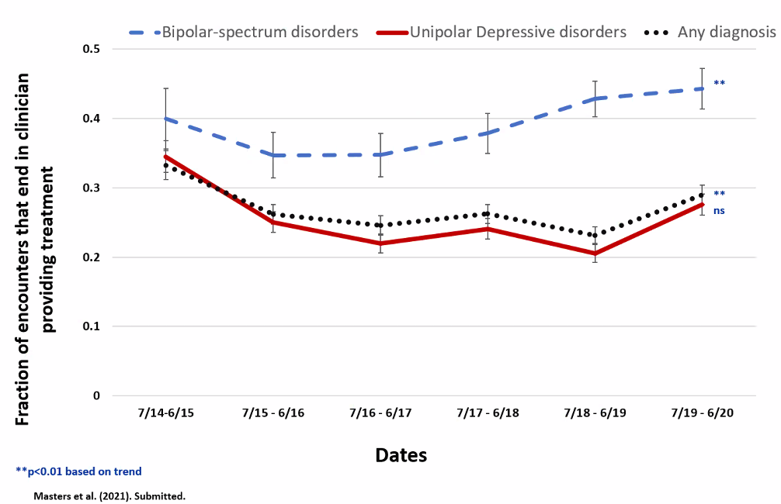
Goal: Build Provider Capacity to Deliver Mental Health Care
Presented by Nancy Byatt, MD at Lifeline for Moms Summit 2022
Notes:
Clinicians actually called less about unipolar depression; face to face consults support comfort in treating more complex illness

Slide 17
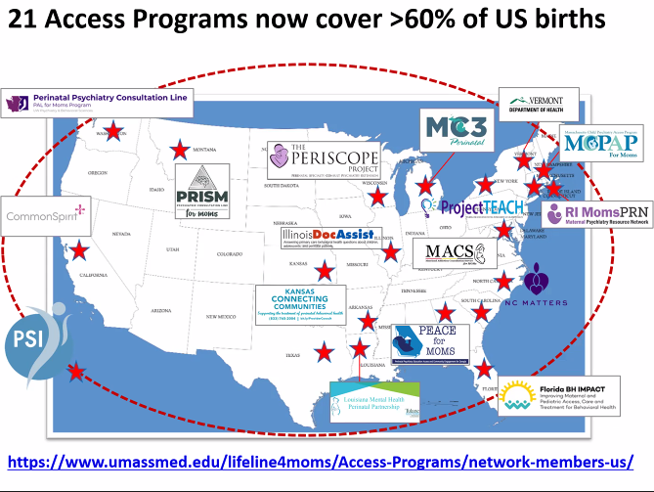
Presented by Nancy Byatt, MD at Lifeline for Moms Summit 2022

Slide 18
What we have learned so far
²⁰²¹
^{November}
^{Application for PeriPAN Pilot}
Discussion with Texas Collaborative for Healthy Mothers and Babies regarding PeriPAN
^{December}
Budget work, discussion on project scope
²⁰²²
^{January}
Budget and Project Proposals due to TCMHCC
^{February}
PeriPAN Work Group began meeting with representation from each identified PeriPAN Pilot site and COSH
Application for PeriPAN Medical Director
TCMHCC ARPA meeting to approve budgets
Lifeline for Moms Program Exchange, Partnering with Child Psychiatry Access Programs
^{March}
Lifeline for Moms Network 2022 Summit – Discussion of state advocacy, funding structures
Meeting with Texas District of American College of Obstetrics and Gynecology
Meeting with HHSC – Discussion of resources available to pregnant and post-partum women in TX
Meeting with NC Maternal Health Matters
Meeting with M3 Michigan integrated CAP and Perinatal Psych Access Program

Slide 19
What we have learned so far
²⁰²²
^{March}
Lifeline for Moms Network 2022 Summit – Discussion of state advocacy, funding structures
Meeting with Texas District of American College of Obstetrics and Gynecology
Meeting with HHSC – Discussion of resources available to pregnant and post-partum women in TX
Meeting with NC Maternal Health Matters
Meeting with M3 Michigan integrated CAP and Perinatal Psych Access Program
^{April}
Lifeline for Moms Program Exchange, New National Maternal Mental Health Hotline: HRSA and PSI
Meeting with ACOG, AIM Perinatal Mental Health Bundles
Lifeline for Moms, TX PeriPAN Consultation meeting
^{May}
Twitter Chat with HHSC for Maternal Mental Health Day
PeriPAN Kickoff Meeting with all pilot site key personnel
Lifeline for Moms Network Exchange PeriPAN Presentation
Ongoing – Trayt meetings, Lantana meetings, data and metric discussions with internal and external teams

Slide 20
Take home points
Integrated Networks are the wave of the future
Provide streamlined process for busy clinicians
Operate at a Cost savings compared to separate lines/separate teams
Strengthened advocacy efforts
Goal is to expand PeriPAN services state-wide in a cost-efficient way
Several programs have direct services to assess women with complex mental health presentation

Slide 21

CPAN
PeriPAN
Pediatricians, Family Docs, PA, NPs invited to enroll regionally state-wide
No cost to clinicians or patients
3 Services in 1 Phone Call
  Resource and Referral Assistance
  Behavioral Planning for youth
  Psychiatric consultation in real time with children’s mental health expert
Education
  ECHO Team Based Learning
  Webinars
  Best Practice Algorithms & Tool Kits
Obstetricians, Pediatricians, Family Docs, PA, NPs, Psychiatrists invited to enroll regionally state-wide
No cost to clinicians or patients
3 Services in 1 Phone Call
  Resource and Referral Assistance
  Behavioral Planning for women in the perinatal period
  Psychiatric consultation in real time with perinatal mental health expert
Education
  ECHO Team Based Learning
  Webinars
  Best Practice Algorithms & Tool Kits

Slide 22
Central Operational Support Hub:
Laurel L. Williams, DO, Medical Director
Jennifer Evans, Program Administrator
Edith Ortiz, Program Manager
Brittany Columbus, Business Coordinator
COSH manages Vendors related to operations
Organize and standardize teams for both CPAN and TCHATT
Will coordinate and facilitate PeriPAN Pilot
PeriPan and CPAN are “sister programs”
Executive Director TCMHCC
TCMHCC Executive Committee
CPAN
Peri-Pan
COSH
Q: Who are the key PeriPAN contacts for communication between COSH and your HRI team?

Slide 23
LANTANA
Recommendation: Just one minor change
Welcome, and thank you for calling the
Texas Psychiatry Access Network.
Please listen carefully to the next few prompts, which will help connect you with your regional team.
For the North and North East Regions, Press 1
For the South and South East Regions, Press 2
For the Valley and Central Regions, Press 3
For the West Regions, Press 4
If you are unsure of your region or would like to speak with central operations support personnel, Press 9
To return to the main menu press star.
Notes:
This will limit confusion on the part of the clinicians who are used to calling CPAN as their menu will not change at all. This will limit the potential number of miscalls to PeriPAN that are from regions outside of the hub regions.

Slide 24
Trayt Data Management
Built as a single integrated
Access Platform
Notes:
This will follow best practices nationally, allow for greater expansion in the future.

Slide 25
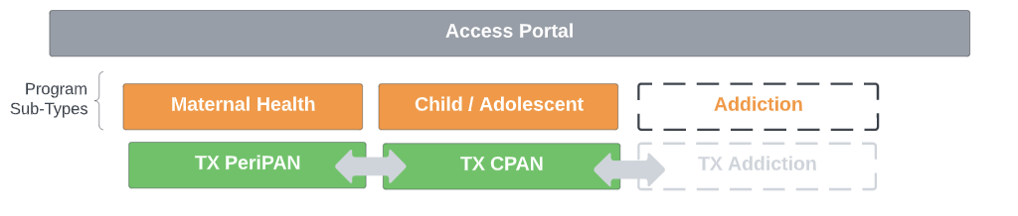
Trayt Integrated Access Platform
Texas Psychiatry Access Network

Slide 26
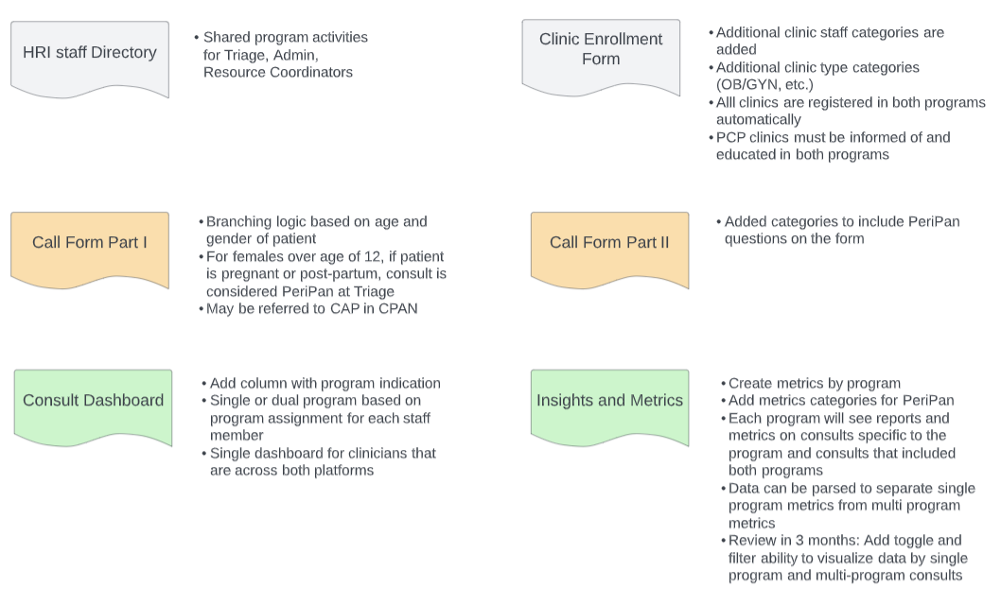
Minor changes to current CPAN features and forms to accommodate integrate Access Platform
Notes:
Trayt is able to build this with only minor changes to the current CPAN work flow. One specific question from the team about pregnancy will trigger the Perinatal call form data capture.

Slide 27
Q: Which of your team members should be included in the various meeting types listed below?
Looking Ahead – COSH Meetings
  May 10th 8-9am
    COSH, CPAN, PeriPAN Key Staff all Pilots
    Training topic: Customer Service, Resources/ Referral Coordination, Welnity overview
  May 17th 8-9am
    COSH, CPAN, PeriPAN Key Staff all Pilots
    Training topic: Psychiatrist Role
  COSH, Medical Director and HRI Specific meeting
    May 24th 8-9am UTSW
    June 7th 8-9am UTDell
    June 21st 8-9am Baylor
    June 28th 8-9am TTUHSC
    Training topic:
  July 5th 8-9am
    COSH, CPAN, PeriPAN Key Staff all Pilots
    Training topic: Prep for Lifeline Training
  July 19th 8-9am
    COSH, CPAN, PeriPAN Key Staff all Pilots
    Training topic: How to coordinate team cross coverage
  July 26th 8-9am
    COSH, CPAN, PeriPAN Key Staff all Pilots
    Training topic: How to enter data into Trayt
  TBD in July: Lifeline for Moms Training

Slide 28
Looking Ahead – Trainings
  Post Partum Support International
    Maternal Mental Health 101, 90min webinar June 9 (free) https://www.postpartum.net/professionals/mmh-online-webinar/
    2-day Perinatal Mood and Anxiety Disorders Training (paid) https://www.postpartum.net/professionals/certificate-trainings/psi-certificate-training/
    Maternal Mental Health Webinar Certificate Course, 8 sessions (paid) https://postpartum.app.neoncrm.com/np/clients/postpartum/event.jsp?event=617&
    Educational materials https://www.postpartum.net/resources/psi-brochure/
    Annual Conference in NOLA July 13-17th https://www.postpartum.net/professionals/psi-conference/
  National Curriculum in Reproductive Psychiatry (free)
    http://ncrptraining.org/learning-modules/
    In depth Classroom, self-study, and CME options
    5 hour essentials
  Lifeline For Moms trainings

Slide 29

Line Launch
August 2022

Slide 30
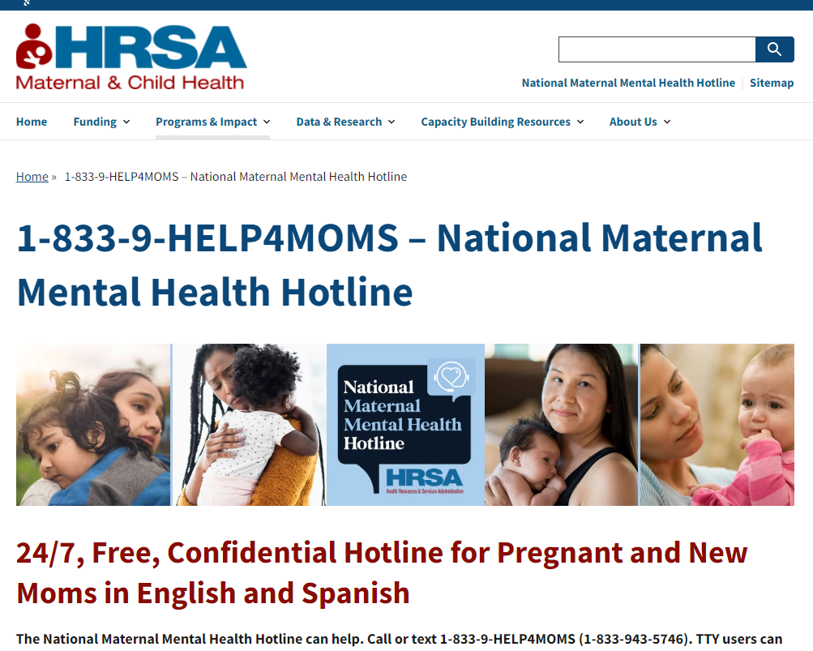
LIVE!

Slide 31
Your Questions

