Slide 1
TCMHCC
PeriPAN
July 19, 2022
TCMHCC Executive Committee Meeting

Slide 2
CPAN Expansion to support Pregnant and Post Partum Women
  Maternal Mortality and Morbidity Review Committee (December 2020)
    Mental and Substance Use Disorders are significant contributors to maternal death in TX
    Improve access in integrated behavioral health care from preconception to one year post partum
  CPAN expansion opportunity in the 3rd Special Session of the 87th Legislature (2021)
    Out of money appropriated, the Consortium may enhance CPAN to improve perinatal mental health services

Slide 3
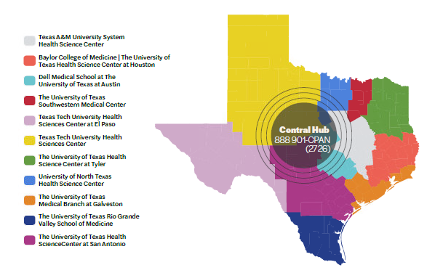
Child Psychiatry Access Network (CPAN)

Slide 4
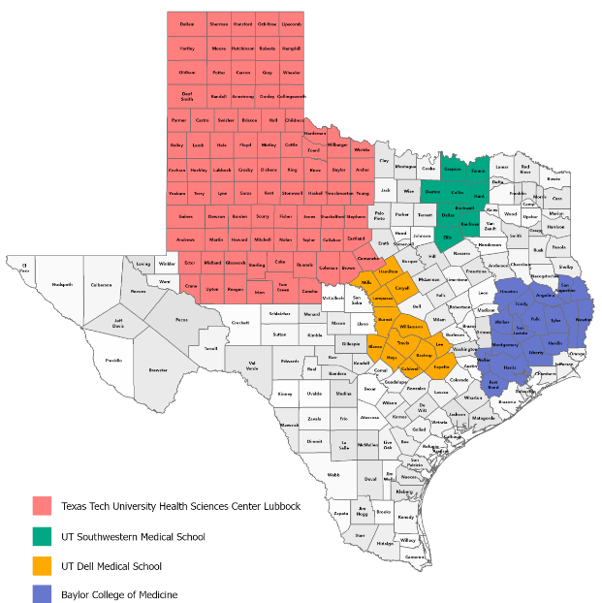
Perinatal Psychiatry Access Network (PeriPAN)
PILOT SITES

Slide 5
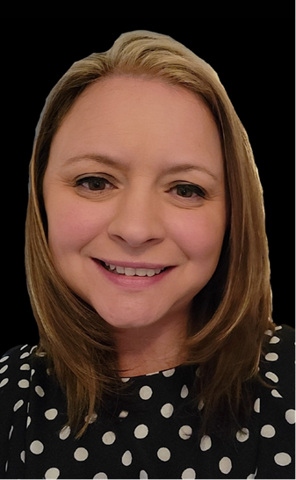
Development/Training
  Lantana
  UT System Pop Health
  PSI Conference
  TRAYT
  TTUHSC Infant Risk Center
  Lifeline for Moms
  Jenn Erdige, MHA
  Program Manager

Slide 6
COSH/Pilot Site Meetings
  May 10th 8-9am
    COSH, CPAN, PeriPAN Key Staff all Pilots
    Training topic: Customer Service, Resources/ Referral Coordination, Welnity overview
  May 17th 8-9am
    COSH, CPAN, PeriPAN Key Staff all Pilots
    Training topic: Psychiatrist Role
  COSH, Medical Director and HRI Specific meeting
    May 24th 8-9am UTSW
    June 7th 8-9am UTDell
    June 21st 8-9am Baylor
    June 28th 8-9am TTUHSC
  July 5th 8-9am
    COSH, CPAN, PeriPAN Key Staff all Pilots
    Review implementation
  July 26th 8-9am
    COSH, CPAN, PeriPAN Key Staff all Pilots
    Training topic: Clinic engagement materials overview
  August 2nd 8-9am
    COSH, CPAN, PeriPAN Key Staff all Pilots
    Training topic: Clinic engagement strategies
  August 5th & 9th, 12-1pm
    COSH, CPAN, PeriPAN Key Staff all Pilots
    Training topic: TRAYT Provider/Clinic Enrollment training
  August 10th & 11th, 12-1pm
    COSH, CPAN, PeriPAN Key Staff all Pilots
    Training topic: TRAYT Triage and Consult Training

Slide 7

Q&A
August 1st – Clinician Engagement Launch
August 18th – Line Live!

