Slide 1
TCMHCC
PeriPAN
February 28, 2022
TCMHCC EXECUTIVE MEETING

Slide 2

Today's agenda
  Provide overview and justification for PerPAN Program
  Medical Director announcement
  Identify HRI's participating in project
  Overview of stakeholders list
  Metrics
  Launch Plans

Slide 3
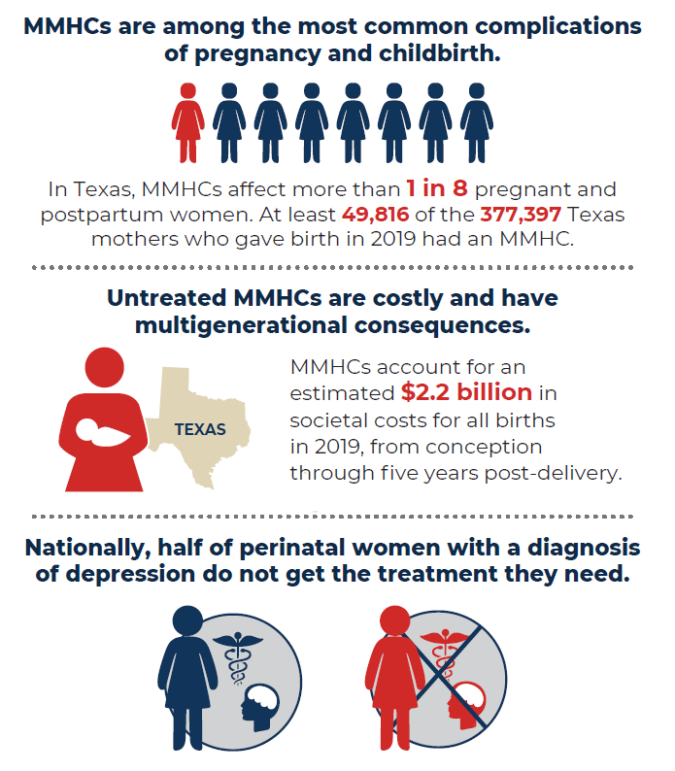

Mathematica.org (March 2021)

Slide 4
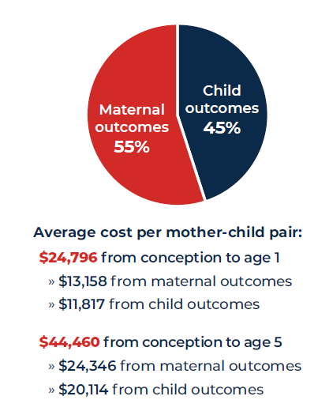
2019 Society Costs of MMHCs
Mathematica.org (March 2021)

Slide 5
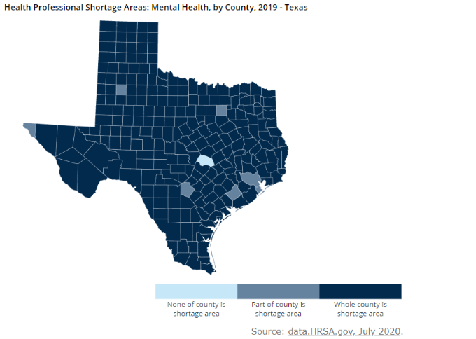
Mental Health Professionals Shortage in Texas
Texas has continued to have high shortage in mental health (MH) professionals. Of these available MH health professionals, few have perinatal mental illness training.

Slide 6
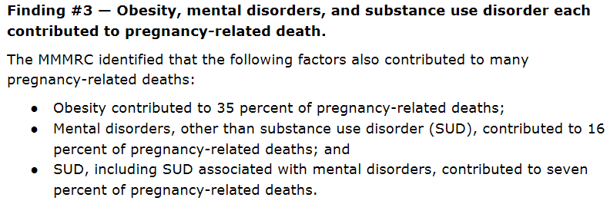
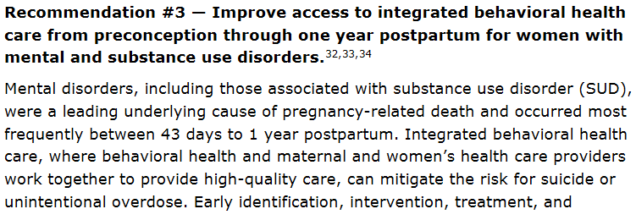

Findings from the Maternal Mortality and Morbidity Review Committee (MMMRC), December 2020

Slide 7
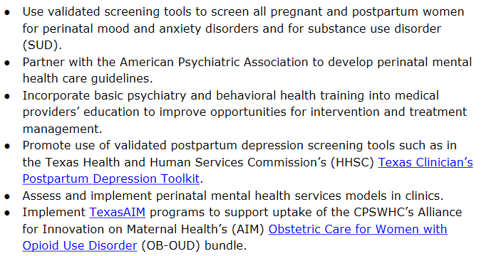
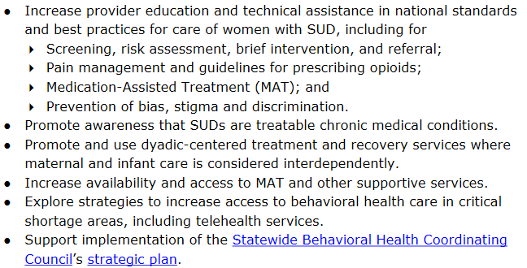
To support integrated behavioral health care, the MMMRC recommends that providers and relevant stakeholder organizations take the following actions.

Slide 8
PeriPAN
Purpose:
To support providers of maternal health care with identifying and managing their patients' mental health and substance use concerns in real time, in an environment in which reproductive psychiatry resources are scarce.
To expand access to education about maternal mental health disease burden and effective treatments.
To improve the mental health care and systems of care for women who are pregnant, post-partum, suffering perinatal loss or planning pregnancy in the context of psychiatric symptoms.
To improve the mental health care and systems of care for children and adolescents of Texas by supporting the women who care for them.

Slide 9

Medical Director
Sarah Mallard Wakefield, MD
Associate Professor & Chair
Department of Psychiatry
Texas Tech University Health Sciences Center Lubbock
Specializing in child/adolescent, perinatal, and forensic psychiatry

Slide 10

HRI's Identified
Texas Tech University Health Sciences Center - Lubbock
University of Texas - Dell Medical School
Baylor College of Medicine
University of Texas - Southwest
Notes:
Representatives from these HRIs have been meeting over the past few months to

Slide 11
Clinical Consultant
Gayle Olson, MD, MPH
District XI Chair Elect and
ACOG Representative on the Texas Collaborative for Health Mothers and Babies

Slide 12
Including (but not limited to):
Texas Community Association of Community Health Centers
American College of Obstetrician and Gynecologist Local Chapter
March of Dimes
Texas Pediatric Society
Association of Texas Midwives
State Agencies
Texas Collaborative for Healthy Mothers and Babies (the state Perinatal Quality Collaborative)
Stakeholders

Slide 13

Metrics
Percentage of PCPs and OBs within each pilot region that are enrolled
Percentage of phone calls answered, by team and by entire pilot program, within 5 minutes
Percentage of consultative requests responded to within 30 minutes, by team and by entire pilot program
Percentage of enrolled clinicians using consultation services at least once, by team and across entire pilot program
Clinicians’ PeriPAN utilization satisfaction derived from satisfaction surveys developed by the Internal Evaluation team (see Internal Evaluation team 3.1)
Clinicians’ comfort score derived from satisfaction surveys developed by the Internal Evaluation team (see Internal Evaluation team 3.1) and PPAN psychiatry physicians

Slide 14
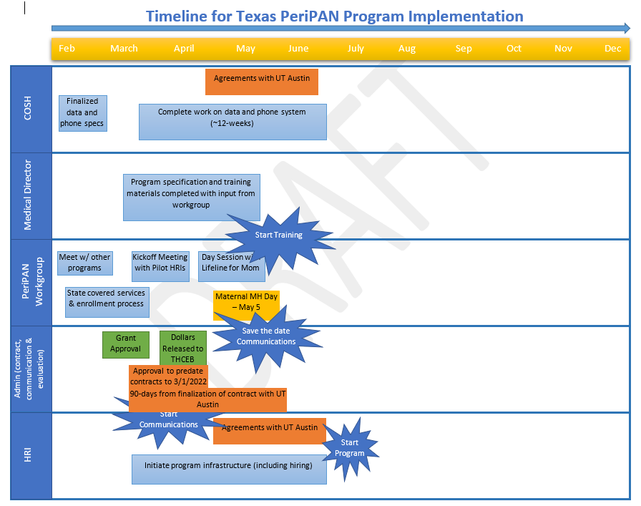

Slide 15
Looking Ahead
  Working on strategies to coordinate with the Texas State Women's programs
  Meeting with organizational stakeholders
  Development of educational and training materials

Slide 16

Kickoff
Summer 2022

