Slide 1
Research Participant Reimbursements
Options and Discussion Points

Slide 2
Option 1: Reimburse only for Participants Recruited This Biennium
HRI will be asked to report the number of new enrollees recruited each month as well as the number of 1-month, 6-month and 12-month participants paid overall.
Participant Payments for any new participants above an average of 12 per quarter would be reimbursed.
Spreadsheet would be submitted monthly but reimbursed quarterly by UTS
HRIs would be notified when estimated obligations have depleted the $600k of available fund.

Slide 3
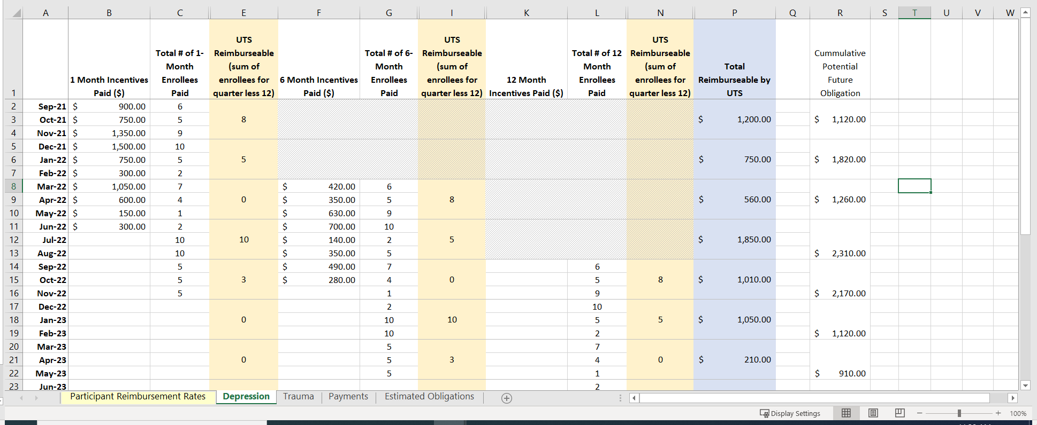
Example Spreadsheet
Notes:
6-month reimbursements wouldn’t kick in until March 2022 since this is the earliest the new enrollees would hit this milestone.
Similarly, 12-month reimbursements wouldn’t kick in until September 2022

Slide 4
Option 2: Reimburse for Any Participant Payments Above 12 /Quarter (Regardless of when recruited)
Doesn’t penalize those HRIs that aggressively recruited at the end of the last fiscal year and now have 6-month & 12-month participant payment obligations this fiscal year.
Will result in a faster burndown of the available reimbursement budget.
Will make it more difficult to forecast potential participant reimbursement obligations unless HRIs provide detail on how many further payments they’re expecting to pay current participants
Higher risk of running out of funds & being unable to follow participants for the full 12-month period (due to funding limitations)

Slide 5
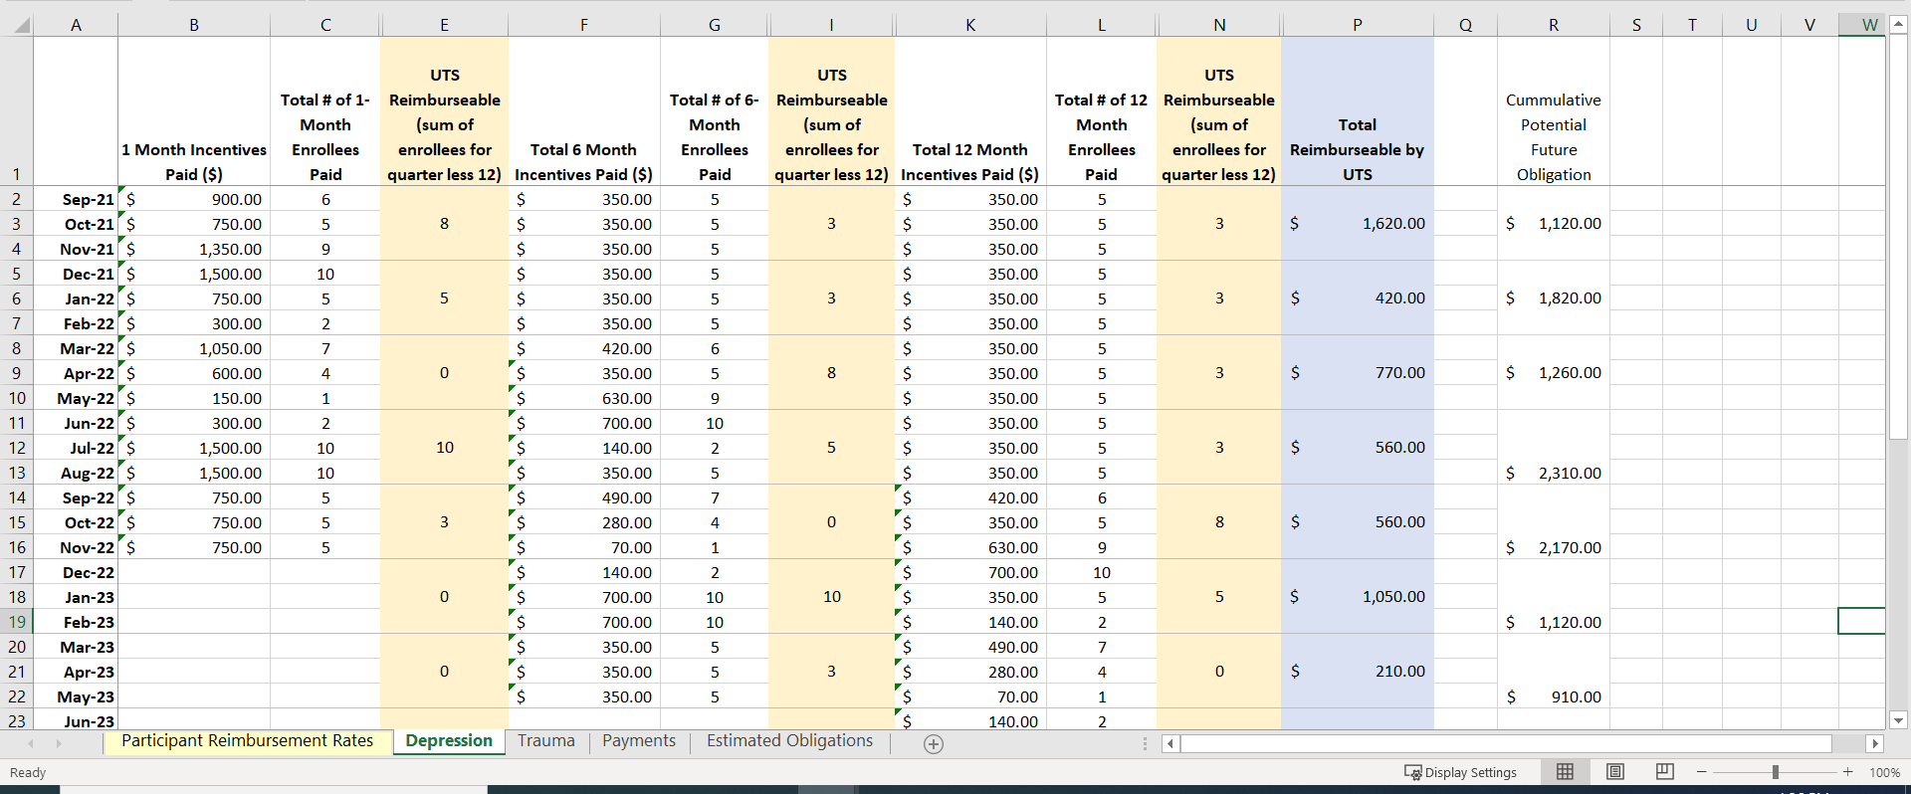
Example Spreadsheet

Slide 6
Points of Discussion
Original budget assumed three payments: 1-month, 6-month and 12-month payments.
If recruited participants are followed longer than 1 year, how many more payments are we expecting?
Impact to budget?
Recruitment period
If we want to follow a participant for at least 1 year, when do we stop recruitment?
What is the end date of the project?
Variations in Payment Amounts
Are all nodes paying the same amount to participants for the different types of visits?
Payment Reporting
Will reporting be done centrally via Hub or by individual HRIs? (Reimbursements assume payments have been made to participants; we need payment amounts validated by the associated HRI).

