Slide 1
TCHATT
Training the Next Generation
Carly McCord, Ph.D.
TCHATT Project Director
Executive Director, Texas A&M Telehealth Institute
Clinical Associate Professor, Department of Psychiatry and Behavioral Sciences and Department of Educational Psychology
Texas A&M University

Slide 2
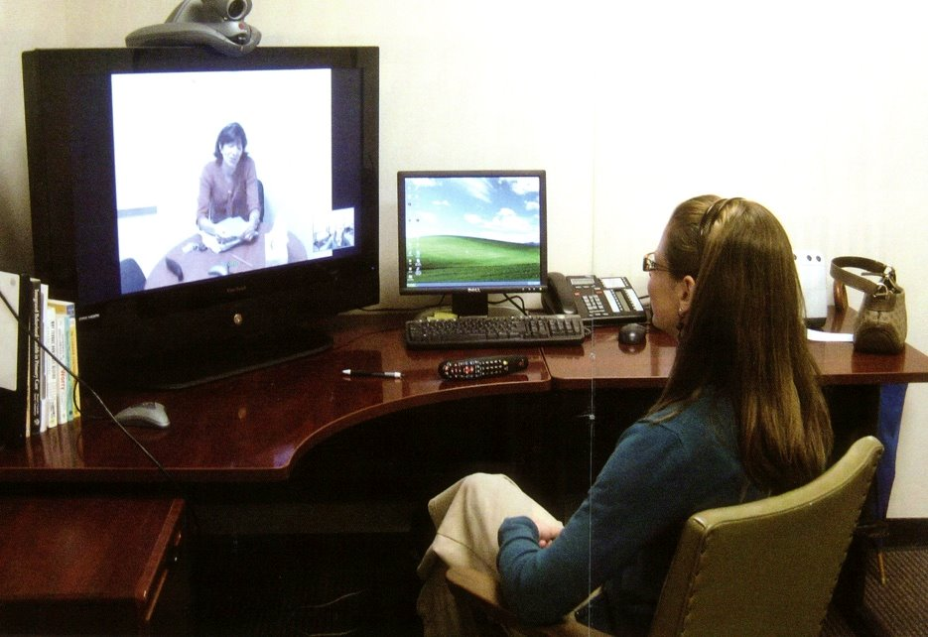
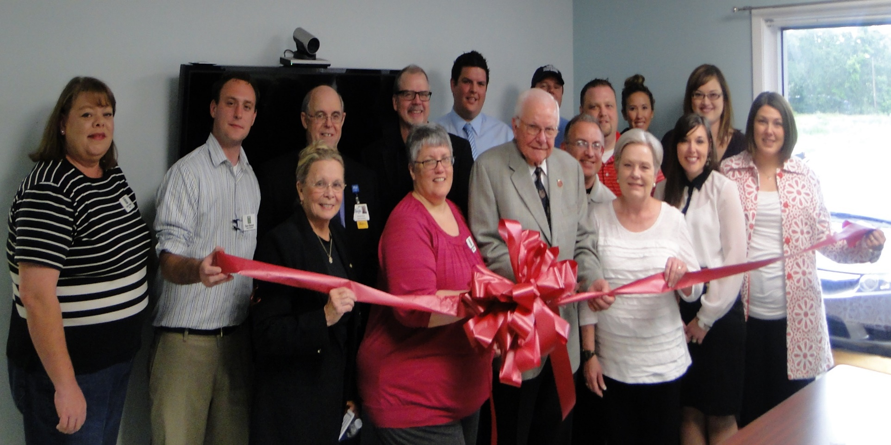

Academic Community Partnership Model
1. Establish Partnership Groups
Community & Academic Stakeholder Engagement
2. Organize Partners
3. Develop Interventions
4. Establish Outcomes

Slide 3
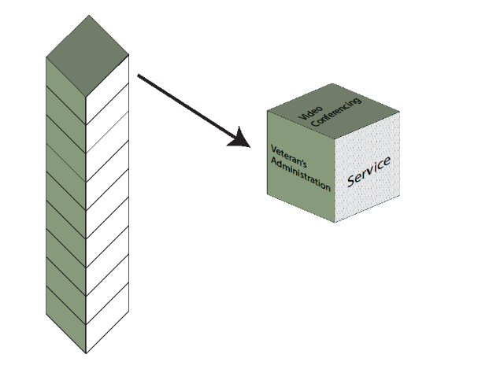
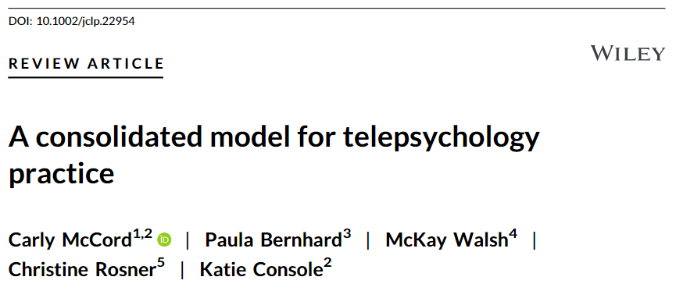
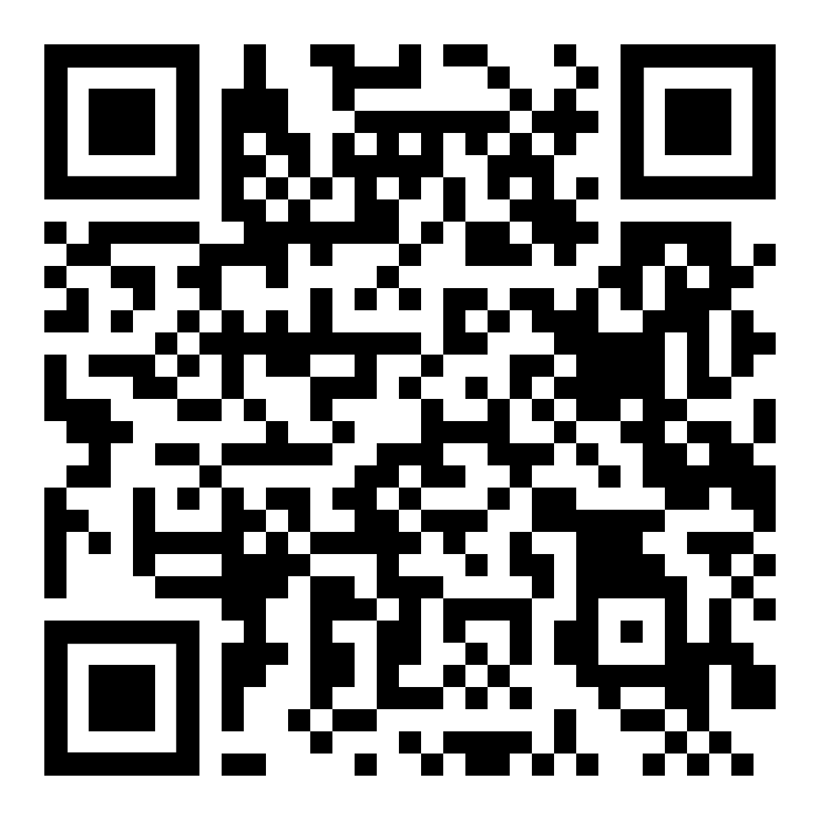
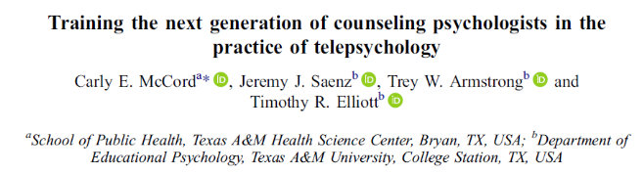
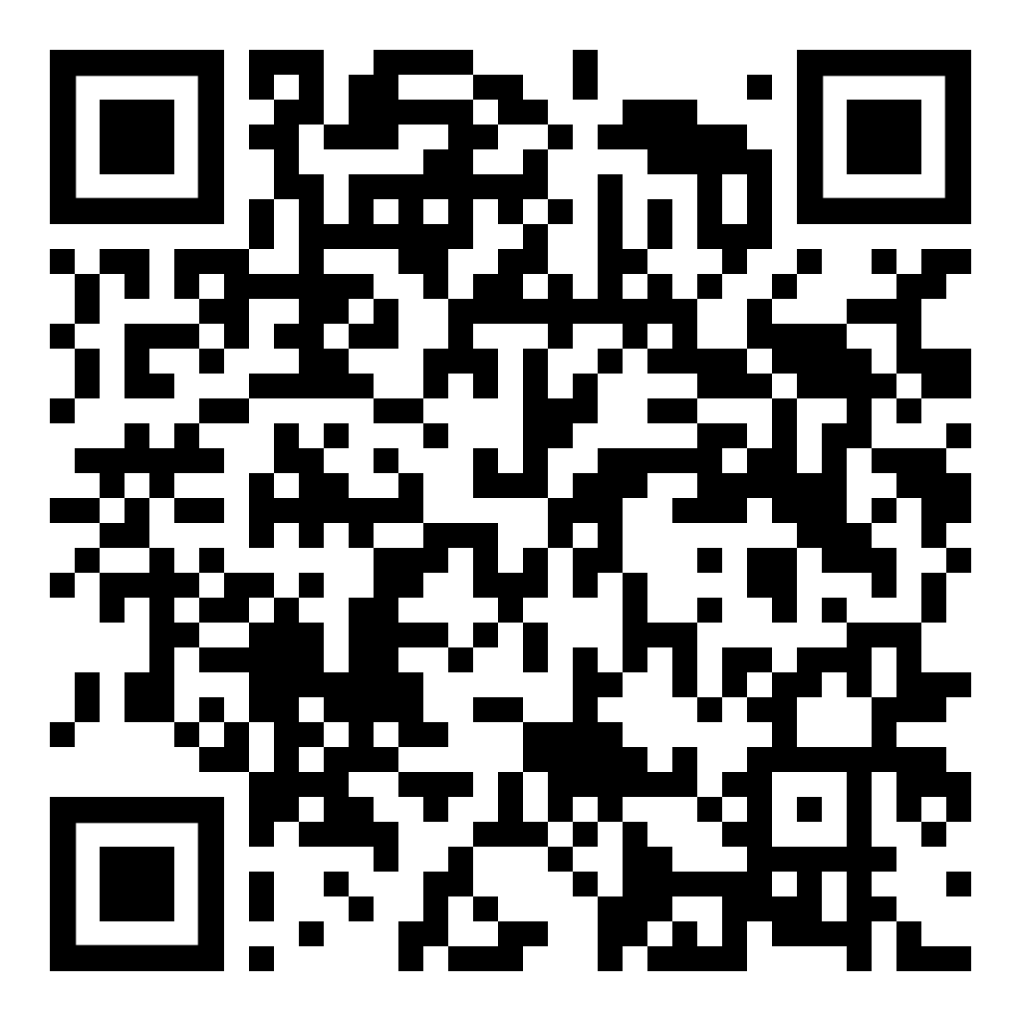
Core Training Elements
Ready for rural and underserved
    Community engagement
    Collaborative care
    Bilingual (Spanish + language line)
    Multicultural considerations of rural practice
Ready for telehealth
    Basics (terminology, techniques, technology)
    Laws and ethics
    Handling emergencies from a distance
Training in EBT
      Brief CBT
      Brief DBT
      Brief Solution Focused
Developmental Model
    I do- we do- you do
      Shadowing
      Role Plays

Slide 4

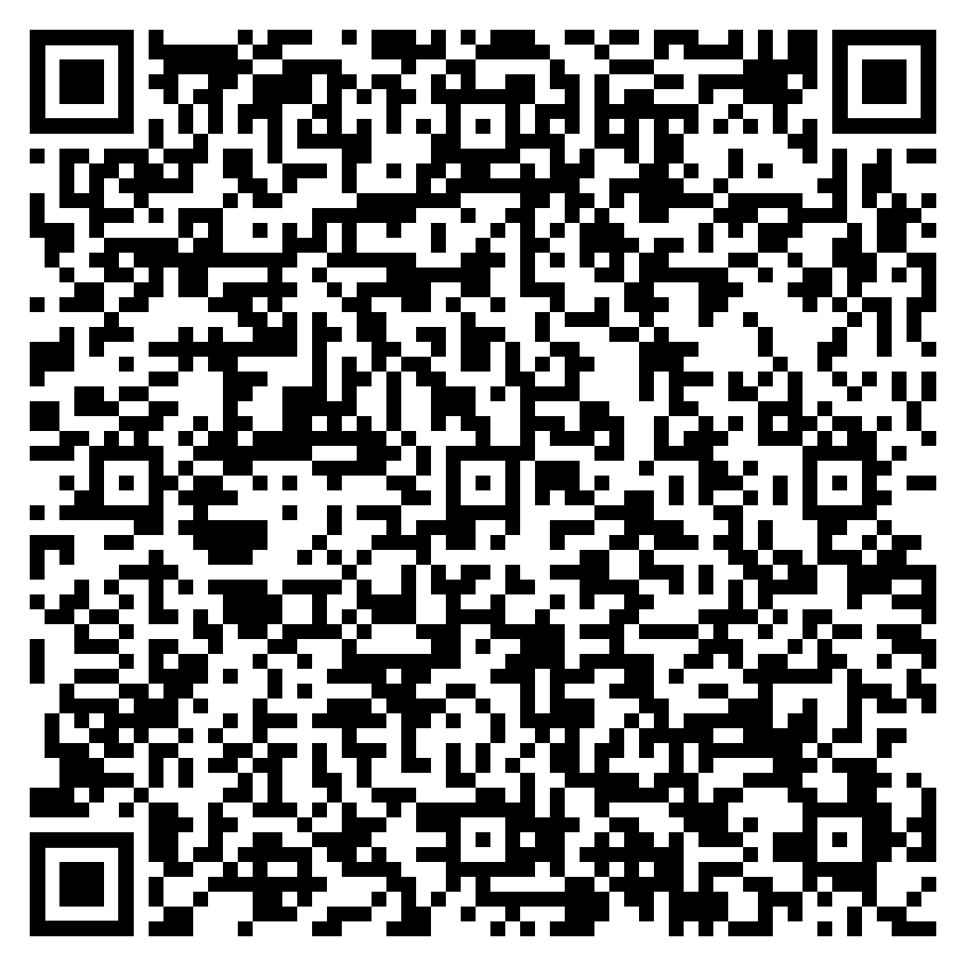
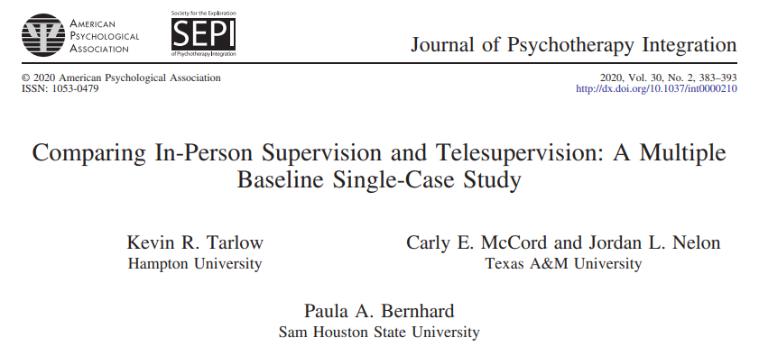
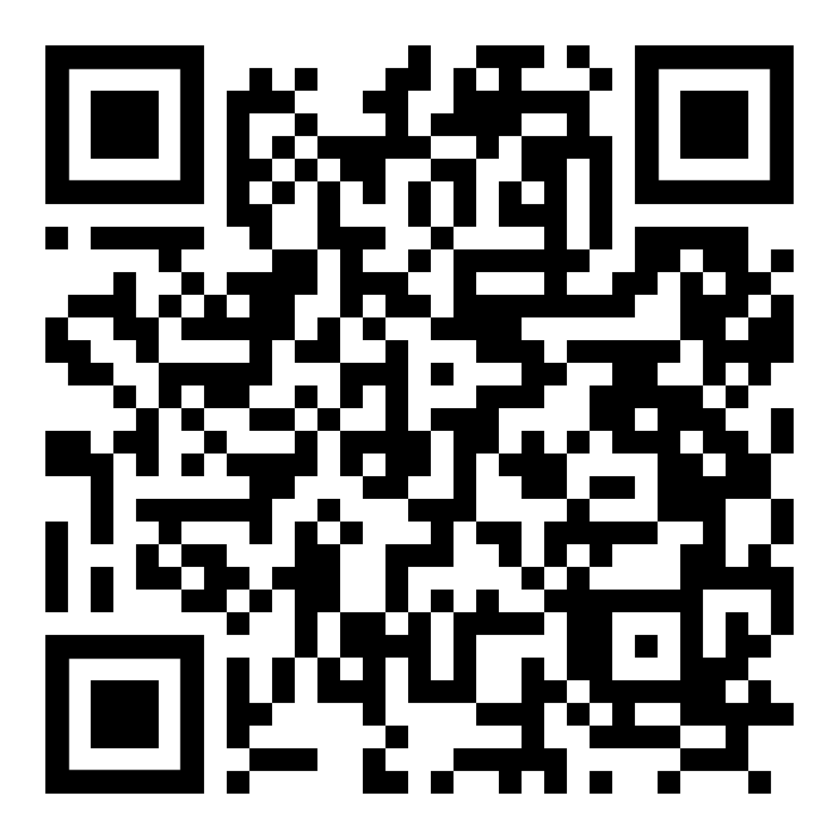
Maximizing Supervision:
Telesupervision
Our model: weekly VCP supervision, in person on sight consultation, hybrid group supervision
Specialty supervision: bilingual, trauma, integrated care, children
Enhance training while overcoming barriers: recruitment, funding, space
Provides firsthand experience being on the receiving end of telehealth
Integrated use of Microsoft Teams for real time consultation
Open door policy and consultation

Slide 5


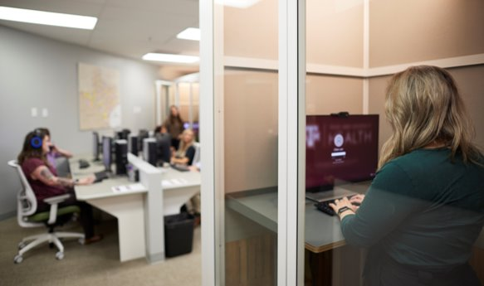
Maximizing Productivity and
Collaboration
Care Coordinators
  Initial parent contacts
  Gathering consents and pre-assessments
  Reducing burden on school counselors
  Conducting parent interviews
  Working with parent throughout care to connect with long-term services
Space
  Booths and open office space
  Increases collaboration and saves square footage
  Promotes community and well-being
  Hybrid for full-time staff

Slide 6



Maximizing Clinical Care: Psychology Doctoral Students
Graduate Assistants (GA)
Benefits
TAMU has 3 APA accredited psychology doctoral program
14 client per week caseload
Clinical care provided under the supervision of a licensed psychologist
Individual and group supervision
Weekly didactics
TCHATT GA’s have consistently matched at top ranked internship sites
GA’s describe TCHATT as their most diverse training experience

Slide 7





Maximizing Clinical Care: LPC Training Pathway
Practicum and Internship for graduate students
  10-14 clients per week
  Individual and group supervision
  Weekly didactic training
LPC-A positions with supervision included
  20-25 clients per week
  Individual supervision and Clinician consultation
  Weekly didactic training
LPC positions once fully licensed
  27 scheduled clients per week with 3 reschedule blocks
  Clinician consultation
  Weekly didactic training (optional)

