Slide 1
TCHATT-Stepped Care Program Update
Eric Storch, Ph.D.
Professor, Vice Chair
McIngvale Presidential Endowed Chair
Baylor College of Medicine

Slide 2
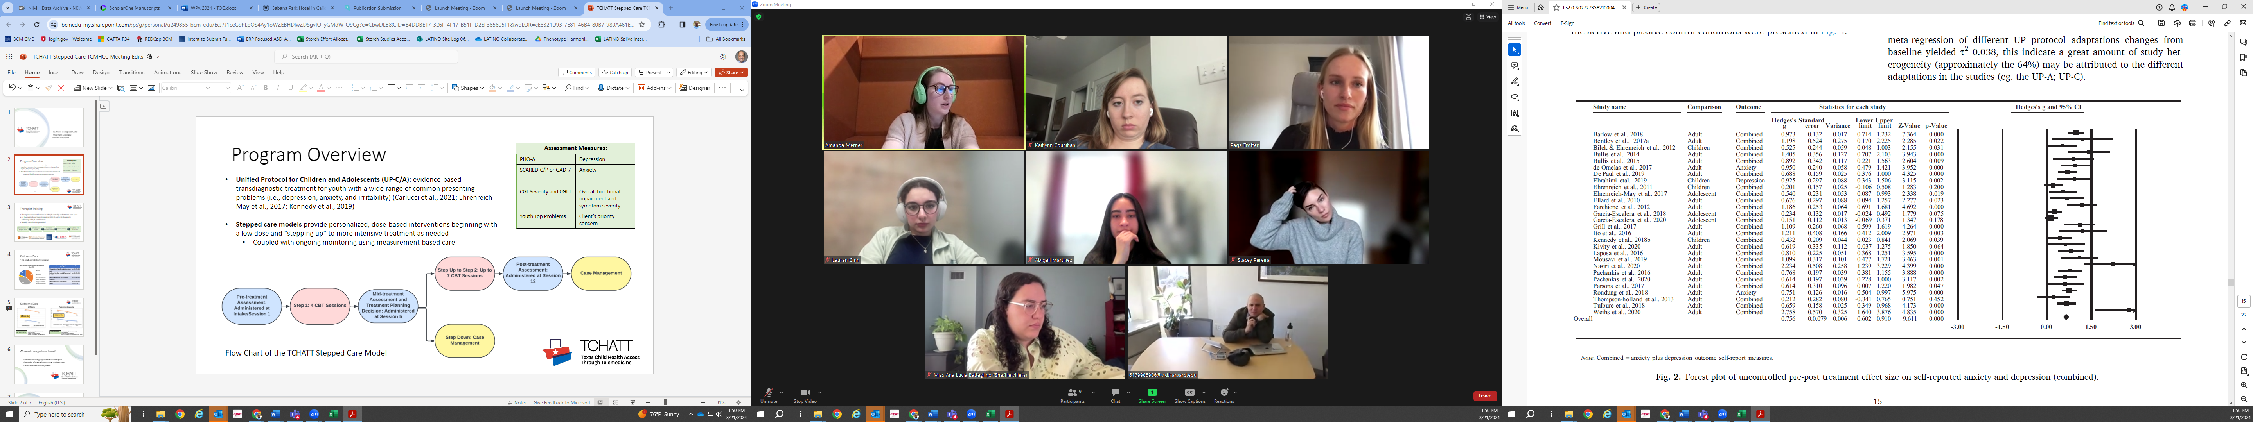
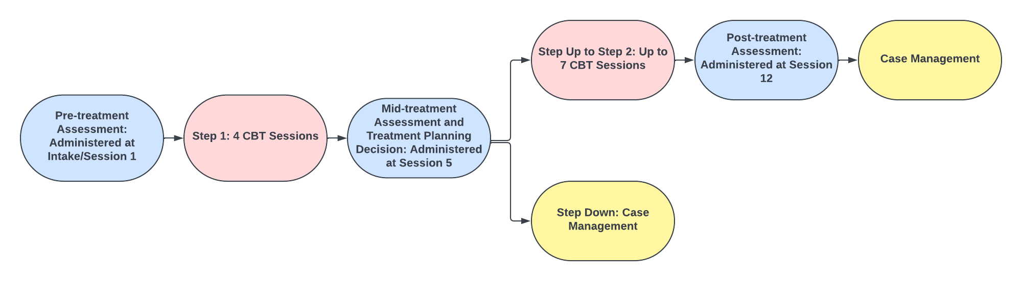
Program Overview
Unified Protocol for Children and Adolescents (UP-C/A): evidence-based transdiagnostic treatment for youth with a wide range of common presenting problems (i.e., depression, anxiety, and irritability)
Stepped care models provide personalized, dose-based interventions beginning with a low dose and “stepping up” to more intensive treatment as needed
  Coupled with ongoing monitoring using measurement-based care
Flow Chart of the TCHATT Stepped Care Model

Slide 3
Therapist Training
Therapists earn certification in UP-C/A virtually and at their own pace
44 therapists have been trained in UP-C/A, with 29 therapists achieving UP-C/A certification
Weekly consultation provided

Slide 4
Outcome Data
352 youth enrolled in the program
Reasons for stepping down​ | n= 104
Therapist and family goals have been met ​ | n=52, 50.0%​
Referred to other mental/behavioral health treatment ​ | n=37, 35.6%​
Patient preference for in-person sessions ​ | n=21, 20.2%​
Patient wished to discontinue ​ | n=14, 13.5%​
Other​ | n=5, 4.8%​

Slide 5
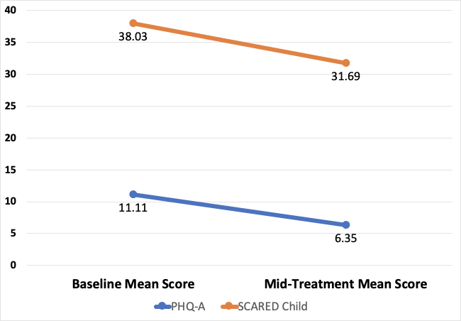
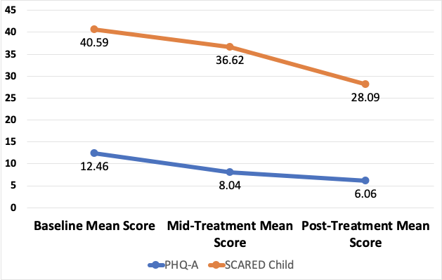
Outcome Data
All Patients
Patients that Stepped Up
PHQ-A: d = .92, SCARED: d = .58
PHQ-A: d = 1.10, SCARED: d = .87
Mid-Treatment
CGI-Improvement
57.9% = much improvement or very much improved
23.6% = minimally improved
18.5% = no change or minimally worse
Post-Treatment
CGI-Improvement
65.3% = much improvement or very much improved
24.6% = minimally improved
8.4% = no change, minimally worse, much worse
Notes:
Among the full sample, youth reports on the PHQ-A demonstrated a statistically significant decrease of 4.76 points from baseline to mid-treatment, evidencing a large effect size, t(172) = 12.11, p<.001, d = .92. Similarly, youth endorsements on the SCARED indicated a statistically significant decrease of 6.34 points from baseline to mid-treatment, demonstrating a medium effect size, t(133) = 6.66, p<.001, d = .58. Among the youth that stepped up, there was a statistical significant decrease of youth depression scores over time with a large effect size, F(2,102) = 40.93, p<.001, η2 = .45. Relatedly, among the youth that stepped up, there was a statistically significant decrease in anxiety scores over time with a large effect size, F(2,66) = 15.88, p<.001, η2 = .33.
57.9% = much improved or very much improved CGI-I; 23.6% minimally improved; 18.5% no change or minimally worse
65.3% = much improved or very much improve CGI; 26.4% minimally improved; 8.4% no change, minimally worse, or much worse

Slide 6
Where do we go from here?
Additional training/certification opportunities for therapists
Consideration of expanding stepped care to other problem areas
Therapist harmonization/fidelity

Slide 7
Questions?

