Slide 1
ARPA Project Budgets
February 15, 2022

Slide 2
ARPA Overview
Section 8 of SB 8 of the 3rd Special Session of the 87the Texas Legislature provides $113,082,885 for “…supporting the operations and expansion of the Texas Child Mental Health Care Consortium to expand mental health initiatives for children, pregnant women, and women who are up to one year postpartum during the two-year period beginning on the effective date of this Act.”
The funds are provided for the following services:
  $20,578,442 for enhancements and expansion of the Child Psychiatry Access Network;
  $56,218,976 for enhancements and expansion of the Texas Child Access Through Telemedicine program;
  $32,991,791 for expansion of the child and adolescent mental health workforce; and
  $3,293,676 for administrative expenses.
  Out of money appropriated the Consortium may enhance the Child Psychiatry Access Network to improve perinatal mental health services.

Slide 3
ARPA Budget Change Requests
The Texas Child Mental Health Care Consortium may transfer up to 10 percent of money appropriated for the purposes described by Subsection (a)(1), (2), or (3) of this section to any of the other purposes described by those provisions.
The Texas Child Mental Health Care Consortium may transfer more than 10 percent of funds for those purposes only with the prior approval for the transfer and expenditure from the Legislative Budget Board.
A request for approval of the transfer and expenditure by the consortium is considered approved unless the Legislative Budget Board issues a written disapproval within 10 business days of the receipt and review of the request by the Legislative Budget Board.

Slide 4
Receiving ARPA Funds
The Texas Higher Education Coordinating Board (THECB) has to submit a grant application to the Governor’s eGrants grant management website by February 28th.
This application requires that we finalize our budget and identify performance metrics.
The amount requested cannot exceed the appropriations listed in Senate Bill 8, 87ths Legislature, Third Called Special Session.
Funds will be provided on a reimbursement basis, once the sub-awards are issued.

Slide 5
Summary of Responsibilities
The Texas Higher Education Coordinating Board (THECB) will receive the ARPA Grant from the Governor’s Office and enter into agreements with The University of Texas at Austin and The University of Texas System Administration
UT System will serve as the administrative oversight entity. They will enter into Service Agreements with UT Austin and THECB. They will collect status reports and metrics from the HRIs and evaluate program performance.
UT Austin will serve as the fiscal agent for ARPA funds. In this role, they will contract with the Health-Related Institutions (HRIs) and the Meadows Mental Health Policy Institute (MMHPI),perform a compliance role and process reimbursement requests.
The HRIs and MMHPI will submit fiscal reports and requests for ARPA cost reimbursement to UT Austin.

Slide 6
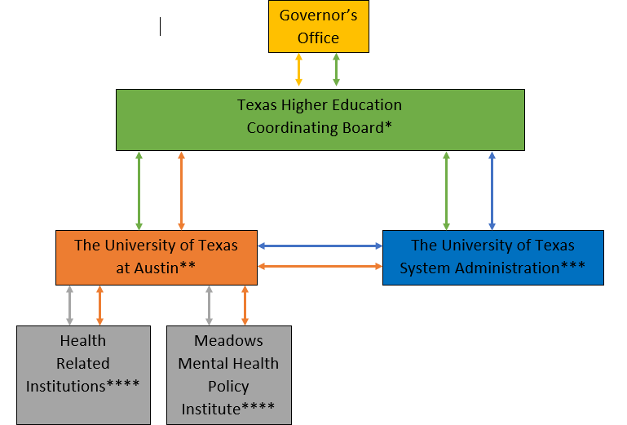
Proposed Fiscal Structure for ARPA Initiatives

Slide 7
Finalizing the ARPA Budgets
Each HRI was asked to fill out a budget template for those initiatives they wish to participate in.
HRI participation has changed from what was originally submitted in early fall of last year.
Final submitted budgets have been consolidated by category on the following slides.

Slide 8
Budget Summary – CPAN Enhancements & Expansion
Enhancements and Expansions of CPAN Initiatives | Participating HRIs | Budget
Additional Consults - Direct Services | (8) - BCM, UT Austin (Dell Med), TTUHSC, TTUHSC EP, UTHSCH, UTHSCSA, UTHSCT, UTMB | $3,946,218
CPAN DM / Text Add-On | (5) - BCM, UT Austin (Dell Med), UTHSCH, UTHSCT, UTSW | $1,237,130
Pediatric Collaborative Care | (9) - BCM, UT Austin (Dell Med), TTUHSC, TTUHSC EP, UNTHSC, UTHSCH, UTHSCSA, UTRGV, UTSW, (Meadows Leading) | $7,000,000
Perinatal CPAN | (4) - BCM, UT Austin (Dell Med), TTUHSC, UTSW | $6,903,167
Suicide Prevention Intervention (FISP) / Zero Suicide ECHO | (7) - BCM, UT Austin (Dell Med), TAMUHSC, TTUHSC, UTHSCH, UTMB, UTSW | $5,572,525
COSH Technology Costs to Support ARPA Projects above | BCM | $3,804,900
 |  | $28,463,940

Slide 9
Budget Summary – TCHATT Enhancements & Expansion
Enhancements and Expansions of TCHATT Initiatives | Participating HRIs | Budget
Additional Sessions As Needed | (7) - UT Austin (Dell Med), TAMUHSC, TTUHSC, TTUHSC EP,UTHSCH, UTMB, UTRGV | $6,074,465
Cover more TCHATT Regions | (5) - TTUHSC, UTHSCH, UTHSCSA, UTMB, UTRGV | $16,640,745
Suicide Prevention (YAM) | (8) - UT Austin (Dell Med), TAMUHSC, TTUHSC, UTHSCH, UTHSCSA, UTHSCT, UTMB, UTSW | $11,515,450
TCHATT Bilingual Trauma | (1) - UTHSCSA | $318,560
TCHATT evidence-based face to face and telehealth groups | (1) - TTUHSC | $5,772,619
TCHATT/CPAN Anxiety Services | (3) - BCM, UTHSCH, UTHSCSA | $2,258,062
Trauma-Focused Expansion | (6) - UT Austin (Dell Med), TAMUHSC, TTUHSC, UTHSCH, UTHSCSA, UTMB | $10,404,551
Youth SUD Expansion | (5) - UT Austin (Dell Med), TTUHSC, UTHSCH, UTHSCSA, UTHSCT | $6,167,318
COSH Technology Costs to Support ARPA Projects | BCM | $1,925,000
 |  | $61,076,770

Slide 10
Budget Summary – Texas Mental Health Workforce Expansion
Expansion of the Texas MH Workforce | Participating HRIs | Budget
LMHA Telehealth Services | (6) - UT Austin (Dell Med), TTUHSC, TTUHSC EP, UTHSCH, UTRGV, UTSW | $9,174,459
LPC/ LCSW / NP Training | (5) - TAMUHSC, TTUHSC, UTHSCH, UTHSCSA, UTHSCT | $5,119,212
Additional Child Fellows / Child practicum for psychology grad students / child & adolescent psychology internship | (6) - UT Austin (Dell Med), TTUHSC, TTUHSC EP, UTHSCH, UTHSCT, UTSW | $4,913,660
 |  | $19,207,331

Slide 11
Budgets by Institution /
Entity

Slide 12
LBB Budget vs Final Budgets Submitted
Program | LBB Approved Allocation | Final Budget Submitted | Variance
CPAN Enhancements and Expansion *including Perinatal Services | $20,578,442 | $28,463,940 | 38% higher
TCHATT Enhancements and Expansion | $56,218,976 | $61,076,770 | 9% higher
Expansion of the child and adolescent mental health workforce | $32,991,791 | $19,207,331 | 42% lower
Administration | $3,293,676 | $3,293,676 | 0%
TOTAL | $113,082,885 | $112,041,717

