Slide 1
TCMHCC Brand Update

Slide 2





Logo

Slide 3
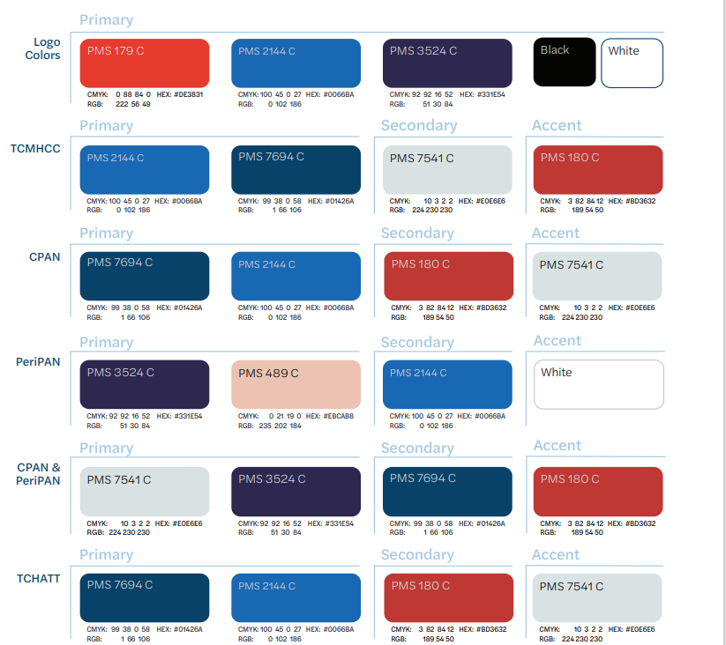
Colors

Slide 4
Questions?

