Slide 1
TCMHCC External Evaluation August 2022

Slide 2
CPAN: Clinic/Clinic Staff Enrollment & Reach
Percentage of Enrolled CPAN Clinics by County-Level Characteristics
2013 RUCC Code^{c}
Metro
Non-Metro
Rural
SVI Scores^{d}
<0.2 (least vulnerable)
0.2 - 0.4
0.4 - 0.6
0.6 - 0.8
0.8+ (most vulnerable)
ª
^{b}
Data sources: (a) Trayt CPAN Clinic and Clinic Staff Directory (May 1 2020- April 30th, 2022). 4 clinics missing RUCC codes (USDA could not calculate the RUCC code). (b) List of providers (adolescent medicine, family medicine, pediatrics, internal medicine, general practice) in Texas purchased from the Texas Medical Association by COSH. (c) 2013 Rural-Urban (RUCC) Continuum Codes, USDA Economic Research Service, U.S. Department of Agriculture. RUCC Codes: 1-3 = Metro; 4-7 = Nonmetro; 8-9 = Nonmetro, completely rural. (d) County-level social vulnerability index data from the CDC, 2018 (SVI-2018; http://svi.cdc.gov/).
Notes:
When compared to the geographic spread of all clinics serving Texas youth identified on the Texas Medical Association list obtained by COSH, the general trend is that there are more CPAN enrolled clinics in non-metropolitan areas (18.4%) compared with Texas clinics overall that are based on non-metro areas (3.7%).
44.5% of clinics enrolled are located in areas with the highest two quintiles of vulnerable counties (SVI score over 0.6), compared with 53.9% of all clinics targeted for enrollment (see Table 4).
Proportionally more clinics are enrolled in the lower to moderately vulnerable counties, (SVI score 0.2 - 0.6) and least vulnerable counties (SVI score < 0.2) (see Table 4). These county-level summary scores likely do not take into consideration variation of SVI scores within urban counties.

Slide 3
CPAN: Service Delivery
(a) Data Source: CPAN Encounter-level Extract, Trayt. April 30th, 2022.
(b) Providers may report more than 1 reason for calling.
Notes:
The majority of CPAN providers called for referral assistance and medication management consultations.

Slide 4
TCHATT: School District Enrollment & Reach
Percentage of Enrolled TCHATT Campuses by Geographic and Population-level Vulnerability Indicators
Campus Size
< 500
500 - 1000
1000 – 1500
1500+
TEA Rural/Urban Codes
Rural
Urban
% Economic Disadvantage
< 70%
>70%
ª
^{b}
(a) Data Source: Texas Education Agency Campus, District, and District Snapshot Data
(b) TCHATT Campus Data, provided by COSH (September 1st 2021-June 30th, 2022)

Slide 5
TCHATT: Service Delivery
Characteristics of TCHATT Sessions (N=28,585)

Slide 6
TCHATT: Service Delivery
ªTrayt Session-level Extract (September 1st 2021-June 30th, 2022) ^{b}TCHATT Sessions may include more than one intervention type

Slide 7
TCHATT: Service Delivery
ª Trayt Referral-level Extract (September 1st 2021-June 30th, 2022)

Slide 8
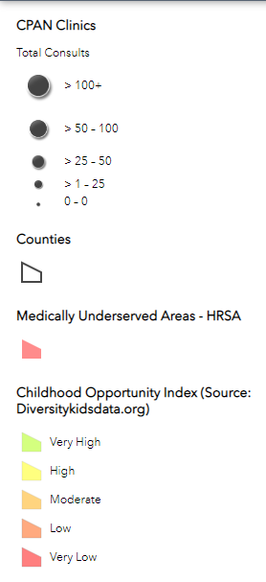
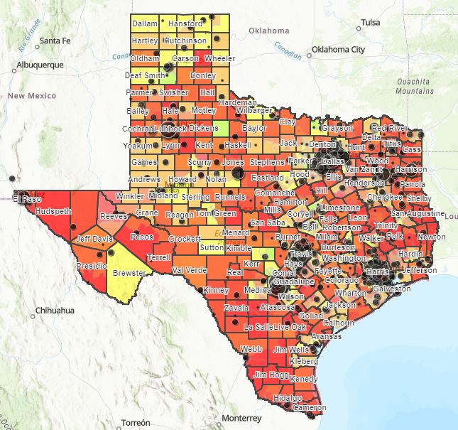
Geographic Vulnerability Index
Notes:
Developed a geographic & social vulnerability index (GSVI) based on existing measures of social determinants of health
Dashboard allows program planners to view CPAN provider & TCHATT school enrollment by factors comprising the GSVI index

Slide 9
External Evaluation Activities
CPWE Interviews
  Conducted interviews with 11 CPWE residents
  Analyzing qualitative interviews to understand residents’ perspectives of benefits, challenges, and potential influence of the CPWE training program on professional development
TCHATT & CPAN Surveys
  Surveying a diverse sample of school districts/campuses (TCHATT) and clinics (CPAN) across HRIs to understand contextual factors influencing program engagement and implementation
  Data collection : June-August (TCHATT survey); August-September (CPAN survey)
Cost Analysis
  Developed instruments for evaluating the cost of CPAN and TCHATT program implementation
  Data collection: HRI worksheets (early September); CPAN & TCHATT surveys (in process)
HRI Evaluation Packets
  Developed packets for HRIs with results of Year 1 external evaluation
  Will disseminate to HRIs in September

