Slide 1
TCMHCC External Evaluation August 2023

Slide 2
TCHATT Survey
TCHATT School Staff Survey Distribution & Responses
Identified TCHATT campuses covered by an MOU with at least one respondent to Year 1 survey
(n=157 school campuses)
Identified TCHATT campuses covered by an MOU, excluding those selected from Year 1 survey, with at least one respondent to Year 2 survey
(n=161 school campuses)
Identified TCHATT campuses covered by an MOU, excluding those selected from Year 1 and Year 2
(n=165 school campuses)
Objective: Adapt and deliver TCHATT
survey to school staff involved in the implementation of TCHATT to understand contextual factors influencing program engagement and implementation
Sample: Identified a diverse sample of campuses across HRIs based on the following factors:
  Rural/urban/charter classification
  Economic disadvantage (i.e., % students eligible for free or reduced-price meals or other public assistance)
  District size
Goal: 200 responses
Combine
Year 3 Survey Sample
(n=483 campuses)
Distributed survey to campuses with contacts identified (April 2023)
(n=463 school staff)
224 respondents
(48.4% response rate)
Notes:
Respondent characteristics: 92% female, 82% counselors, 84% reported being the person who coordinates TCHATT at their schools

Slide 3
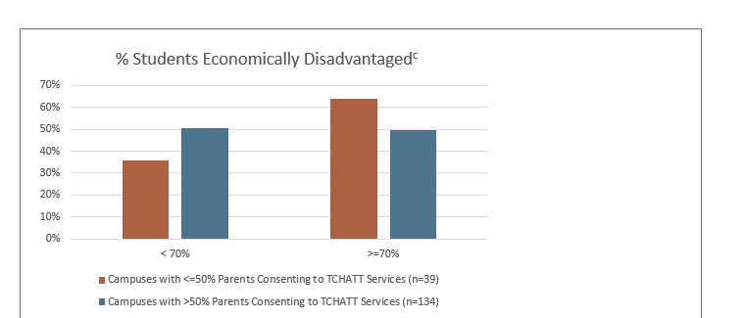
Economic Disadvantage and Percentage of Parents Consenting to TCHATT Services

Slide 4
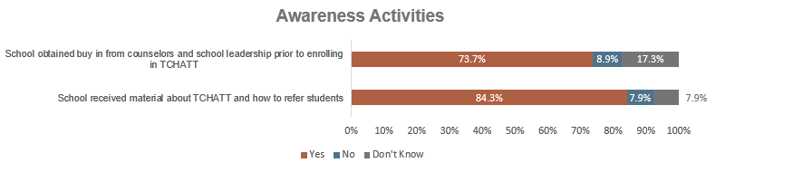
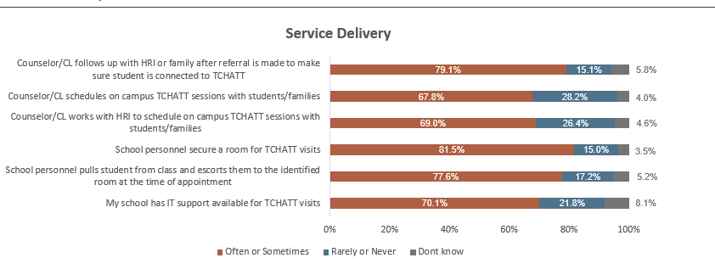
TCHATT Activity Checklist
Notes:
We also have training and engagement, referral, and ongoing care

Slide 5
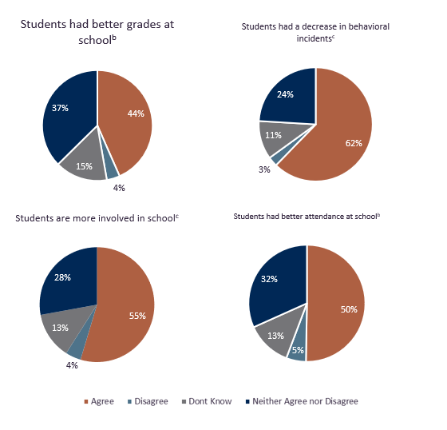
Participants’
Perceived
Outcomes of TCHATT

Slide 6
Questions?

