Slide 1
TCMHCC External Evaluation December 2022

Slide 2
CPWE Program Evaluation
Overall Goal: to describe CPWE fellow’s experiences, particularly as they relate to the strengths, challenges, and impacts of the CPWE program
In-Depth Interviews conducted with 11 CPWE Participants: (6 residents and 5 fellows) representing 10 different HRIs were interviewed as part of this Year 2 evaluation
Regarding Expanding the MH Workforce in Texas:
“It's actually one of the things which brought me to the fellowship - having those multiple options, community reach options, which many programs still don't have across the country. Having that wide exposure to populations and settings was one reason that I chose this fellowship.” -Fellow
Notes:
The goal of the CPWE program external evaluation was to understand how the initiative is progressing in its efforts to: (1) build the capacity of community mental health centers serving children and adolescents, and (2) prepare trainees to enter the public mental health workforce post residency or fellowship.
We conducted in-depth interviews with 11 CPWE participants (6 residents and 5 fellows) representing 10 different HRIs. Two HRIs did not have current or recent residents or fellows in the CPWE program; therefore, they could not be represented in the data collection and analysis.
The implementation of the CPWE program is still in the early stages of implementation; therefore, it will take time to see the full impact of the program on participants and communities. However, year 2 of the CPWE program has shown promising indicators of progress toward accomplishing its goals.

Slide 3
Year 2 CPWE Key Findings (Qualitative)
The CPWE training did not impact participants’ future career plans directly, but generally contributed positively to reaffirming career decisions or expanding their thinking about career options.
“The diversity of the population that I saw definitely changed my perspective on what I really wanted to work on and do. Not just the outpatient or inpatient settings, but even the population that I want to work with… At this point, still deciding, but I'm leaning more towards community practice.” -Fellow
The CPWE program offers exposure to diverse patient populations that has helped prepare participants for cross-cultural interactions and culturally responsive mental health care.
“I just feel they're [patients] so deserving with the services and support, and they're receptive. You feel like you're part of the solution and you feel like progress is being made. You learn so much about people and their cultures and their perspectives and their motivations. That definitely is rooted in a community mental health experience more than any other psychiatric rotation experience.” -Fellow
Notes:
Key Findings:
Overall, participants were highly satisfied with their CPWE training experiences.
When participants were asked how the CPWE program has influenced their decisions about future career plans, the majority indicated that the program did not directly impact their decision-making but did provide a valuable learning experience.
Fellows reported that their exposure to either working with children or working in a community mental health environment prior to their rotation in the CPWE program led them to seek out this type of fellowship and re-affirmed their decision to pursue a career working with youth in a community mental health setting.
Residents often indicated that the CPWE training program broadened their understanding of the field of psychiatry and expanded their thinking about community mental health as a future career option.
When discussing how the CPWE program has prepared participants for working with culturally diverse patients, the general consensus was that sheer exposure to diverse patients has helped prepare them for providing individualized mental health care that is responsive to the needs and beliefs of their patients.
Direct exposure to patients of different cultures and socioeconomic backgrounds, helped them better understand the challenges of their patients and how they impact treatment plans, how patients’ cultural backgrounds and norms can influence treatment options, and how navigating nuances is important to delivering effective care.
Further, working in a community mental health settings allowed participants to see how important accessibility to mental health services is to their patients, contributing to their understanding of the need to reduce disparities.
When discussing how the CPWE program has expanded participants’ capacity to serve diverse patient populations (i.e., both in terms of demographics and psychopathologies), participants indicated that exposure to demographically diverse patients experiencing a variety of mental health conditions and understanding community resources to make referrals have been most impactful.
Participants shared how their exposure to patients experiencing different symptoms, diagnoses, and psychosocial stressors have also exposed them to a variety of assessment strategies and treatment modalities that have built their capacity as providers.
67% of participants explained how their knowledge of community resources has increased through their CPWE training, making them more confident in their ability to make patient referrals to counseling or social services.
Areas of improvement to the CPWE program identified by participants largely reflected the challenges experienced, which were perceived differently by residents versus fellows.
Residents would like to see improvements to supports and resources to help address treatment of complex cases and make appropriate referrals, enhanced learning opportunities to better understand systems of care and community resources, and more in-person visits with patients to improve their overall training experience and provide more effective care to patients.
Fellows would like the CPWE program to how time limitations at rotations could be addressed to the extent possible. They acknowledged that the structure of their fellowships provides excellent exposure to multi-faceted areas of child psychiatry but time constraints impact their ability to dive deeper into the experience (e.g., patients; systems) and can affect patient care (e.g., building rapport; turnover in care).

Slide 4
Year 2 CPWE Key Findings (Qualitative)
The CPWE program has built the capacity of participants to serve diverse patient populations through exposure and enhancing knowledge of resources.
“The pathologies, the diagnoses I see in these individuals are very wide-ranging. It's rarely the same thing twice. I see a lot of individuals with different diagnoses, have different assessments, and because of that I've used a lot of different treatment modalities. That has helped me learn more about the future.” –PGY2 Resident
Areas of improvement to the CPWE program identified by participants largely reflected the challenges experienced, which were perceived differently by residents versus fellows.
  Residents would like to see improvements to supports and resources, enhanced learning opportunities, and more in-person visits.
  “I'd like for all the patients to have to come in person, but I don't think that that's unique to the CPWE program.” –PGY3 Resident
  Fellows would like the program to consider how time limitations at rotations could be addressed to the extent possible.
  “We hate to have to change every two months. Then patients lose hope because every time they get there-- it affects rapport, it affects compliance.” -Fellow
Notes:
Key Findings:
Overall, participants were highly satisfied with their CPWE training experiences.
When participants were asked how the CPWE program has influenced their decisions about future career plans, the majority indicated that the program did not directly impact their decision-making but did provide a valuable learning experience.
Fellows reported that their exposure to either working with children or working in a community mental health environment prior to their rotation in the CPWE program led them to seek out this type of fellowship and re-affirmed their decision to pursue a career working with youth in a community mental health setting.
Residents often indicated that the CPWE training program broadened their understanding of the field of psychiatry and expanded their thinking about community mental health as a future career option.
When discussing how the CPWE program has prepared participants for working with culturally diverse patients, the general consensus was that sheer exposure to diverse patients has helped prepare them for providing individualized mental health care that is responsive to the needs and beliefs of their patients.
Direct exposure to patients of different cultures and socioeconomic backgrounds, helped them better understand the challenges of their patients and how they impact treatment plans, how patients’ cultural backgrounds and norms can influence treatment options, and how navigating nuances is important to delivering effective care.
Further, working in a community mental health settings allowed participants to see how important accessibility to mental health services is to their patients, contributing to their understanding of the need to reduce disparities.
When discussing how the CPWE program has expanded participants’ capacity to serve diverse patient populations (i.e., both in terms of demographics and psychopathologies), participants indicated that exposure to demographically diverse patients experiencing a variety of mental health conditions and understanding community resources to make referrals have been most impactful.
Participants shared how their exposure to patients experiencing different symptoms, diagnoses, and psychosocial stressors have also exposed them to a variety of assessment strategies and treatment modalities that have built their capacity as providers.
67% of participants explained how their knowledge of community resources has increased through their CPWE training, making them more confident in their ability to make patient referrals to counseling or social services.
Areas of improvement to the CPWE program identified by participants largely reflected the challenges experienced, which were perceived differently by residents versus fellows.
Residents would like to see improvements to supports and resources to help address treatment of complex cases and make appropriate referrals, enhanced learning opportunities to better understand systems of care and community resources, and more in-person visits with patients to improve their overall training experience and provide more effective care to patients.
Fellows would like the CPWE program to how time limitations at rotations could be addressed to the extent possible. They acknowledged that the structure of their fellowships provides excellent exposure to multi-faceted areas of child psychiatry but time constraints impact their ability to dive deeper into the experience (e.g., patients; systems) and can affect patient care (e.g., building rapport; turnover in care).

Slide 5
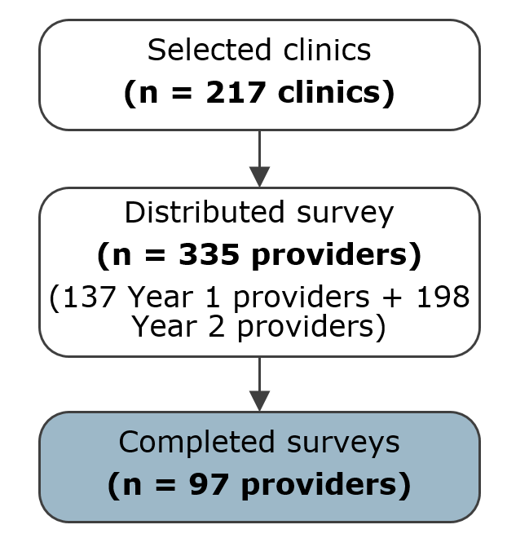
Year 2 CPAN Key Findings (Qualitative)
Benefits of the CPAN Program (n=64)
  95% indicated that accessibility to psychiatrists for quick and direct access to consultation services, information, and resources was the greatest benefit of the program.
  Several respondents mentioned that CPAN has increased their confidence in treating pediatric patients with mental health needs.
Barriers and Improvements to the CPAN Program (n=62)
  Greatest barrier was time constraints for making calls to CPAN were perceived as a disruption of workflow and requiring additional time built into schedules to allow for consultations.
  To a lesser extent, lack of buy-in and support at their clinics and the program not meeting their needs were reported as barriers.
  Frequently mentioned areas for improvement included: improved outreach and awareness of CPAN (31%), more implementation support and training on the program (31%), and improved connections to community resources and referrals (18%).
Year 2 CPAN Survey Participation
Notes:
We conducted a content analysis of open-ended responses to the CPAN survey. The focus of this analysis was only on the qualitative responses related to CPAN program implementation benefits and improvements.
Benefits of the CPAN Program (n=64)
Overall, 64 (66%) of participants responded to the open-ended question asking about the greatest benefits of the CPAN program.
Of those, 95% (n=61) indicated that accessibility was the greatest benefit of the CPAN program. Respondents specified that the accessibility of consultation services, information, and resources by the CPAN program helped them to better address the pediatric mental health needs of their patients.
Several respondents mentioned that CPAN increased their confidence in treating pediatric patients with mental health needs.
Barriers and Improvements to the CPAN Program (n=62)
Overall, 62 (64%) of participants responded to the open-ended question asking about barriers and suggested improvements to the CPAN program.
The greatest barrier to utilizing CPAN services identified was time constraints. As busy care providers, making calls to CPAN can disrupt workflow and requires additional time built into schedules to allow for consultations despite the benefits of the program.
Other barriers discussed, though to a lesser extent, included a lack of buy-in and support at their clinics and the program not meeting their needs (e.g., lack of information about medications and keeping patients out of the hospital, and referrals to patient resources being outdated).
Although CPAN providers varied in their responses to areas for program improvement, the most frequently mentioned areas for improvement included:
Improved outreach and awareness of CPAN (31%)
More implementation support and training on the program (31%)
Improved connections to community resources and referrals (18%)

Slide 6
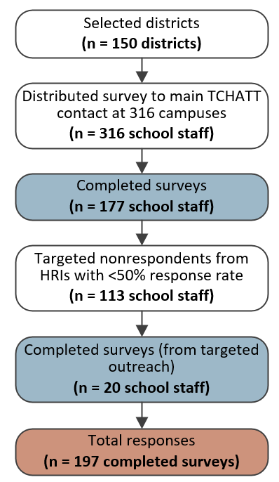
Year 2 TCHATT Key Findings (Qualitative)
Benefits of the TCHATT Program (n=127)
  79% indicated that accessibility of care for underserved students in need was the greatest benefit of the TCHATT program.
  Many respondents mentioned that TCHATT provides a level of mental health care to students that cannot be provided by school counselors alone due to specialized needs and time constraints.
Improvements to the TCHATT Program (n=99)
  Frequently mentioned areas for improvement included: the desire for a more efficient and streamlined paperwork system (30%), better communication and follow-up (20%), more training on campus (12%), more flexibility in scheduling students (11%), and additional sessions for students (8%).
Additional Comments (n=58)
  31% of respondents provided positive feedback about the program and its impacts on students.
Year 2 TCHATT Survey Participation
Notes:
We conducted a content analysis of open-ended responses to the TCHATT survey. The focus of this analysis was only on the qualitative responses related to TCHATT program implementation benefits and improvements.
Benefits of the TCHATT Program (n=127)
Overall, 127 (64%) of participants responded to the open-ended question asking about the greatest benefits of having the TCHATT program available in their schools.
Of those, 79% (n=100) indicated that accessibility of care for underserved students in need was the greatest benefit of the TCHATT program.
Other respondents mentioned that TCHATT provides a level of mental health care that cannot be provided by school counselors alone (e.g., since school counselors may not have the level of expertise some students require and often have time constraints caring for large student populations).
Improvements to the TCHATT Program (n=99)
Overall, 99 (50%) of participants responded to the open-ended question asking about improvements to the TCHATT program. The program is seen as a convenient and valuable external resource that can support school staff and parents in getting children the mental health care that they need when alternative resources are extremely limited.
TCHATT stakeholders varied in their responses to areas for program improvement.
The most frequently mentioned areas for improvement include:
The desire for a more efficient and streamlined paperwork system that works better for both the counselors as well as the families they refer (30%)
Better communication and follow-up while students are involved in the TCHATT program (20%)
More training on campus, including refresher trainings and education (12%)
More flexibility in scheduling students (11%)
Additional sessions for students to avoid gaps in care (8%)
Additional Comments (n=58)
Overall, 58 (29%) of participants responded to the open-ended question asking for additional comments related to the TCHATT program.
Out those respondents, 31% (n=18) provided positive remarks regarding the program in terms of support offered to students and school staff.
Other responses were similar to the open-ended responses related to benefits and areas for improvement previously mentioned.

Slide 7
Questions?

