Slide 1
TCMHCC External Evaluation July 2022

Slide 2
Trayt Data
Year 2 Objective: Describe CPAN & TCHATT program reach & coverage across HRIs
  Key process and outcome evaluation metrics
    Total reached to date: Reach (e.g., # PCPs enrolled in CPAN, # school districts enrolled in TCHATT)
    Service delivery (e.g., PCPs using CPAN at least once, students receiving at least one TCHATT session)
CPAN & TCHATT Reach (as of 6/30/22)
CPAN enrolled PCP & staff | 10,182
TCHATT enrolled campuses | 3,207
  Outcomes not captured through existing Consortium sources (e.g., Trayt) or able to be measured through external evaluation surveys
Logic models informed the development of a quarterly process evaluation report as well as CPAN & TCHATT surveys

Slide 3
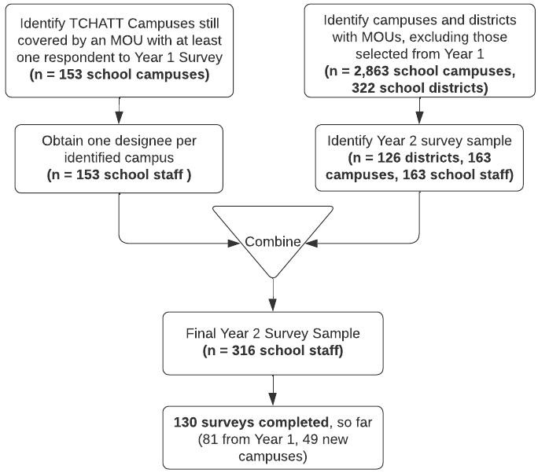
TCHATT & CPAN
Surveys
Year 2 Objective: Adapt and deliver TCHATT & CPAN surveys to understand contextual factors influencing program engagement and implementation
Developed sampling frames to identify a diverse sample of school districts/campuses (TCHATT) and clinics (CPAN) across HRIs
Goal: 100 campuses/clinics from Year 1; 100 new campuses/clinics
Survey Timeline: July-August 2022

Slide 4
CPWE Interviews
Year 2 Objective: Conduct interviews with CPWE residents to understand their perspectives on:
  Program satisfaction
  Program challenges
  Potential influence of program on professional development and future career plans
Updated CPWE interview guide from Year 1
Conducting interviews with residents (1 per HRI)
  7 (out of 10) interviews completed
Timeline: June-July 2022

Slide 5
Cost Analysis
Year 2 Objective: Evaluate the cost of CPAN and TCHATT program implementation
Reviewed existing data sources for obtaining cost data (e.g., Trayt, Lantana, and HRI quarterly reports)
Developed instruments for obtaining cost/time data not available through existing sources
  Surveys for HRIs
  Questions added to CPAN survey (PCPs) and TCHATT survey (school personnel)
Timeline: July-August 2022

Slide 6
Geographic Vulnerability Index
Year 2 Objective: Describe CPAN & TCHATT program reach/coverage by community factors, with a focus on indicators of vulnerability (e.g., geographic factors, demographic, social vulnerability)
Developing a geographic & social vulnerability index (GSVI), based on existing measures of social determinants of health
Create a dashboard to allow program planners to view CPAN provider & TCHATT school enrollment by factors comprising the GSVI index.

Slide 7
HRI Evaluation Packets
Year 2 Objective: Disseminate external evaluation results to HRI leadership to promote quality improvement of the program throughout the evaluation period
Developing packets for HRIs with results of Year 1 external evaluation Will schedule calls with HRIs to review results, as needed
Timeline: August 2022

