Slide 1
Texas Child Mental Health Care Consortium
Melanie Susswein, MSW

Slide 2
Fall 2021
Fall +
Winter 2021
SPRING +
SUMMER 2022
Fall +
Winter 2022
Project onboarding
Information gathering
Formative research
Initiating creative development
Formative research
Develop/refine outreach and communication plan
Collaborate with physician engagement expert
Provide HRIs with initial tools and strategies
Paid search
Overview video launch
Continued outreach support
Social media
Other implementation tactics
Continued engagement
and implementation of communication plan
Evaluation plan

Slide 3



Digital Strategies
Facebook Ads: Key Messages
Patient psychiatric consultation
Vetted referrals
Free
Fast support
Feel confident
Strategy.
The goal of the media plan is to drive our target audience from awareness to engagement.
Increased clicks & click through rates (CTRs)
Increase site traffic to CPAN
Increase provide engagement
Tactics.
Paid Search
Continuous refinement of the audience

Slide 4
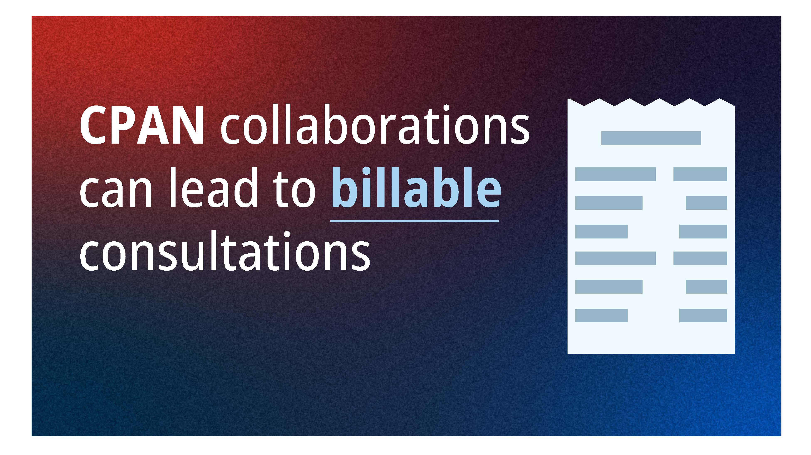
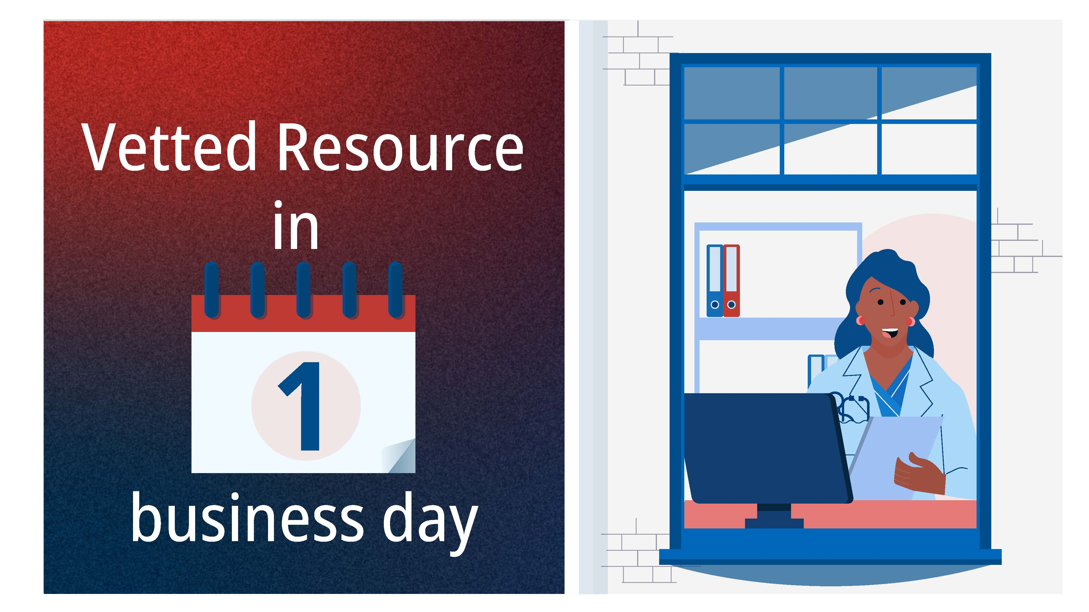
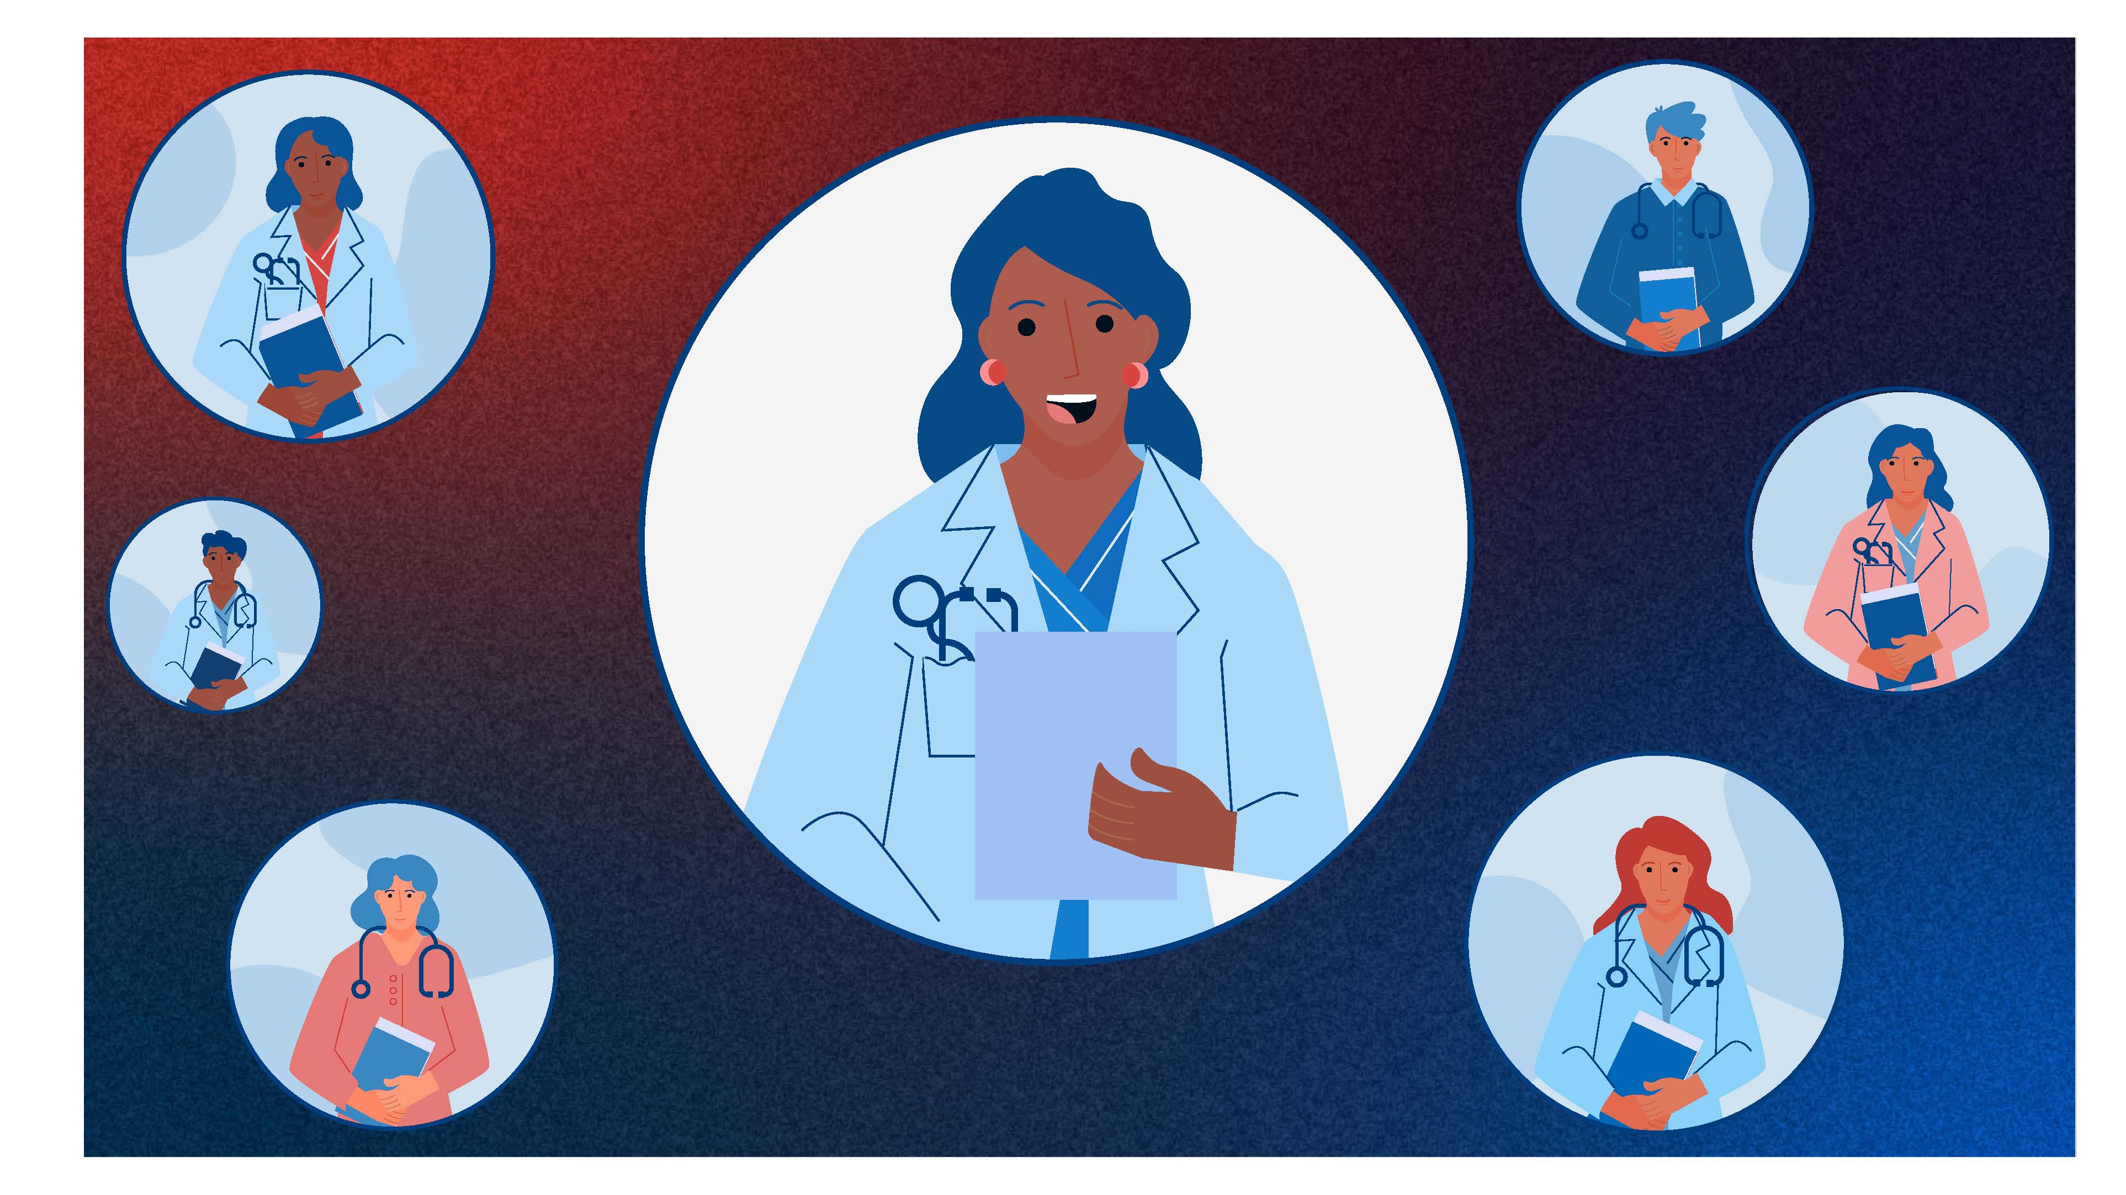
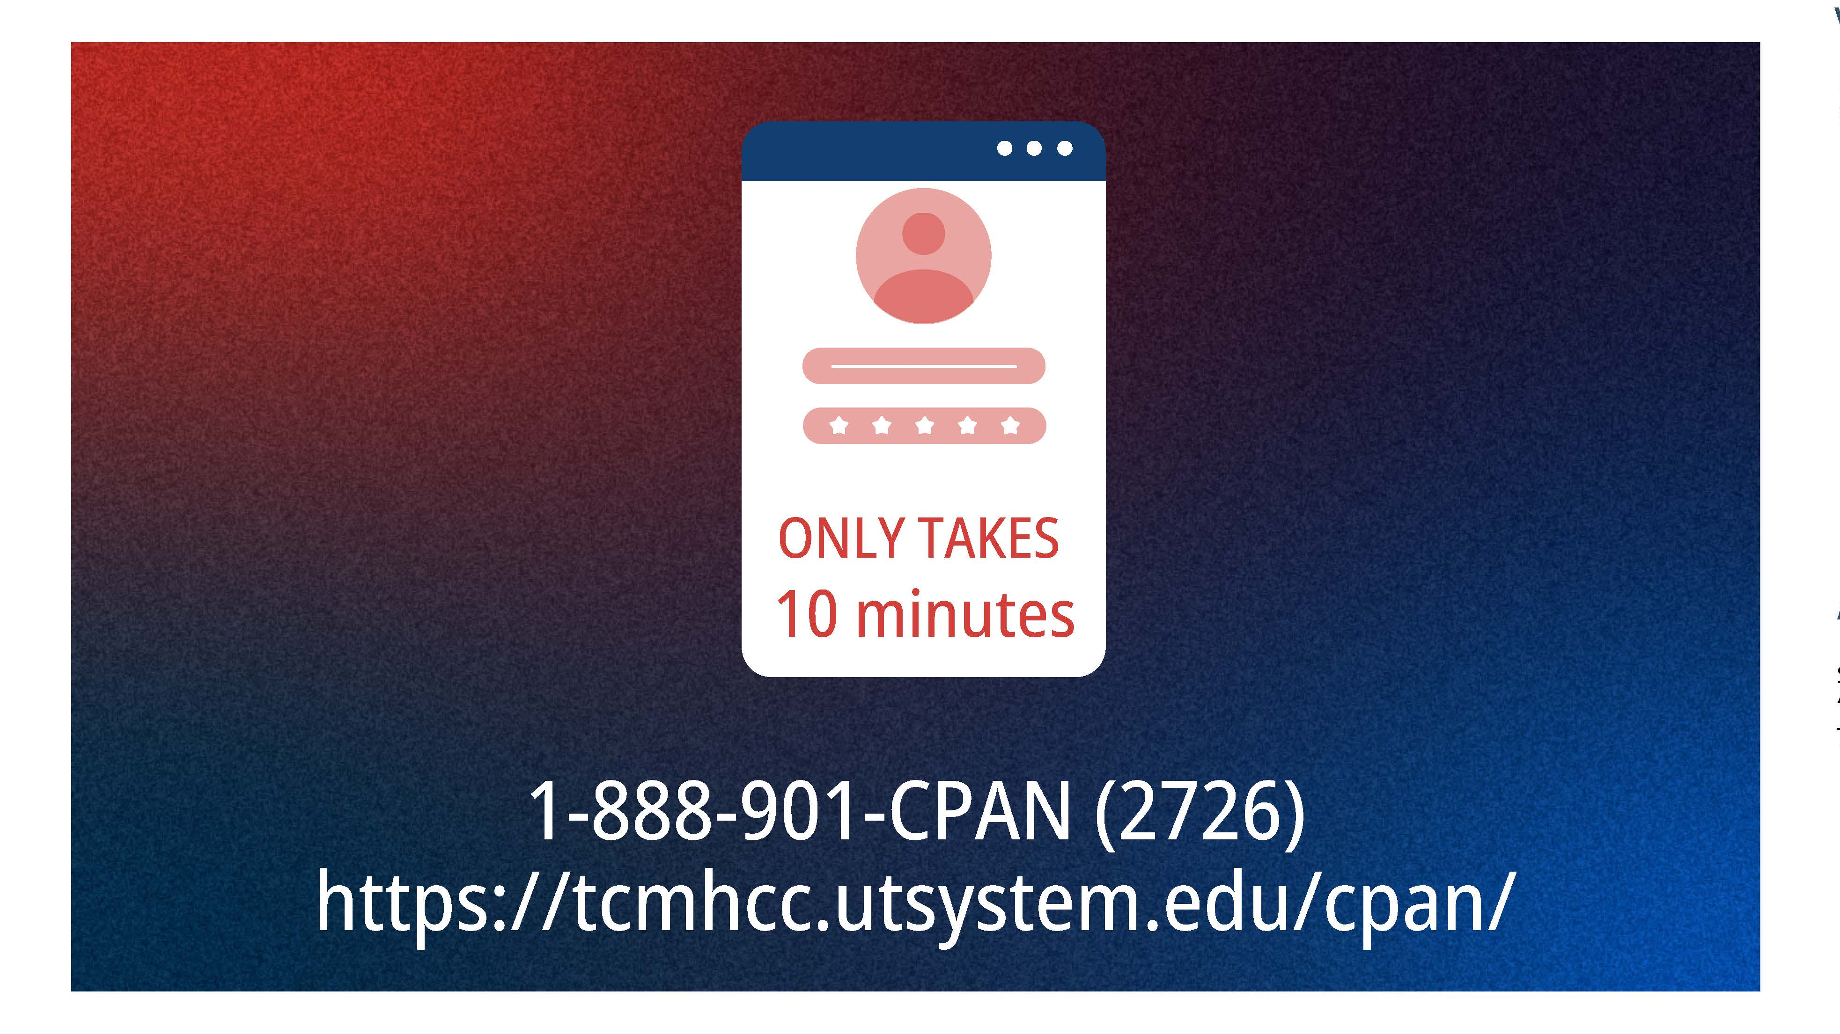
Overview Video launch
Identify Key Messages
Script Development
Production
Video Editing
1
2
2. Script Development
3
4

Slide 5
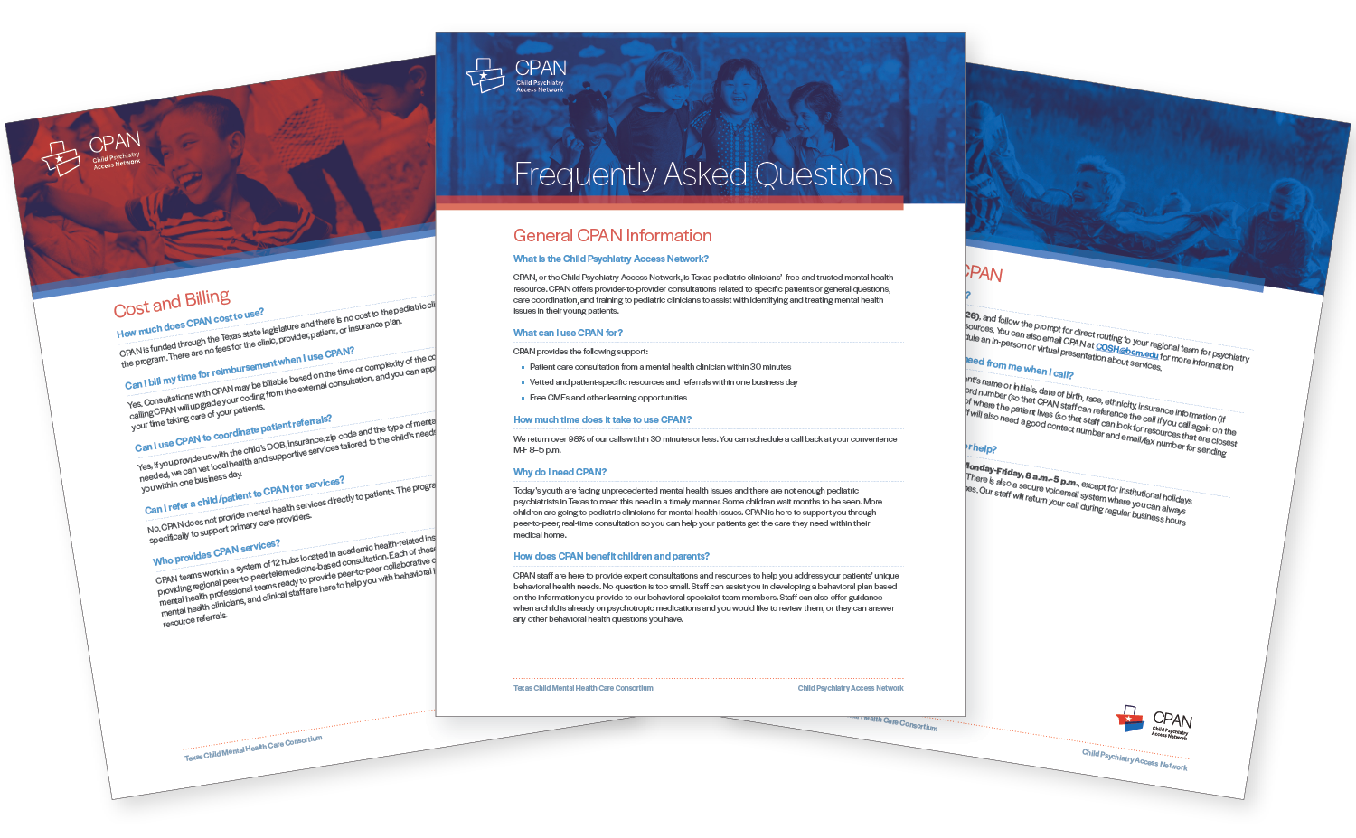
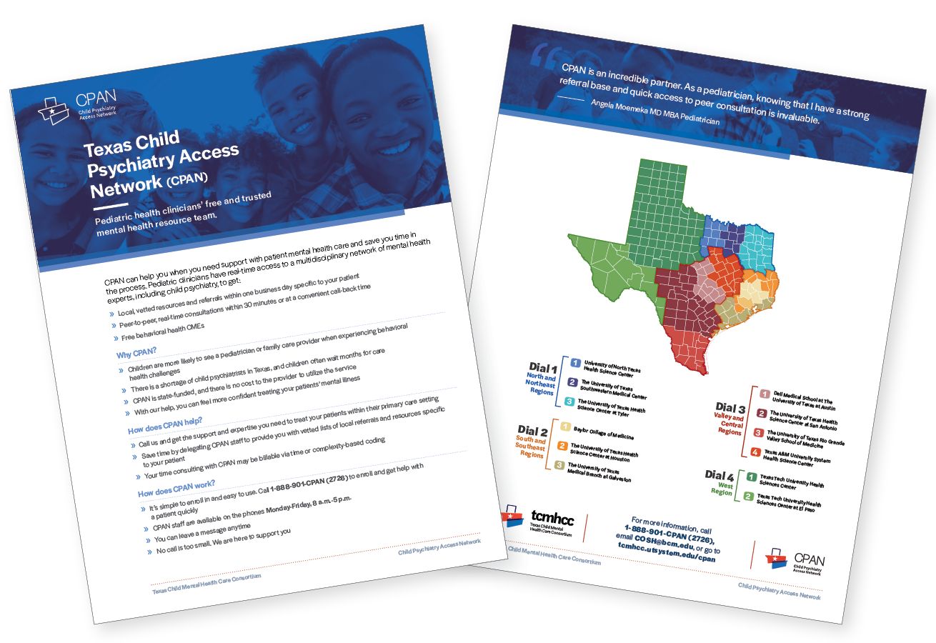
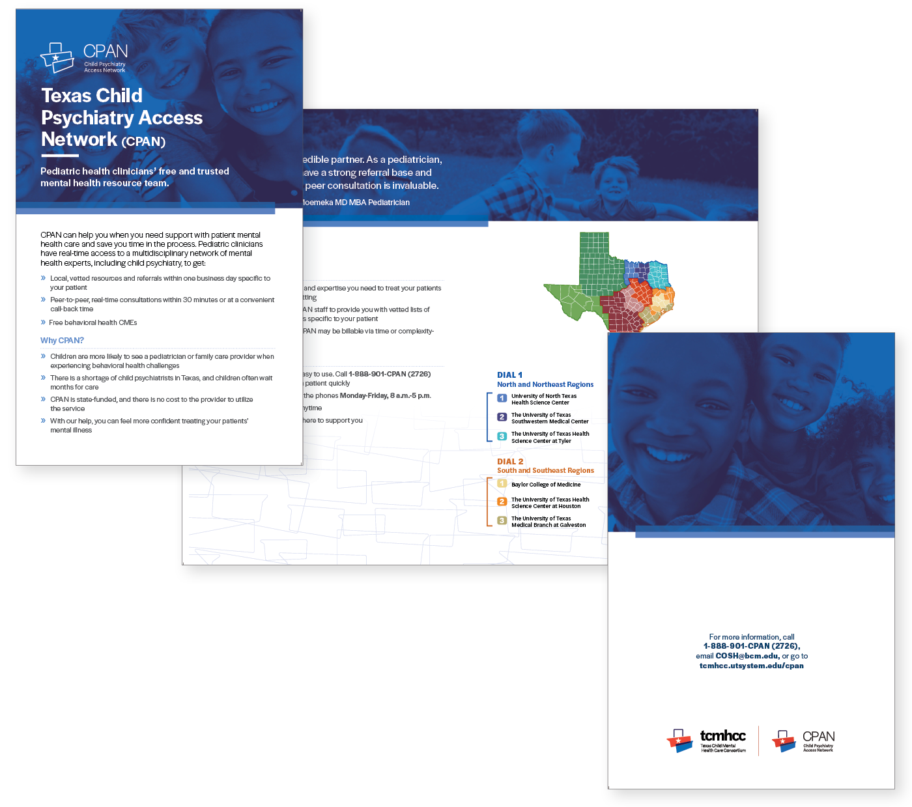
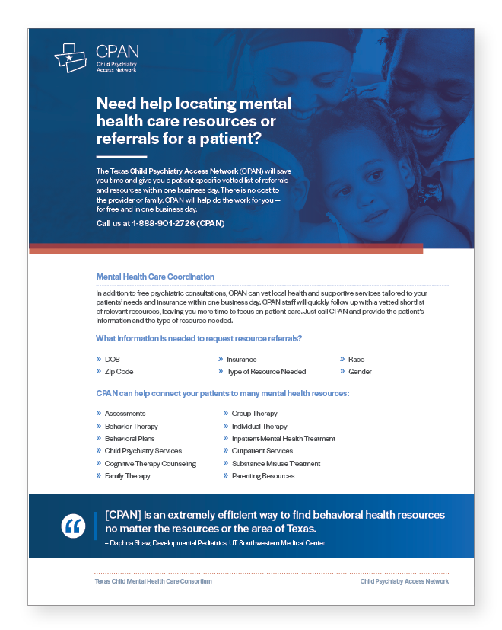
Completed CPAN Materials
FAQ Document
General Flyer
General Flyer- Bifold
Resource One Pager

Slide 6
Completed CPAN Materials
FAQ Document

Slide 7
Q & A

