Slide 1
Texas Child Mental Health Care Consortium
Enhancing Awareness and Outreach for CPAN and PeriPAN | March 2023 Update
Melanie Susswein, MSW

Slide 2
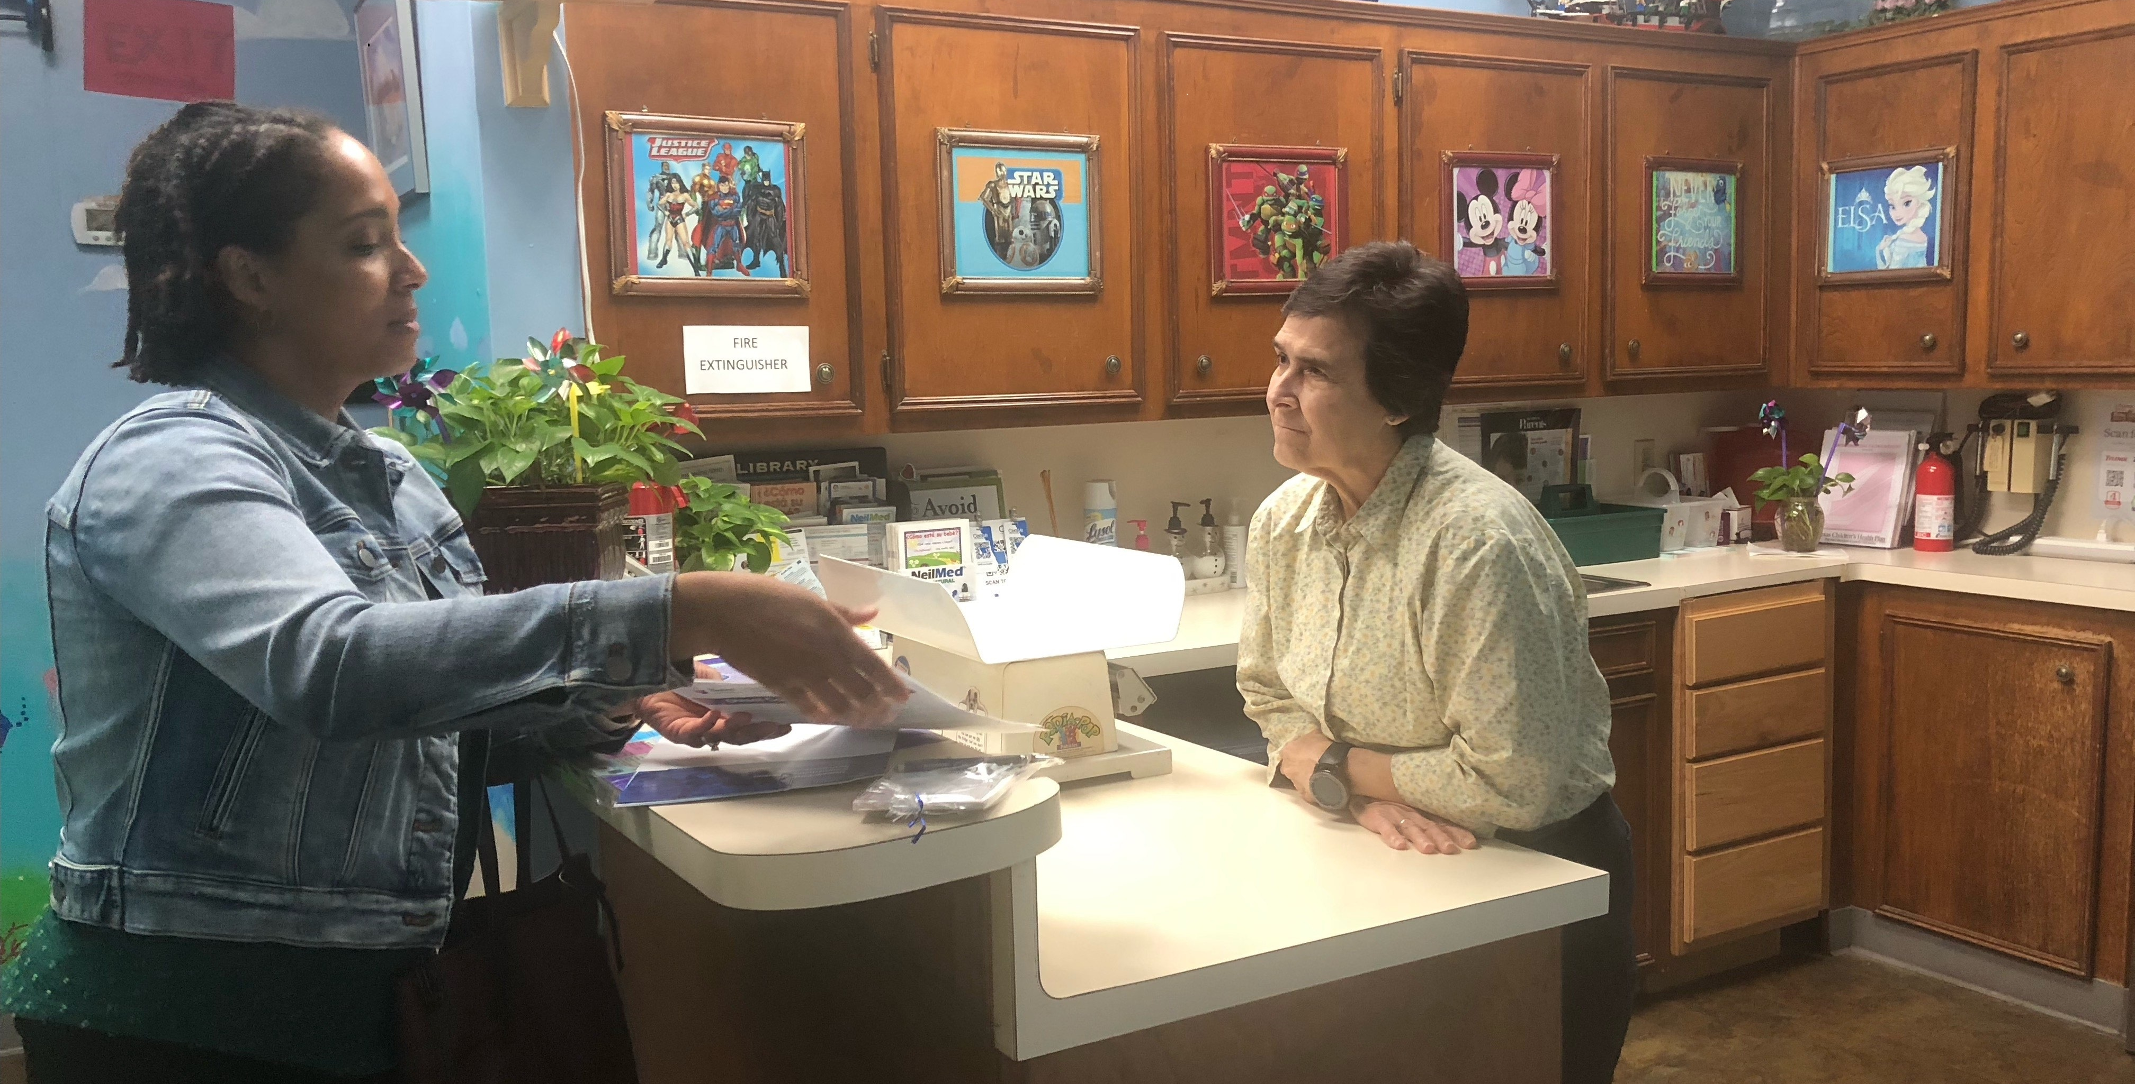

CPAN and PeriPAN Strategic Support and Outreach
PeriPAN HRI Listening Sessions
Community of Practice - Newsletter and Social Media Presentations and Guidance to HRIs
In-Person Outreach Consultation With BCM
  3 days, initial calls, visited > 50 clinics, enrolled 4, follow-up strategy
  4.5 out of 5 usefulness and helpfulness rating
Newsletter Best Practice Review and Guidance
CPAN Stakeholder Report
  Presented 200+ opportunities statewide and by region
PeriPAN Stakeholder Plan –Deeper dive with 7 key partners
Continued Creative Deliverables and Support Cross-Promotion With Other Relevant CHC Projects

Slide 3
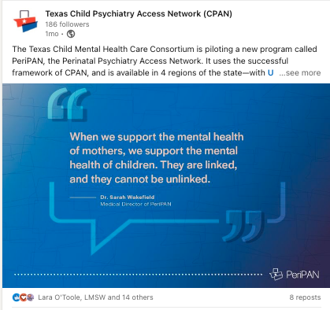
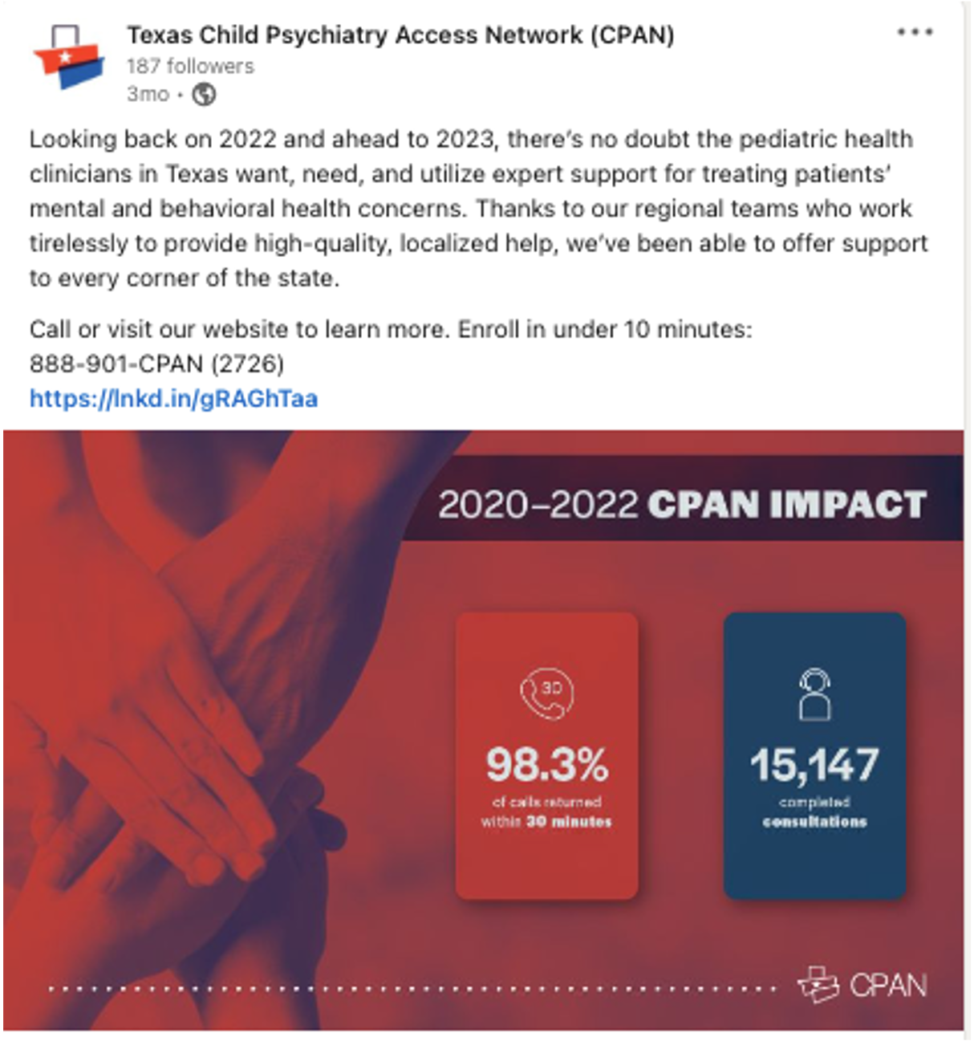
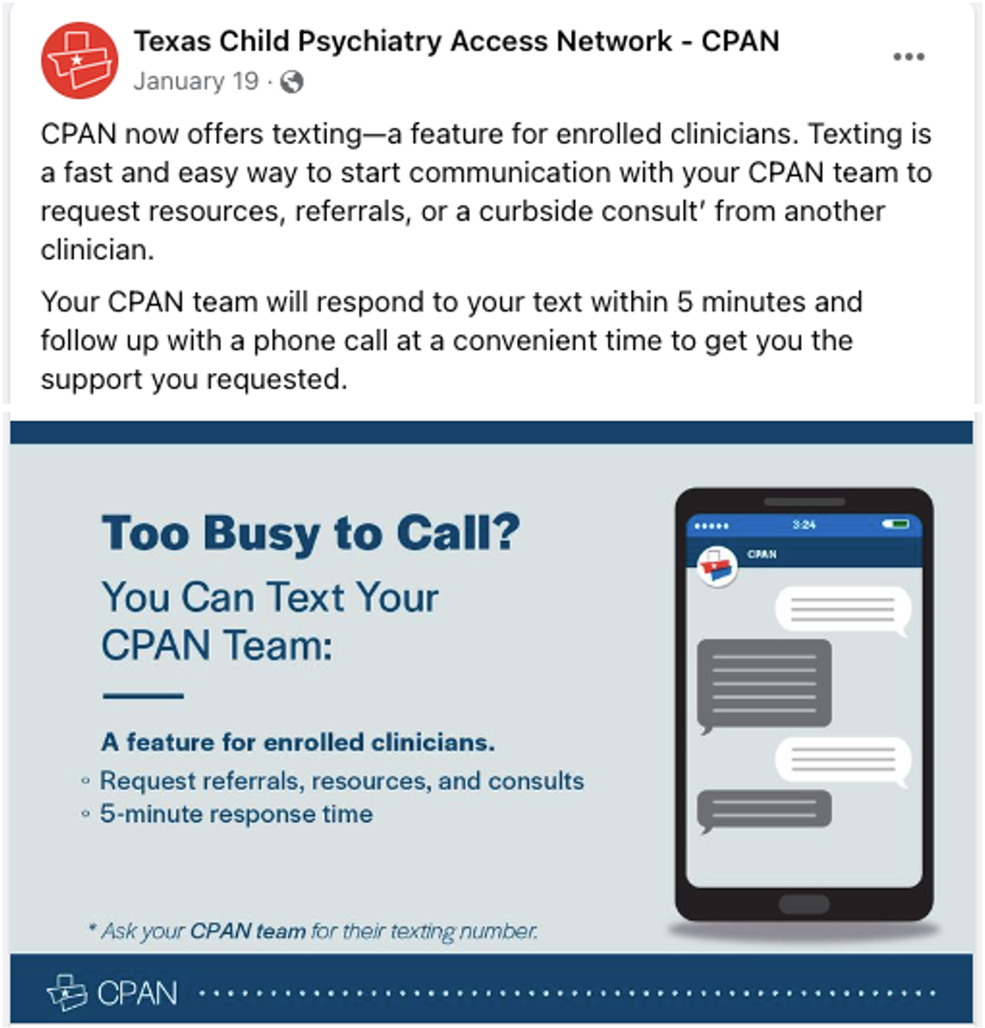
CPAN Social Media Analysis
December – February 2023
Impact:
44 posts across Facebook and LinkedIn created by CHC
5,049 total cumulative reach; 10% increase from
last quarter.
Quarterly Growth:
Facebook – 7.7% increase, from 480 to 517 followers.
  On track with the 6.9% increase last quarter
LinkedIn – 72.6% increase, from 106 to 183 followers.
  Surpasses the already impressive 51.4%
  increase last quarter
Notes:
https://www.linkedin.com/feed/update/urn:li:activity:7008140827449298944/
https://www.linkedin.com/feed/update/urn:li:activity:7028376821582745601/
https://www.facebook.com/TexasCPAN/posts/pfbid0Xqdk85MGY2egFqnPLq3usq78MgxaQaRSfKHCHR1ZgTtoQRX5so6B1xbUCo1sUfgTl

Slide 4
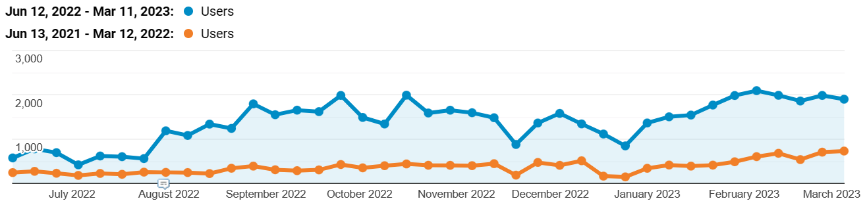
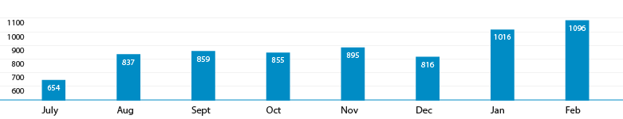
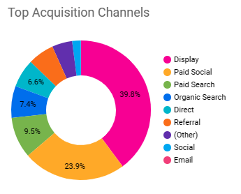


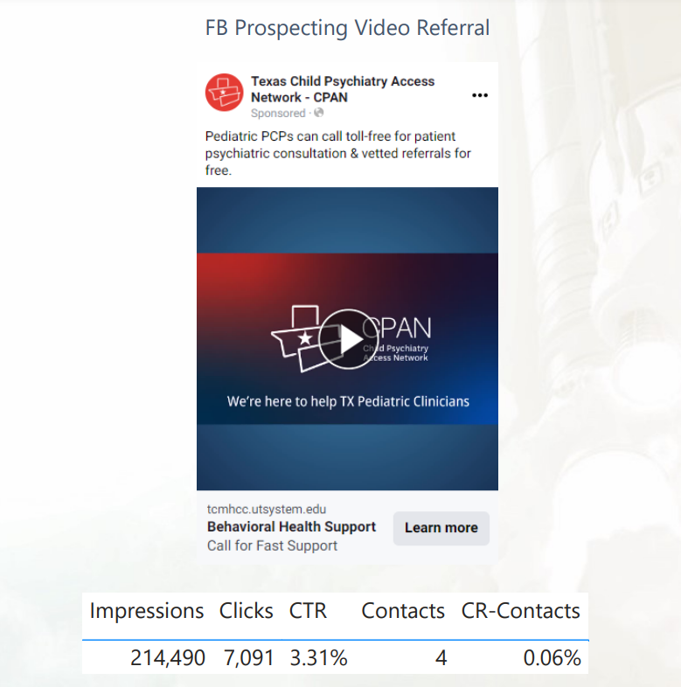
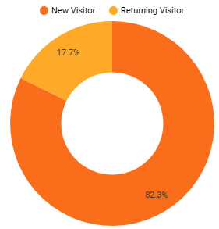
CPAN Digital OUTrEAch analysis
August 1, 2022 – March 12, 2023
Website Year Over Year
August 2022 - Digital Outreach Begins
Cross-use of videos:
A total of 6,101,210 impressions:
  467,711 on Facebook
  5,604,796 programmatic display via websites
  28,703 Google Ads
18,053 clicks total, 88 resulting in CPAN calls.
Website traffic (/CPAN):
  24,191 users (684% increase*)
  23,814 new users (749% increase*)
  29,412 sessions (573% increase)
  82% of visitors are new visitors
  Top acquisition channels driving traffic to website are attributable to digital campaign (see figure)
  Sessions by device
    13.3K Mobile
    12.7K Desktop
    1.8K Tablet
CPAN Consults 2022 - 2023
*Source: Google Analytics 8/1/22-3/12/23, comparison period 8/1/21-3/12/22

Slide 5

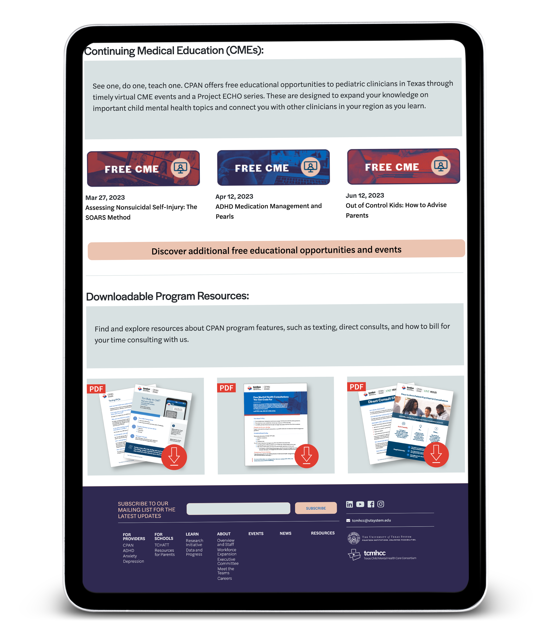
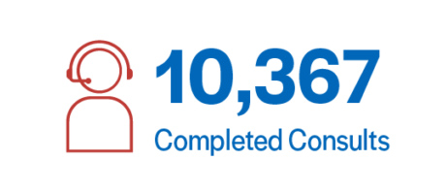
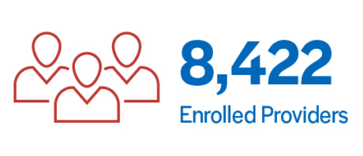

What’s Next
CPAN 3rd Anniversary – Theme of Threes
  Top 3 reasons clinicians call CPAN
  3 ways CPAN fits into your day
  3 statistics – consults, satisfaction, and education
  E-Blast and Social Media - Brief & Visual for HRIs
CPAN and PeriPAN Web Pages and SEO
PeriPAN Foundational and Outreach Items:
  Provider Toolkit
  Video
  Key Stakeholder Partnerships
  Direct Mail

Slide 6
Q & A

