Slide 1
Texas Child Mental Health Care Consortium
Melanie Susswein, MSW

Slide 2
1
CPAN Project Update
2
Q&A
Agenda

Slide 4
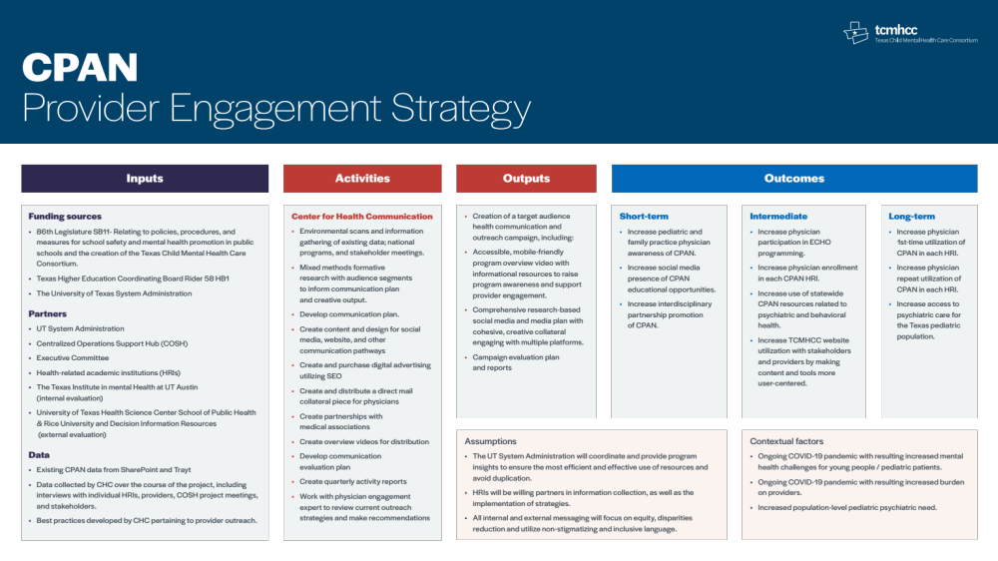

Slide 5
Communication plan
Engagement Strategies + Tactics
2 STRATEGIES
Outreach
Media

Slide 6
Fall 2021
Fall +
Winter 2021
SPRING +
SUMMER 2022
Fall +
Winter 2022
Project onboarding
Information gathering
Formative research
Initiating creative development
Formative research
Develop/refine outreach and communication plan
Collaborate with physician engagement expert
Provide HRIs with initial tools and strategies
Paid search/keyword marketing
Overview video launch
Continued outreach support
Social media
Other implementation tactics
Continued engagement
and implementation of communication plan
Evaluation plan

Slide 7
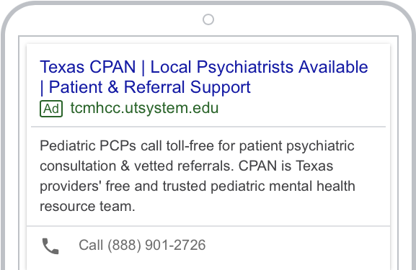
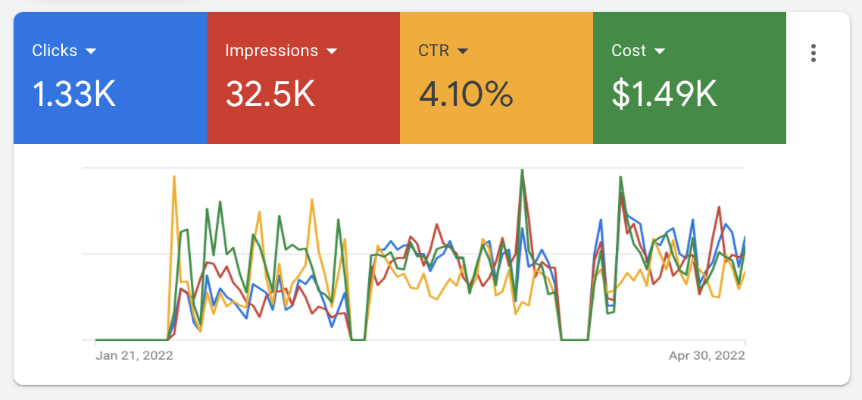
Paid search/outreach
CLICKS: | People who saw the ad and then engaged with it.
IMPRESSIONS: | The amount of times a Google search user saw our ads on their screen.
CTR (CLICK THROUGH RATE): | The rate of users clicking on the ad and clicking on something else on the landing page.
COST: | Ad spend @ $500/month.

Slide 8
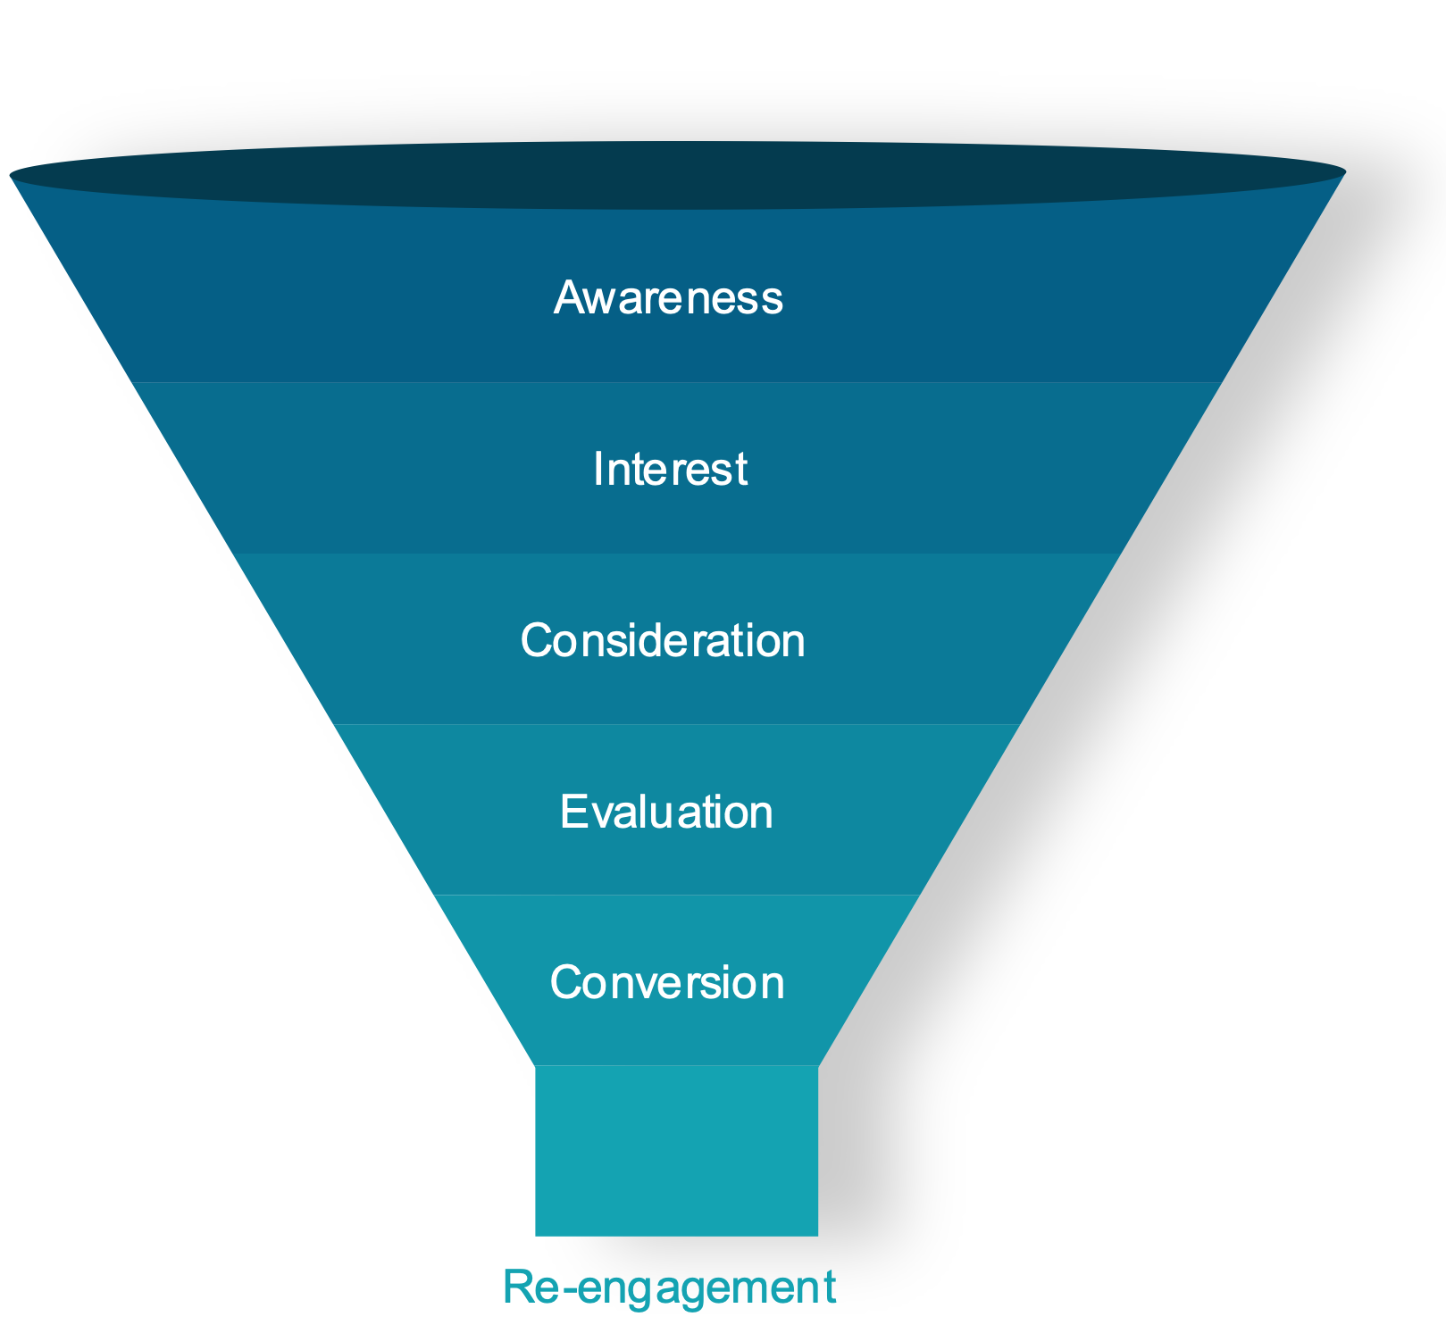
Digital Strategies
Strategy.
The goal of the media plan is to drive our target audience from awareness to engagement.
Increased clicks & click through rates (CTRs)
Increase site traffic to CPAN
Increase provide engagement
Tactics.
Initial launch in May-June 2022:
Paid Search
Continuous refinement of the audience

Slide 9
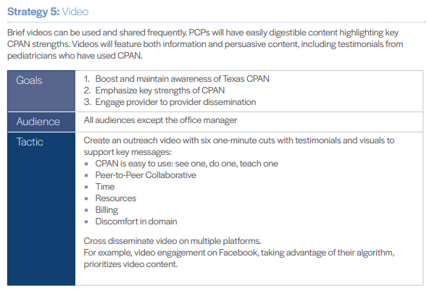
Overview Video launch
Identify Key Messages
Script Development
Production
Video Editing
1
2
2. Script Development
3
4

Slide 10
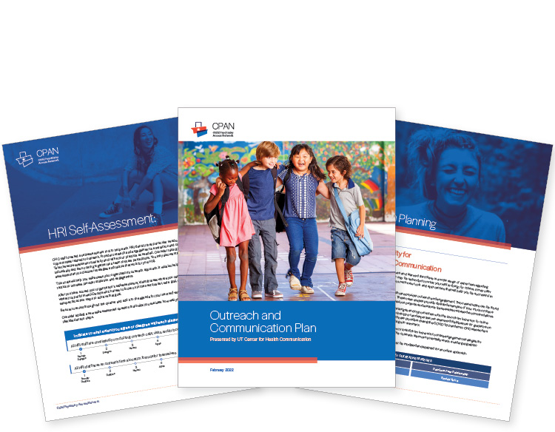
Continued outreach Support
Individual
Consultation:
Continued
Support
10 HRIs 1:1 meetings
1 HRI in person all-day outreach strategy session
2 additional visits planned
Communication review
Script practice
Community groups
and events
Putting Strategy
into Action
Relationship building
Targeted messages
Measuring and goal setting
Brainstorming

Slide 11


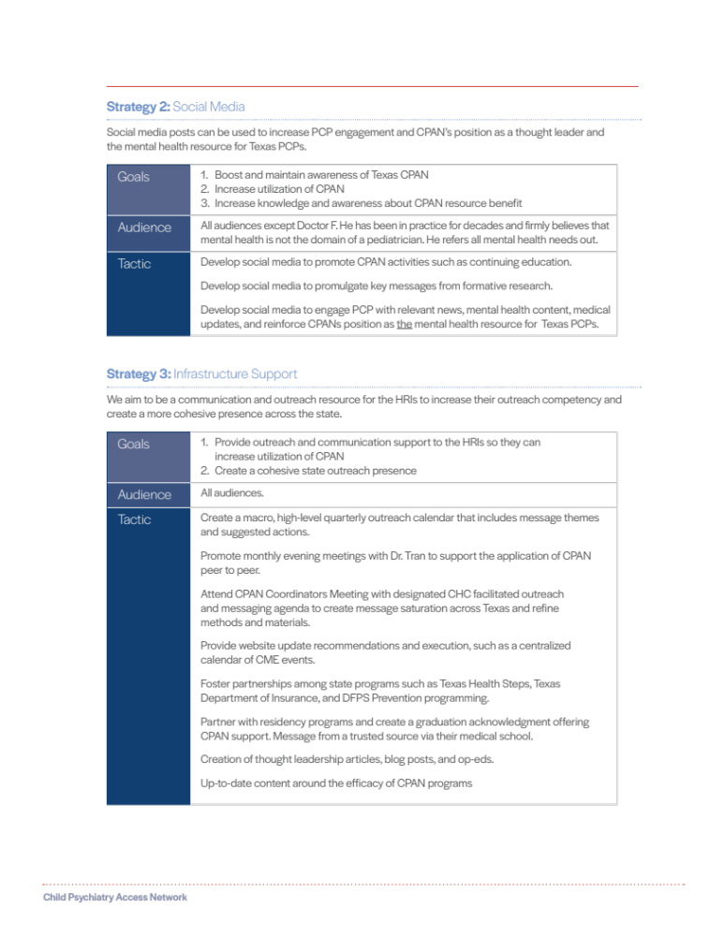
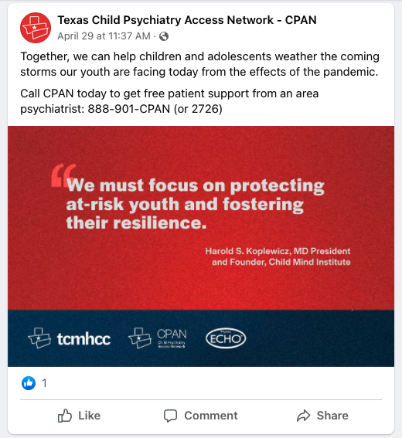
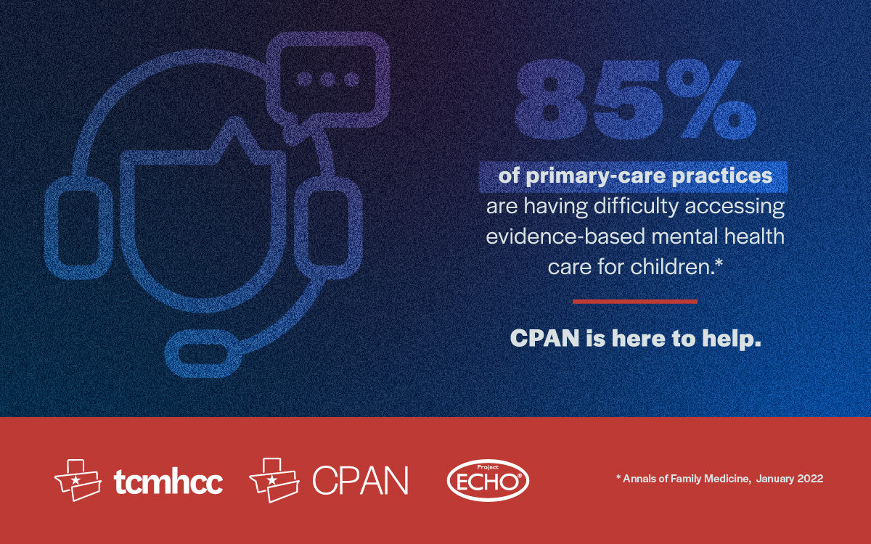
Social
media
Instagram
Facebook
LinkedIn

Slide 12
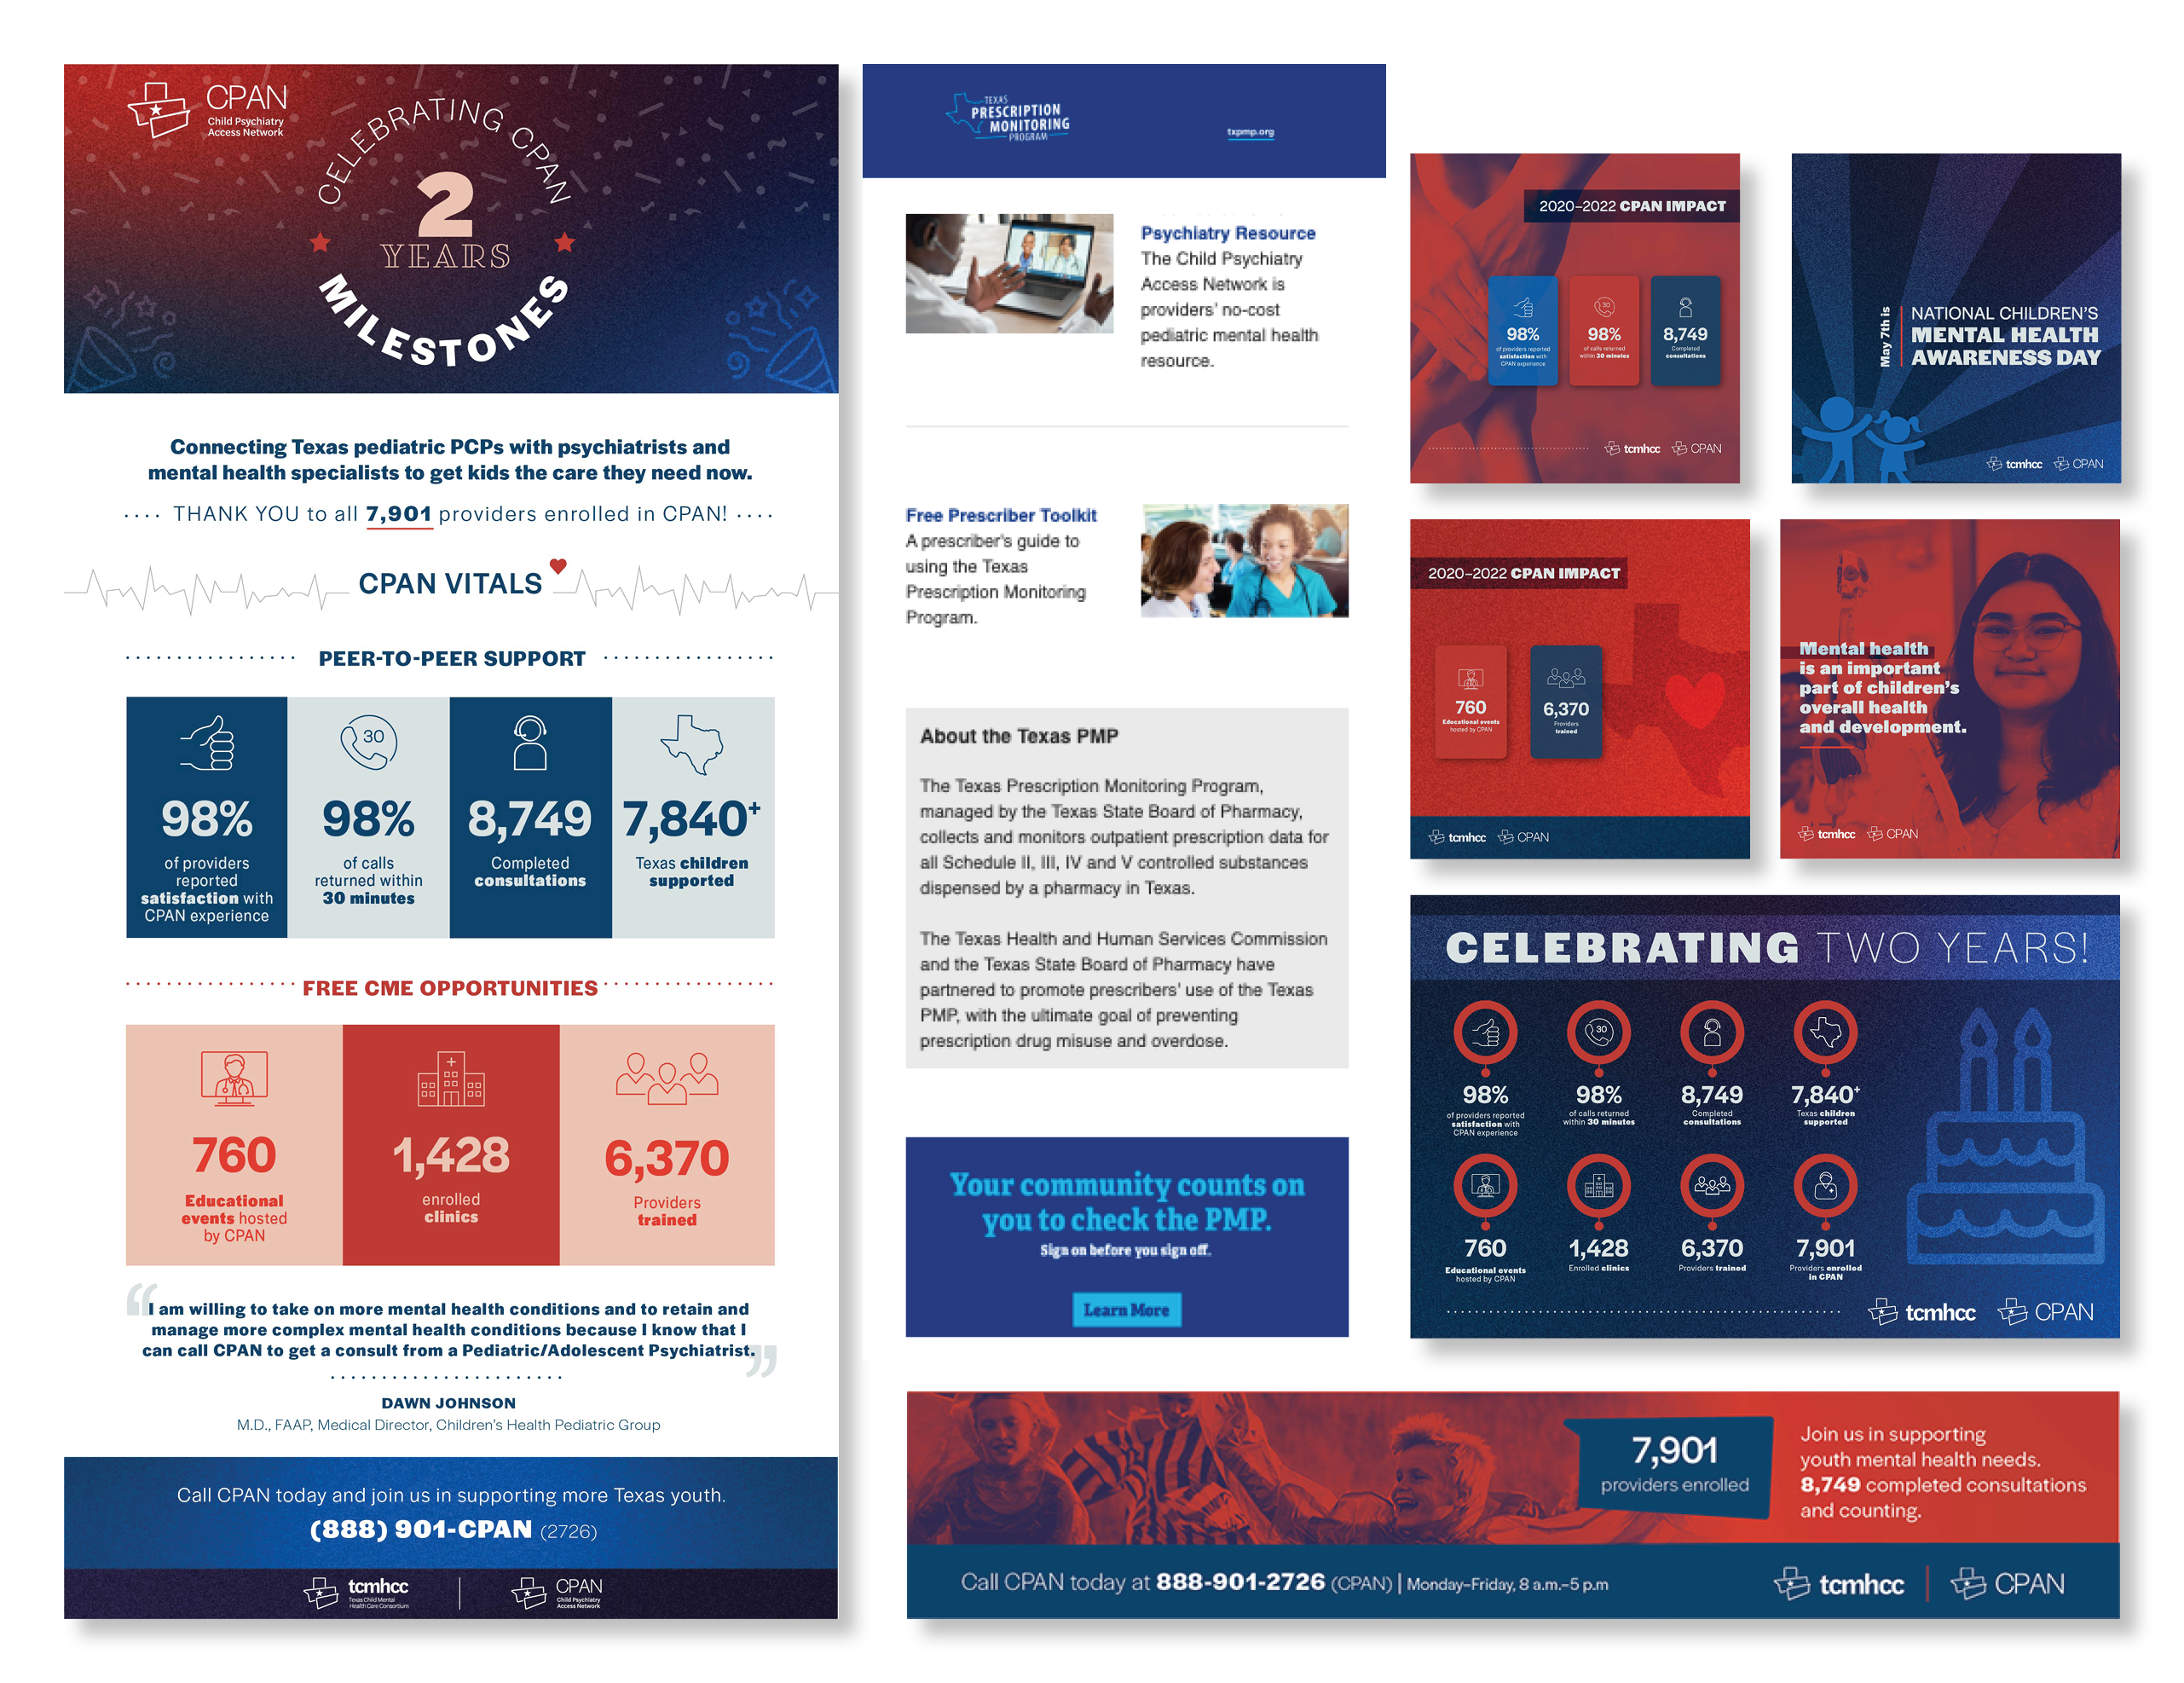
Embedded Email Image
Email Content
Anniversary
Social Media Graphics (FB, IG, LinkedIn)
Multiple tactics to promote and recognize 2-year anniversary milestones and achievements.
Social Media
Email content
Email images
TPS Website Banner
Op-ed
Prescription Monitoring Program Emails (15,000)
Michael and Susan Dell Healthy Living Webinar (14,000)
Banner Ad for TPS website

Slide 13
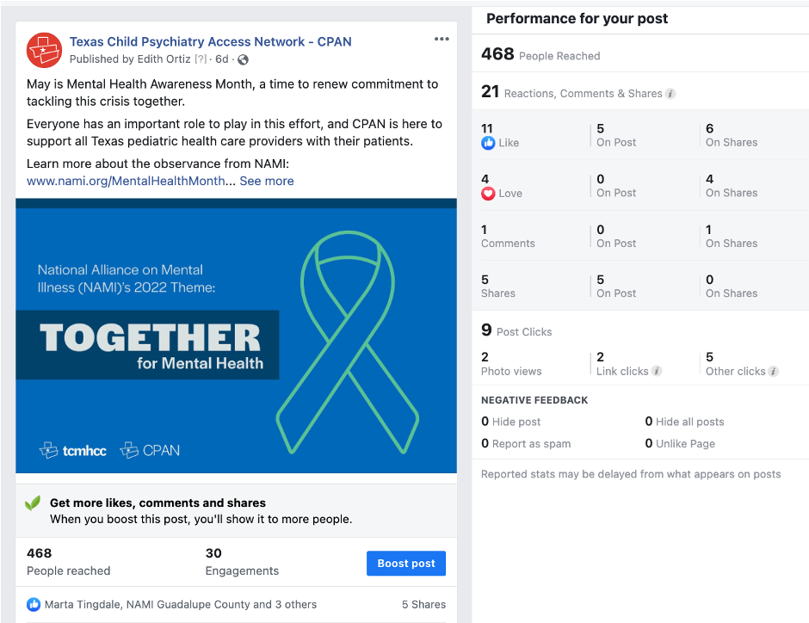
Social Media Analysis
Quarterly reports
Top 12th post of all time for the CPAN Facebook account.
Average reach on a CPAN Facebook post is 269, and this one has already reached 468 people so far.
This post has only been online since May 3, and momentum should continue until the end of Mental Health Awareness month. We expect it to perform even better in
the coming weeks.

Slide 14
Q & A

