Slide 1
Texas Child Mental Health Care Consortium
Melanie Susswein, MSW

Slide 2
Timeline
Research and
Responsive Production
Cohesive and
Branded Materials
Video Creation
Leveraging Wisdom
for Strategic Outreach
Outreach
HRI Support
Social Media
Digital Media
Year One
Year Two
Project Onboarding
Formative Research
Outreach Communication Plan
Branding and Style
Outreach
HRI Support
Social Media
Digital Media
Cohesive and
Branded Materials
Video Distribution

Slide 3
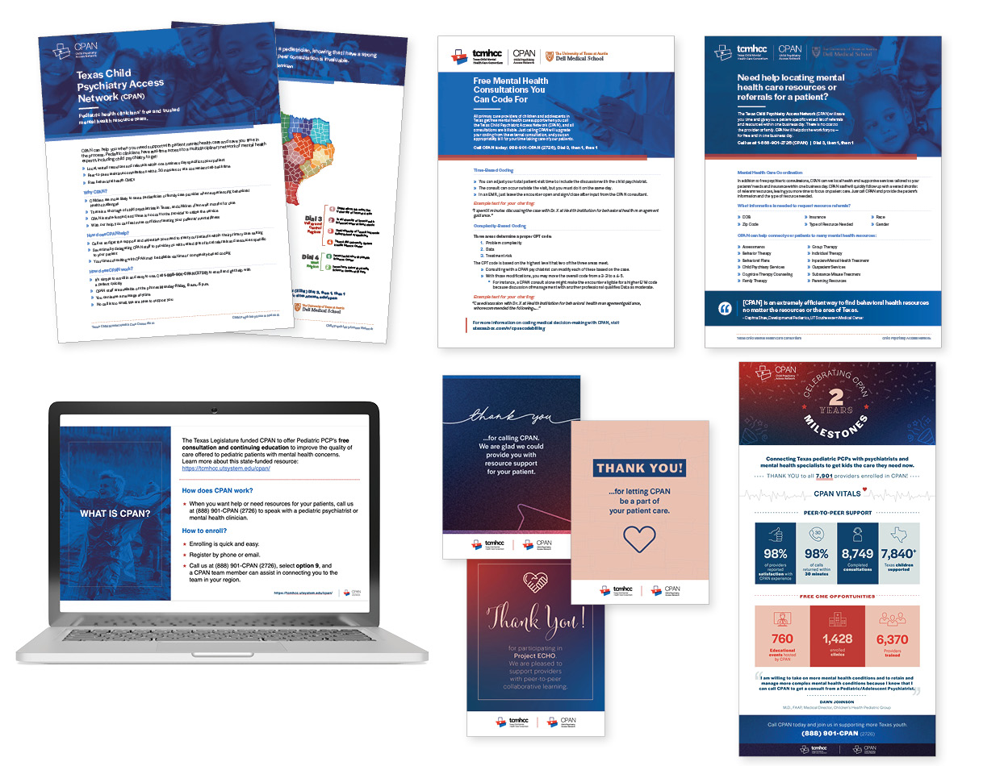
Collateral Material
Development
HRI Email Templates
Resources One-Pager
Billing One-Pager
Program Flyer
Thank You Card Templates
Promotional Materials Mockups
CPAN Branded PowerPoint Template
Anniversary Celebration

Slide 4
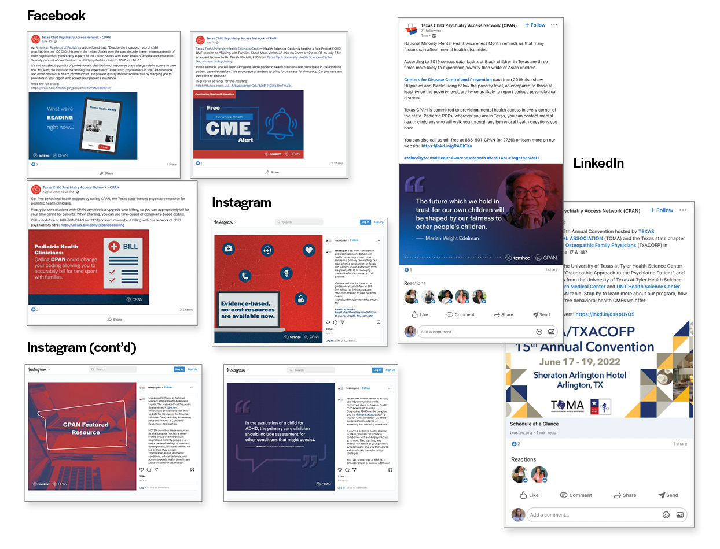
Social Media Analysis
March–August 2022
Impact:
165 posts across Facebook, Instagram, and LinkedIn with 141 created by the CHC.
12,047 total cumulative reach.
Growth:
Facebook – 26.8%, from 354 to 449 followers
Instagram – From the end of Q1 to the end of Q2 the account grew by 16.9%
LinkedIn Growth – 141%, from 29 to 70 followers

Slide 5
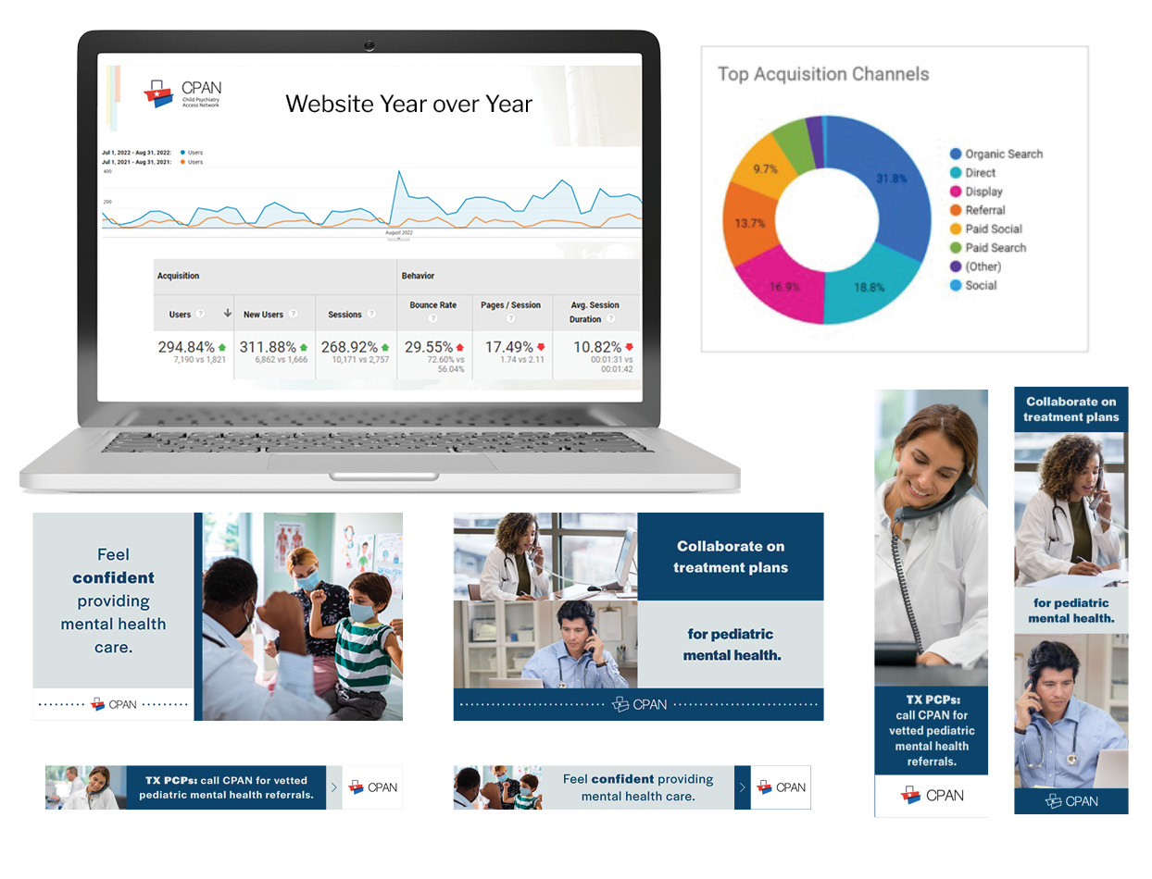
Digital Analysis
August 1–31, 2022
Created two digital ads – one for awareness building, one for retargeting.
Cross-use of two video cutouts.
A total of 707,792 impressions:
  78,951 on Facebook
  623,562 programmatic display via websites
  5,279 Google Ads
1,641 clicks total, 9 resulting in CPAN call.
Note: Trayt shows an increase in consults during same time period. (654 consults in July to 837 consults in August).
Website traffic (during August):
  5,323 users (153% increase from July)
  6,915 sessions (112% increase)
  72.5% of users or 5,014 were new site visitors (171% increase from July)
  Top acquisition channels driving traffic to website are attributable to digital campaign (see figure)

Slide 6
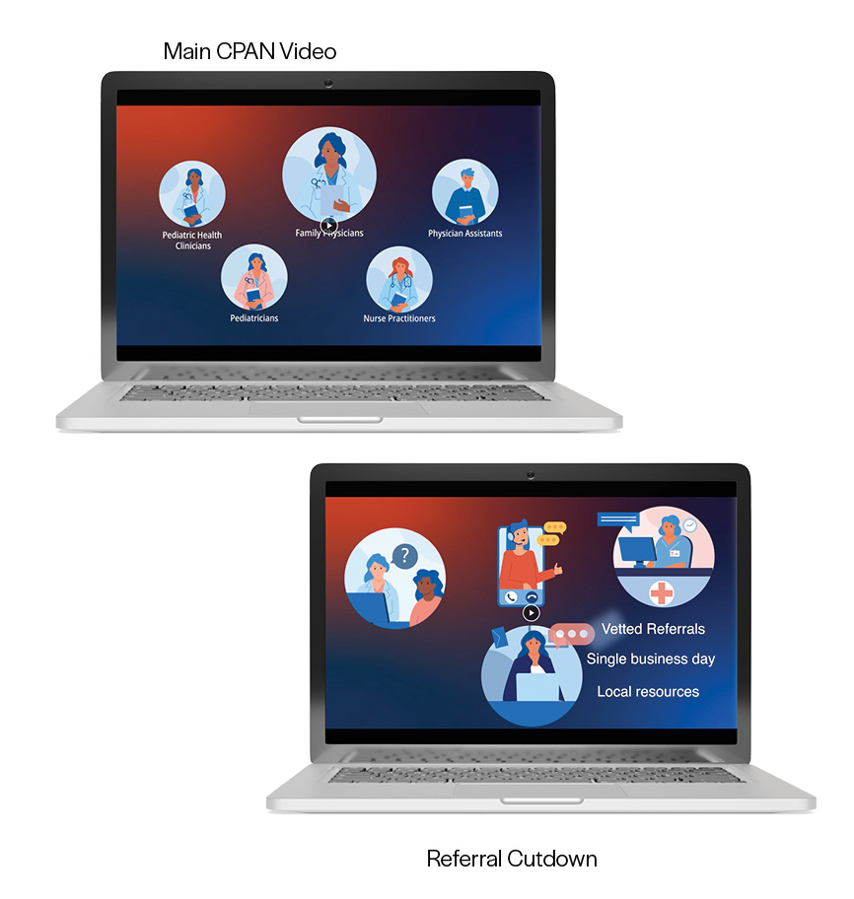
Video
One full 3-minute video to be posted on CPAN website and announced in October social media
Five key message videos of <:30 completed:
  General
  Referrals
  No Cost and Billable
  Discomfort in Domain
  Collaboration and Time Sensitive
Video distribution plan so key themes are aligned with social media messages.

Slide 7
Q & A

