Slide 1
TX-YDSRN
Madhukar Trivedi, MD
Center for Depression Research and Clinical Care
UT Southwestern Medical Center

Slide 2
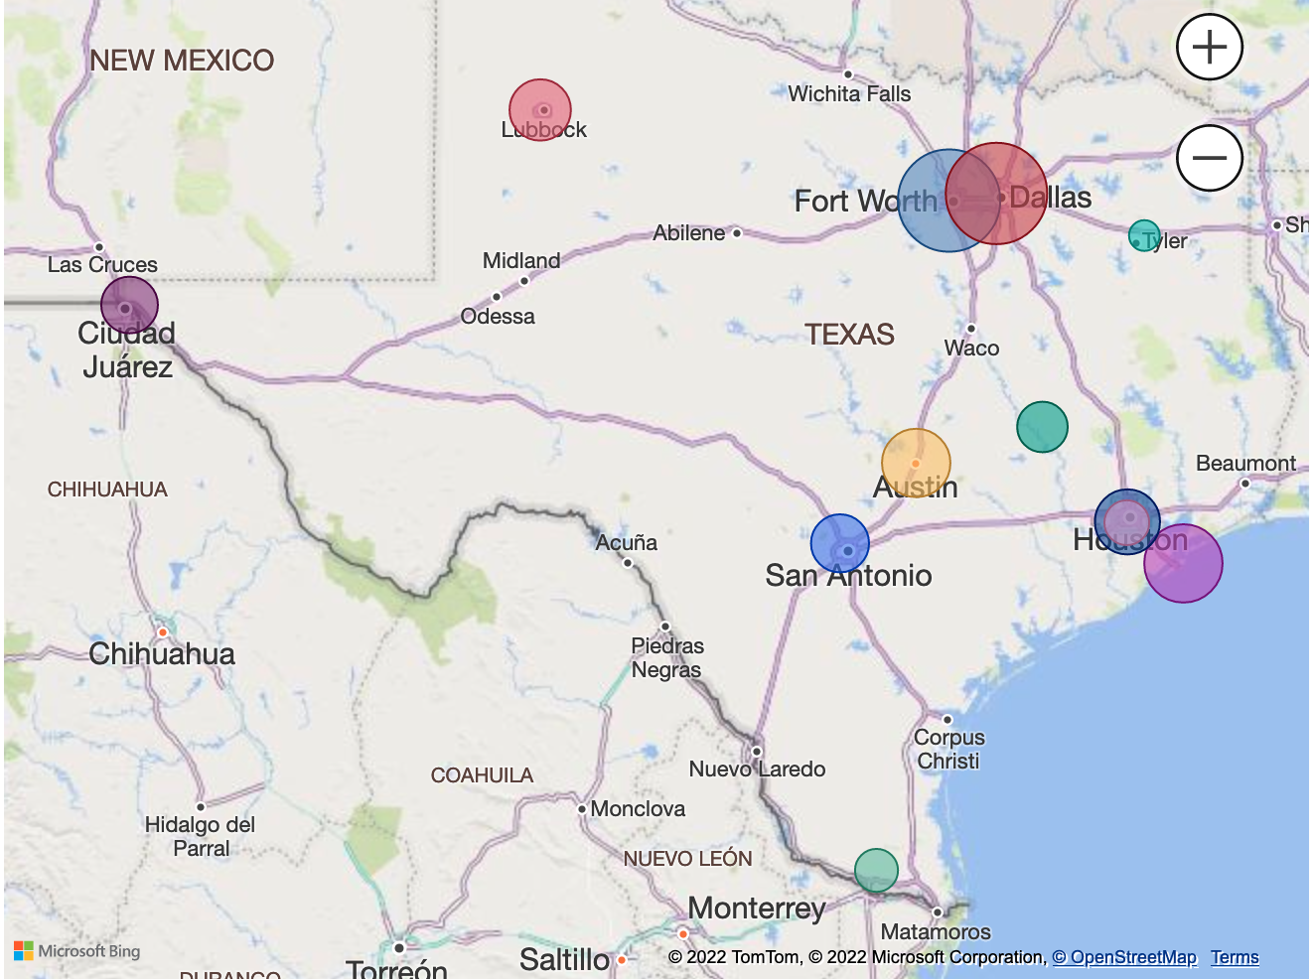
TX-YDSRN Network Overview
Multi-institutional research network aimed to improve mental health care for children and adolescents in the State of Texas.
Network consists of 12 HRIs across Texas
Registry study following youth across 2 years
Eligible youth must
  Be ages 8-20,
  Screen positive for depression or suicidality, OR
  Be in care for depression

Slide 3
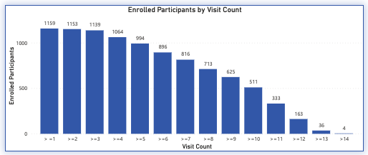
TX-YDSRN Study Status
Total Consented
1292
Total Enrolled
1165
Node | Enrolled Participants
BCM | 102
TAMU | 85
TTUHSC – El Paso | 73
TTUHSC – Lubbock | 90
UNT/JPS | 191
UT Dell | 112
UT RGV | 41
UTH - Houston | 52
UTH – San Antonio | 91
UTH - Tyler | 16
UTMB | 132
UTSW | 180
994 participants have provided data at 5 or more visits
Notes:
Total Consented = 1292
Total Enrolled = 1165 (Numbers on right add up to total enrolled)

Slide 4
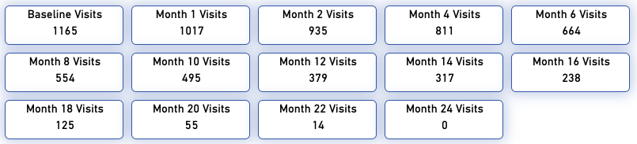
TX-YDSRN Completed Visits
Total Visits Completed = 6,769 Visits
5000+ hours completed on conducting assessments and scoring/data entry
Notes:
We are about to start our first 24 Month follow up visits.
5000 hours does not count time to schedule and recruit participants. (Time is calculated based on the average amount of time for each Node given their study population)

Slide 5
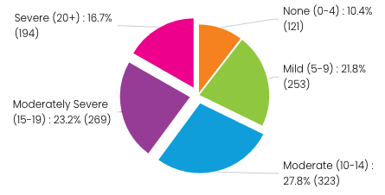
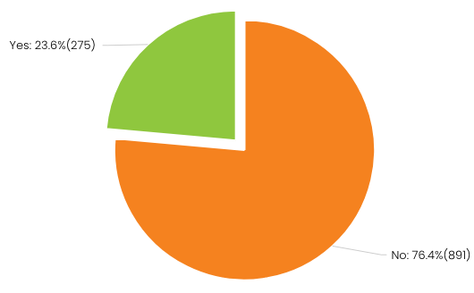
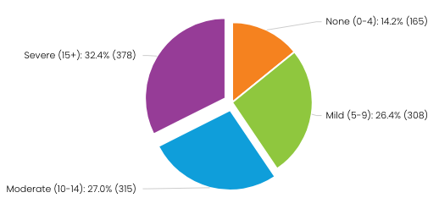
Data at Study Entry
Age (Mean 15.59, S.D.2.43)
8-11 years | 6.6% (77)
12-17 years | 67.6% (788)
18-20 years | 25.8% (301)
Depression Severity (PHQ-A)
Suicidal Thoughts (CHRT-SR)
Sex at Birth
Male | 27.0% (315)
Female | 73.0% (850)
Race
White | 67.1% (782)
More than one race | 11.5% (134)
Black or African American | 9.9% (116)
67.7% with moderate to severe depression
23.6% endorsing suicidal thoughts
Anxiety (GAD-7)
Ethnicity
Hispanic | 44.3% (517)
59.4% with moderate to severe anxiety
Notes:
Depression: N=1160 Mean=12.84
Suicidal Thoughts: N=1166
Anxiety: N=1160 Mean=11.29

Slide 6

Next Phase of the Network: Publications
Goal is to build on the work that has been done and is ongoing.
Publications should be a representation of the Network.
  7 proposals in progress
  8 proposals in development
  11 proposal ideas under consideration
Emphasis on collaboration across the Network for publications and presentations.
  Challenge each Node to take the lead on at least one paper in the next six months.
  Challenge each Node to collaborate with another Node(s) on at least one paper in the next six months.

Slide 7


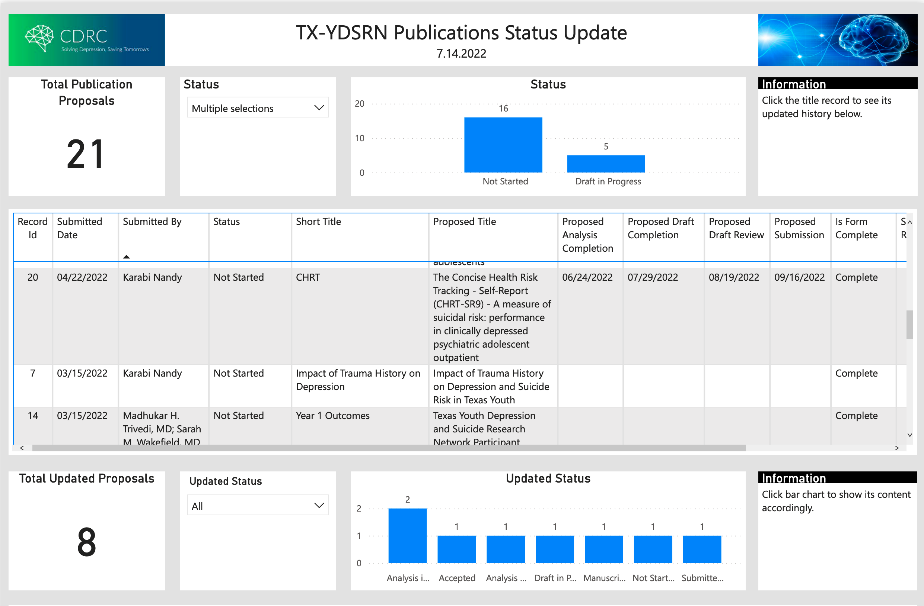

Accomplishments
Monthly Network News
Publication Portal to Track Manuscripts
Locked Dataset for First 1000 Participants – Focus on Publications
14
Network SharePoint
Latest News
Node Resource Folders
Dashboard Portal
External Website
Publication Portal
Measurement Based Care Presentations

