Slide 1
TX-YDSRN:
Network Updates
Madhukar Trivedi, MD
Center for Depression Research and Clinical Care
UT Southwestern Medical Center

Slide 2

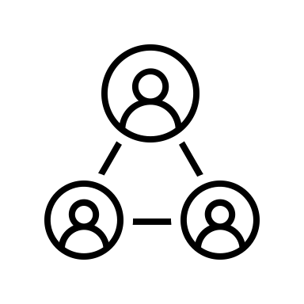


Successes for Network
Establish a Research Network of 12 Academic Medical Centers across the state of Texas that is comprehensively trained and ready to implement research projects
  Trained 155 staff in research procedures and assessment​
  Established a uniform regulatory binder and monitoring process​
  Weekly Node meetings provide additional support and training (as needed)
Develop a Network Participant Registry to describe population health outcomes for youth with depression and/or suicidal ideation or behavior
Total Enrolled
1186
  Consented 1300+ youth and enrolled 1186​
  UNT/JPS has enrolled their 200th participant
Characterize and support measurement-based care (MBC) and collaborative care (CC) coordination in participating clinics
  Hosted 14 Measurement-Based Care presentations to the Network and associated providers
  Developed instrument to capture use of MBC and CC
Develop predictive models for short- and long-term outcomes for youth with depression and/or suicidal behavior
  Have completed over 7,000 research study visits
  Have 400+ visits completed for 12 month follow up
  Starting first 24 month follow up in the coming weeks.

Slide 3
Ongoing Maintenance of Existing Network
Collect and analyze data on youth across Texas
Analyze and disseminate
information learned through presentations and manuscripts​
  Expand recruitment efforts with goal of 2500 participants
  Increase number of participating providers by adding new recruitment sites
  Add assessments to track youth for a total of three (3) years
  Tracking and cleaning data
  Manage data, dashboards, and perform QA monitoring
  Oversee regulatory requirements
  Conduct analyses for upcoming publication
  Coordinate and support authors on publication efforts

Slide 4

Expansion of Network to Learning Healthcare System
Align stakeholders around a common goal.
  Engage community partners (mental health agencies, foundations, local, state, and federal government agencies)
  Identify a health care champion at each Node to oversee efforts and direction of the Learning Healthcare System at a Node level
  Create an Advisory Council at each Node comprised of patients and families, clinicians and key stakeholders
  Host Advisory Council Meetings (Local and State-wide)
  How annual Collaborative Learning Healthcare System Conference
Internet Citation: About Learning Health Systems. Content last reviewed May 2019. Agency for Healthcare Research and Quality, Rockville, MD. https://www.ahrq.gov/learning-health-systems/about.html

Slide 5

Expansion of Network to Learning Healthcare System
Refine current standards in evidence-based care models and implement continuous quality improvement
  Implement collaborative care model and engage patient
  care navigators at participating sites
  Enhance MBC at each site by implementing
  and training Nodes in VitalSign6 in order to
  provide point of care decision support to providers
  Provide new training opportunities to increase
  knowledge of MBC, evidence-based interventions,
  and linkage with local and/or telehealth mental health providers
Create an interactive forum where information, resources, updates, and suggestions can be shared.
  Create an interactive platform (e.g., community app) where ideas can easily be exchanged among key stakeholders/collaborators
  Conduct focus groups with constituents to provide input into the directions of the Statewide initiative

Slide 6

New Areas of Focus
Encourage the development and implementation of projects that address healthcare system level challenges to address the mental health needs of youth
  Targeted research funding aimed towards accelerating the Learning Healthcare Systems Model
Address the lack of mental health providers trained in Measurement-Based Care
  Develop network-wide internships and research rotations
  Develop quarterly education series aimed at primary care and pediatric clinicians
  Conduct annual research symposium
  Expand MBC training opportunities for other health workers

Slide 7
Q & A

