Slide 1


Telehealth & Scheduled Drugs
Post PHE
Mari Robinson, JD
Director of Telehealth, UTMB

Slide 2
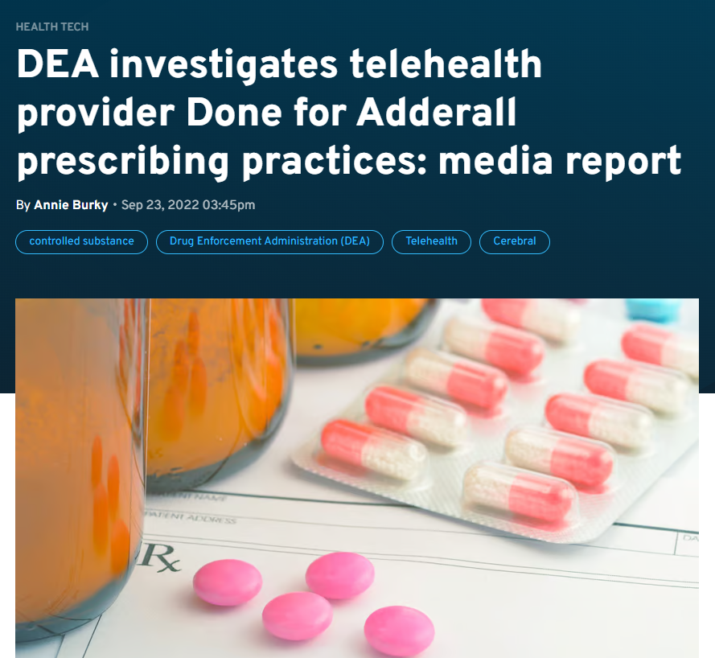
Why is this necessary?
https://www.fiercehealthcare.com/health-tech/dea-investigates-telehealth-provider-done-adderall-prescribing-practices-media-report

Slide 3
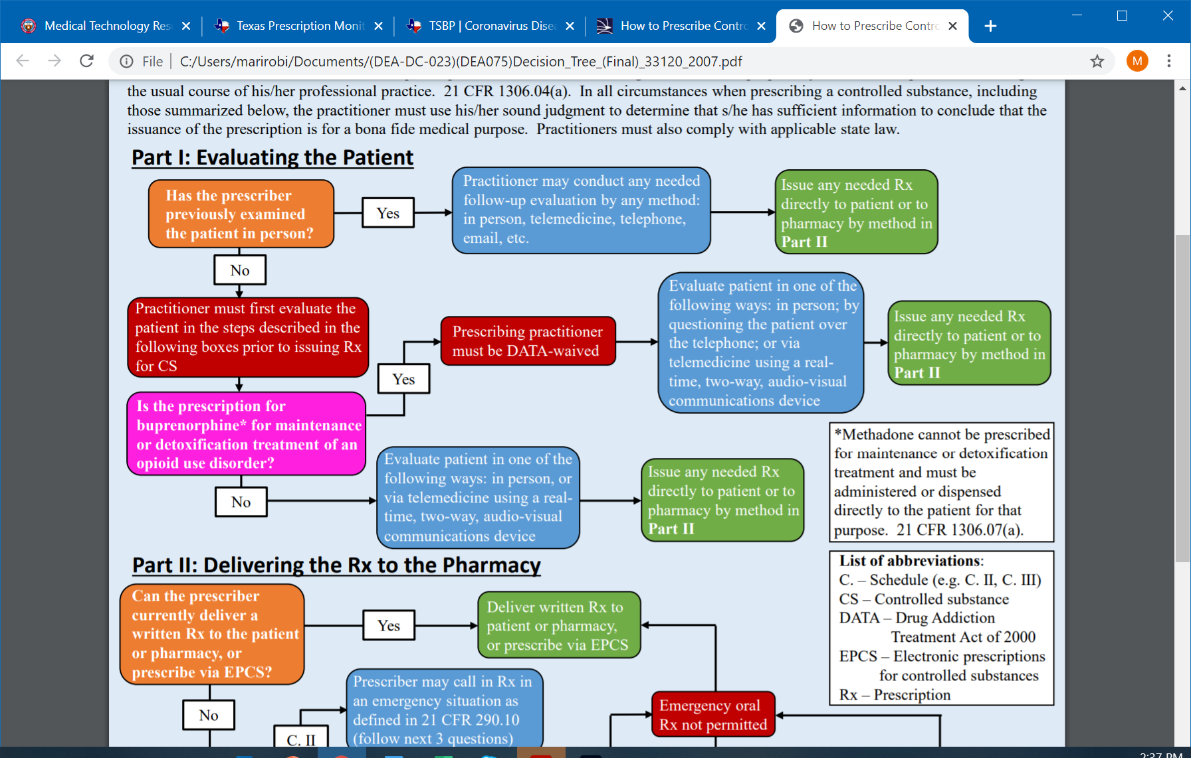
PHE Flexibilities
https://www.deadiversion.usdoj.gov/GDP/(DEA-DC-023)(DEA075)Decision_Tree_(Final)_33120_2007.pdf

Slide 4
Current Status
DEA, jointly with SAMHSA, is issuing this temporary rule to effectuate the following:
• The full set of telemedicine flexibilities regarding prescription of controlled medications as were in place during the COVID-19 PHE will remain in place through November 11, 2023.
• Additionally, for any practitioner-patient telemedicine relationships that have been or will be established on or before November 11, 2023, the full set of telemedicine flexibilities regarding prescription of controlled medications as were in place during the COVID-19 PHE will continue to be permitted via a one-year grace period through November 11, 2024. In other words, if a patient and a practitioner have established a telemedicine relationship on or before November 11, 2023, the same telemedicine flexibilities that have governed the relationship to that point are permitted until November 11, 2024.
https://public-inspection.federalregister.gov/2023-09936.pdf

Slide 5
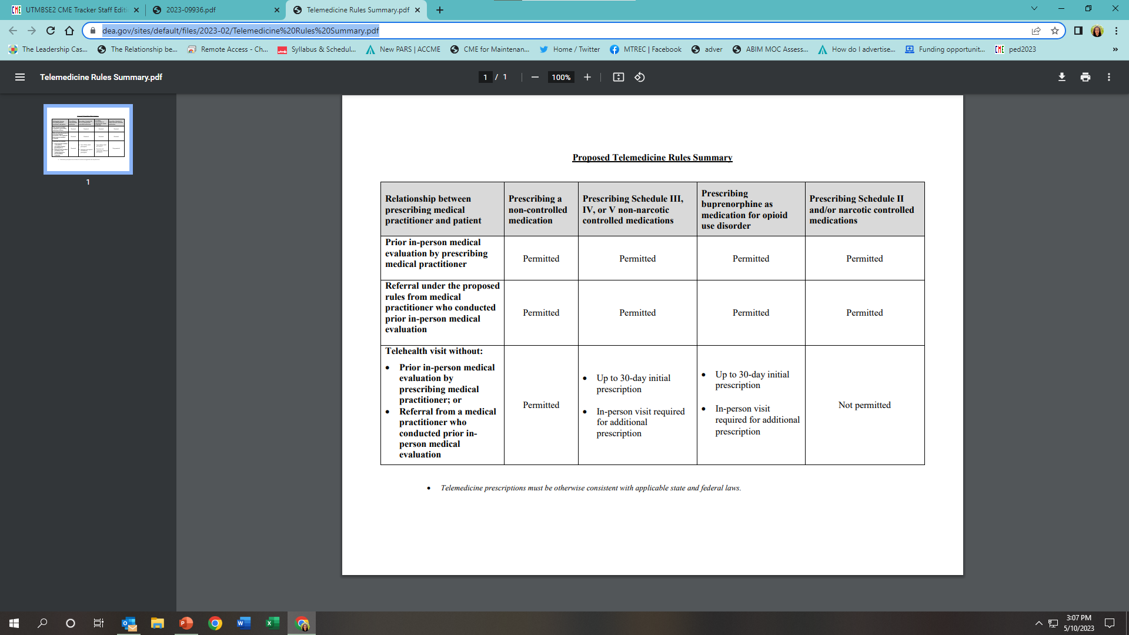
Possible Future
https://www.dea.gov/sites/default/files/2023-02/Telemedicine%20Rules%20Summary.pdf

Slide 6
Remember:
This only DEA and only prescribing; other agencies did things differently
There may be state laws
This may all change again, as these rules are temporary

Slide 7

Questions??

