Slide 1
UT Health Houston
TCMHCC Town Hall
IMM July 21, 2023
Cesar A. Soutullo MD, PhD
Vice Chair and Chief of Child and Adolescent Psychiatry, UT Health Houston
Presentation to TCMHCC Executive Committee Oct 16, 2023

Slide 2
Objectives of the UT Health Houston TCMHCC Townhall
July 21, 2023
-Introduce our Teams to the Community
SB11: CPAN, TCHATT, CPWE & ARPA Extension Projects
-Present Results and Resources
-Have a space for all the Teams to meet and reflect on our cooperative effort, lessons learnt and ideas moving forward.

Slide 3
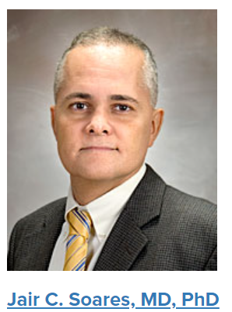

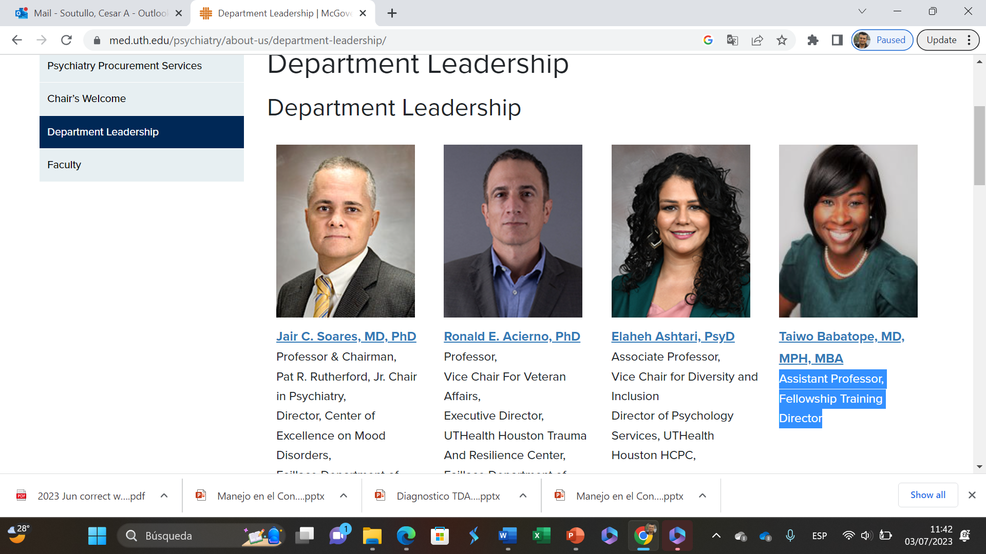
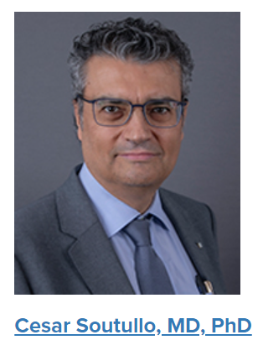
Professor & Chairman,
Pat R. Rutherford, Jr. Chair in Psychiatry,
Director, Center of Excellence on Mood Disorders,
Faillace Department of Psychiatry & Behavioral Sciences,
Executive Director, UTHealth Houston John S. Dunn Behavioral Sciences Campus
Director,
Management Operations
John S. Dunn Endowed Professor,
Vice Chair and Chief of
Child & Adolescent Psychiatry
Director of ADHD
Outpatient Program
Program Director, ARPA
Assistant Professor,
Fellowship Training Director
Executive Director
SB11 Programs
Meet our UT Health Houston
TCMHCC Leadership Team

Slide 4



Town Hall Agenda (& Thesaurus!)
Introduction.
Jair Soares, MD, PhD, Taiwo Babatope MD, MPH, Cesar Soutullo MD PhD
CPAN. Child Psychiatry Access Network,
TCHATT. Tx Child Health Access Through Telemedicine
TCHATT (ARPA) Extensions. American Rescue Plan Act. 2021-2023
  TCHATT Extra Regions and Extra Sessions
  YAM. Youth Aware of Mental Health
  ASUD. Adolescent Substance Use Program
  ARPA-Anxiety
  ARPA-Trauma Informed and Focused Care
CPWE. Community Psychiatry Workforce Expansion
  Training programs & Community Psychiatry
    Psychology Internship
    Social Worker Fellowship
    LMHA
Meet our Teams outside the Hall

Slide 5
UT Health Houston TCMHCC Attendance
N=186. 46.2% in person >60 Different Job Titles

Slide 6
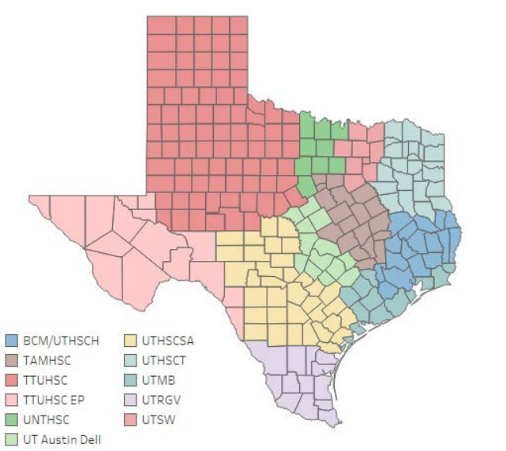
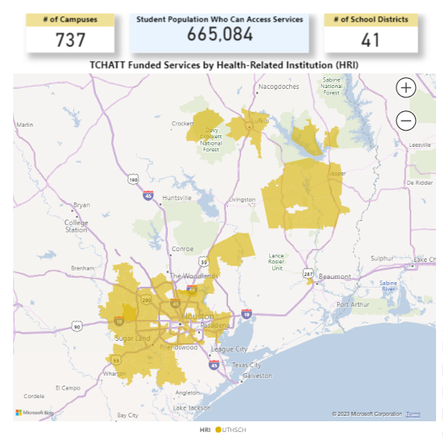
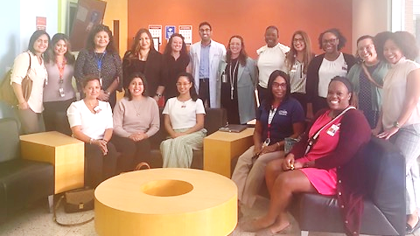
TCHATT
Services
Geography
Team
Volume/Impact

Slide 7
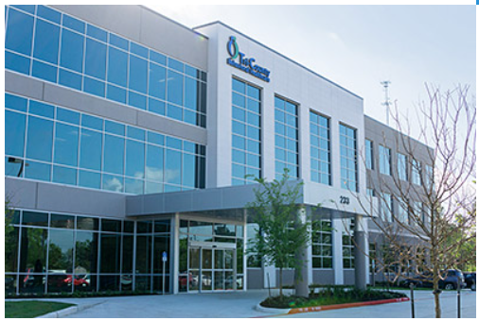
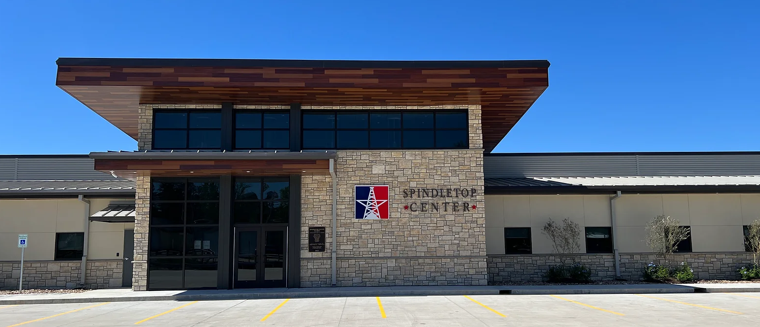
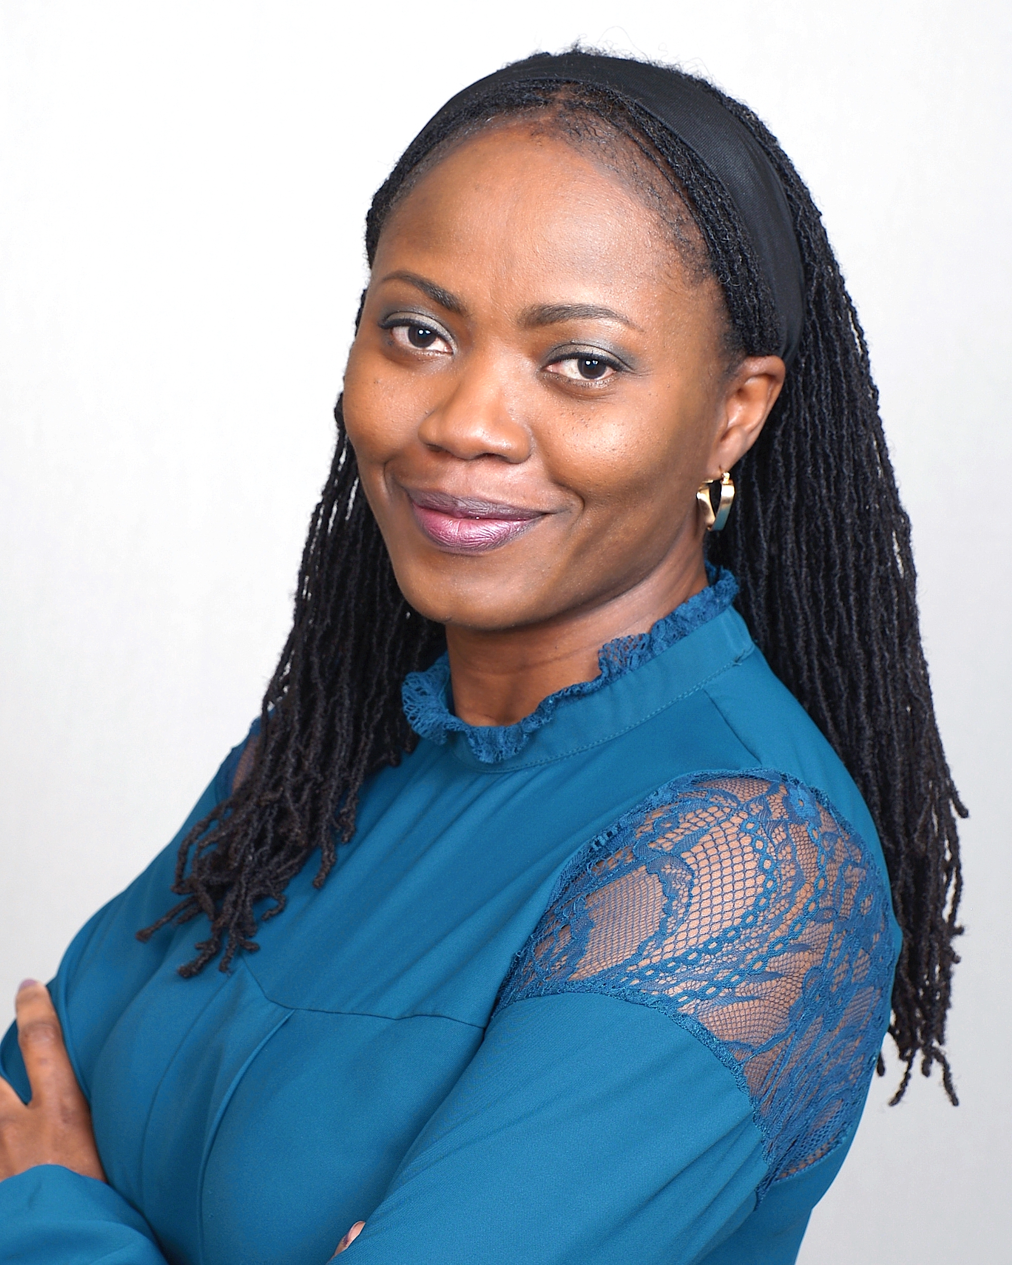

Partner sites
LMHA
  UTHealth Houston partners with LMHA to provide:
  -Clinical care (Telemedicine),
  -Clinical rotation (Psychiatry residents & fellows).
Spindletop Center. 05/2023 -
  M/W/F
  Spindletop Ctr S. Campus, Beaumont, TX
  Spindletop Ctr. Orange County Outpatient Clinic, Orange, TX
Tri-County Behavioral Healthcare. 07/2023 -
  Tu/Th
  Conroe Service Ctr, Conroe, TX
Tomide Oyelakin, MD, MPH
Medical Director, LMHA Program
Leah S. Wallace
Program Manager - Telepsychiatry

Slide 8




Exhibit Hall
Meet our Teams
outside the Hall
Results:
-Good participation
-Referrals, new Schools, ASUD…
-Job Applications
-Networking for further Outreach

Slide 9
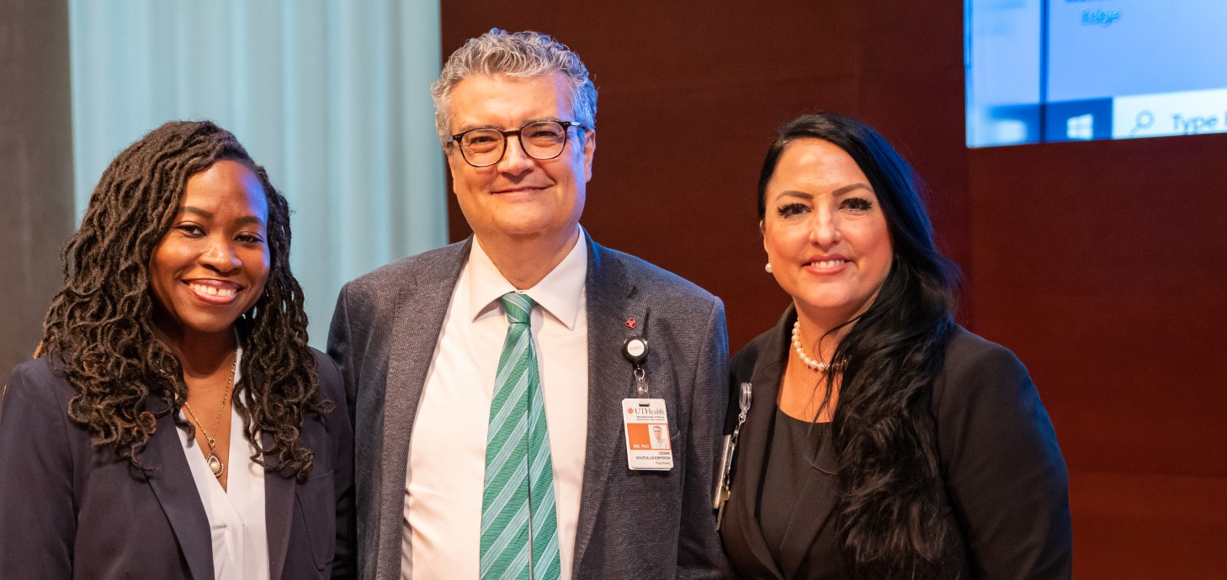

Thanks a lot!
Q&A

