Slide 1
YAM Project Updates
Madhukar Trivedi, MD
Center for Depression Research and Clinical Care
UT Southwestern Medical Center

Slide 2
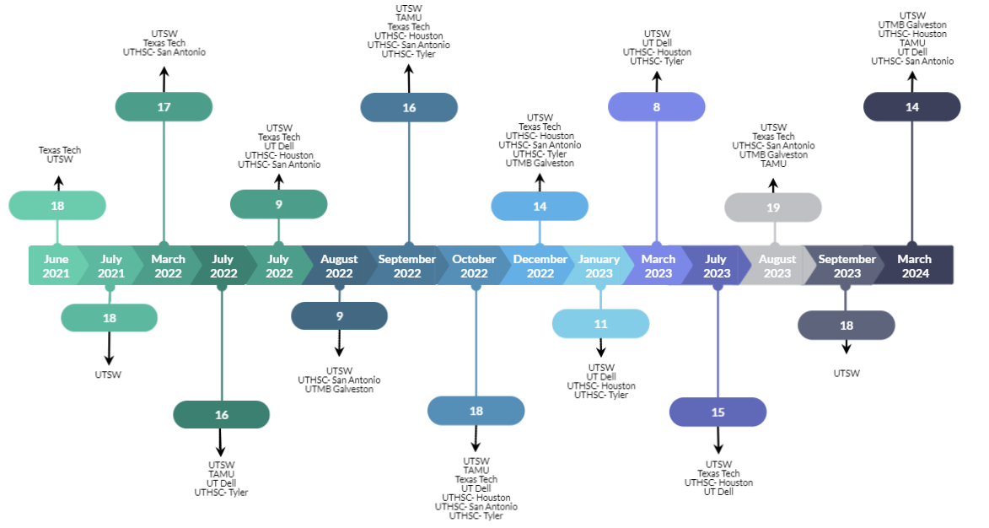

Progress:
220
Instructors Trained
March 2024
Currently Active:
126

Slide 3








How does a school engage?
Contact your local YAM Health-Related Institution (HRI)
Information about the program has been developed for all stakeholders to make an informed decision.
Resources Available:
School Leadership Flyer
Once contact is made, the HUB as well as the HRIs hold information sessions for all stakeholders, including the superintendent, school board members, principals, school staff, parents, community members, and students to ensure all questions about the program are addressed.
Teacher FAQ Flyer
Parent FAQ Flyer
Parent Consent Form
Parent Opt Out Form
3

Slide 4
MOU’s Signed by Region as of
March 2024
UTSW | UTHSC- Tyler | Texas Tech | UT Dell
17 | 32 | 47 | 81
EC - 12th Grade Student Population for all MOU’s
192,210 | 58,418 | 37,671 | 257,602
UTHSC- Houston | UTMB- Galveston | UTHSC- San Antonio | TAMU
21 | 15 | 21 | 69
EC - 12th Grade Student Population for all MOU’s
366,013 | 44,518 | 117,984 | 214,312
Total Student Population Reach
Across All Regions =
1,247,282

Slide 5
Texas Students Receiving YAM
YAM Student Classes
N = 30,366 to date
Projected Total Reach
End of 2023-2024 SY
35,000
N = 1,531 to date
Projected Total Classes
End of 2023-2024 SY
2,000
Note: UTSW began implementing YAM, building the team, and establishing relationships with schools in 2016.
(UTSW & Texas Tech started implementation in Spring 2022, the additional HRIs joined the effort in Fall 2022)

Slide 6

What Students Are Saying About YAM…

Slide 7
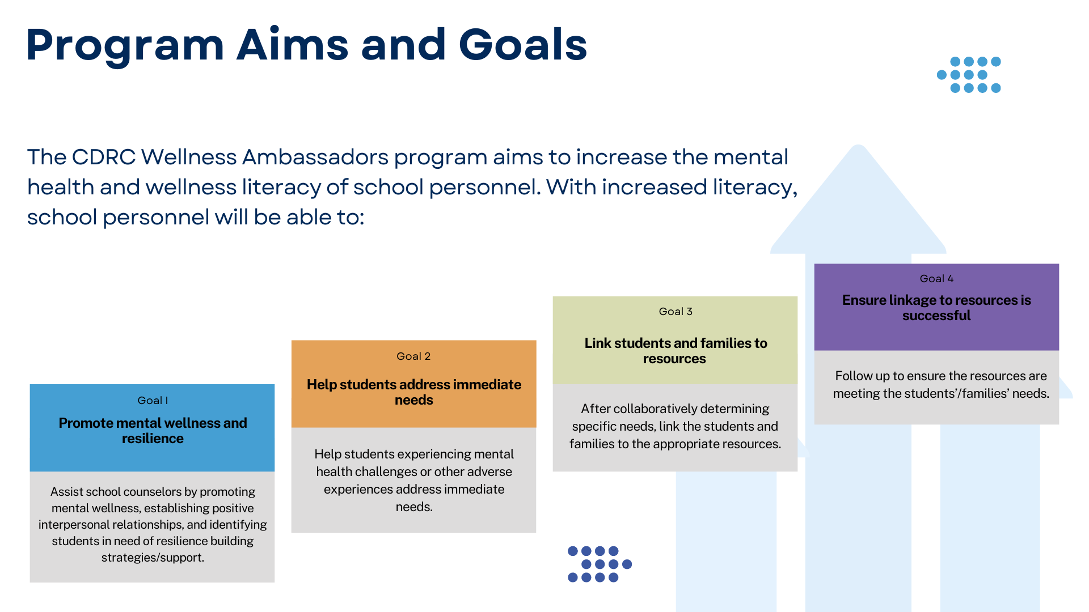
Wellness Ambassadors Program

Slide 8


