Slide 1
YAM Project Updates
Madhukar Trivedi, MD
Center for Depression Research and Clinical Care
UT Southwestern Medical Center

Slide 2
Youth Aware of Mental Health (YAM)
Evidence-based program delivered by certified facilitators to students in the classroom setting
  A 5-hour interactive mental health promotion program
  Delivered over 3 – 5 weeks
  Encourages
    increased discussion and knowledge about mental health
    development of problem-solving skills
    emotional intelligence and
    resilience

Slide 3
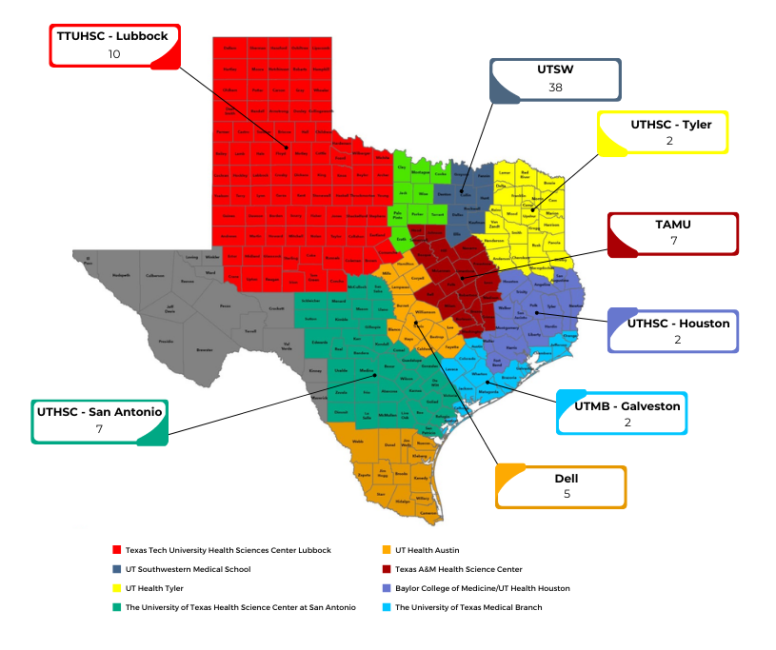
Progress: 73 Instructors Trained
Additional Trainings Scheduled in September and October

Slide 4





























School Partners

Slide 5
YAM Implementation Timeline
August 2022
1 Facilitator Training
35,000 student booklets and
100 sets of posters delivered to HRIs
FIRST WEEK
September 2022
FIRST YAM Sessions implemented by UTSW and TTUHSC
January – April
Facilitator Trainings
YAM Implementation in Schools Across Texas
September – November 2022
Facilitator Trainings
YAM Implementation in Schools across Texas
June – August 2023
Facilitator Trainings
September – November 2023
YAM Implementation

